Slide 1
Will Canada go to War

Slide 2
OF COURSE!
When Great Britain declares war, Canada, Australia, India, and all the African colonies are automatically at war too.
"It is our duty to let Great Britain know and to let the friends and foes of Great Britain know that there is in Canada but one mind and one heart and that all Canadians are behind the Mother Country."

Slide 3
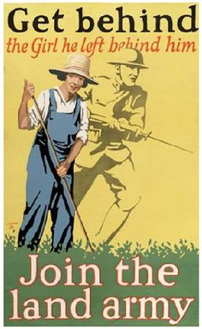
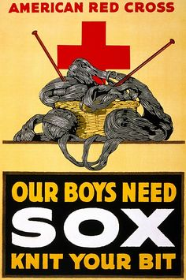
Total War
Restructuring Society for maximum war capability
Requires War measures act to really work.
In total war the entire population is considered “at war”

Slide 4
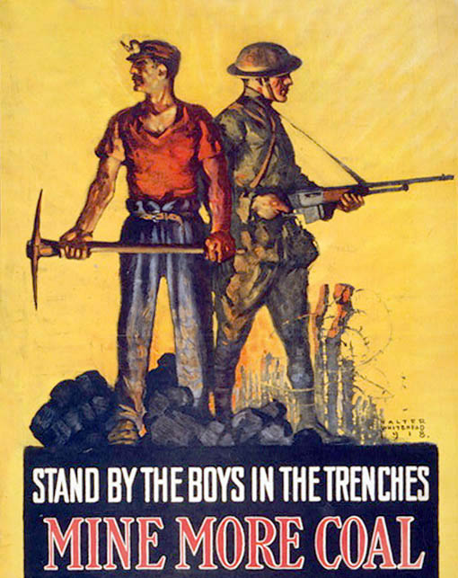
More Total War Propaganda Poster

Slide 5
Total War turns to income tax
1917 Income War Tax: They wanted to tax rich people so that the wealthy were seen as “doing their part” in the total war.
Although the law was too late to help out with the war. The war tax came late and proved incredibly profitable to help pay off the war debt.
This temporary war measure act is the direct descendant of all the income tax we pay to the government today. It also violates the constitution.

Slide 6
Canada’s Role
Was a large supplier of manufactured goods during the war.

Slide 7
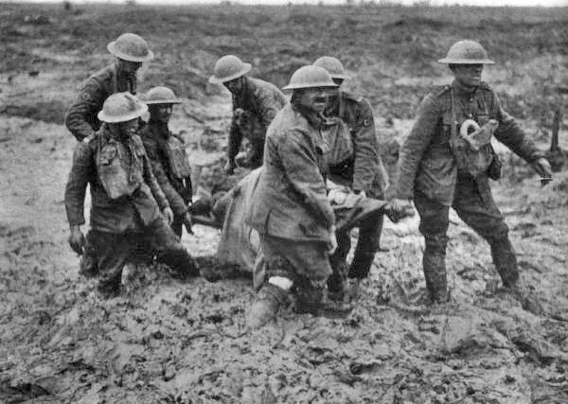
CEF (Canadian Expeditionary Force)
Self directed Canadian force.
Regarded by the allies and central powers as the most effective military force on the Western Front.
Germans called them “storm troopers.”

Slide 8
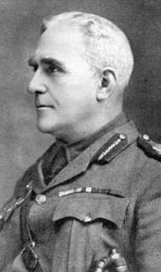
Sam Hughs
In charge of training Canada’s soldiers.
Trained them with techniques from the 1800’s
Gave leadership positions to his friends. (Based on patronage)

Slide 9
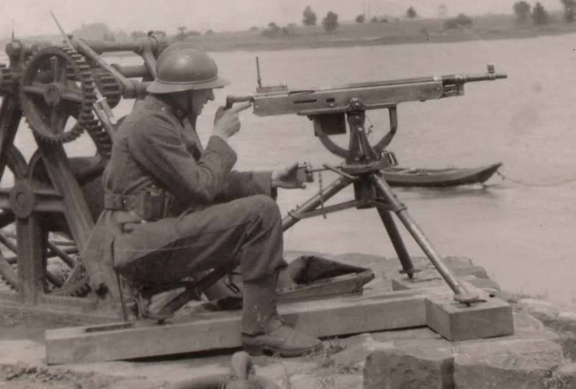
Problems in Battle
Colt Machine Gun
Took 4 people to fire.
Would overheat after a minute of firing.
Gun would jam.

Slide 10
Problems In Battle
Ross Rifle
Problems
Bayonet fell off when you shot
Gun would jam.
Gun rarely worked.
If miss assembled the gun would still fire but the bolt would eject into the soldiers face.
Did not fire British ammunition

Slide 11
The Ross Rifle
“They jammed after firing, at most, three rounds. To force the bolt open, a man had to lie down and take his heel to it." — Arthur Bishop
It takes five men just to keep one Ross Rifle firing. ---Chris Scriven
Favourite weapon of allied sniper divisions

Slide 12
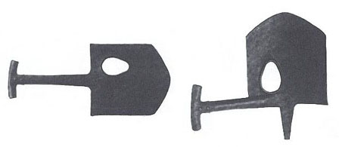
McAdam Shield Shovel
Not very good for Digging as a result of the big hole in it.
Weighed three times as much as a regular military shovel.
Had no bend to the shovel so it was not as good in the mud.
In a war where infantry movement was fast, it was weighing soldiers down.

Slide 13
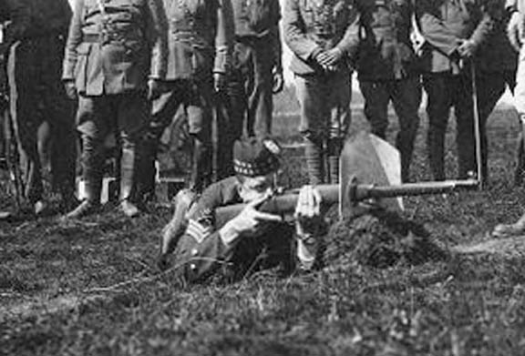
Macadam Shield Shovel in use.
The intention of the shield shovel was to block enemy bullets while providing safe cover.
It blocked peripheral vision.
The amount of Iron needed to block bullets made the shovel ridiculously heavy.
It could not block bullets. (even German pistols would penetrate the shovel)

Slide 14
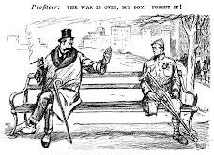
Why use bad weapons and have bad leadership?
MONEY
CORRUPTION
PROFITEERING

Slide 15
Biggest corruption scandal in Canadian history
1. People in government were profiting from the war
2. Businesses were profiting from war.

