Slide 1
What were the Dark Ages

Slide 2
The Fate of The Roman Empire

Slide 3
The Political Organization
Under Caesar the Roman Empire was centralized
Europe becomes decentralized without a strong Roman Empire.
Weaker political structures would limit trade and progress

Slide 4
Understanding Decentralization
Limits border crossing.
Roads fall apart
Trade shuts down
Schools shut down
Courts shut down
Local “landlords” take over but they don’t have the capacity to build a giant coliseums or even a castle.
This is one of the reasons we call the period Dark Ages.

Slide 5
The Dark Ages
Why the “dark ages” were dark.

Slide 6
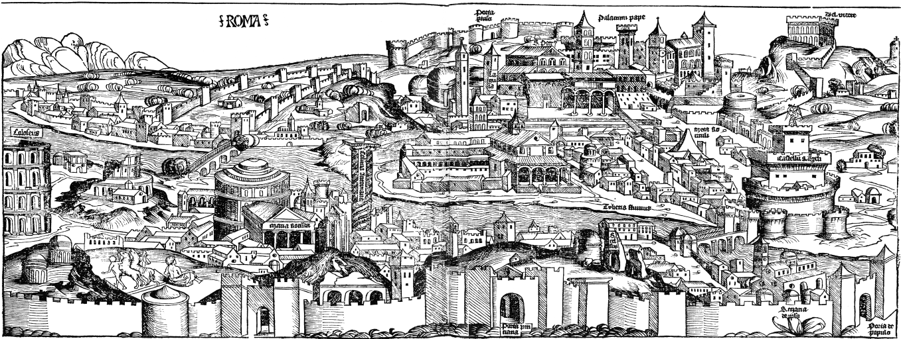
1. Dwindling population
Population of Rome goes from 1 million to 50 thousand. In a few years
It would not reach the same population until just before World War 2 (Mid 1900’s)
Not a single city with more than 50,000 people until after 1000 AD
2/3 of the Roman population

Slide 7
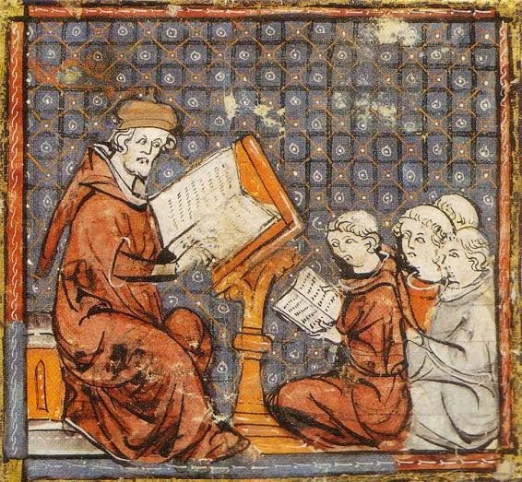
2. Lack of Education
Literacy rates fall dramatically
The only books being written after 500 were Bibles (and Beowulf) being produced by monks.
This (combined with low trade) makes transfer of ideas or progress really hard.

Slide 8
3. Lack of Structure in Society
Miniature Empires were laughable
No Armies
No Organization
No Infrastructure
No Trade
Schools and Courts had disappeared
Nobody had money or the knowledge to repair and maintain what the Romans had given them.

Slide 9
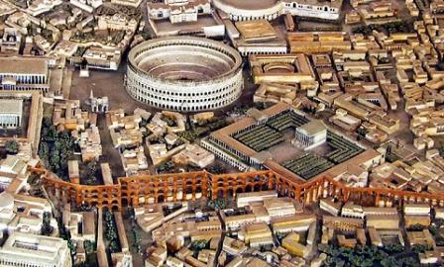
The people from 500-1000 could not match their predecessors in any category.

Slide 10
The Dark Ages
Reasons the Dark Ages WERE NOT Dark

Slide 11
1. Its Only Dark in Western Europe
China
Is building steam pumps
Navigational tools
Paper making.
Ummayed Empire (Arabs)
Is doing advanced math
Building structures as impressive as the Romans
Forming an extensive empire

Slide 12
1. Its Only Dark in Western Europe
Byzantines
Still have the Greek cities
Constantinople is the largest city in the world
The Dark Ages
Is the most Eurocentric Term
The most ethno-centric term

Slide 13
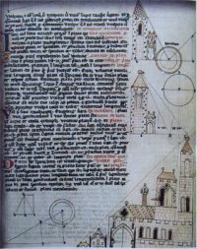
2. The Church was advancing in science.
Church Run Schools
Church Run Scientific research
Church would eventually create universities.
Correspondences between monks about math a science.

Slide 14
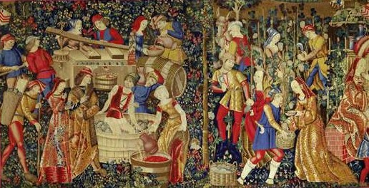
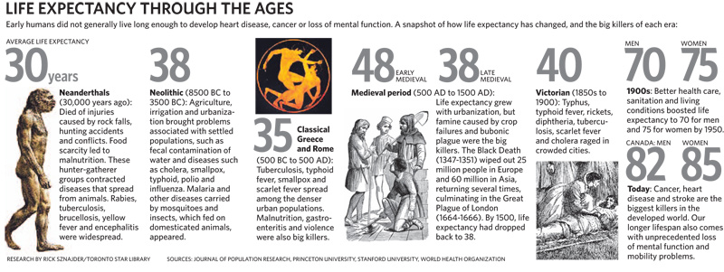
3. Raised standard of living.
Less people =
More food.
Less disease.
Longer lives
Simple living.
Roman’s average age was 30
The Dark Ages average age was 40 (today its over 80)

Slide 15
Understanding Pre-Enlightenment Thinking
Doing our best to see the world through a different lens

Slide 16
What is Enlightenment
Using Reason, Logic, Science to guide our thinking.
Questions to Ponder
If I plant a coconut tree on a Campbell River beach will it grow?
If the Church accuses me of doing something that I did not do, am I innocent or guilty in the eyes of God?
Should I put myself in danger to prove my faith?
If archeology seems to disagree with what I’m learning in Church is the church wrong? (Mt Sanai, Jesus’ Tomb)

Slide 17
What is true?
Medieval Ideas
Do whatever the church says, because the Church is God
Whatever the King says because he was chosen by God to lead.
Enlightenment Ideas
God has made a logical scientific world.
Using logic and science rather than traditions we choose rational responses to issues
If the church refuses logic and science they are wrong.
What do I do when the king tells me to disembowel myself when I feel sick?

Slide 18
You are all products of the Enlightenment
How do I know this?
You question authority including the church.
You believe leaders could be wrong.
You believe in cause and affect.
You believe doctors can heal.
You use science and math to find answers and accept the answers that science leads you to.
You pursue material comfort and personal enjoyment.

Slide 19
Were people in the Middle Ages dumb?
No it was an Age of Faith and we can learn from it.
Church was involved with science as a way of understanding God. But it lacked the willpower to overcome its preconceived ideas.
Church was educating people to help them understand God’s glory.
People were looking to God first to guide their lives and decision making.
People were focused on the life to come (heaven) rather than their present life.
Everything was done to give God glory.

Slide 20
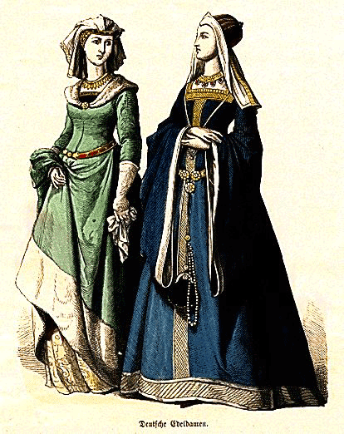
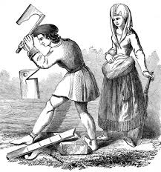
What do clothes look like in an Age of Faith
Fashion follows the celebrities. Who would be a celebrity in an age of faith.

Slide 21
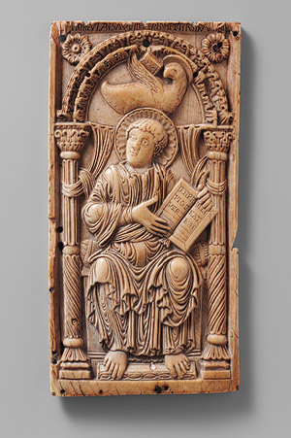
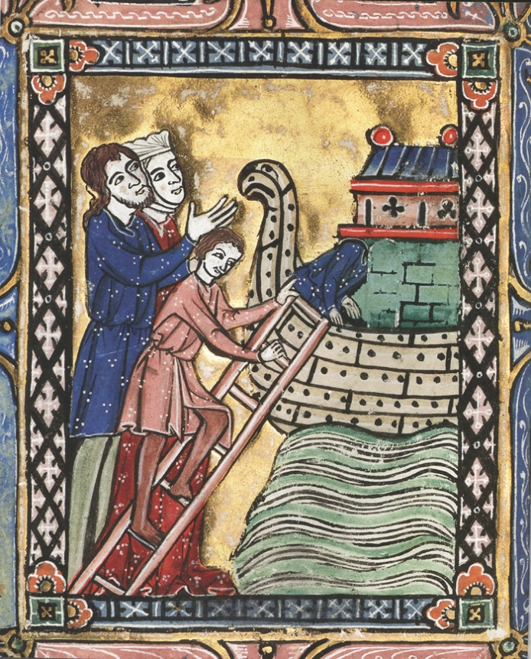
What Does Art Look Like in an Age of Faith

Slide 22
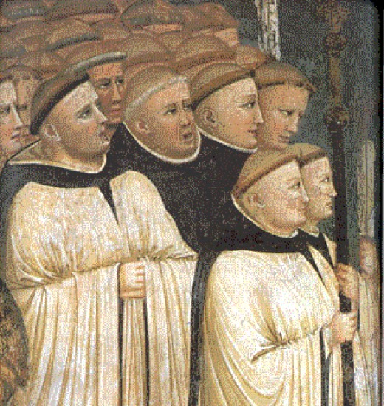
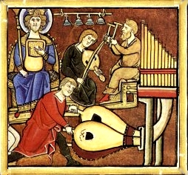
What does music sound like
No surviving musical notation. They might not have had any way of duplicating music other than listening.
Instruments could not be duplicated easily so they relied on the human voice.
Without recorded music there was a considerable amount of improvisation.
Not done to sound good for man.
Done in Latin

Slide 23
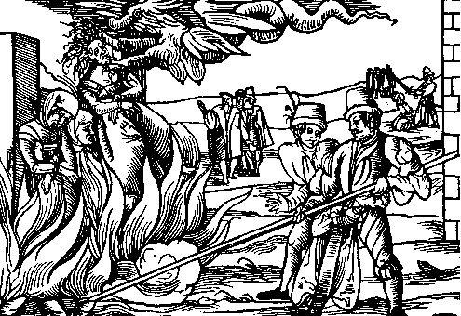
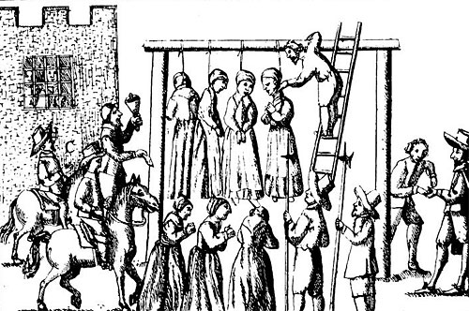
What does the justice system look like in an Age of Faith?
The church and the king are in charge of administering justice.
Fear of witchcraft and sorcery “the dark arts” is one of the churches big fears.
If anyone was suspected of using “the dark arts” they would be killed. But this was easily exploited to get lots of innocent people killed.

Slide 24
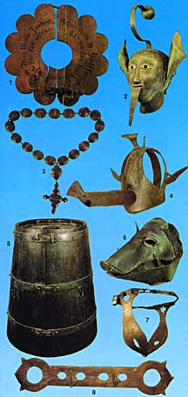
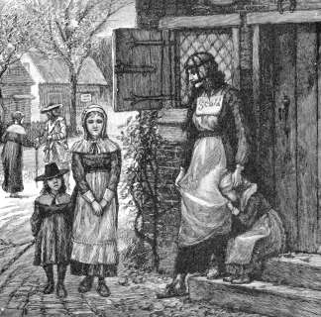
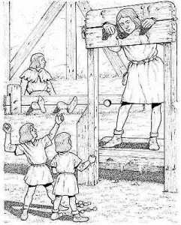
Public Shaming
For Small offenses
For the offense of gossip and acts that would not warrant death.
Pillory

Slide 25
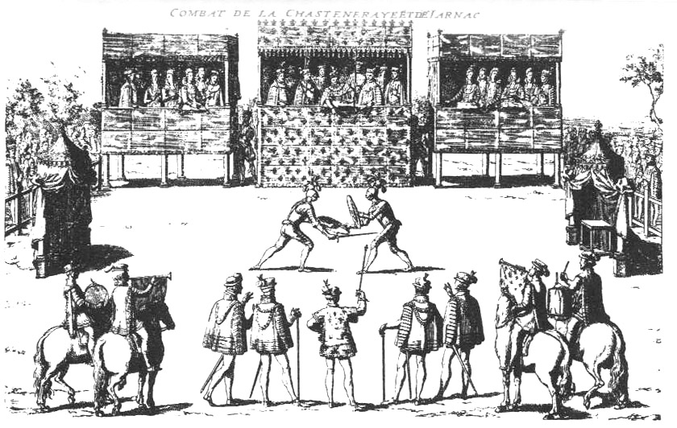
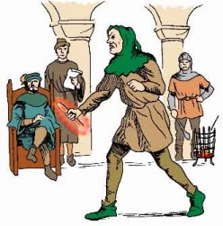
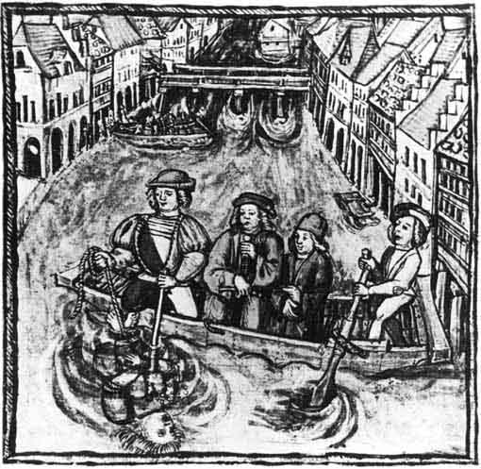
Trial by Ordeal
Trial by Water
Trial by Fire
Trial by Combat

Slide 26
Create a trial by Ordeal
Come up with a crime
Come up with an ordeal that will verify that crime.
Create a small play in which a judge orders an ordeal.

Slide 27
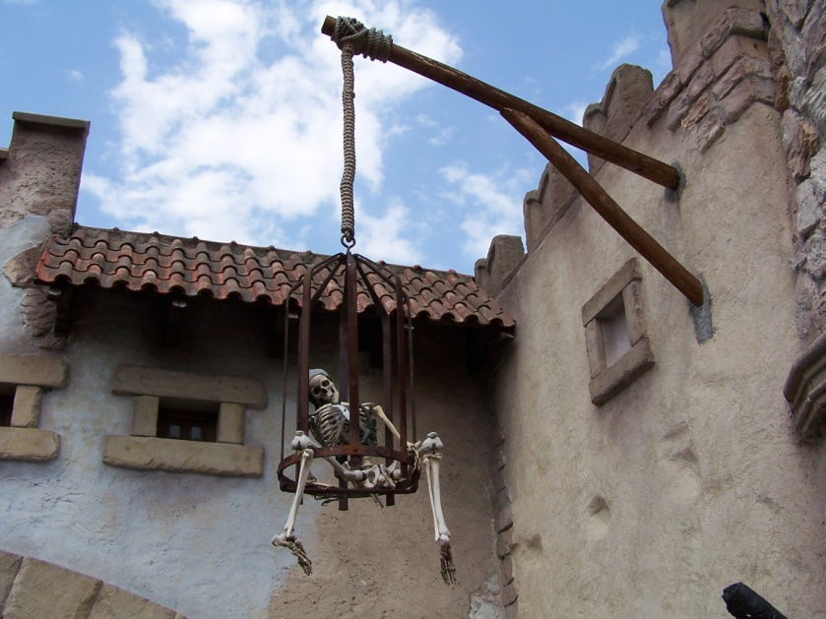
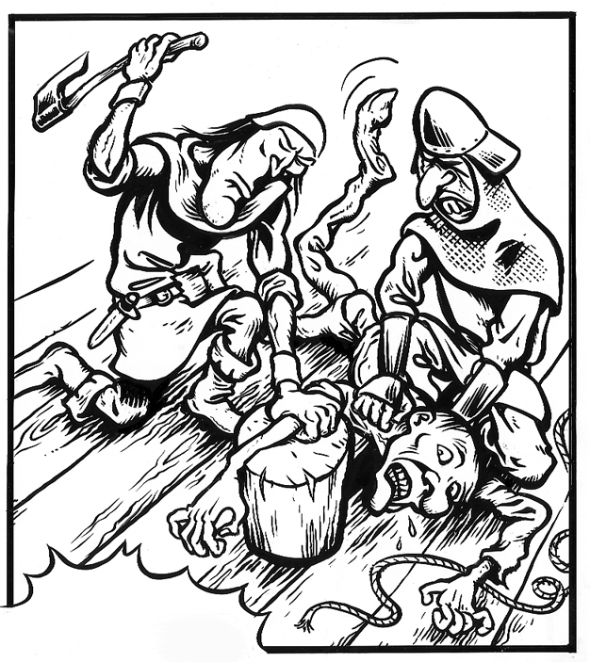
Trial by Jury
Prisons were mostly a place to starve to death.
Mostly they would just kill you.
Minor crimes involved chopping off body parts.
Sometimes fines (if there were money shortages)

Slide 28
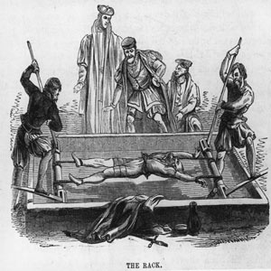
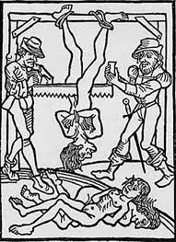
Torturing (reserved)
Not many people faced torture. Mostly for treason and serious offenses.

Slide 29
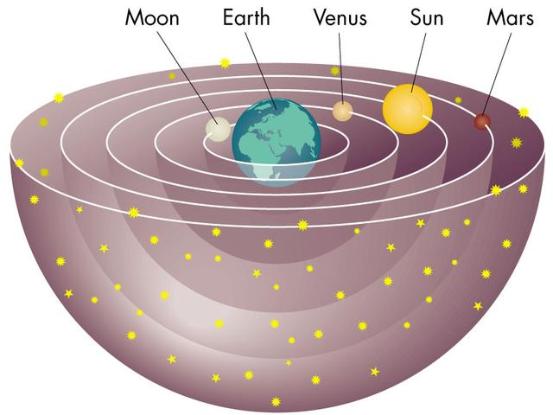
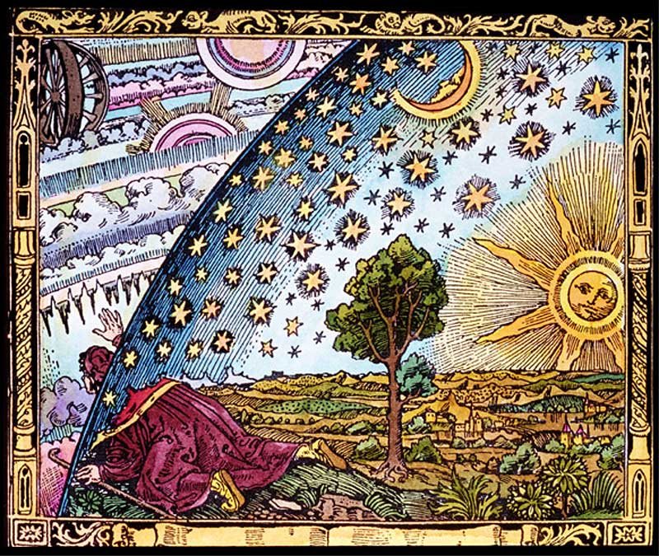
What does Astronomy look like
Mostly about time keeping.
They had no telescopes and math was in its infancy.

Slide 30
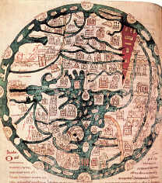
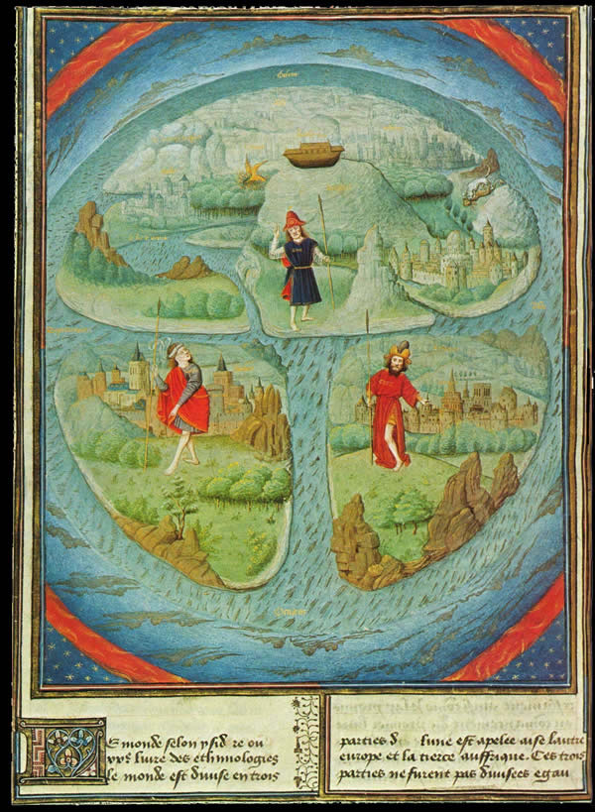
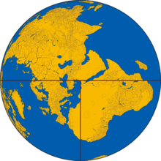
What does geography look like
Make a map of Vancouver Island
T-O map

Slide 31
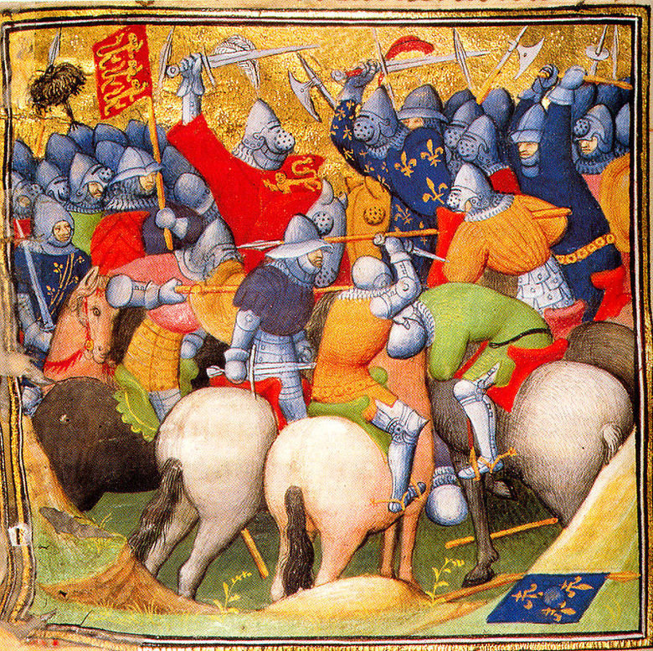
What Does Warfare look like
Most of the well armored knights lacked skill.
They lack the necessary engineering or math to build siege machines.
War might have lacked tactic.

Slide 32
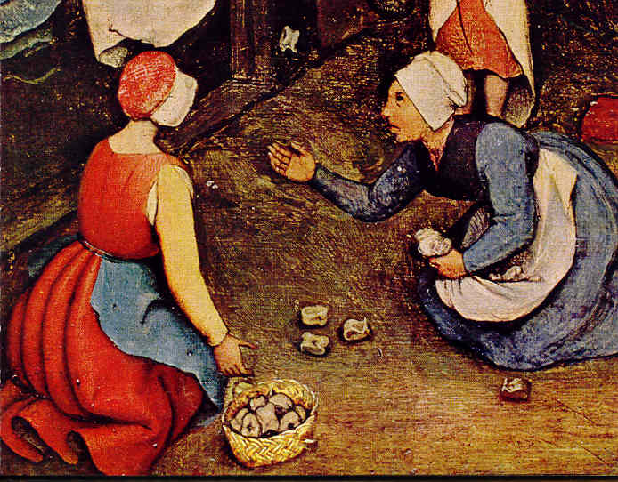
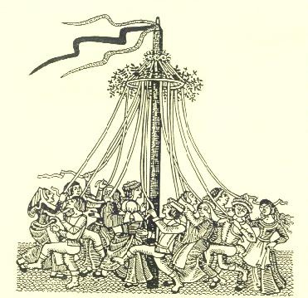
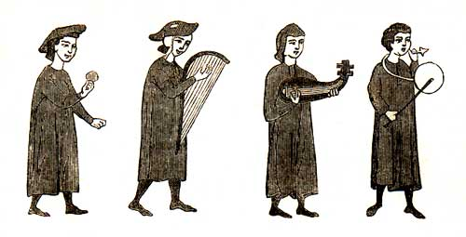
Entertainment
Troubadours (bards)
Games
Festivals

Slide 33
Who Were the Vikings?

Slide 34
Where did the Vikings live?
Maroon = Original Territory
Red & Orange = New Territory
Yellow = Shortly Owned Territory
Green= Areas of Frequent Raids

Slide 35
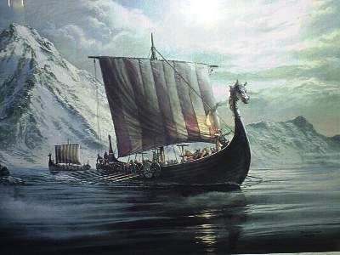
Vikings (the basics) 750-1066
They went in long boats
They raided nearby settlements and stole their stuff
They chose undefended targets.
Often they chose monasteries because they were always undefended and had wealth in them.

Slide 36
True False Test
Women Vikings could join on the raids.
Vikings lived in the area that is now known as Canada.
Vikings wore hats with horns on them.
Vikings who got to go to Valhalla (heaven) would enjoy peace and prosperity.
Vikings were normally blonde haired.
Vikings never had a king which ruled them.
Vikings would free any slaves or peasants they captured.
Vikings invented the “Trial by Ordeals”
Lots of English words were inherited from the Viking language.
Most Vikings farmed instead of pirated.

Slide 37
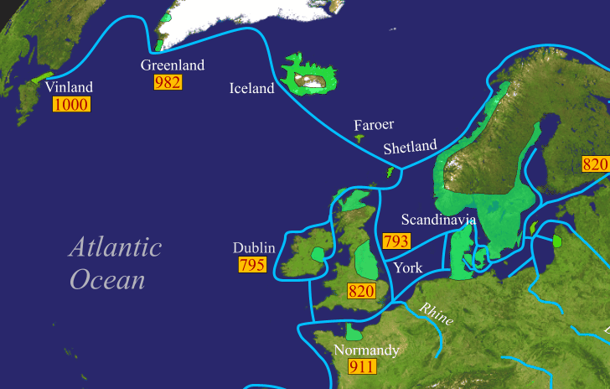
Viking discover America 1000 AD

Slide 38
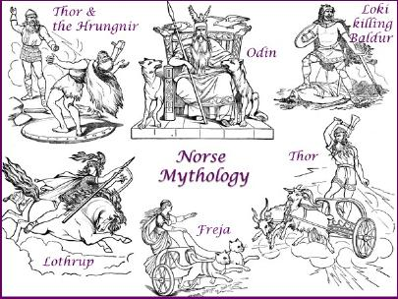
Viking Culture
They had their own God Structure
They were organized, clean, they treated women well.
Lots of our current ideas about, elves, dragons wizardry etc. is all inherited from the Vikings.
Mostly fish and whale eaters, but they would farm as well.

Slide 39
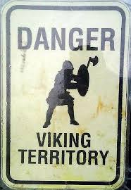
Where did the Vikings Go?
They were dealt a major military defeat in 1066 in by England
William the Conqueror would gradually eliminate their presence in Western Europe.
Many of them would Christianize and become the Christians (Christians don’t make good Pirates)
Europe was getting organized and raiding became impossible (Castles and Kings)

Slide 40
Viking Quiz
What was the first letter of the monastery you raid?
Why did Vikings cast Runes?
What were you judged on in this quest game?

Slide 41
Carolingian Renaissance

Slide 42
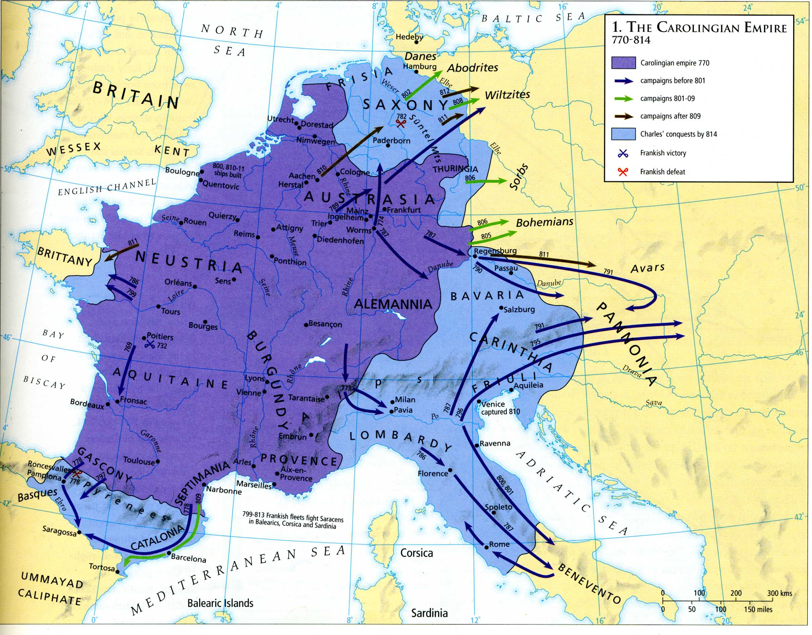
Charlemagne the Conqueror
Charles the First, (Charlemagne) moved Europe from decentralization back towards centralization.
The purple represents land that he inherited. This is partly to do with strategic marrying
The blue represents the areas he conquered. (He by most accounts was a wrecking crew on the battlefield)

Slide 43
About Charlemagne
Full head higher than most people.
Savage on the battlefield
Devoted his life towards learning to reading.
Despite his hard work he never learned to write.
Promoted a convert or die form of Christianity.

Slide 44
Why is centralization important
He standardized currency
Promotes Trade
Exchange ideas
Opens up travel.
He standardized laws and leadership (common laws)
Promotes common identity.
Brings more order to rampant lawlessness.
He promotes Education and the Arts
Makes schools mandatory in monasteries. (future of the Bible secures itself)
Literacy in Latin becomes more common.
Ideas and artistic creations rapidly advance

Slide 45
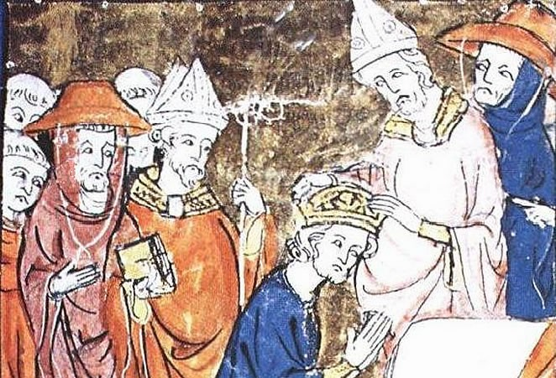
The Rebirth of the Roman Empire 800
The church saw Charlemagne as their golden child.
In the year 800 the pope crowned Charlemagne as leader of the Holy Roman Empire.
This idea of the greatness of Rome would be a heritage for all of Europe.

