Slide 1
United-Nations
A document formed to promote international peace and security.
Red = Definition
United Nation main organs
security Council
Peacekeeping
Peacemaking
Peacekeeping forces
Trade Sanctions

Slide 2
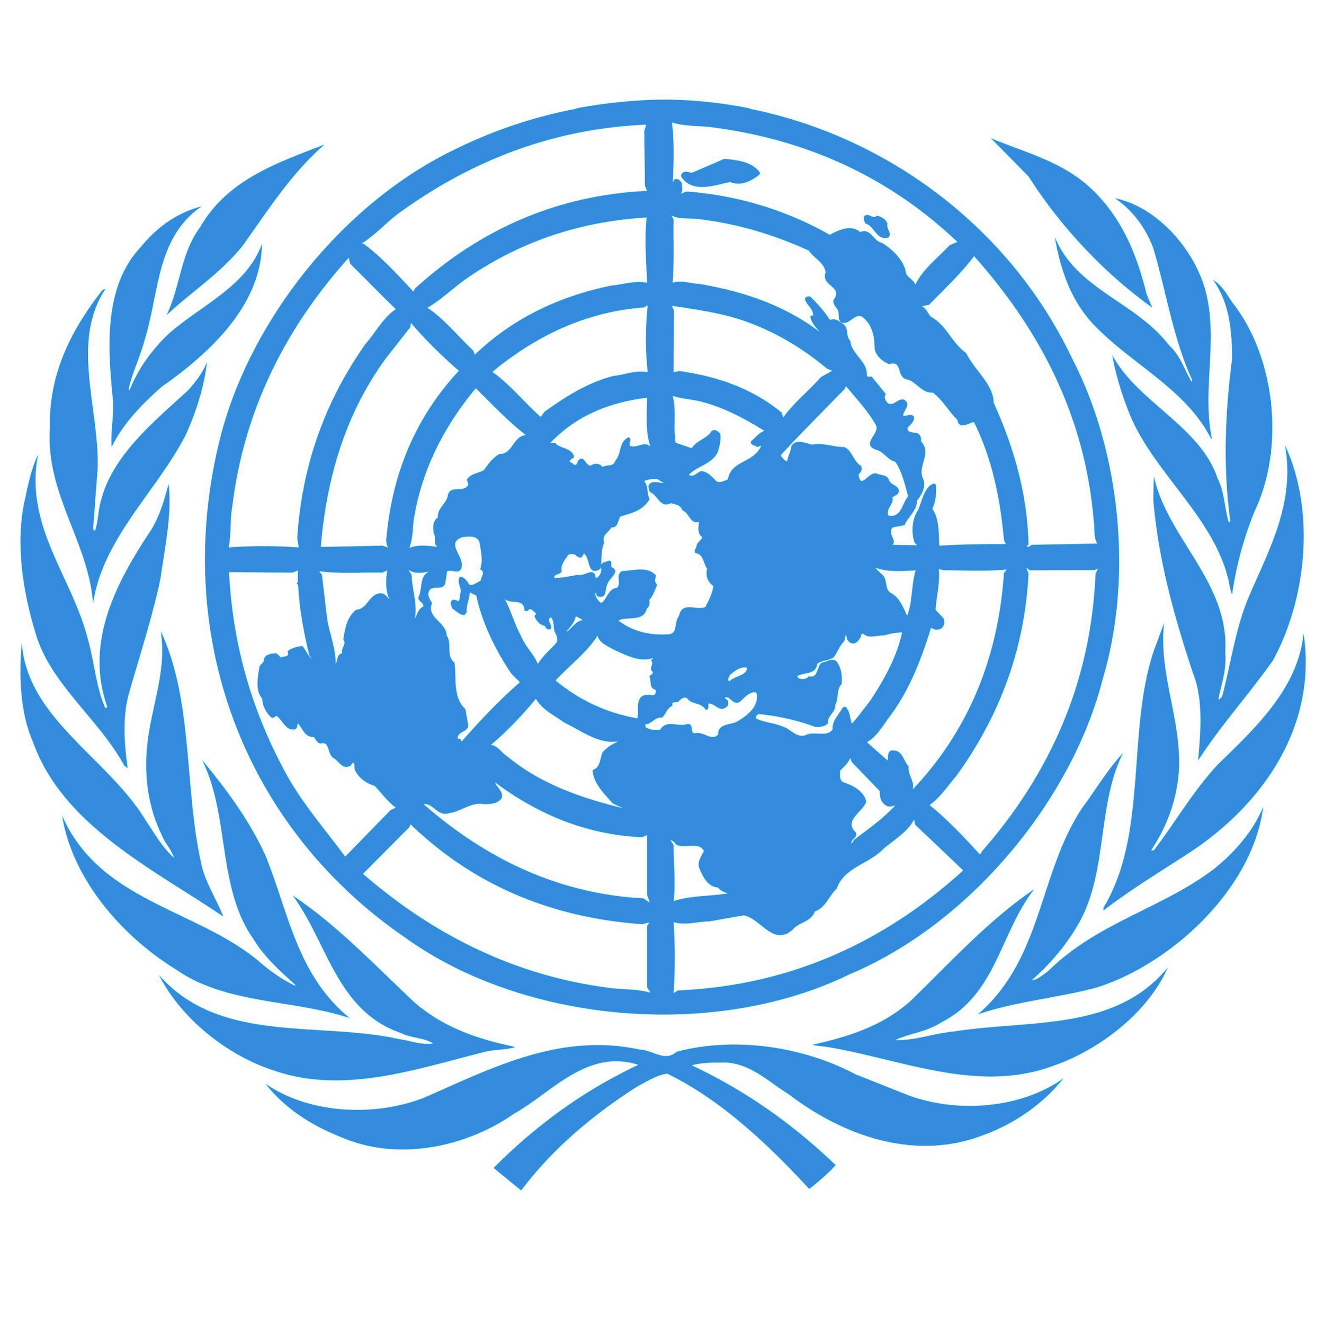
No matter how small or poor a nation is, it still has a voice and a say in the development of the world.
United Nation Symbol

Slide 3
Definition of Words. P.1
United Nation Main Organs:The main parts which help it run smoothly and to do what it does.
Security Council:A division of the united nations charged with maintaining international peace.
Peacekeeping:A maintenance of international peace (sometimes military is involved).
Peacemaking:A person or group who tries to make peace with opposing groups.
Peacekeeping Forces:The blue helmets are the UN’s peacekeeping force.
Trade Sanctions/:The administrative control of a territory to a country.
Known also as Trusteeship

Slide 4
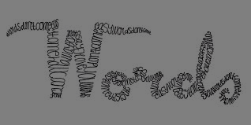
Definition of Words. P.2
General Assembly:
The main deliberative body of the United Nation, composed of delegations from member nations.
Economic Council/ Social Council:One of the principal organs of the United Nations, responsible for coordinating the economic, social and related work of 14 UN specialized agencies.
Secretariat:A permanent government administration office or department .

Slide 5
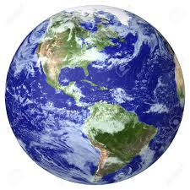
United Nations Main Organs
There are 6 main organs that keep the United Nations running.
General Assembly
Security Council
Trusteeship Council
Economic Council
Social Council
Secretariat

Slide 6
Economic Council
Security Council
General Assembly
United Nations
Social Council
Trusteeship Council
Secretariat

Slide 7
United Nations Throughout history!
Vietnam war:There was not a lot that the United Nation could do for three of their members were involved in the war and the three wanted to see the outcome. The three members are the United States, the Soviet Union, and China.
Korean war:The Korean war was the United Nations most important, since if they didn't resolve it they would have lost credibility. Koria is now split in two North and South and this is how the United Nation settled the war.
Modern: It solves international problems such as wars. UN and world VS Isis.

Slide 8
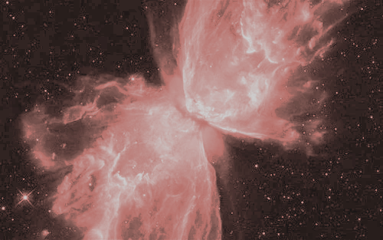
Cause and Effect
On January 1st 1942 the idea of the united nation comes into existence, but it was not till October 24 1945 when it actually comes into existence.
50 countries came together to sign the United Nation charter, later on becoming 51 members due to Poland signing at a later date.

Slide 9
What does United Nations do?
The United Nation is an international organization that is dedicated to maintaining and creating peace and security around the world it is also developing friendly relations among nations and keeping human rights.

Slide 10
Important Dates.
Signing of the Charter.(26 June 1945)
The real start of the UN.(October 24 1945)
1945-2016
and still going.

Slide 11
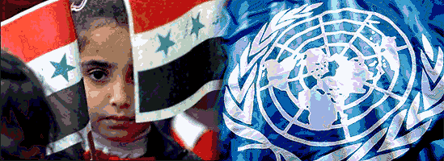
Why is this Important?
It creates guidelines to keep the world at peace, as much as they can the UN cannot make full laws but it is a big part of this world.
No matter how small or poor a nation is, it still has a voice and a say in the development of the world. This is the main reason why the UN is important.

Slide 12
Where was this?
It was signed in San Francisco but it has 50 different countries involved in the signing in 1945, a little while later poland joined to make 51. (At the start of 2016 there are 193)
Here are the first 51, France, the Republic of China, the Union of Soviet Socialist Republics, the United Kingdom of Great Britain and Northern Ireland, the United States of America, Argentina, Australia, Brazil, Belarus, Belgium, Bolivia, Canada, Chile, Cuba, Colombia, Costa Rica, Czechoslovakia, Denmark, the Dominican Republic, Ecuador, Egypt, El Salvador, Ethiopia,Greece, Guatemala, Haiti, Honduras, India, Iraq, Iran, Lebanon, Liberia, Luxembourg, Mexico, Netherlands, New Zealand, Nicaragua, Norway, Panama, Paraguay, Peru, Philippines, Poland, Saudi Arabia, South Africa, Syria, Turkey, Ukraine, Uruguay, Venezuela and Yugoslavia

Slide 13
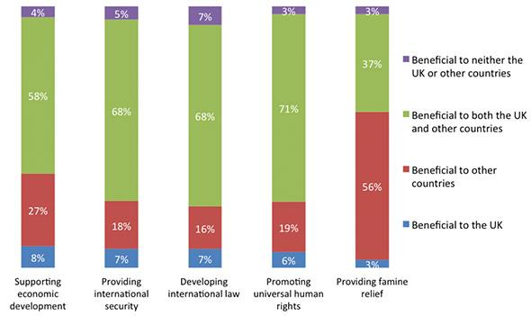
Why should you care?
The UN creates peace and keeps it, it also provides a whole bunch of other relief as shown on the chart.

Slide 14
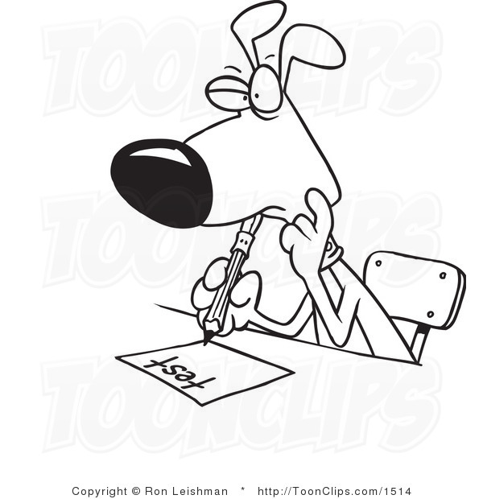
Test Questions
(HARD)
What were the 6 main organs of the UN?
How many signed the United Nations Charter when it was made? A. 51 B. 50 C. 62 D. 43 (Trick Question Sorta)
Where was the UN charter signed?

