Slide 1
Understanding the Crusades

Slide 2
The East West Schism 1054
The Roman Catholic Church and Orthodox church decide they have too many differences. The main difference “the Filioque”
Eastern orthodoxy believes the Holy Spirit came from God the father.
Roman Catholics believe the Holy Spirit came from God the father and Jesus.

Slide 3
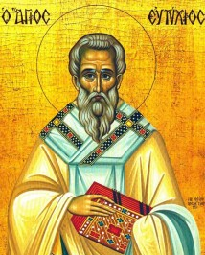
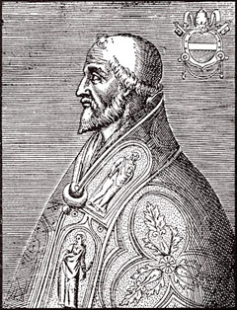
The Filioque problem
God has total authority over the Holy Spirit
The Holy Spirit came from Jesus too!

Slide 4
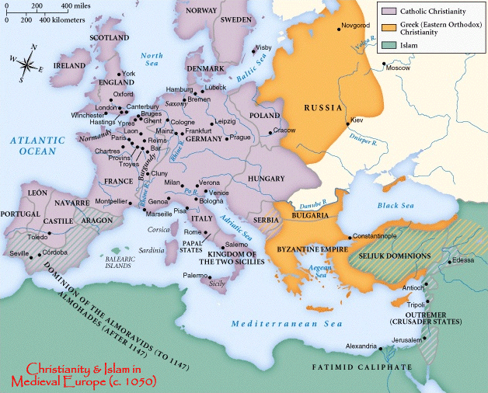
The Split that Still Exists Today

Slide 5
Other Reasons for a Split
Language……………. Latin and Greek
Custom……………. Roman Law Greek Philosophy
History………………… Politically separated for 400 years
Political…………… Central empire dissociated monarchies
Spiritual…………… Lots of petty disputes.

Slide 6
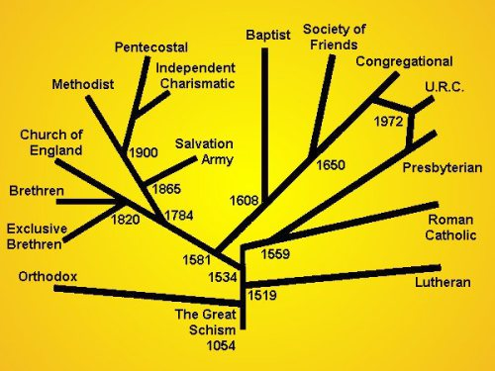
Why is this Important

Slide 7
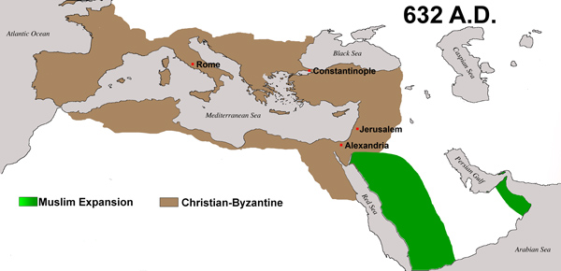
Understanding the Geography

Slide 8
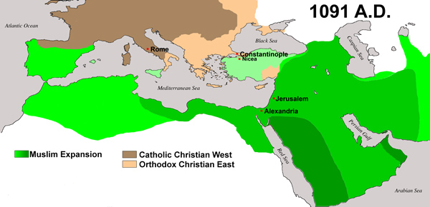
Understanding the Geography

Slide 9
Some important Dates that Proceed the Crusades
637 AD Jerusalem is conquered by Islamic rulers. (5 years after Muhammad's death)
734 AD Battle of Tours, Western Europe narrowly avoids a take-over by Islamic empire.
837 AD Muslims try to invade Rome.
1054 AD The churches finally split.
1076 AD The Muslims destroy all holy Christian sites in the Holy Land
1095 AD the city of Constantinople under Muslim threat.

Slide 10
So what Do You Believe about Crusades
Christians killed thousands of innocent people in God’s name. Therefore the crusades are evil.
The crusades are an example of how the Catholic pope manipulated people to get a political agenda done. Therefore the crusades are bad.
The Crusades are an example of Christians resorting to violence to defend their territory. Christianity does not condone violence therefore the crusades were a necessary evil.
The Crusades are an example of Christians trying to liberate and protect other Christians and the Christian heritage of the Holy Land. Therefore the crusades were perfectly acceptable.

Slide 11
Problems faced when going on a Crusade

Slide 12
Logistic Problems
Go to page 128 Fig. ___ in your Pathways textbook how many kilometers is it from Tours to Jerusalem?
If someone can walk 4km an hour and ten hours a day. How many days would it take to cover the distance?

Slide 13
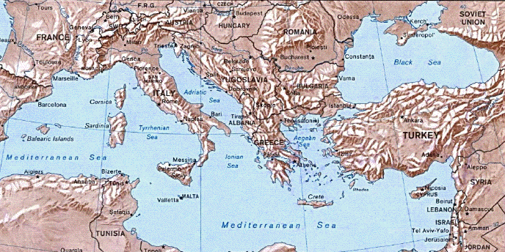
Geographic Problems
Using this map find out how many of the kilometers traveled are in mountain regions?
200 km

Slide 14
Geographic Problems (continued)
Using the map below count out how many rivers were crossed when traveling between the two dots.

Slide 15
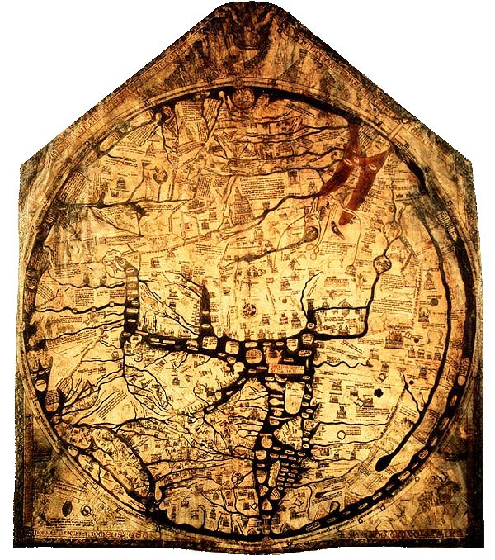
Geographic Problems Continued
Using the map chart a course to Jerusalem from the “X”. What problems would this map present to people going on a crusade?

Slide 16
Financial Problems
The Average Baron on a crusade with 10 knights would have to pay 3000 Franks per year to be on the Crusades. Barons did not make this amount of money. Why would so many people impoverish themselves, and risk their lives to go on a crusade?

Slide 17
Size and Scale Problems
Force size approx. 14,000 persons, 2-3,000 horses
Food and drink requirements, per day:
For men: 28 tons unmilled wheat grain for bread
14,000 gallons of clean fresh water
For horses: 12-18 tons of grain
13-20 tons of hay
4-5 tons straw
20-30,000 gallons of fresh water
Why do these numbers present a huge problem? How much milled wheat would be required for this force over the course of a year?

Slide 18
Culture and Language Problems
The First Crusade had three different kings and lords (many of them didn’t like each other) and over 10 different languages spoken how would this affect the organization of the crusades?
Most Knights had not been trained in tactics or had undergone any sort of formal training for war. How would this fact combined with question 8 affect battle plans.

Slide 19
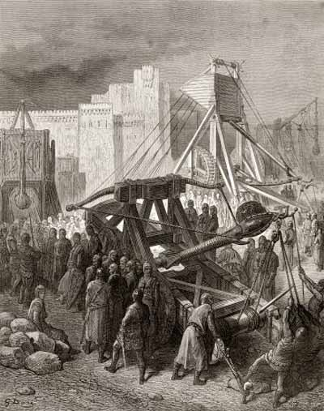
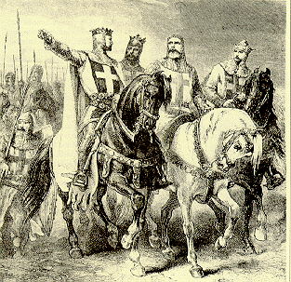
Pictures of the First Crusade

Slide 20
Brief outline of the crusades
1095-1300 AD

Slide 21
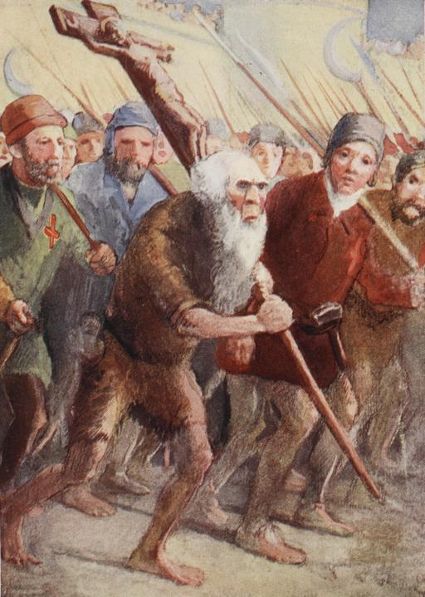
People’s crusade (peasants crusade)
It’s not officially a crusade
Mostly peasants with sticks and pitchforks.
They often pillaged the cities they marched through to feed themselves.
Very excited about what God was going to do.

Slide 22
First Crusade 1066
Arguably the ONLY Successful crusade.
3 kings siege Jerusalem and take it back for Christianity.
Kingdom of Jerusalem established.
(Assassins Creed 1) Time of pilgrimage.

Slide 23
Second Crusade 1147
Two popes later.
Jerusalem was actually quite peaceful.
Decides to liberate Asia minor to create more of a land bridge to Jerusalem.
Total Failure.

Slide 24
Third Crusade 1187
Saladin recaptures Jerusalem so a bunch of kings go to take it back. Including the emperor and king Richard.
They won their battles but didn’t take back Jerusalem.

Slide 25
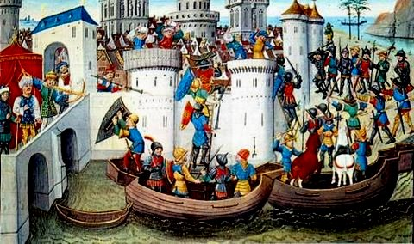
Fourth Crusade 1202
In order to raise money the crusader actually attack Constantinople. (the city the first crusade tried to protect)

Slide 26
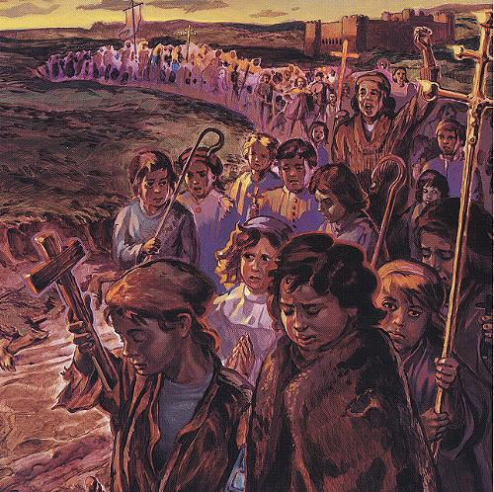
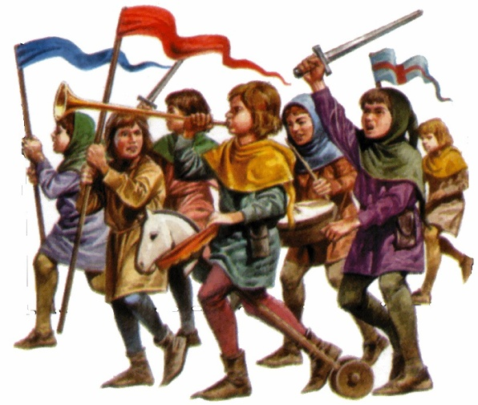
Children’s Crusade 1212
Sending kids to the Holy Land to fight. Most were sold into slavery before arriving.

Slide 27
Crusades 5-9 1215-1300
Lots of these were in Africa or even in areas of Europe. Some simply supplied the Christian Kingdoms in the Holy Land.
Some were even organized without the Pope’s blessing.
The Crusades Finally ended with the Fall of Constantinople and the loss of Christian Kingdoms in the Holy land.

Slide 28
Postcard Sample

Slide 29
Crusade Sample Postcard Text
Dear Sarah,
We’ve been following Peter the Hermit along the Danube River for about three week since I last wrote, gradually we’re entering into a hilly country. We’ve recently left a city filled with Jewish interlopers and a breed of Europeans who are so apposed to God’s divine mission which he has sent us on, that we were forced to justly sack the city… Belgrade I believe it was called. Some of our group did not conduct themselves well, having all their sins pre-absolved they proceeded to loot, rape, and enact violence, in particular against the Jews of the city. Normally God would be displeased, but thanks to the pope the representation of God himself, our actions will be seen as righteous and necessary in the building of His kingdom; in the same way that Joshua was forced to take the Holy Land we too now take the Holy Land. Though I am told Belgrade is not close to the Holy city, I see a need to first cleanse our own before cleansing the lands in the east. With all my love: John

Slide 30
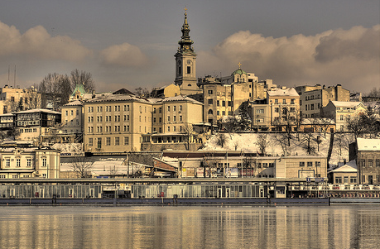
Belgrade (January 1096)

Slide 31
Grade 8 Bibliography

Slide 32
You need 4 pieces of information
You need the name of the author
You need the Title of book/webpage or article.
You need the full URL
Date or last update
List them all IN THIS ORDER!
Name. Needs to be given last name first. If there is no individual author, use a corporate author. If no name is given leave it out.
Example: http://www.historylearningsite.co.uk/second_crusade.htm
Example: http://en.wikipedia.org/wiki/Second_Crusade

Slide 33
You need four pieces of information
Title MUST be included. Usually it is in Bold on top of the website. When you write it in your bibliography you must put the title in “quotes”
Example: http://en.wikipedia.org/wiki/Second_Crusade
Example:
https://answers.yahoo.com/question/index?qid=20150207221819AAcHWJY

Slide 34
You need four pieces of information
You need a full URL. Its simple just copy and paste. Pictures when cited must use the URL from the webpage, not just “google” please remove the hyperlink.
You need a date (or last updated) some web pages don’t have one. It’ll normally be on the bottom
Example: http://www.historylearningsite.co.uk/second_crusade.htm

Slide 35
The end result
Name Last, Name First “Title of whatever you used”, URL .com.org.ca.edu.-in/full, date

Slide 36
Knights Templar

Slide 37
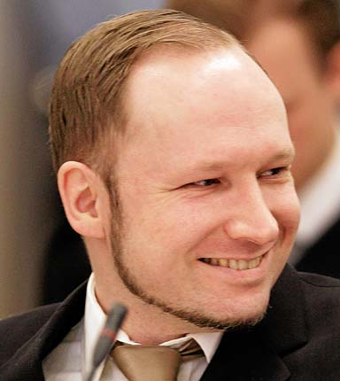
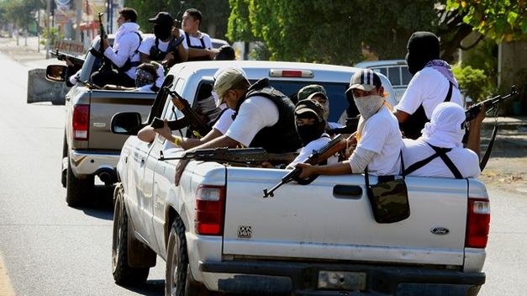
Who are the Templars
Anders Behring Breivik
Templarios

Slide 38
Historical Templar
Pilgrimage to Jerusalem is become the rage in Europe.
Touching the grave of Jesus could take away sins.
The journey itself had some value for the soul.
Source of prestige. and status
Maintains presence in the Holy Land (political)
This would be called “the Grand Pilgrimage”

Slide 39
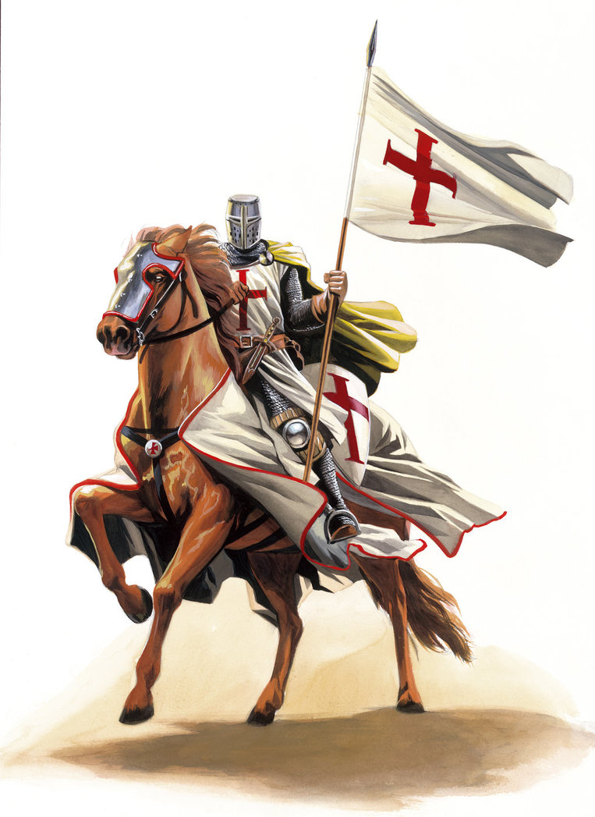
Historic Templar
Pilgrimage was very dangerous and it was very difficult to navigate to get there.
The knights templar were allowed by Muslims and sanctioned by the Catholic Church to help pilgrims travel safely.

Slide 40
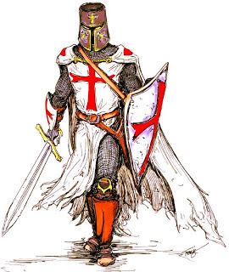
Historic Knights Templar
By 1129 the Templar have adopted the red cross as their emblem.
They are being given lavish donations.
They are training knights for combat.
They are being given land.

Slide 41
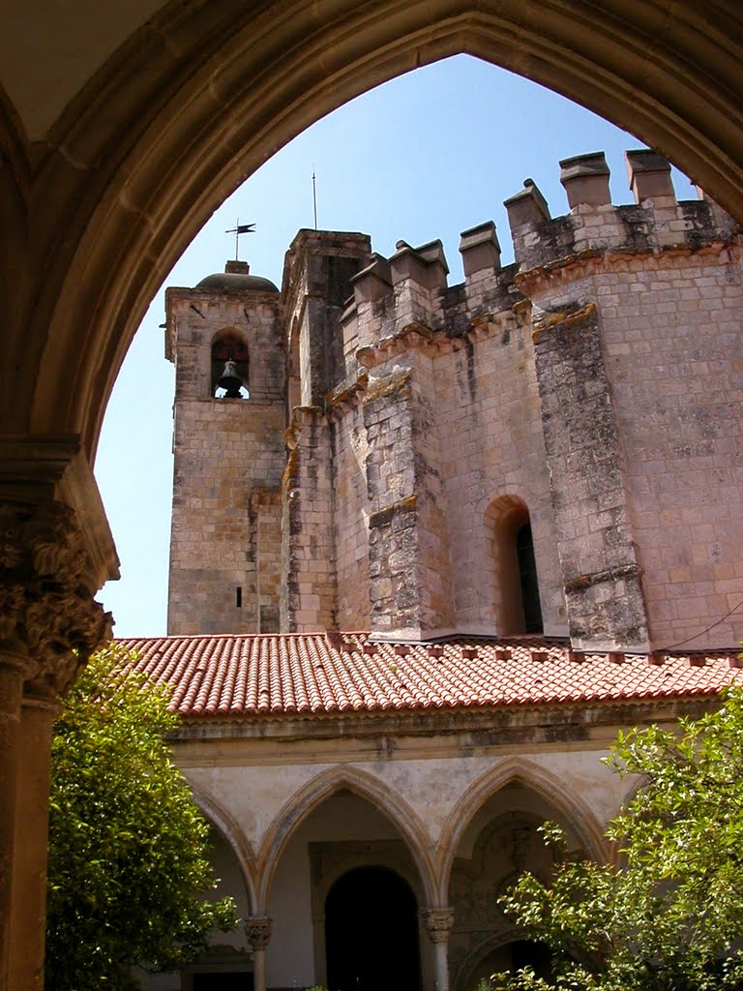
Knights with too much Power
They begin a foreign bank so visitors can make withdrawals abroad.
They excel in combat and in knowledge thanks to their secular monasteries.
They start trade routes and get rich.
They exert considerable control over monarch and church decisions

Slide 42
Conspiracy Theory Begins
1307 ALL templar are excommunicated and sentenced to death by the Catholic church. Accusations include:
Devil worship
Homosexuality
Corruption
To this day there are theories on what the Templar were up to to get them excommunicated?

Slide 43
Did the Templar Cease to be?
The conspiracies:
They kept the Holy Grail from the Vatican.
They had secret knowledge of Jesus
They had discovered the new world (America)
They were establishing a world order which controlled everyone and everything.
Became free masons/ secret fraternities

Slide 44
What to Believe

Slide 45
Make up a Conspiracey
Why did the Templar suddenly get excommunicated?
What “crazy” thing had they done or discovered.
What evil thing was the catholic church trying to do?
Who are the knights Templar today?
How do the knights templar affect everyday humans.

Slide 46
The Illuminati Conspiracy Theory
Illuminati was a secret society in 1776 which wanted to manipulate monarchies.
It was consumed by the Freemason secret society a few years later. And disappeared by 1800.
In 1797 and 1798 two famous writers blamed the French Revolution on the Illuminati.
Some people believe it traveled to North America and some believe it continues to influence through the Freemasons

Slide 47
Who Runs the Show
Illuminati run by Jews
Illuminati run by Templars
Illuminati run by Catholics
Illuminati run by secular humanists
Illuminati run by Christian Masons
Illuminati run by Satanists
Illuminati run by Richest people in America

Slide 48
Illuminati
Watch Snuff films
Control Hollywood films and music.
Assassinate democrats
Give democrats presidential elections
Caused both World Wars
Blackout Superbowls
Anything bad that happens is caused by them. (Essentially becomes its own religion, an exceptionally superstitious one)

Slide 49
What to Believe
Facts that are verifiable
It is documented officially
It is recorded or videotaped from different sources.
Physical artifacts are present.
Verified testimony from reliable witness
Not reliable if they are not mentally sane
Not reliable if they pose to gain from their testimony.
Not reliable if the testimony was achieved under duress
Not reliable if they’ve been proven to be not reliable in the past.
Not reliable if they claim to be experts in a field they know nothing about.
Scientific evidence

Slide 50
What Not to believe
Conjecture: creating what if scenarios or “using an inch to take a mile”
Pariah: Straw man building. Endowing something with negative attributes but denying its value.
Heresay: using popular rumor in place of fact.
Cranks: Believing the outlier. 10,000 historians say one thing but 1 says another.
Sexy ideas: Ideas that are designed to be more attractive than the truth.
Supernatural ideas: Facts that heavily mix in supernatural elements but have no biblical basis

Slide 51
Assignment
What Hollywood Stars are in the illuminati?
What facts prove it?
Do these facts survive the “what not to believe test.”

