Slide 1
Understanding Islam
A brief history of the Arabs

Slide 2
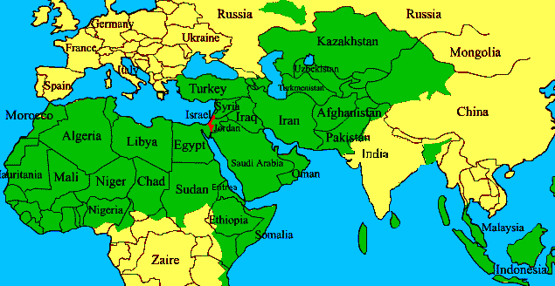
Where are we?

Slide 3
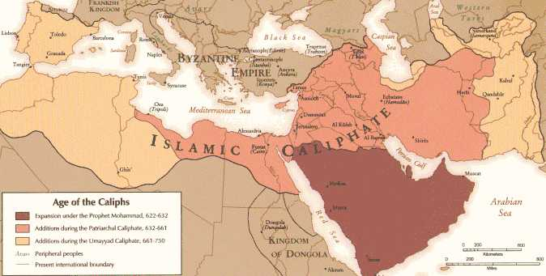
Where are we?

Slide 4
The Early History
Government was weak or non-existent
The Byzantines and Persians fought for the land.
The religion was mixed between various polytheistic beliefs Zoroastrian and Nestorian Christianity.
Women had no status, prostitution and polygamy was rampant.

Slide 5
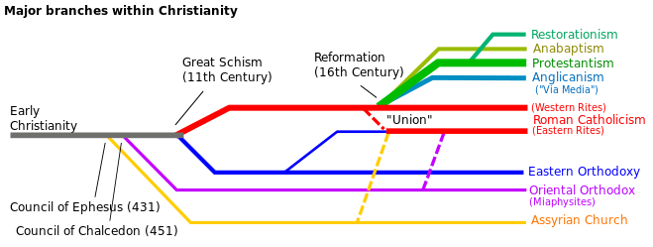
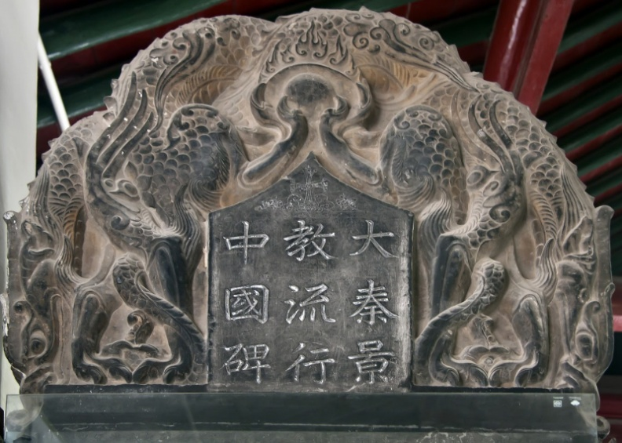
Nestorian Christianity
Separates moments when Jesus was God and when Jesus was fully man.
This church moved to China, Persia, India.
St Thomas is the patriarch

Slide 6
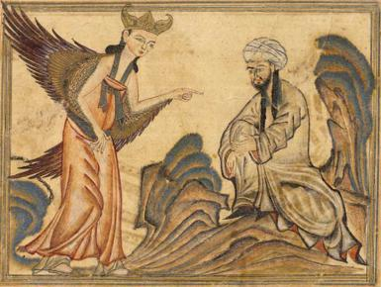
Mohammed comes.
Believed to be a prophet. Like Moses, like Jesus.
Visited by the angel Gabriel. (same angel that visited Mary)
Visited during Ramadan

Slide 7
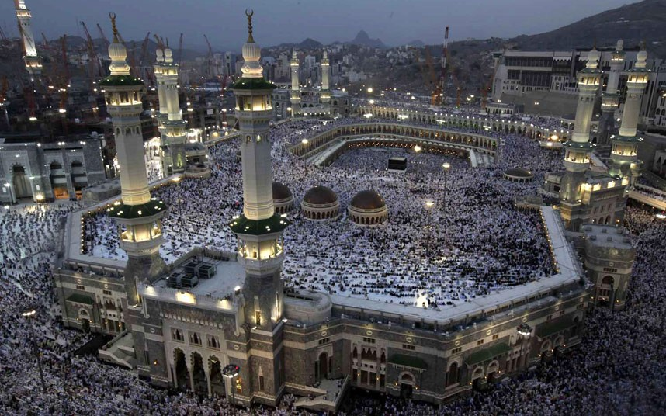
Mohammed 570-632
He was a rich merchant.
Called to proclaim the one true God.
Gained only 40 followers, mostly friends and family.
Was persecuted severely sacrificed quite a lot. (not in this for wealth)
Took over Mecca with military force. 630

Slide 8
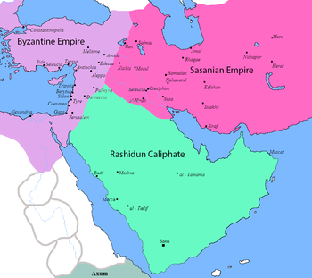
Region taken by force
Was not miraculous.
There was no government law or organization in immediate region.
Why would God need another prophet?
Why a special message when a church is in the area?
Why would Christianity spread through peace but Islam spread through warfare?

Slide 9
What is the essence of Islam
The 5 pillars of Islam:
A dedication to monotheism
Prayer
Charity
Fasting
Pilgrimage
Holy War?
Find out more: What is Islam

Slide 10
The End of Mohammed’s Life
Was one of bloody conquest. 8 battles, 8 raids and gave orders for 38 military operations.
Within 10 years after his death his force rivaled the Byzantines and Persians.
His personal example is not one we would want to follow. It was cunning and brutal.
Elevated dying for one’s faith in the defense of Islam as the utmost glory.

Slide 11
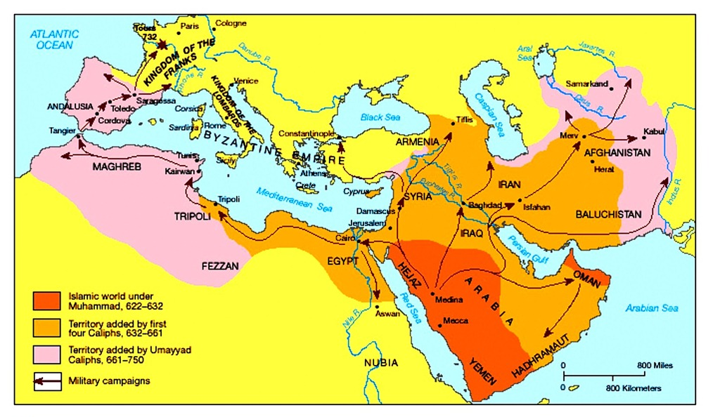
The beginning of the next Caliphate
People want to abandon being Muslim
They are all put to the sword until they resubmit to Muhammad.
Islam spreads in this fashion without resistance until 730.

Slide 12
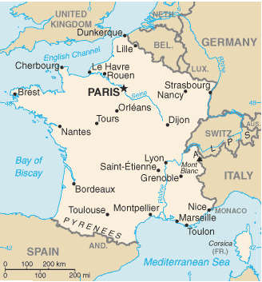
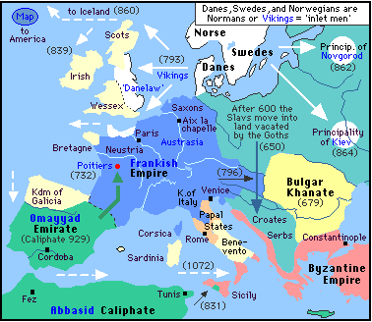
The battle of Tours 730
Franks are the strongest empire in all of Europe (besides the Byzantines)

Slide 13
Islam has something to offer.

