Slide 1
Tour of the House of Commons (and legislature buildings)

Slide 2
The House of Commons or Parliament or Lower House

Slide 3
House of Commons
Government MP’s sit on one side
Opposition to the government MP’s sits on the other.
Prime minister “leader of the Governing party” sits on one side.
Leader of the opposition sits on the other side.

Slide 4
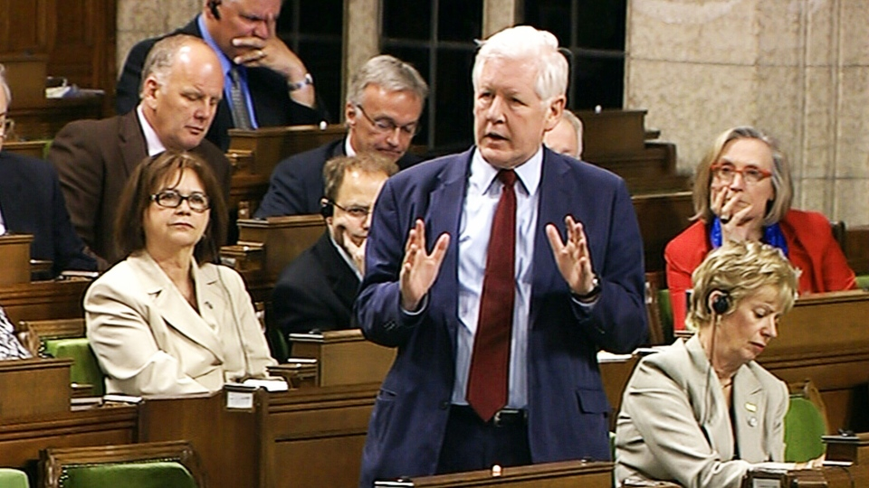
What Government Does.
Government runs the country.
MP’s create and vote on laws for the country
Opposition questions actions of government.
MP from the opposition asking what government will do about problems in Syria

Slide 5
Government (general information)
The house of commons is the only federal institution which is elected by the people of Canada.
The federal government must have an election every 5 years (normally 4 or less)
If we elect a really bad government we might have to suffer for 5 years.
We do not elect the Prime Ministers we only elect MPs.

Slide 6
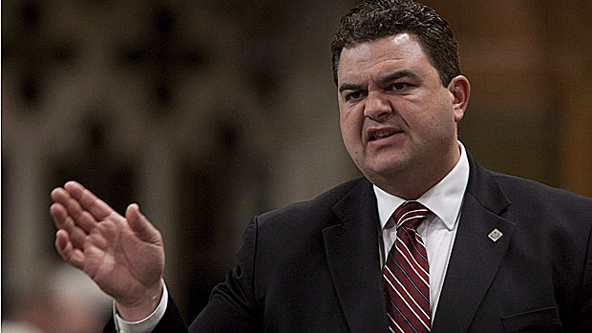
MP’s (member of parliament)
Represent their “riding” 100,000 people.
Vote on new laws.
Question or defend governments actions

Slide 7
Layout of Canada’s House of Commons (each square represents one riding)
Disclaimer: This is 6 years old/ aka 2 elections

Slide 8
The House of Commons

Slide 9
Answer Key (for self review)
Speaker 3. Government Members 4. Opposition Members* 5. Prime Minister 6. Leader of the Official Opposition 8. Clerk and Table Officers 9. Mace 10. Hansard Reporters 11. Sergeant-at-Arms 12. The Bar

Slide 10
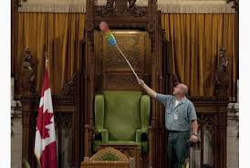
The Speaker of the House
Referee, makes sure everyone obeys parliaments rules
He has a tie breaking vote
Looks important

Slide 11
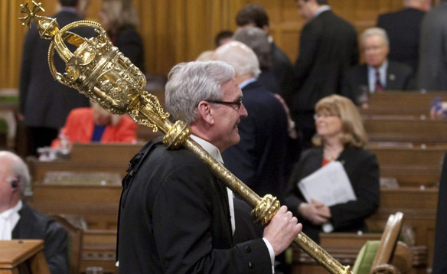
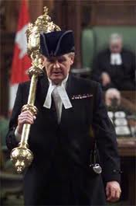
Sergeant at Arms
Carries a mace
Makes sure parliament is secure.
Leads a parade for every parliament

Slide 12
Clerks
Keeps Important documents.
Hansard: Documents that keep track of what happened in parliament.

Slide 13
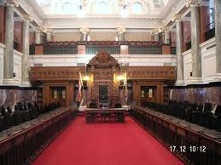
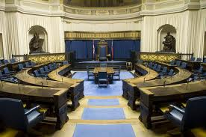
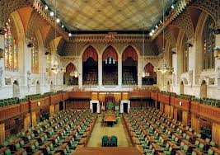
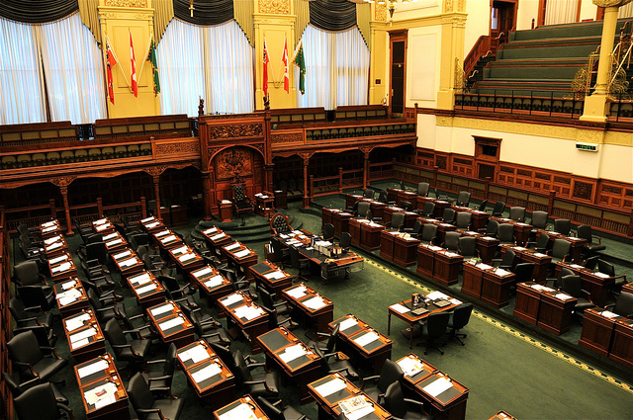
Provincial Legislature Building
British Columbia Manitoba
(Federal Government) Ontario

Slide 14
Similarities between provincial government and federal government.
Provincial Gov.
Premier
Lieutenant Governor
Opposition Leader
Speaker of the House
Legislature
Members of Legislative assembly (MLA)
Federal Gov.
Prime Minister
Governor General
Opposition Leader
Speaker of the House
Parliament
Members of Parliament (MP)

Slide 15
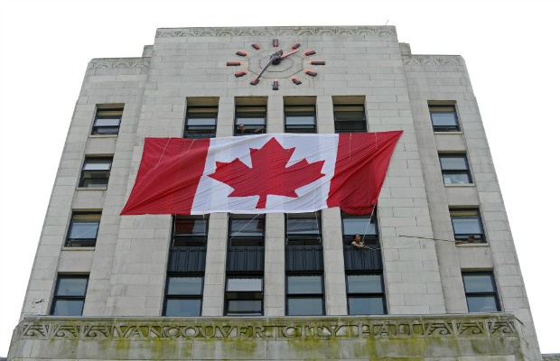
Municipal Government
Vote for municipal government
Don’t need to know much about this

