Slide 1
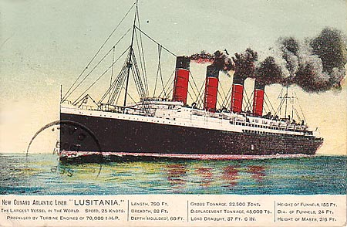
The Lusitania

Slide 2
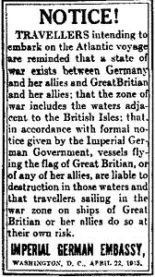
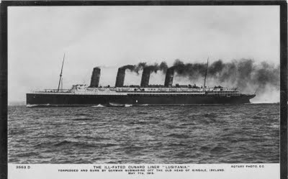
The Warning
Do not Sail
Something might happen

Slide 3
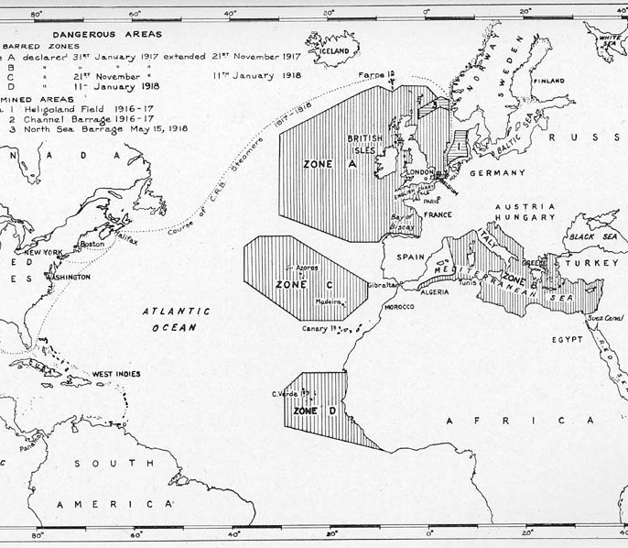
Unrestricted Submarine Warfare
Difference between prize rules and unrestricted submarine war.
The result of British Naval blockade

Slide 4
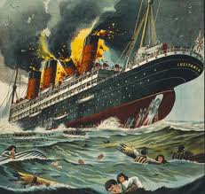
This is not the Titanic
One Torpedo fired. Two explosions were heard approximately one minute apart.

Slide 5
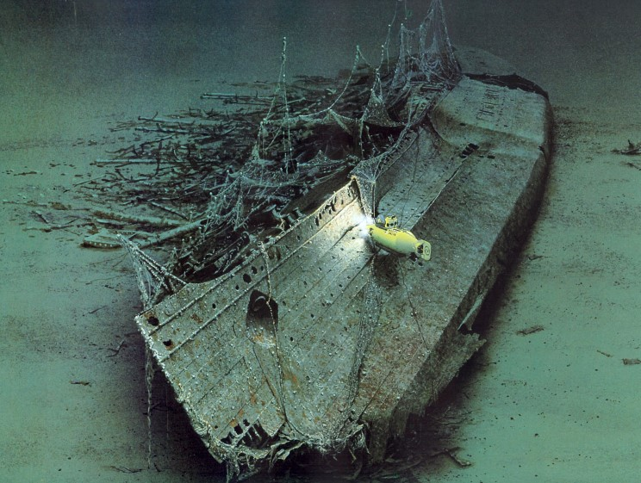
A Quick Sink
Most ships sink in 4-5 hours
Lusitania sank in 18 minutes. As a result there were many deaths

Slide 6
Propoganda Posters

Slide 7
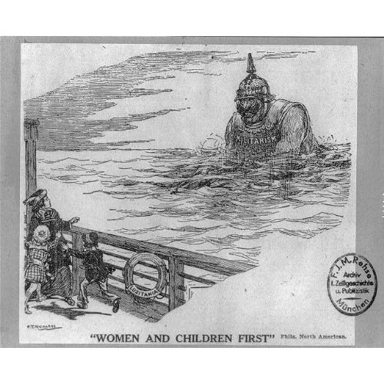
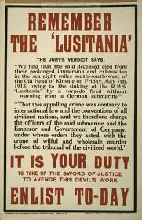
Americans jumped into World War 1 and the rest is history.
Poster Reads: Women and Children First.

Slide 8
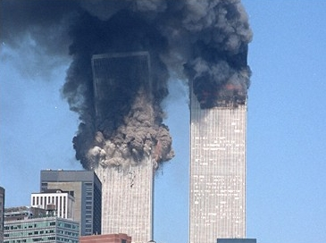
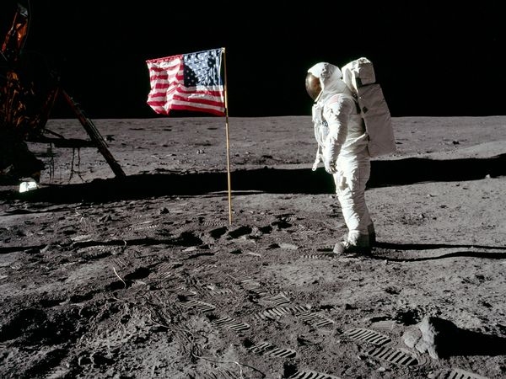
How did America get involved?
Conspiracy
Cover-up

Slide 9
Tragic Accident Or Government Conspiracy?
Look over the evidence package and the internet: Write three reasons why is this clearly a conspiracy.
Look over the evidence package and the internet: Write three reasons why this is clearly not a conspiracy.
Decide which side is more convincing

