Slide 1
The Korean Proxy War
Nadia Klaue

Slide 2
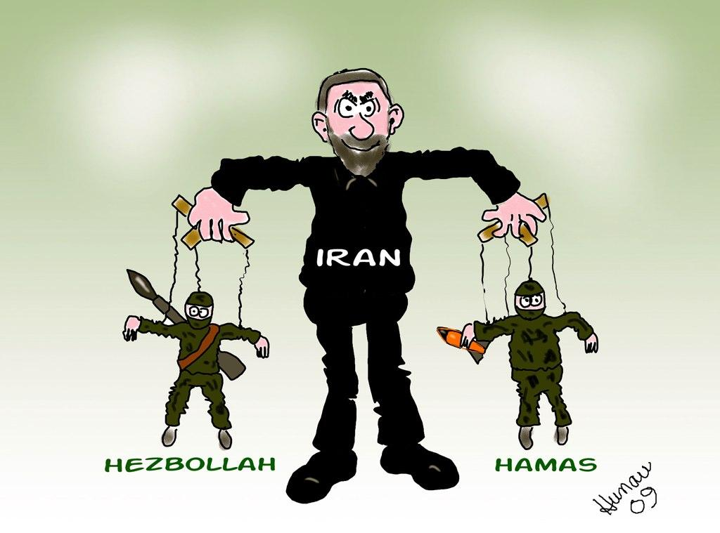
The Korean Proxy War
Proxy War: A war instigated by a major power that does not itself become involved.
Korean War: begun on June 25, 1950, between North Korea, aided by Communist China, and South Korea, aided by United States/other United Nations. (Formed the United Nations Armed Force)
Leader of South Korea: Kim Il Sung
Leader of North Korea: Syngman Rhee

Slide 3
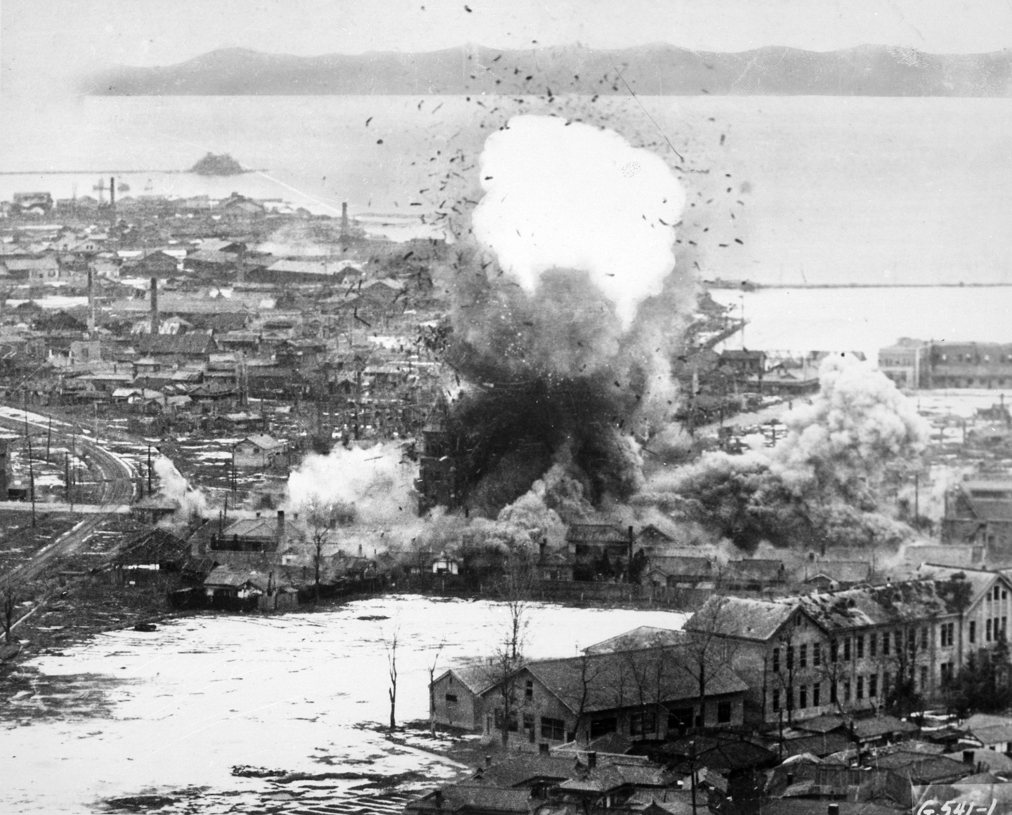
The Korean War
The Korean War marked the rise of two superpowers: the Soviets and the United States.
This proxy war sets the stage for the duration of the Cold War.
This was the first was with which the UN were involved.
The Korean War lasted for three years and was one of the most brutal conflicts. It had no clear winner.

Slide 4
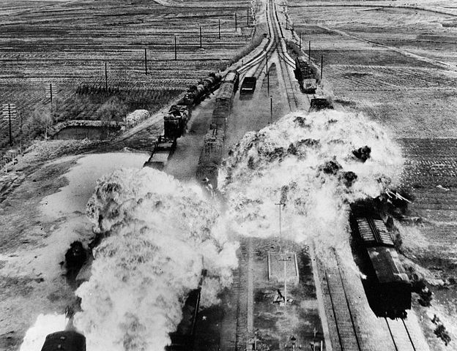
Continued...
In total, over five million Americans, Chinese, and Soviets were killed or wounded on the battlefield.
The War took a heavy toll on all, in the over five million dead, wounded, or missing, over half of them were civilians.
The war was not only a civil war but, it was a major proxy war between the U.S. and the Soviet Union.

Slide 5
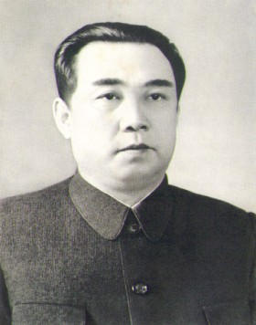
Kim IL Sung (1912-1994)
Kim Il Sung was the dictatorial leader of North Korea from 1948-his death in 1994.
He fought in the Russian Red Army. Which is why he later on teamed up with the Soviets to fight South Korea.
Allied with Soviet leader, Joseph Stalin and Mao Tse-tung , leader of the People’s Republic of China
He was an ardent Communist, and went on to lead the first government in North Korea: People’s Democratic Republic of North Korea.

Slide 6
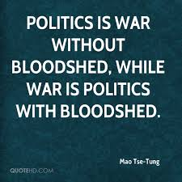
He sought to reunify all of Korea under his own Communist leadership.
Sung led North Korea throughout the Korean War, at times nearly achieving victory or falling in defeat.
He strategized and convinced his allies to invade South Korea to unify the country under Northern Control. Thus, initiating the Korean War.
He later agreed to Armistice in 1953 and continued to rule his country with an iron fist for another 40 years.
Throughout his reign, North Korea slid farther and farther into poverty and authoritarianism.

Slide 7
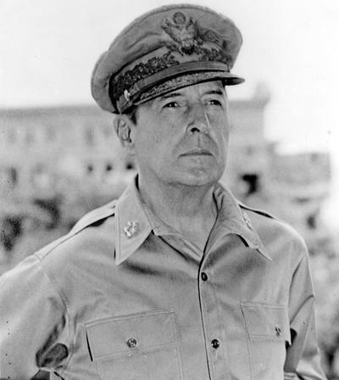
General MaCarthur
Placed in Command of the newly created United Nations forces. (1950)
His American troops drove North Koreans back towards the Chinese Border.
Was overconfident and began to attack China; thinking that the chances of China retaliating were slim.
A Massive force of Chinese troops crossed into North Korea and drove American lines back into South Korea.
“Old soldiers never die; they just fade away.”

Slide 8
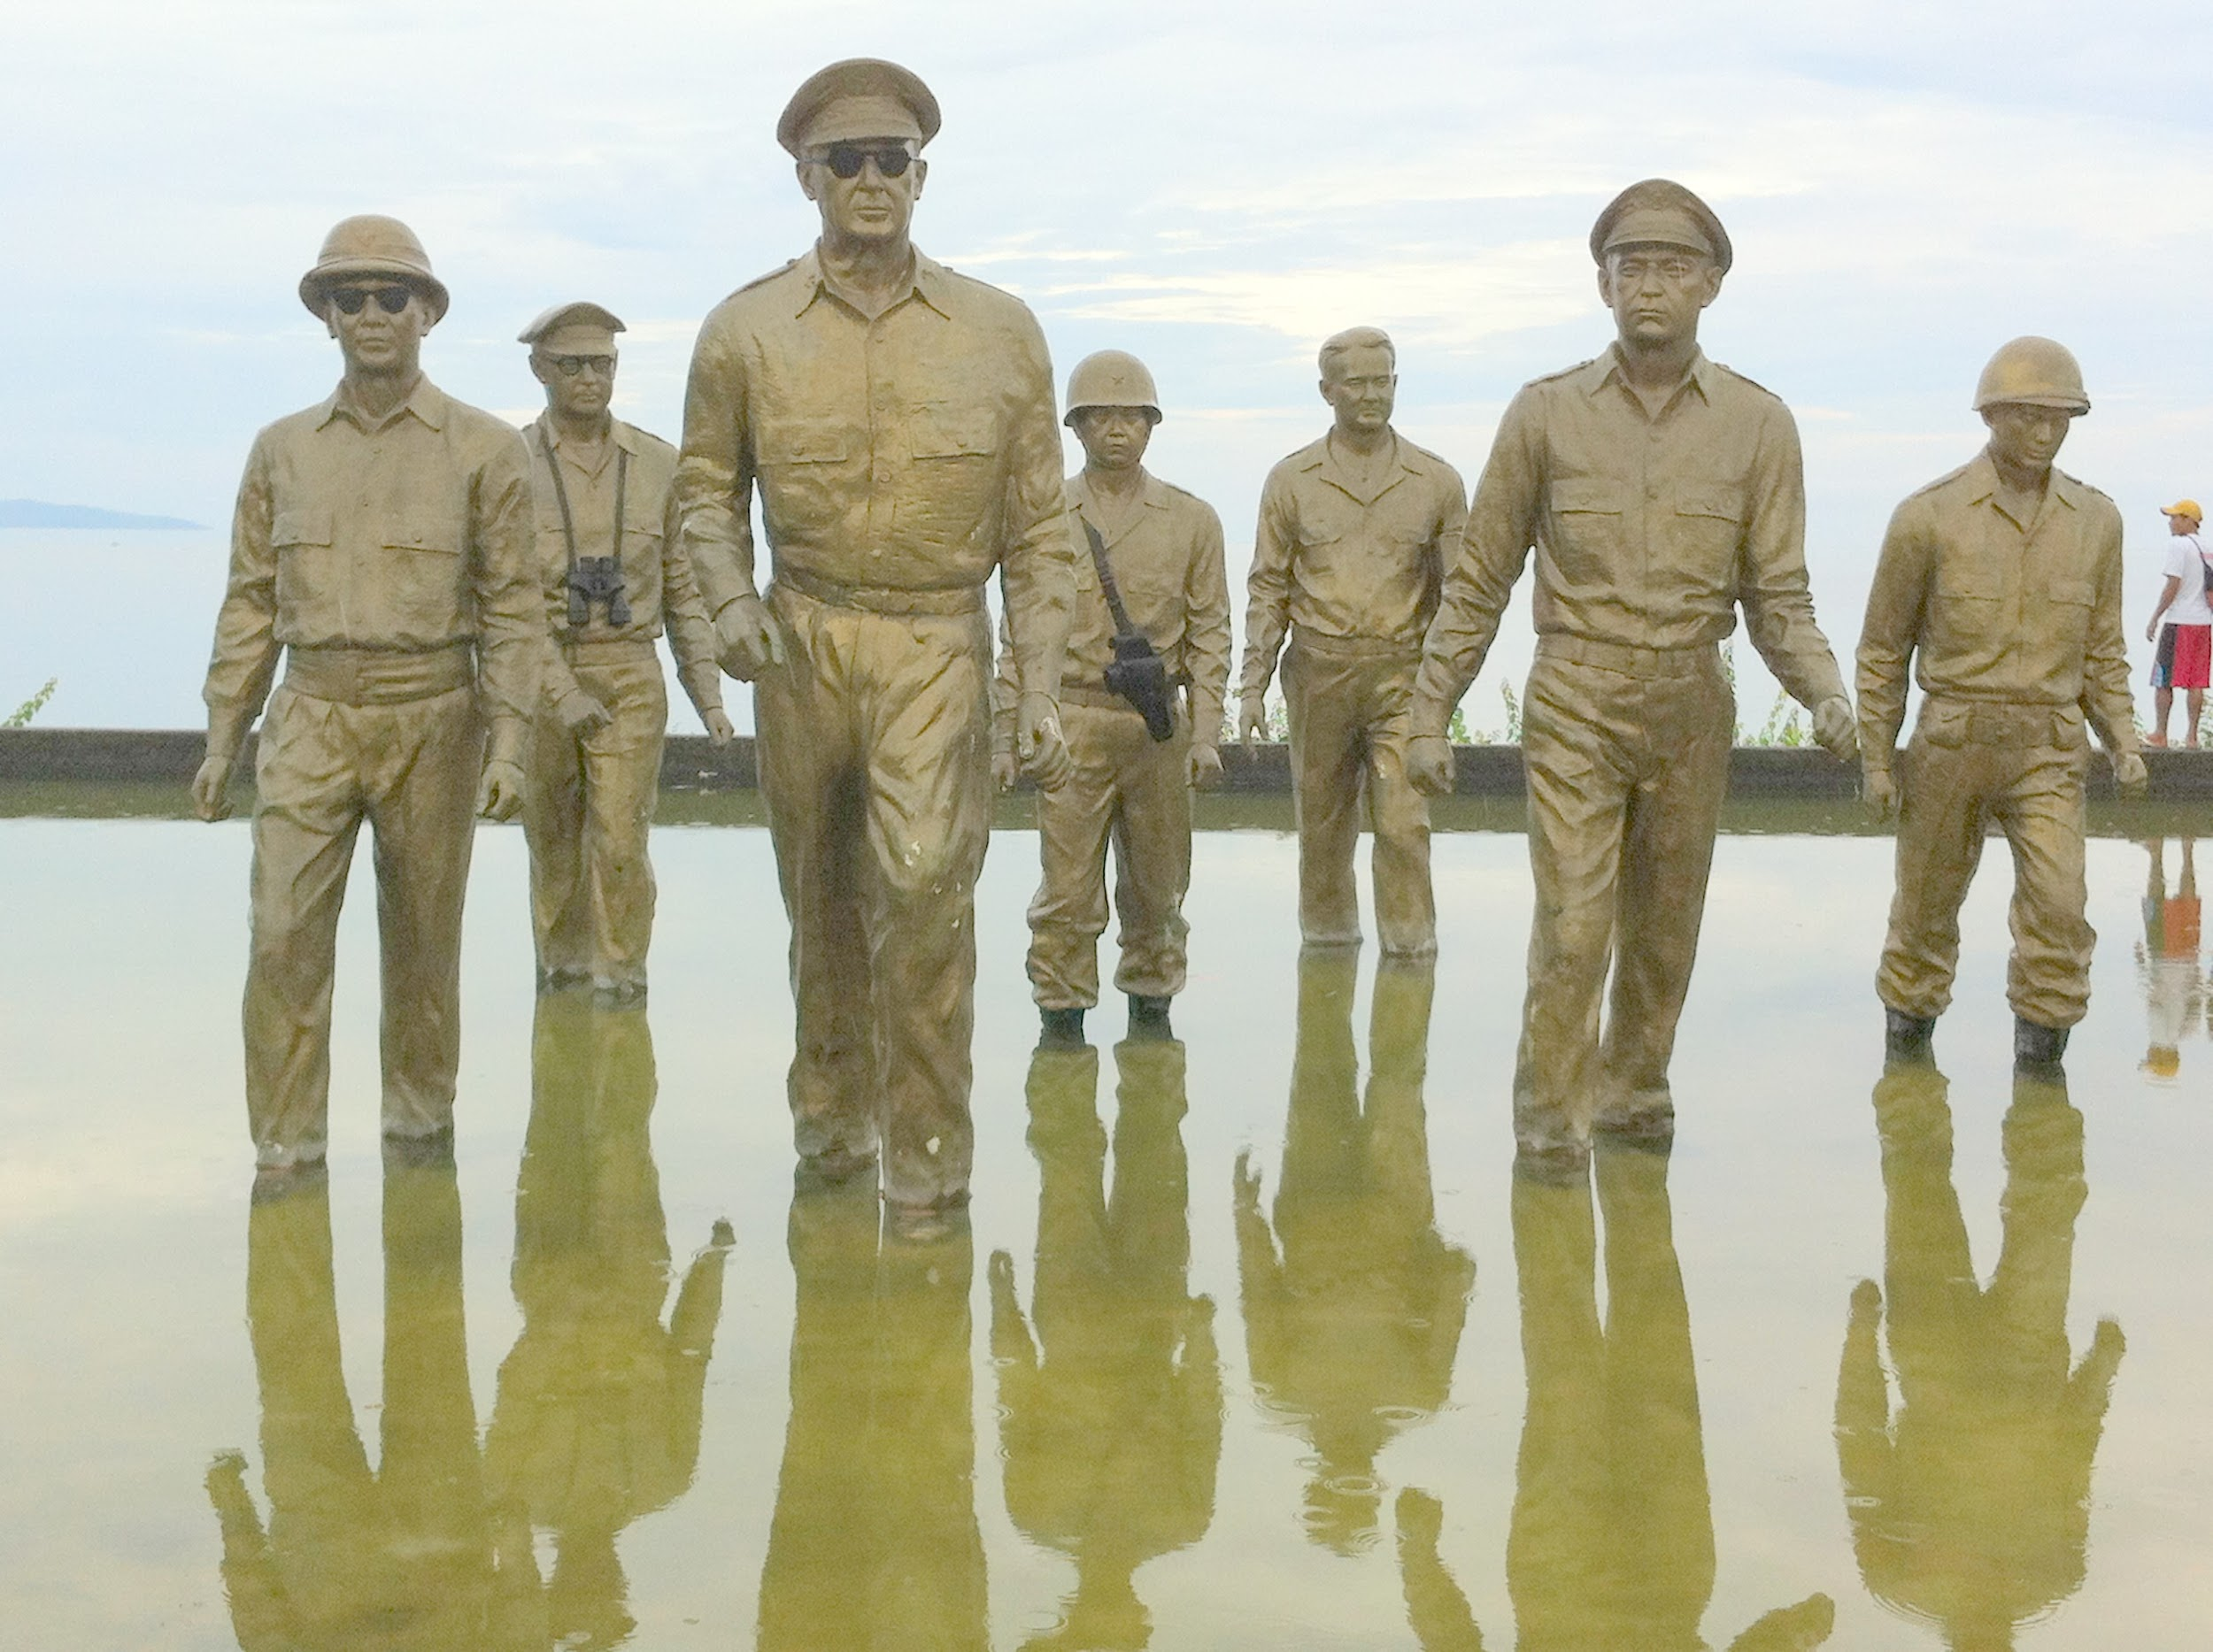
Continued...
He then asked his superior if he could bomb communist China and use Nationalist Chinese forces to fight against Communist China.
When he was denied permission, he flew into a public rage.
In 1951, he was removed from command for insubordination.

Slide 9
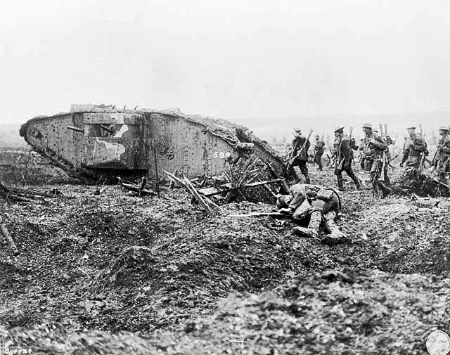
Canada’s and United Nation’s Involvement
Canada
Agreed in principle with the moves to halt the aggression by the UN but, but did not immediately commit its forces.
At the end of WW2, Canadian Forces had been reduced in strength. The ones who remained were specially trained for the defence of Canada.
Limited strength of Active force meant that it was not able to provide an expeditionary force without seriously weakening home defence.
With later thought, 26,000 troops were sent to Korea to help with the fighting.
Canada’s military contribution was larger, in proportion to its population, than most other UN participants.

Slide 10
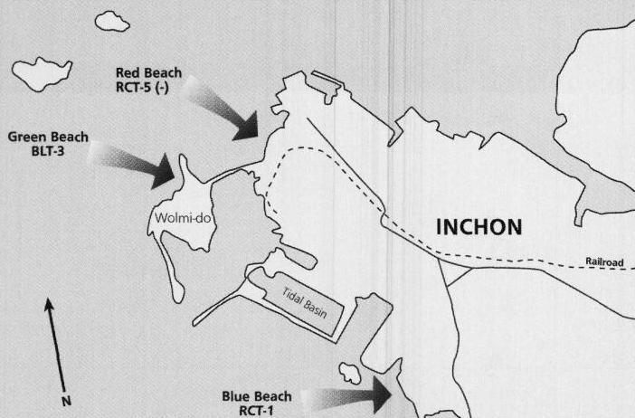
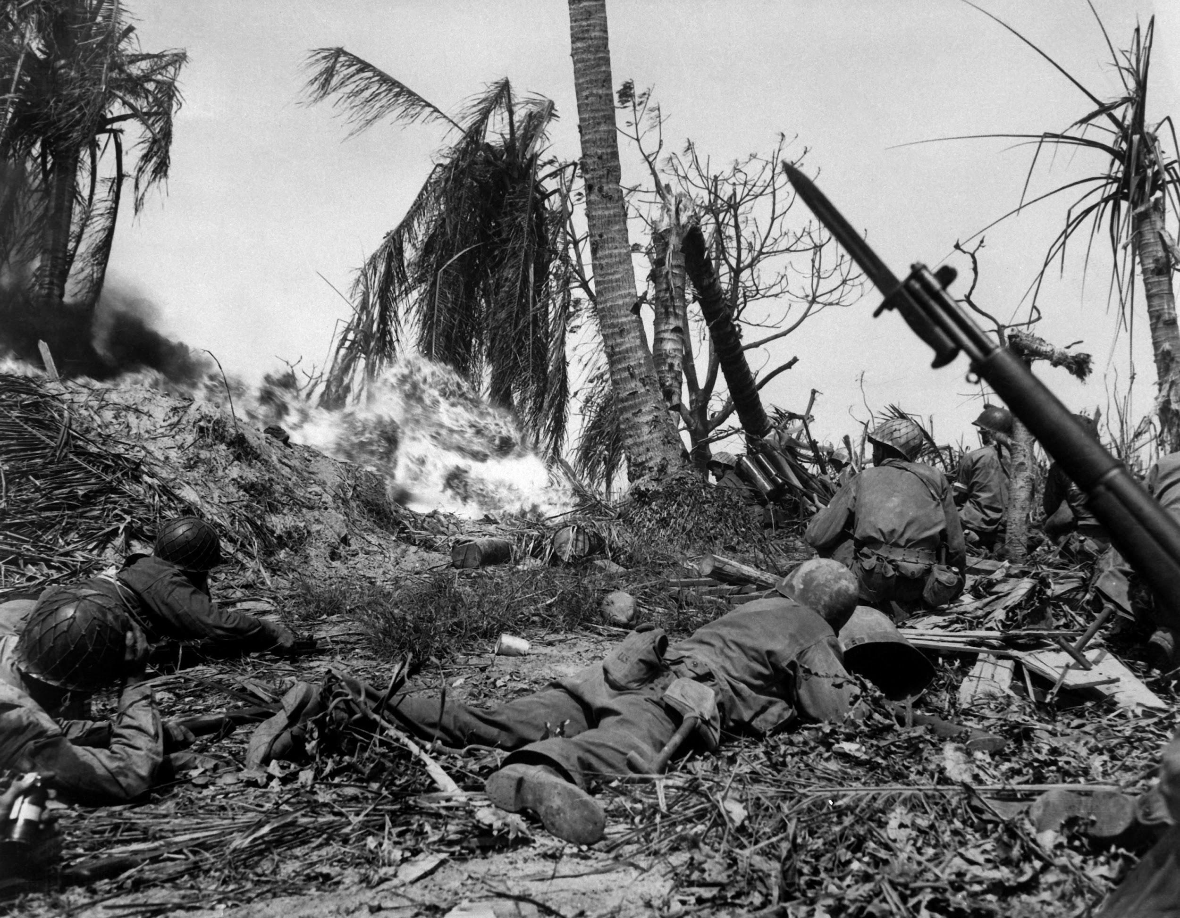
Continued…
United Nations
UN troops wanted to resolve conflict between member nations primarily through dialogue and negotiation as they were in the pursuit of peace.
16 member states would provide troops under a United Nations Joint Command; which would then join the South Korean Army.
Under the command of General MacArthur, American/UN and Korean troops landed and attacked Inchon.
The attack was successful and American/UN troops were able to push back the North Korean soldiers out of South Korea.
American/UN then, under and over-confident leader, went on to attack Communist China.

Slide 11
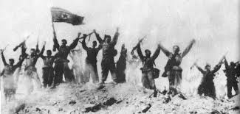
Why do they hate each other…?
North Korea was communist driven, while South was democratic.
Leaders of North Korea were trying to build up communism through both parts of Korea.
North Korea invaded the South to try and turn them.
Today, tensions between North and South Korea are still strong. South Korea is still occupied by 30,000 US troops while the Northern part of Korea is free.
Western Media portrays pro-US imperialist propaganda in which to demonize free Koreans.
Majority of Korean people in both the North and South want to be united and the US occupation to end.
**North Koreans are communist and the South are not.**

Slide 12
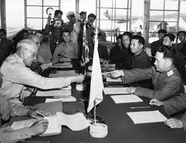
When did it end…?
With everyone fearing a nuclear War the invasion became a stalemate and the North retreated.
The Korean War ended on July 27th, 1953 due to the armistice agreement.
Armistice: an agreement made by opposing sides in a war to stop fighting for a certain time; i.e. a truce.
North and South Korea remained separate and occupied almost the same territory they had when the war began.

Slide 13
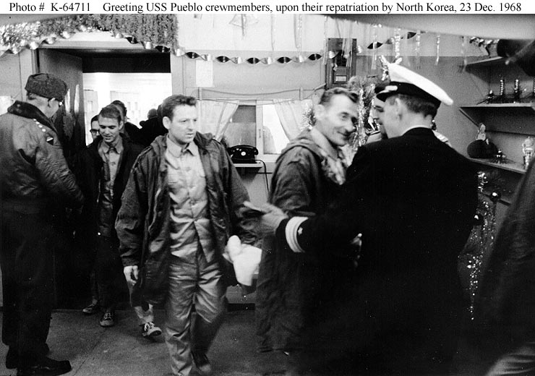
Continued...
“Why did the Korean War end with an armistice instead of a treaty?” Basically, Korea no longer wanted to fight and kill, but the need to solve their problem was dire. They decided to stop the fighting so that they could try to figure out another solution to their problem.
Definition: A treaty is a formally concluded and ratified agreement between countries.

Slide 14
Test Questions….!!
Why did Canada not want to join the Korean War?
Why did the Korean War end with an armistice instead of a treaty?
Why did North and South Korea feel the need to be at war?

