Slide 1
The History of Conflict in the Middle East

Slide 2
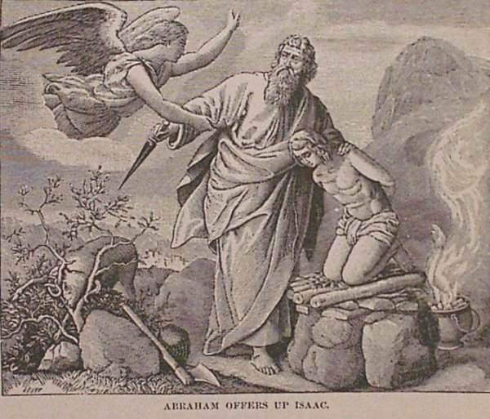
Abraham is asked to offer his Son
Melchizadek Gen 14
Covenant Problems
Typology

Slide 3
Many Years Later
The Jews come out of Israel
David makes his capital city on the same mountain.
Solomon builds the temple of God on the same mountain.
To this day it remains the most holy place for the Jews.

Slide 4
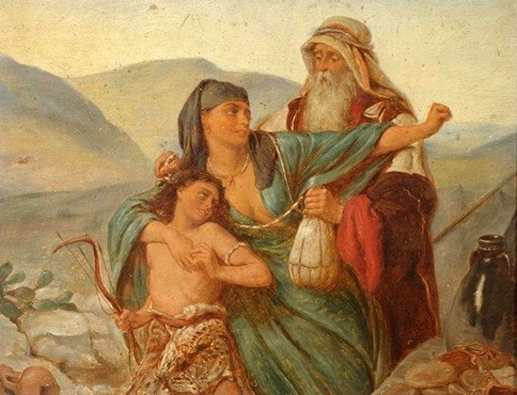
The Alternate Story
The Bible is clear Abraham is both the father of the Jewish nation and another great nation from the child of Hagar.
Muslims believe Abraham offers his son Ishmael and the blessing
is his.

Slide 5
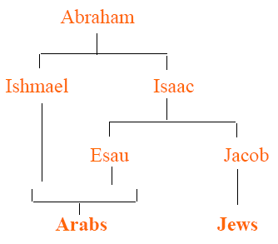
The Lineage
Ishmael great great descendants are the Muslims.
What does the bible
say about his lineage
Read Gen 16

Slide 6
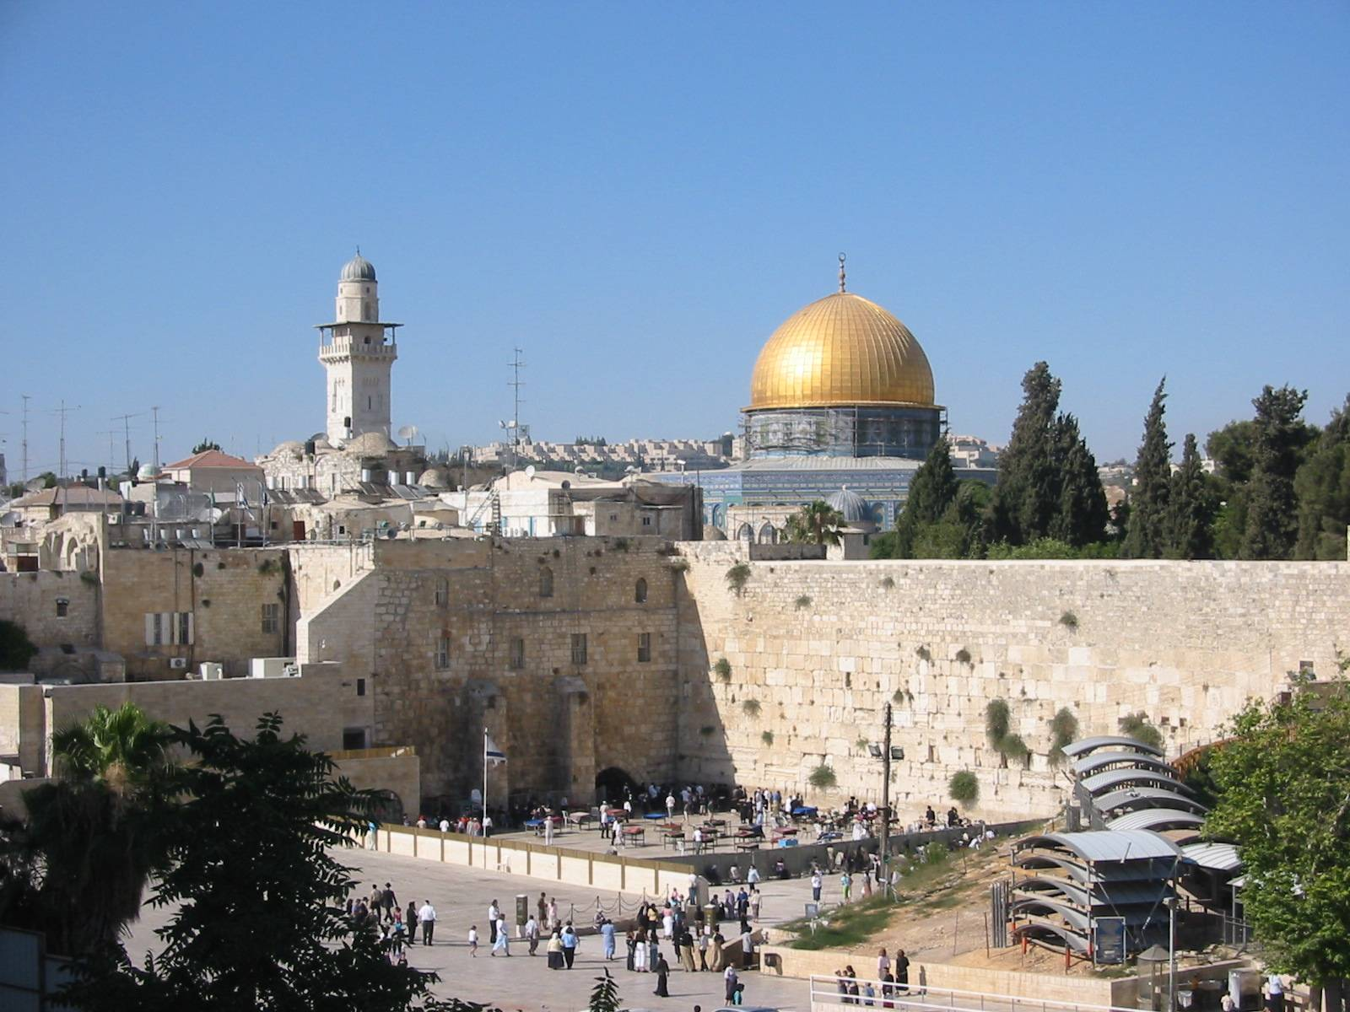
The Jews go into Captivity
Solomon's temple gets destroyed.
The rebuilt temple gets destroyed.
The Muslims erect their temple in the spot where Ishmael was offered to God

Slide 7
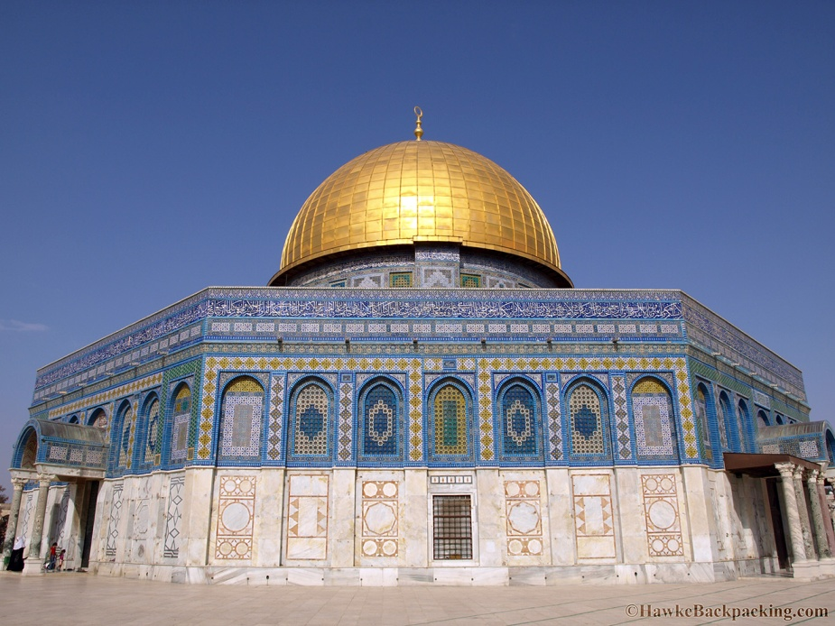
The second most holy Muslim cite
The dome of the Rock sits directly on top of the rubble of Jewish Temple.

Slide 8
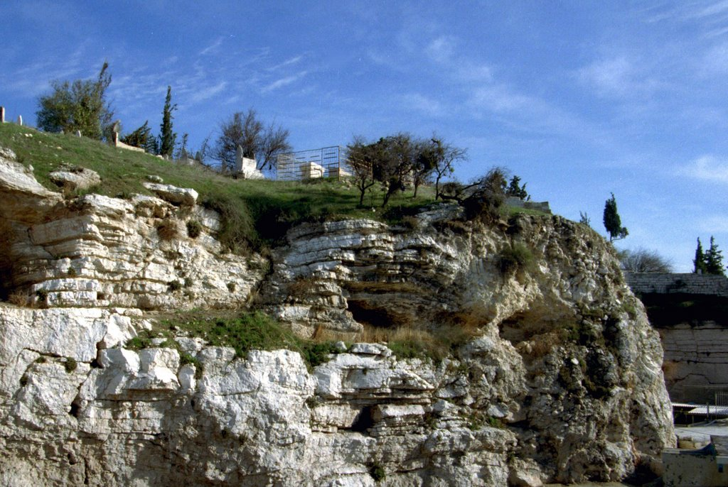
Jesus is killed
Golgatha overlooks the temple mountain. Same place same hills.

Slide 9
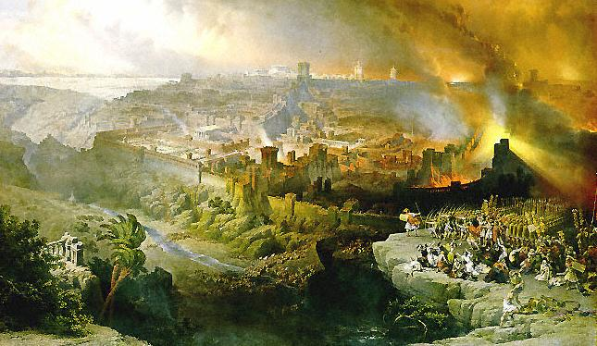
Rome Sacks the Temple/ Diaspora
Even when they tried to rebuild it fire came up from the ground.
Most say it was air pockets from the second destruction
The temple has
Never been rebuilt.
Over time mulsims
Overrun the holy land

Slide 10
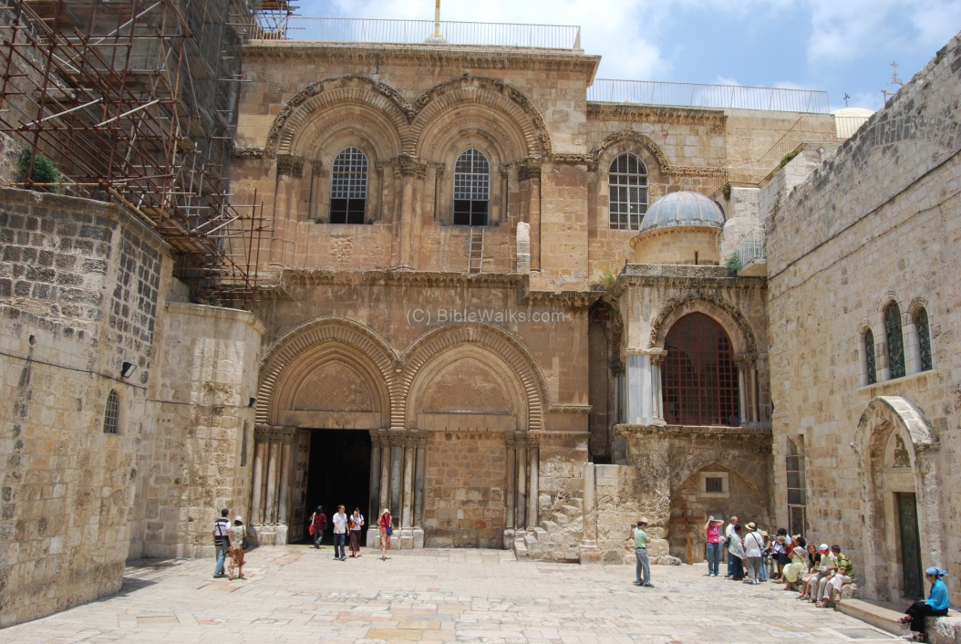
The Crusades
Europeans come and destroy Muslims and Jews and claim the holy land for themselves.
They build some of their most holy cites.

Slide 11
3 religions
All 3 claim to worship the one true God.
All essentially are worshiping the same God.
All religions claim Jerusalem to be their most holy cite.

Slide 12
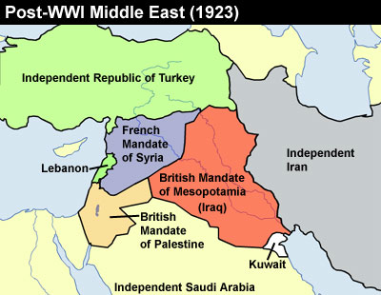
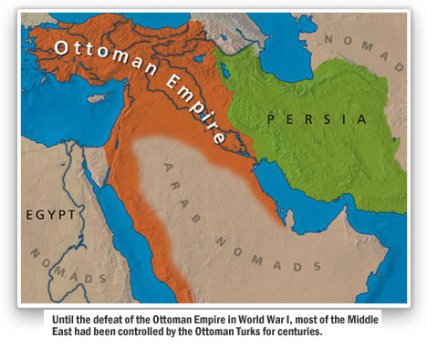
500 years
For 500 years it remains Arabian territory.
It is Colonized after WW1 (mostly by the French)
The Arabians battle each other. But the region is relatively peaceful.

Slide 13
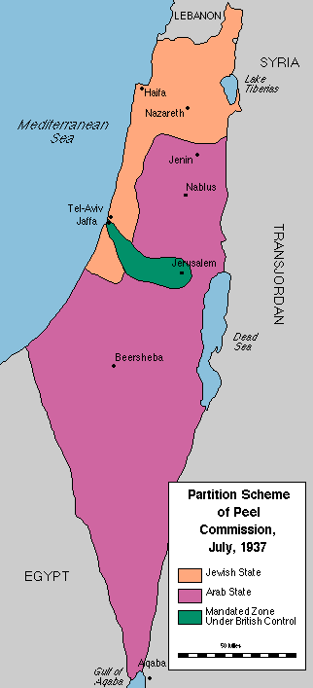
The Peel Commission
The Jews still living in the area keep trying to control some of the territory.
There are small fights developing
They study the area and decisions are made to divide the territory but these never go ahead.

Slide 14
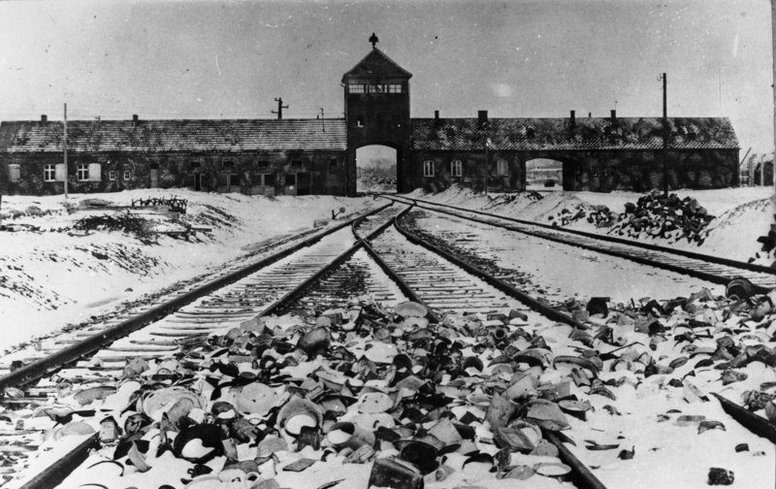
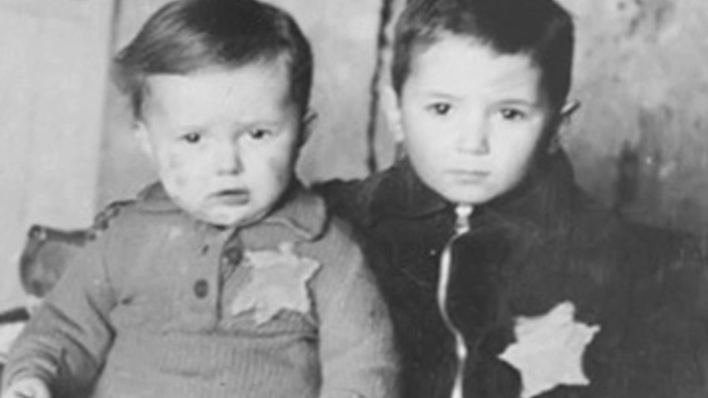
WW2
During WW2 the Hitler Attempts to kill every Jew on the face of the earth. He gasses them and starves them to death on mass

Slide 15
Jews Regain a Homeland
WW2 ends in 1948
Colonies are entirely abandoned.
The (now) British colony of “Palestine” owned and managed by the British Government is given back to the Palestinians.
A chunk of Palestine is given back to Jews as a newly created Israel.

Slide 16
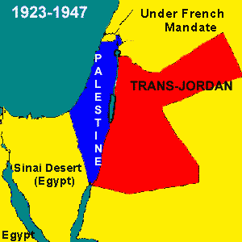
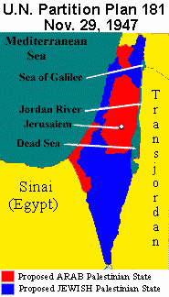

Slide 17
The UN resolution
Give Jews a home from the existing European colonies.
It was agreed upon by all Western countries at the time.
The Arabians however did not like the decision partly due to bad blood dating all the way back to Abraham.
Partly because the land had been in their possession for 500 years… or more.

Slide 18
The Arabian Response
“The Arab world is not in a compromising mood… your plan is rational and logical, but the fate of nations is not decided by rational logic. Nations never concede; they fight. You won't get anything by peaceful means or compromise.” Pasha 1947

Slide 19
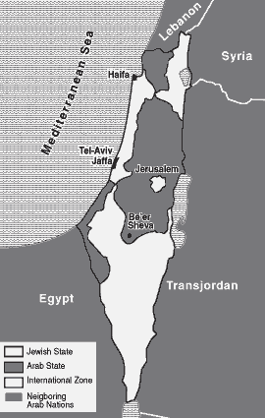
The Final Map
The checkerboard approach.
Based on populations

Slide 20
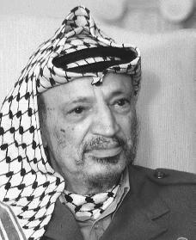
PLO is formed
Sole intention of getting rid of the state of Israel.
They begin a process of bombing cites in Israel controlled cities
Largely supported by Iraq.

Slide 21
1967 “Six Days War”
“The danger of Israel lies in the very existence of Israel as it is in the present and in what she represents”
The inevitable coordinated attack of the Arabian states begins forming.
Jordon, Syria and Egypt… with support from Iraq, Kuwait, Algeria, Saudi Arabia. All wanting to “drive Israel into the sea”

Slide 22
The Arabian Attack Plan

Slide 23
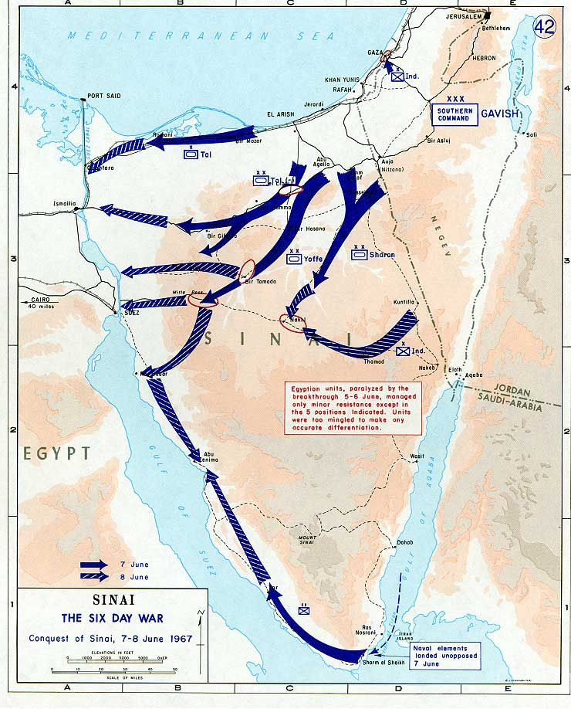
The Egyptian Front
With American support of weapons the Israelites beat the Arabians back on almost every single front.
They gain control of three new areas.

Slide 24
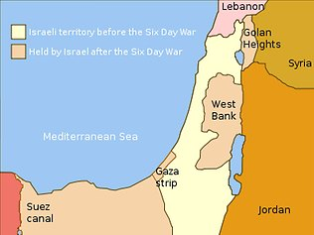
Territory gains
Land promised by God in Abraham’s covenant.
Land has been fought for.
If regained they’ve assured they’ll attack again.
Palestinian lack a
homeland.

Slide 25
Yom Kippur War 1974
Yom Kippur one of the most holy days on the Calendar.
The Arabians attack again trying to regain what was taken from them. The same people all attack.

Slide 26
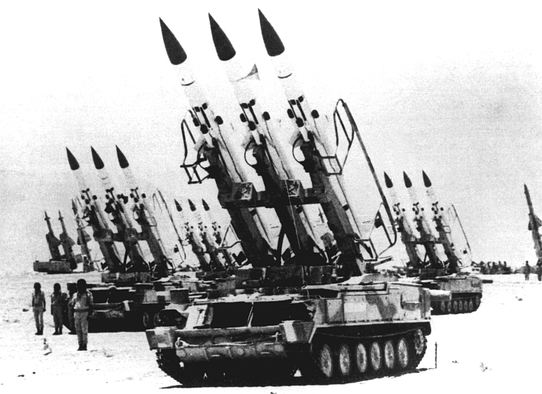
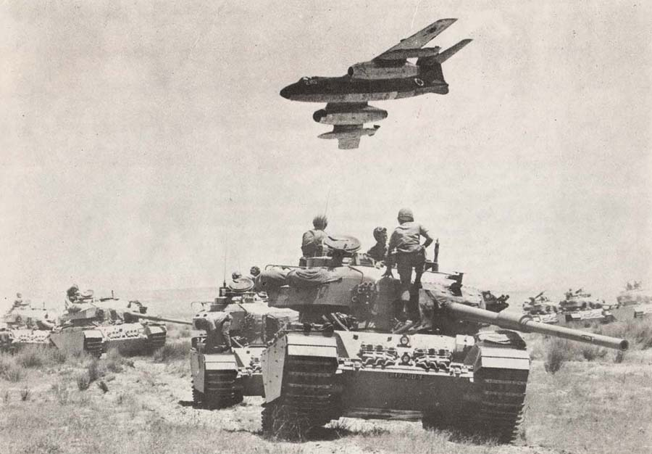
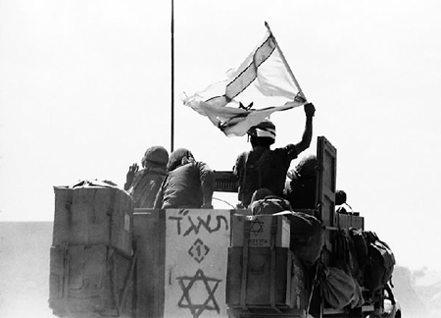
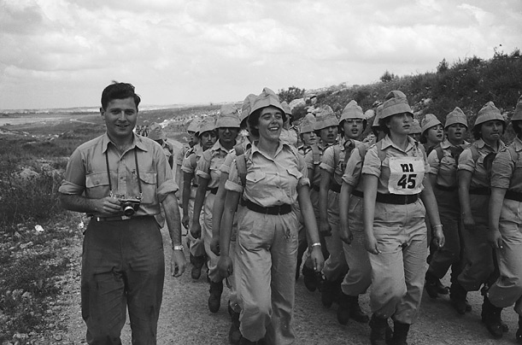
The Two Wars

Slide 27
Peace Talks
Peace talk after peace talk during the 1980’s-1990’s
The same PLO which wants to kill Israel is now gaining a sympathetic ear from western nations.
People start feeling sorry for Palestinians.
Series of plans they all operate on the same principles. Land given for peace.

Slide 28
Problems
Muslim nations have never seemed to be interested in peace.
1995 Israel gives Gaza political autonomy.
In 2005 Israel gives back Gaza
Terrorist “Hamas” organization moves into territory in 2005 and starts using it as a launch site for missiles

Slide 29
