Slide 1
The High Middle Ages
1066-1400

Slide 2
A list of key events
Battle of Hastings
Doomsday book
Magna Karta and Bad King John
Towns and Guilds

Slide 3
Battle of Hastings
Topic #1

Slide 4
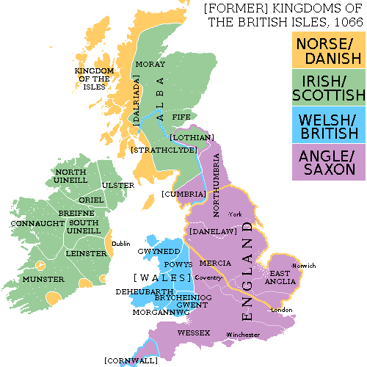
The Norman Conquest
England has Anglo Saxons
England has various Viking rulers
To the south England is faced with a powerful Norman army

Slide 5
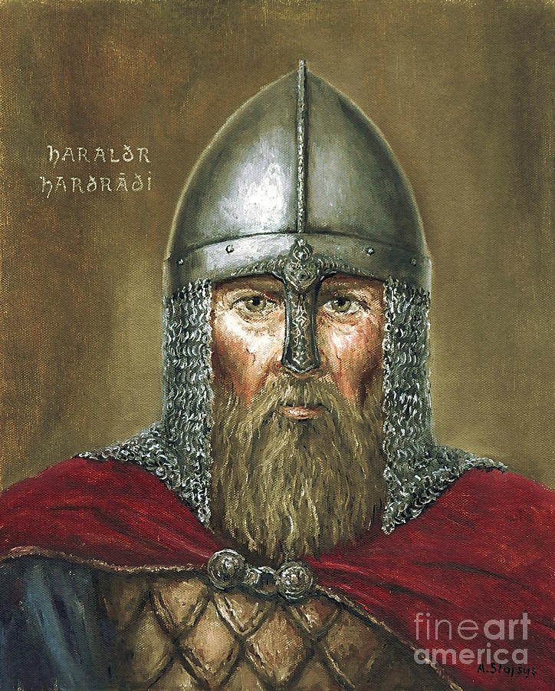
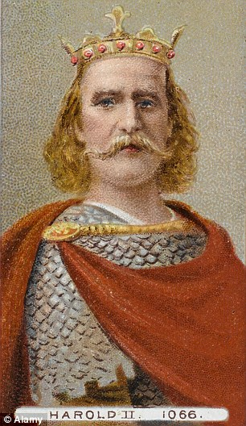
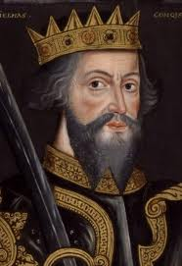
3 Kings
Harald Harada
William the Conqueror
Harold Godwinson
No male heir had been produced by the previous king and now everyone wants to be king.

Slide 6
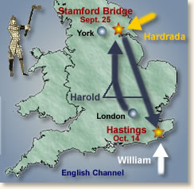
The Norman Invasion

Slide 7
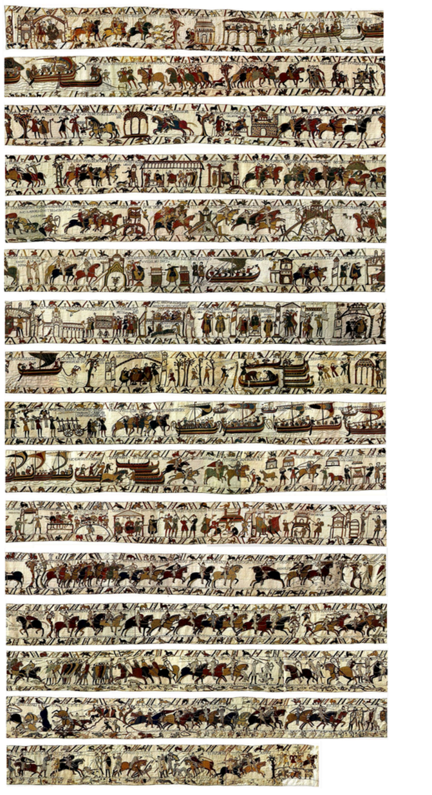
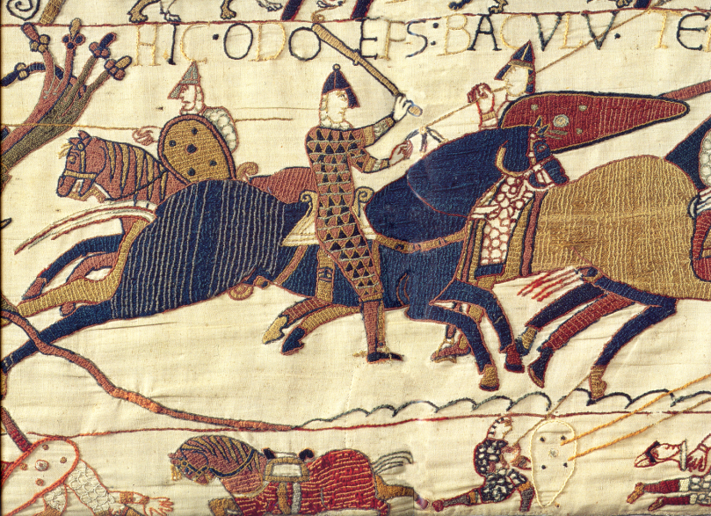
Battle of Hasting 1066
The start date of the High Middle Ages
Most of what we know about the battle is from the Bayeux Tapestry

Slide 8
The Bayeux Tapestry
Primary Source Contradictions
Search Bayeux Tapestry unpicking the past.
Who made the Bayeux Tapestry?
What are 2 controversies presented in the Bayeux tapestry?
Are primary sources reliable?

Slide 9
Battle of Hastings 1066
Go to “BBC Battle of Hastings game”
What steps are required to make William the Conqueror successful?
What tactical advantages does Harold Godwinson have?
What advantages does William have over the English?

Slide 10
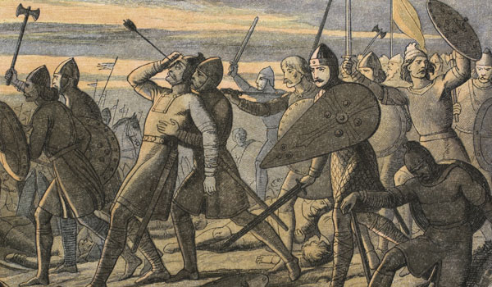
The End of the Battle
William becomes King
The Anglo-Saxons lose control and French gain control of the land
German, Viking, Latin and French mix to form the English Language.

Slide 11
Society in the High Middle Ages
Topic #2

Slide 12
Society Gets Organized
Power shifts, the idea of a “country” with leaders and boarders emerges. (Nationhood)
Landholdings become bigger and lords have stronger security and work together under the king. (Feudalism)
Feudalism maximizes food production while simultaneously increases security. (Townships.)

Slide 13
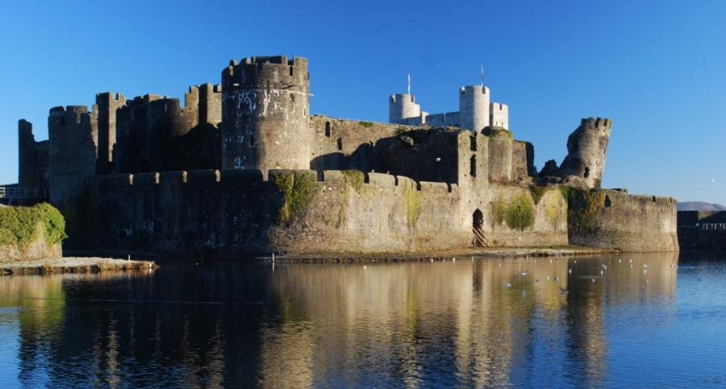
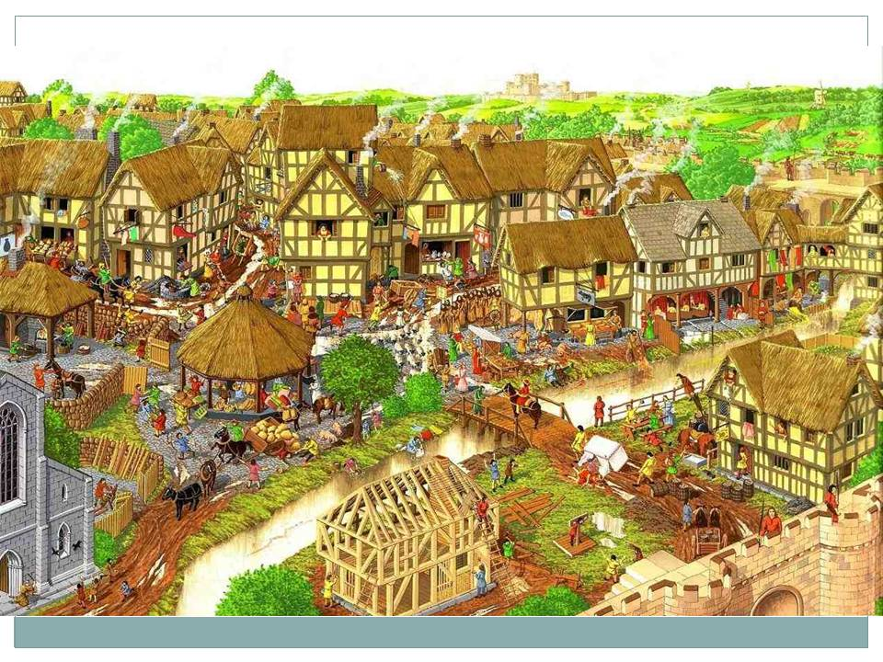
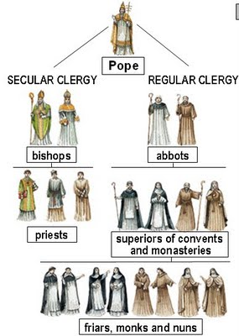
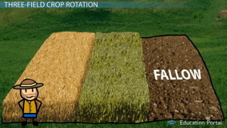
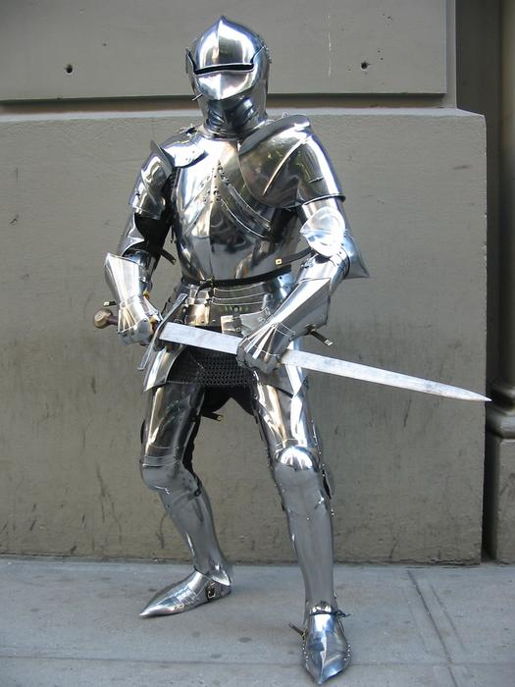
Society Gets Smarter

Slide 14
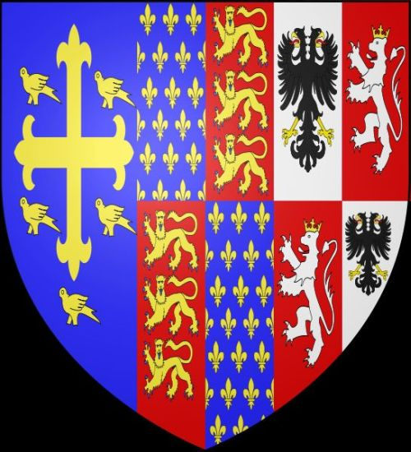
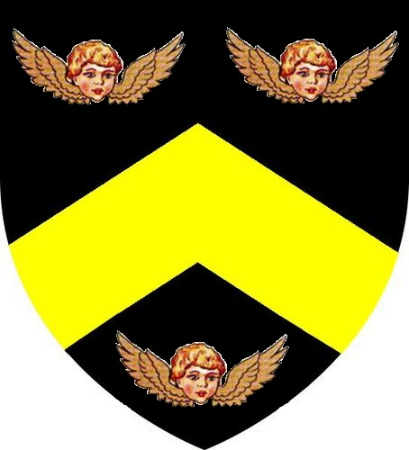
Knights get organized by using and loyal through Coats of Arms
Sometimes its referred to as Heraldry
When Noble houses were combined they combined their symbols.

Slide 15
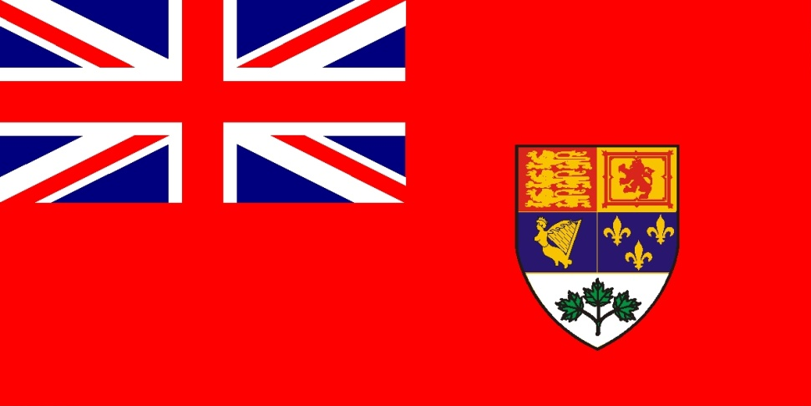
High middle ages is a time of Heraldry
Symbols that individuals identify with would become the basis for national flags.
BC Flag
Red Ensign

Slide 16
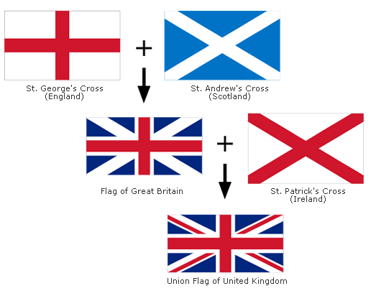
Evolution of heraldry

Slide 17
Wealth and Trade grow
Imagine a society where:
Everyone wears raw wool.
Food has no spice because spice does not exist.
Sugar does not exist except on the mystical island of “Candia”
Medicines mostly kill people as opposed to cure them.

Slide 18
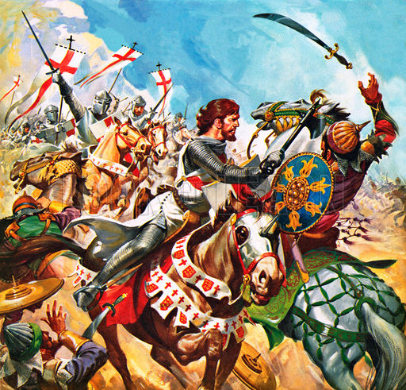
Suddenly!
People see silk and lighter softer fibres.
People taste food which has flavour
They find precious stones they’ve never seen before.

Slide 19
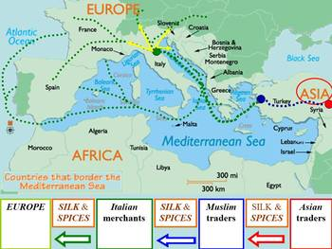
East West Trade Develops

Slide 20
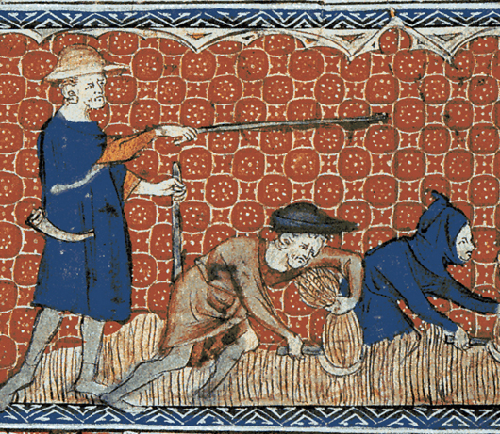
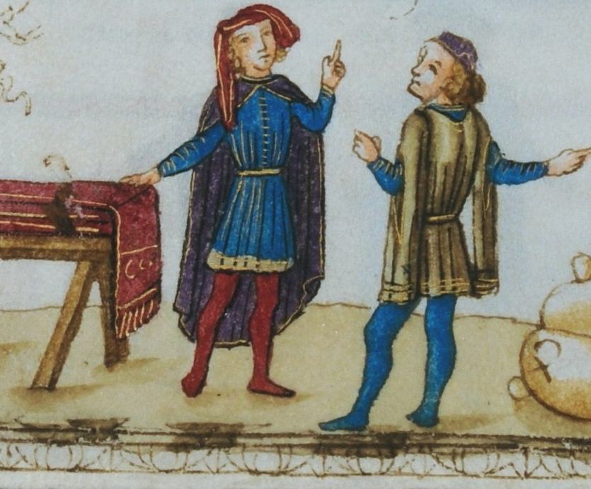
Europe Changes
Subsistence Farms
Trade and Barter

Slide 21
Trade Causes 3 things
Invention (we’ll talk about it later)
Towns
Guilds

Slide 22
Guilds
Merchant Guilds and Craft Guilds
Knowledge of special “trades” was transferred through the guilds. Blacksmithing, broken bone setting, baking, toy making.
The guild had levels. Apprentice to Grand Master.

Slide 23
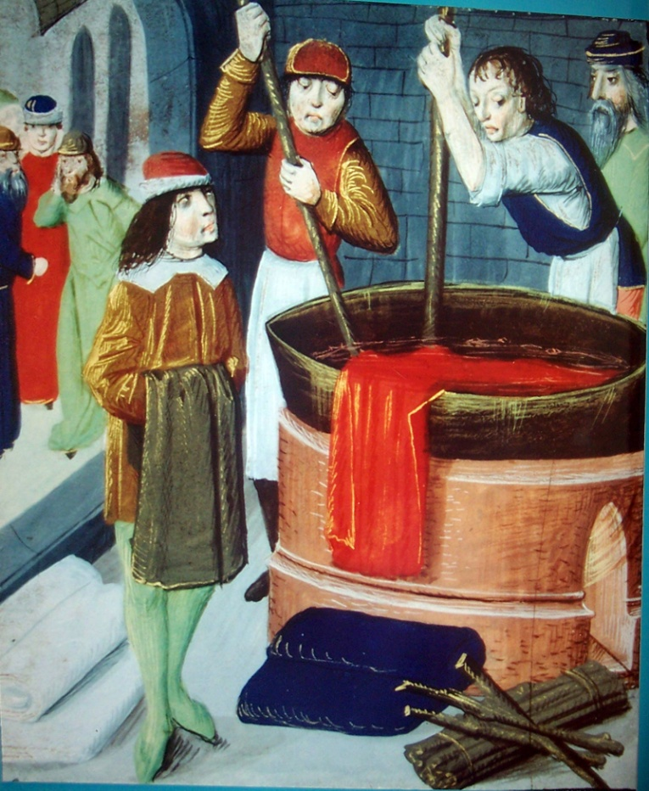
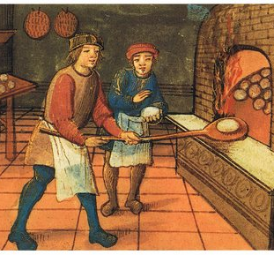
Guilds
Merchant Guilds
Craft Guilds

Slide 24
Based on what you see (and intuition)
Who lives in the town?
What technologies have/ have not been invented?
How do these technologies or lack of technologies affect how people live?
What was life like in the high middle ages?
What would prevent people from living like this in the early middle ages?

Slide 25
Village/Town Life

Slide 26
Assignment: Yearly Summary
Farmer (serf)
Merchant
Knight
Guild apprentice
Priest
Farmer (serf)

Slide 27
Architectural Comparison
Early Middle Ages
High Middle Ages

