Slide 1
The Great Depression
5 reasons
6 consequences
4 solutions

Slide 2
Stock Market Crash
Black Tuesday Market Closes Down.
Black Thursday was the week before when the up trend becomes a down trend.
Reasons for the Stock Market Crash.
Overproduction
Speculation
Banks lending too much money

Slide 3
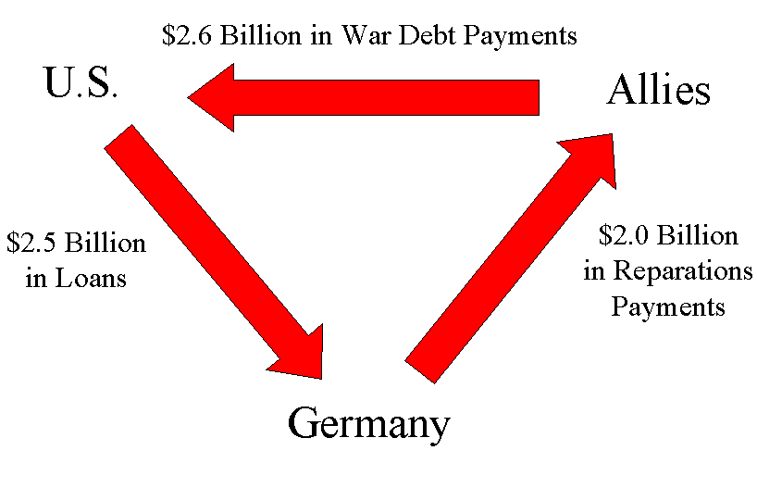
Countries Defaulting on Loans
Reparations: Germany pays back France and England for damages in the war.
France and England pay back U.S for money borrowed to finance the war. (lend lease)
Problem: Germany cannot pay the money. If Germany goes bankrupt so do other western countries.
United States Loans money to Germany so they can pay England and France so they can pay.
“Give him another injection to keep him alive.”

Slide 4
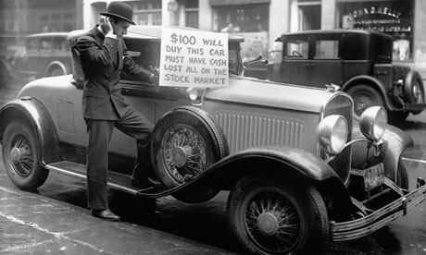
No Cash only Credit
There is no money in the system.
Everyone owes everyone and nobody can pay each other back.
People stop spending money.
This causes business to fail.

Slide 5
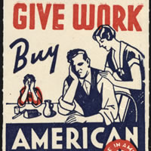
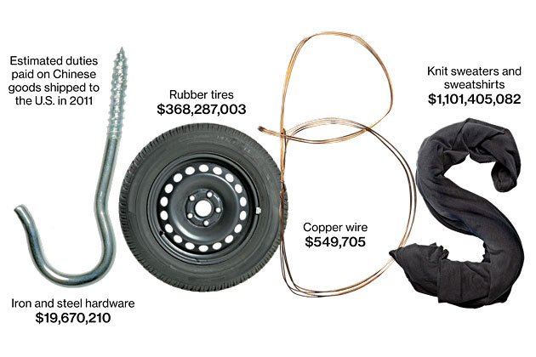
1930 Tariffs
Countries try to help their businesses by buying locally.
They use Tariffs to do this.
Countries respond by building their own tariffs.
International trade shuts down.
Jobs are actually lost everywhere.

Slide 6
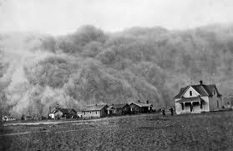
Dust Bowl
Farming practices dug up too much top soil
Lack of rain and continued bad practice caused the soil to dry out.
Dry soil blows away with the wind and causes farm land to look like a dessert.
This is referred to as a dust bowl

Slide 7
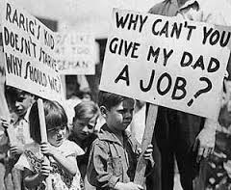
Consequences #1 No Work
Reasons:
Farms Fail
Businesses go Bankrupt
Nobody is buying.
Nobody can get a loan.
Tariffs are too high

Slide 8
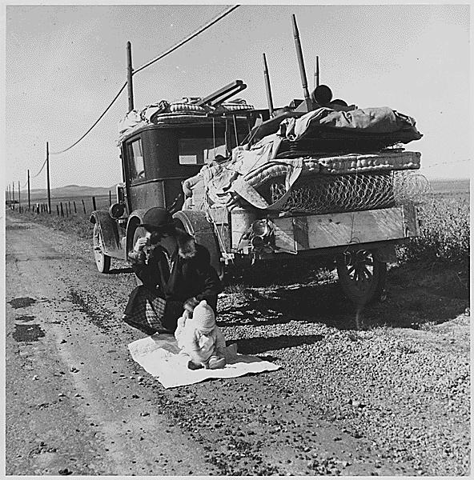
Consequence #2 Homelessness
Reasons:
Banks take homes to try to repay their own debts.
People walk away from their farms and businesses.
Children and wives are abandoned

Slide 10
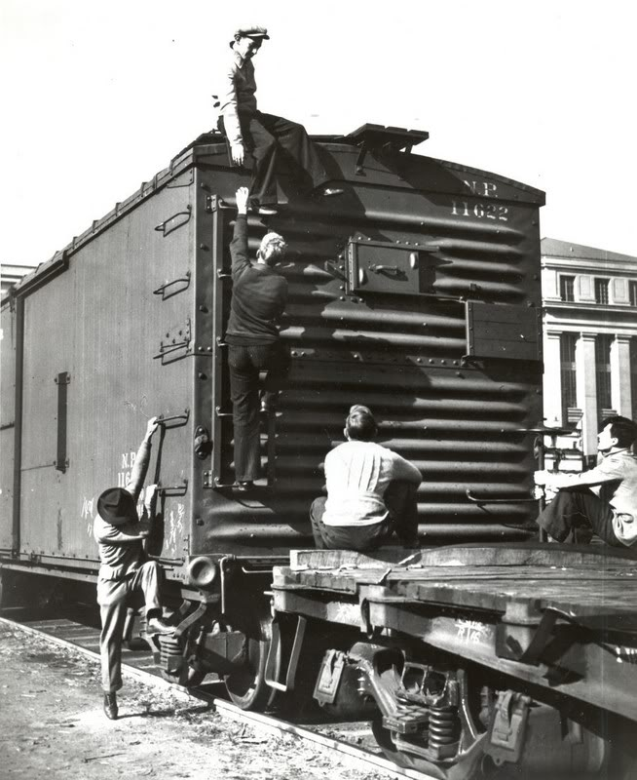
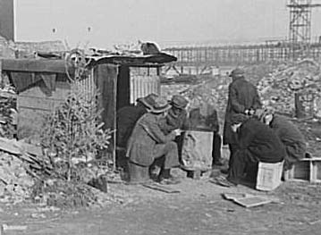
Consequence #3 Hobos, Hobo Jungles, Riding the Rails
Men left their families and jumped on trains to look for work.
Lots of criminal behavior among these transients.

Slide 11
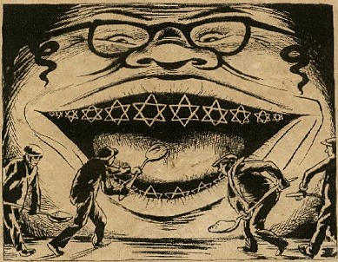
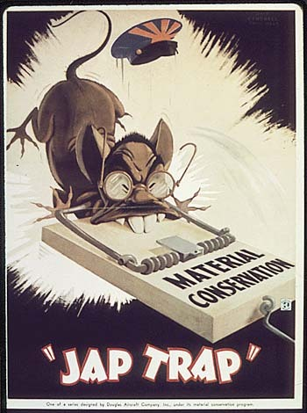
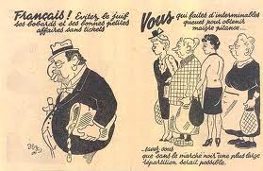
Consequence #4 Immigration Policy & Racism
Problems were often blamed on immigrant minorities.
In Europe Jews were blamed, especially in Germany
In Canada Chinese people were faulted
Chinese people not allowed to immigrate.

Slide 13
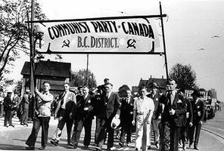
Consequence #5 Fear of Communism
Communist party kept growing
Fear of Russian style revolution
Communists kept promising they could solve all problems

Slide 14
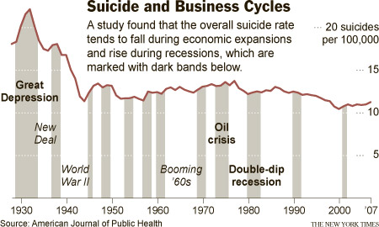
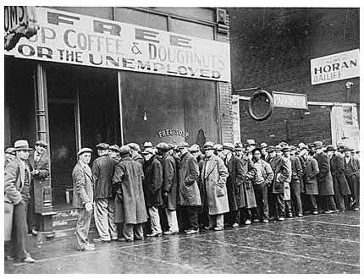
Consequence #6 Hopelessness

Slide 15
Mackenzie King’s Solutions
Wait. Do nothing. Laisez-Faire
Told people to get help from the provincial and municipal governments.
Eventually lowered Tariffs
Ban the Communist Party

Slide 16
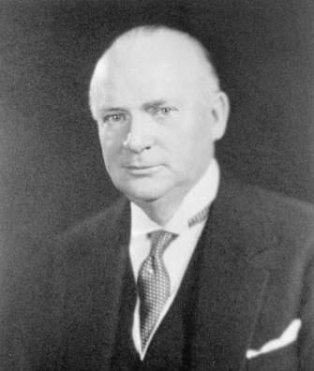
RB Bennett's Solution
Work Creation Programs
($20 million dollars)
Work Camps
Pogey (20-60$ a month for a family to live on)
Raise Tariffs even higher. (wheat board)
Unemployment insurance
(CCF Solution democratic communism)
25$ promise

Slide 17
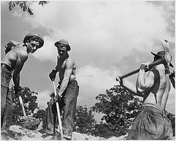
Work Camps
20 cents a day
(plus food and shelter)
Inhumane living conditions.
Hard labour

Slide 18
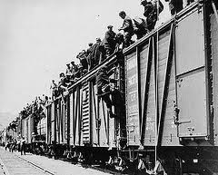
On to Ottawa Trek

Slide 19
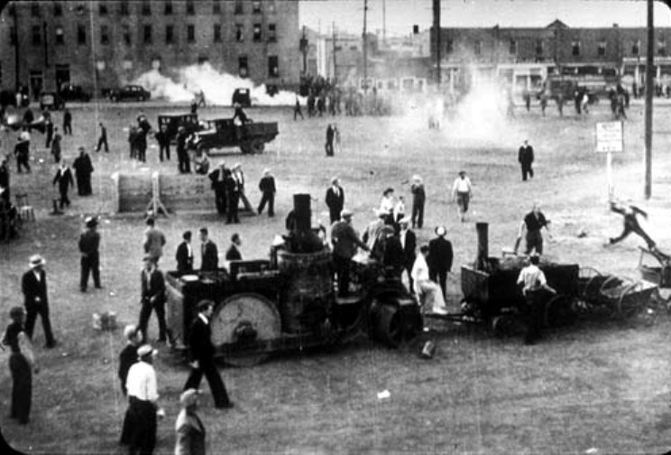
Ottawa Trek’s Demands
First Aid in the camps
Better conditions in the work camps
Fair pay
Bennet:
throws the leaders in prison and temporarily accuses everyone of being communists

Slide 20
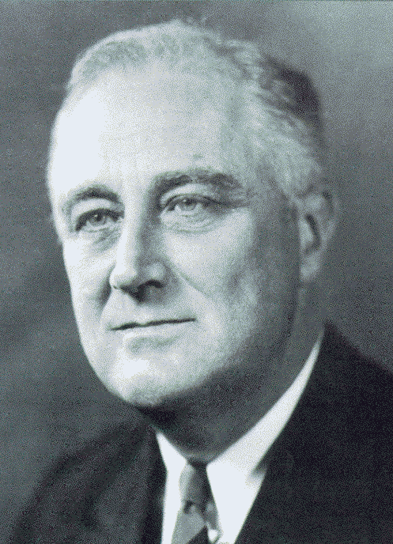
Roosevelt’s “New Deal”
Federal Government needed to spend and borrow like crazy to help out the American people.
This resulted in social programs. But did not fix low consumer demand. (everyone was holding their money)
The new deal was revised to bring up employment rates.

Slide 21
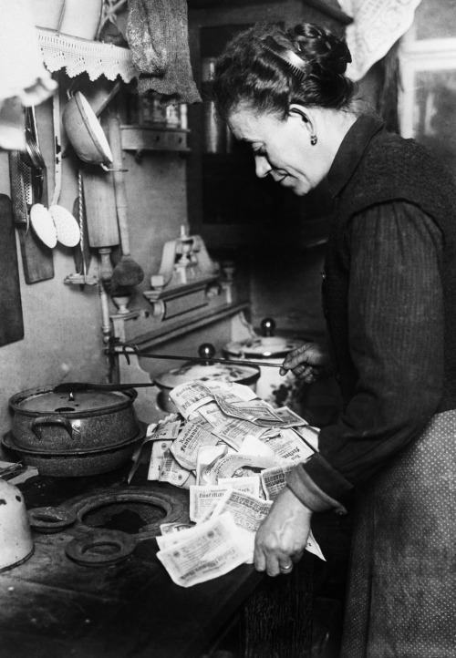
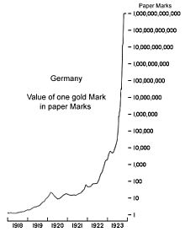
German Solution
Tried to initially print money in order to meet war reparation demands. (Hyperinflation)

Slide 22
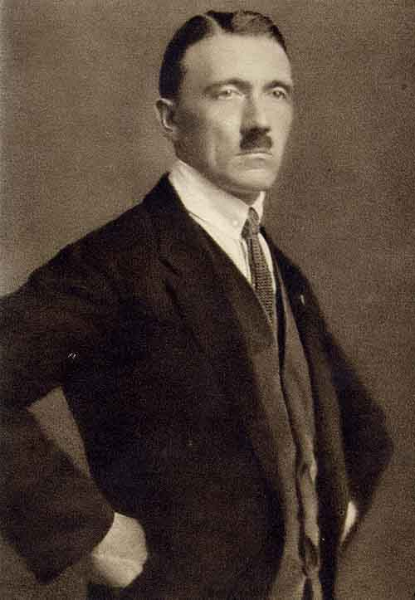
Nazi Solution
“The Crash” hit Germans hardest because their country was being upheld be American money lending.
Nazis wanted to end reparation payments.
Nazis wanted to tear up treaty of Versailles.
Nazis blamed the Jews for Financial crisis.
Nazis perfected propaganda (mimicked in modern campaigns today)
Nazis promised jobs if the state relinquished complete control to a leader.

Slide 23
Essay Questions
Compare and contrast Bennet’s response to Mackenzie King’s response to the Great Depression
Compare the “roaring twenties” to the “dirty thirties”
What caused the Great Depression?
How did Canada and other countries try to respond to the great depression

