Slide 1
The Feudal System

Slide 2
Problem in the Land
Vikings, Magyars, Raiders, Villains keep killing and stealing peasants.
Small kings emerged after the fall of Rome to lead and protect these peasants.
The kingdoms remained small in order to adequately protect the peasants.
But as time passes the kingdoms become bigger.

Slide 3
The Feudal System

Slide 4
Understanding the size of each position

Slide 5
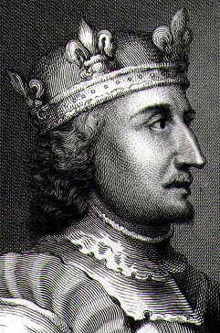
The King
He is given his position by God.
His oldest child gets to be king after him.
Primogeniture
Female children
Going to a Baron
The story of King Stephen
Matilda
Robert

Slide 6
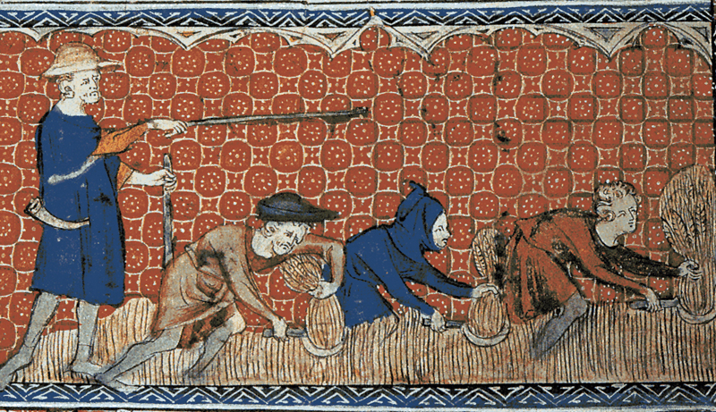
The King
The king can make any rules he wants to make.
Since he is appointed his position by God nobody can disagree with him.
The king owns all the land and everything in it. Nobody under him has freedom they all exist to serve the king.

Slide 7
The Princess Myth
Daughters of the king were called “lady” Not PRINCESS
“Ladies” had no choice in whom they would marry.
They were almost always spoken for by age 7
“Ladies” had no individual rights they were the property of the men who married them.
Nobility hadn’t figured out diet. They never ate many vegetables so their teeth were weak and fell out.

Slide 8
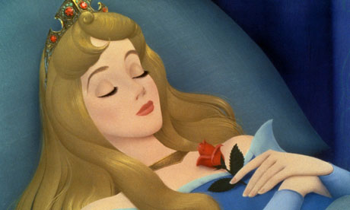
The “Princess”
They were very valuable in forming strategic alliances.
Noble women had very restrictive lives until the 1920’s.
They never married for love. It was actually a foreign concept for nobility.

Slide 9
The Disney Myths
Explain why this would be historically ridiculous
Princes marry commoners… (Cinderella)
Princes were often single… (every Disney movie)
Princesses have a choice who they marry… (Tangled, Frozen, Aladdin)
Princesses often rebelled against their oppressed lives. (Little Mermaid, Brave)
Why keep telling a story that isn’t true?

Slide 10
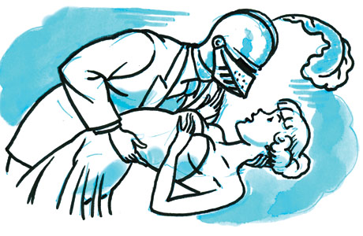
Nobles and Knights
Sometimes called Barons or Lords.
They were essentially miniature kings but they owed everything to “the big cheese”
Adhered to a special code called Chivalry

Slide 11
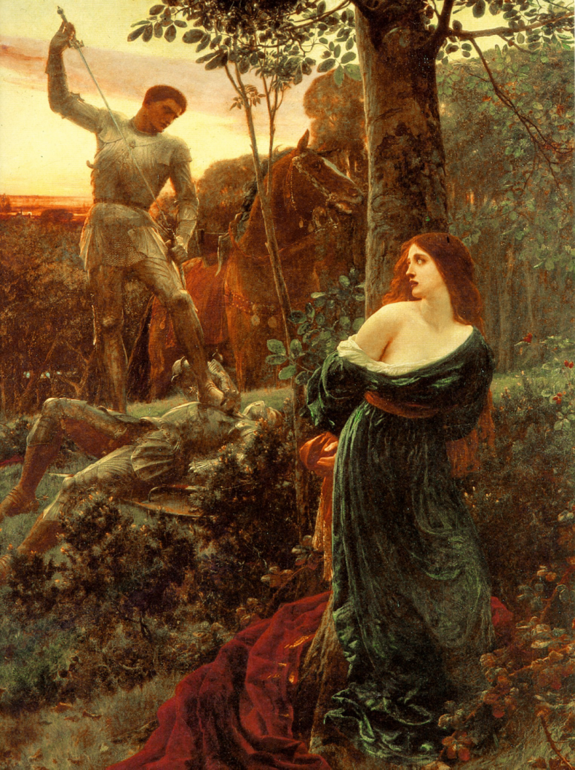
Chivalry
Modern Usage: How a man ought to respectfully treat a woman. Associated with being a gentleman.
Medieval Usage: How a knight should exemplify Godly character towards countrymen, towards women of virtue, towards church, towards battle.

Slide 12
The Reality
(landless knights) were hired by Lords because they were effective killers.
They often had lots of illegitimate children.
Knights often did not kill, they held their opponent for ransom and set them free.
Not nearly as brave or “lonesome” as any of the movies.
Often created the troubles not cleaned them up.

Slide 13
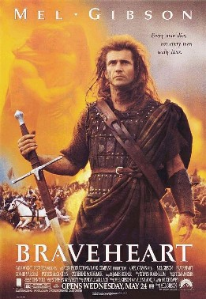
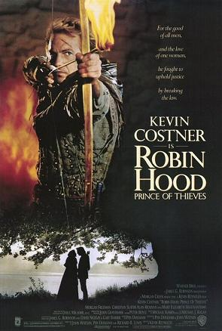
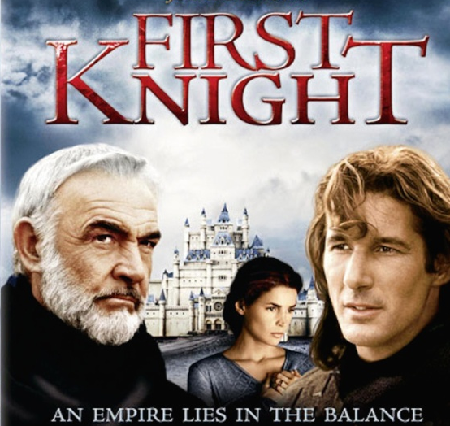
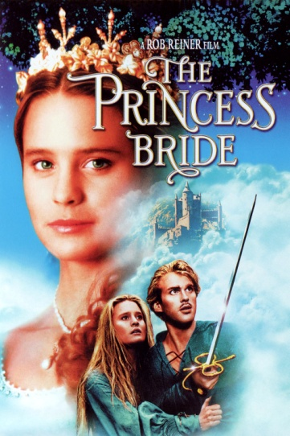
The movie myth.
We keep telling stories of noble knights who
Want to rid evil from the land.
Save and win the heart of women.
Protect the virtues of the innocent.
Why do we keep telling this story if its not true.

Slide 14
Peasants
Serfs are like slaves. They are owned and considered part of the land itself. They cannot leave the land.
Villains have a small private garden but also work or donate their time to farm the Knight or Lords demesne.
Freeholders (freemen) are like small farmers. They rent land from the knight. (who rents from the lord who rents from the king)

