Slide 1
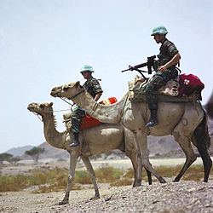
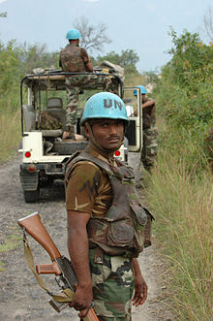
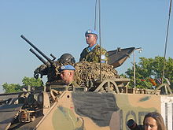
The Blue Helmets
The United Nations peacekeepers or Blue Helmets/Blue Berets are the UN’s Police, they ensure peace is kept in a post war country. It was developed in the Cold War to resolve conflict between states with a lightly armed military.

Slide 2
Getting them out there
In order for the Blue Helmets to be deployed the Security council must unanimously agree, if just one country disagrees then the blue helmets cannot be deployed. The security council is made up of the five most contributing countries, the UK, USA, Russia, China, and france they are the permanent members on the security council. There also are five non-permanent members and they currently are, Azerbaijan, Guatemala, Morocco, Pakistan and Togo.

Slide 3
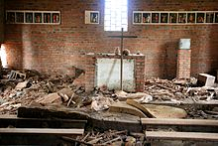
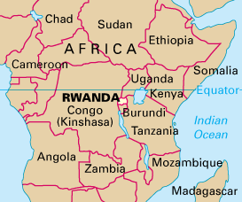
The Rwanda Genocide
The Rwandan Genocide was the slaughter of 500,000 - 1,000,000 Tusi by the Hutu, wiping out 70% of the Tusi and 20% of the Rwandan population in a 100 day period.
Over 5,000 people were hiding in this church and were killed by grenades, rifles, and machetes

Slide 4
What was done?
The UN created the UNOMUR (United Nations Observer Mission Uganda-Rwanda)and in 1993 when Rwanda and Uganda requested military surveillance along the common border to prevent military use in the area.
The UNOMUR was established to ensure that no military assistance reached Rwanda.

Slide 5
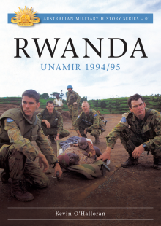
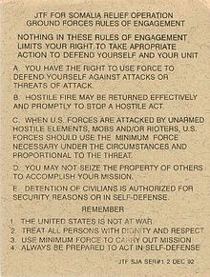
What is the UNAMIR?
The United Nations assistance mission for Rwanda was established by the UN in October 1993. The goal of the mission was the end the Rwandan civil war. The mission lasted from Oct. 1993 - March 1996.
The UNAMIR received attention for their lack of involvement because of the restrictions of the rules of engagement.

Slide 6
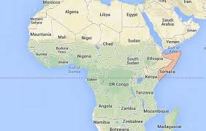
The Somalia Crisis
The starvation of 260,000 people

Slide 7
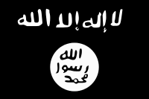
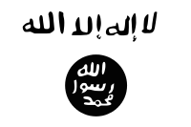
What happened?
The Al-Shabaab militant group which is aligned to al-Qaeda, denied that their was a Famine and refused western aid from entering countries under their control.
Al-Shabaab War flag
After the UN declared famine in july 2011 and were banned entry 10% of children under five died of starvation, an estimated 4.6% of the total population died of malnutrition. thousands of people fled in search of food, the entire horn of africa was affected by the famine. In february 2012 the UN declared the famine over.
Al-Shabaab Administration flag

Slide 8
Test Questions
What was the blue helmets role in the Rwandan genocide?
a. To fight the Hutu and end the Genocide
b. To end the Civil War
c. To watch and let them fight it out
d. To help the Hutu end the Tusi
2. Who banned the western aid from entering countries under their control
3. Opinion question: Do the blue helmets provide a significant role in peacekeeping?

