Slide 1
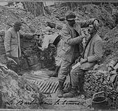
The Trench

Slide 2
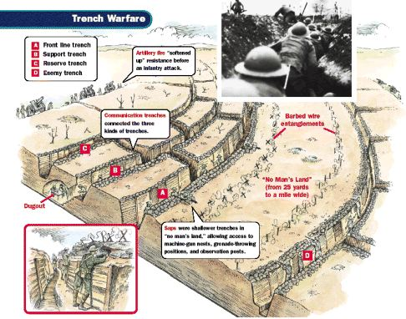
Easy to defend hard to attack

Slide 3
The Trench Line

Slide 4
Over The Top

Slide 5
New Technologies

Slide 6
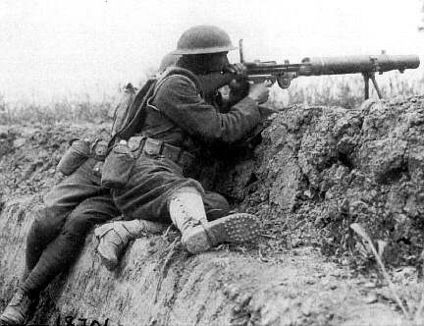
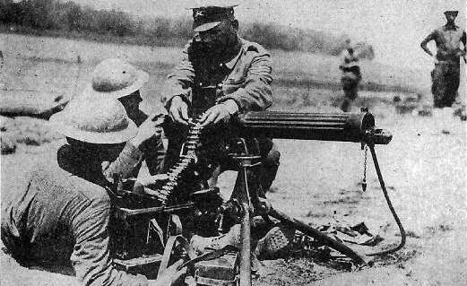
The Machine Gun
Took 4 men to operate the weapons.
1 machine gun was estimated to be equal to the killing power of 60 rifles.
Could not cross open territory.

Slide 7
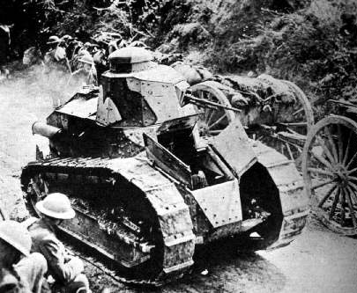
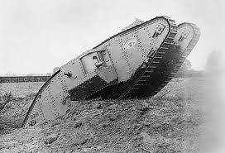
The Tank
Always got stuck in the mud
Could not move faster than humans.
German tank moved 5 km per hour.
1/3 would reach the intended target.

Slide 8
Zappers “Engineers-Tunnelers”

Slide 9
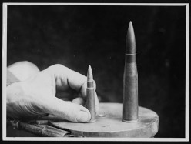
Counter Measures for Tanks

Slide 10
Big Bertha (Could hit targets 120km away)

Slide 11
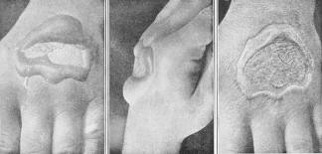
Chemical Warfare
Lots of times the wind would blow the gas back onto the person firing it
Extremely frightening
But not highly effective for killing people.

Slide 12
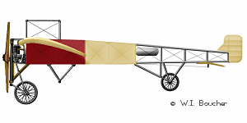
Airplane 1913
1 Person flies it.
Hold a hand gun and shoot while you drive.
Mostly used for recon.

Slide 13
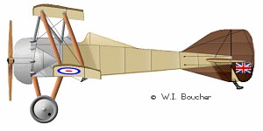
Airplane 1915
Gun invented that can shoot through a spinning propeller.
Planes get fast and can fly higher.
Age of aces is developed.
Planes are still having little effect on the war.

Slide 14
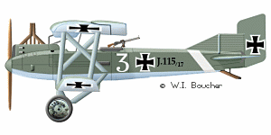
Airplane 1918
Planes are made of metal
Attaching bombs to the wings.
Using planes to help out ground troops

Slide 15
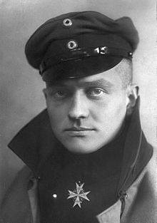
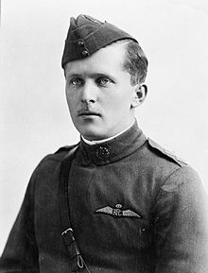
WW1 Legend Aces (more than 20 kills)
(German) “The Red Baron” 80 kills
(French) Rene Fonck 75 Kills
(Canadian) Billy Bishop 72 kills
5 Canadians in the top 10 aces of WW1

Slide 16
U boats/ Submarines

Slide 17
Casualties of War
Country | Mobilized Forces | Total Casualties | % of Force
Russia | 12,000,000 | 9,150,000 | 76%
British Empire | 9,000,000 | 3,200,000 | 36%
France | 8,400,000 | 6,200,000 | 73%
Germany | 11,000,000 | 7,100,000 | 65%
Austria-Hungary | 7,800,000 | 7,000,000 | 90%

