Slide 1
Pressure Groups
5 ways to influence government.

Slide 2
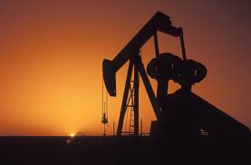
The Alberta Tar Sands (the pros)
One of Canada’s #1 sources of money.
Alberta’s #1 source of revenue.
One of the worlds largest sources of oil.
Strong desire to trade the oil with China for even more money.

Slide 3
The CONS (bad side)
Getting oil from the Alberta Tar sands is bad for the environment.
Other countries have
started to complain
about the Tar Sands
Canada continues to
make the Tar Sands
bigger

Slide 4
Conservative Government Policies
Expand the Tar Sands
Promote oil and gas expansion by giving tax breaks .
Create pipelines to export more oil to foreign markets.
Ship oil from British Columbia’s shores to China
HOW DO WE STOP HARPER????

Slide 5
Voting
Why is this the most effective way of influencing government?

Slide 6
Pressure Groups
The biggest environmental pressure groups in the world

Slide 7
Pressure Groups
Pressure groups represent ideologies and ideas outside of the government parties.
“Pressure Groups” or “Interest Groups” pay money to certain people called Lobbyists who directly try to influence government.
They can also bully the government if they have enough power.
Some powerful interest groups are:
Greenpeace. They support and advocate for environmental issues.
Canadian Bank Association, they try to influence decisions that will help secure the banks.

Slide 8
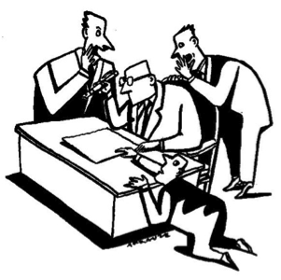
Lobbyists
Can be politicians from other countries.
Normally they represent powerful businesses.
Sometimes represent interest groups “churches or elderly”

Slide 9
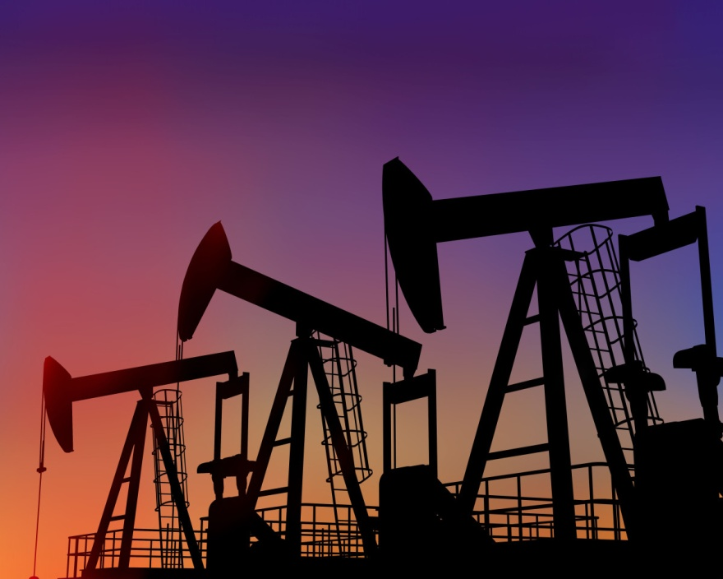
Lobbyists
Most often Lobbyists will be directly from large powerful companies.
-Gas companies
-Mining companies
-Foreign Companies
THINK: What decisions will the oil companies want government to make.

Slide 10
What Lobbyist do.
They make friends with the governments and try to influence decisions made by government. (using economic power, detailed information and studies, opinion polls)
They make enemies with government and friends with the media and try to embarrass government. Essentially try to influence public opinion.

Slide 11
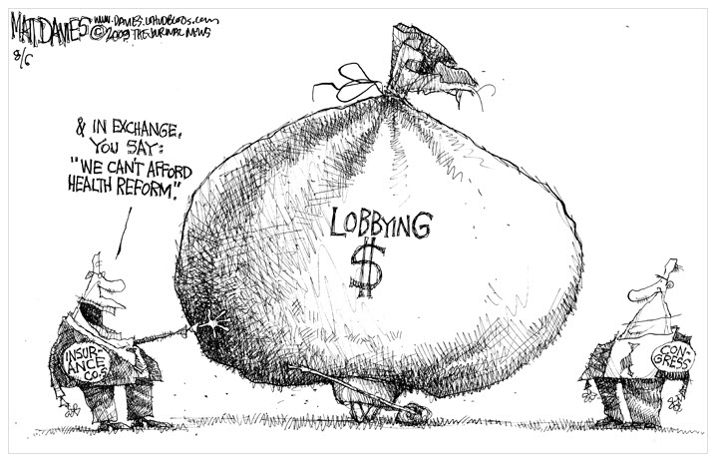
The Good bad and Ugly of Lobbyists
THE UGLY
Sometimes they pressure the government to give them money.
Sometimes they pressure government by giving them money.

Slide 12
THE UGLY
Conflict of interest. Is when a Government official directly or indirectly benefits from a decision made in government.
For Example: The government supporting a bank that is going bankrupt, they just happen to choose the bank most government people have their money in.
(This is not to be confused with Bribe, Fraud, and Buying Influence; these are criminal acts)

Slide 13
The Bad
Expensive. It takes a lot of money to hire lobbyists and try to influence government. Since the average Canadian cannot afford this opportunity some believe that Lobbying stands in the way of democracy.
Control. Is the government which the Canadian people have voted for autonomous or are the lobby groups slightly manipulating government.

Slide 14
The Good
Status Quo: Lobby groups generally support keeping things the way they are. They tend to be conservative and for the most part quiet.
They ensure that the government is responsible to consider businesses and special ideologies that might not get noticed. Since these groups often don’t have as much voting power.
They are a direct way of citizens influencing government actions.

Slide 15
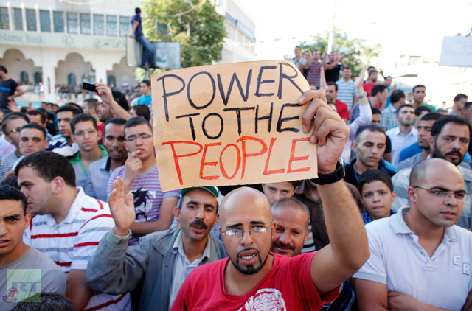
Protesting
There are levels and degrees of protests. Each has a different influence.

Slide 16
Legal Protest
Why Choose this form of protest?

Slide 17
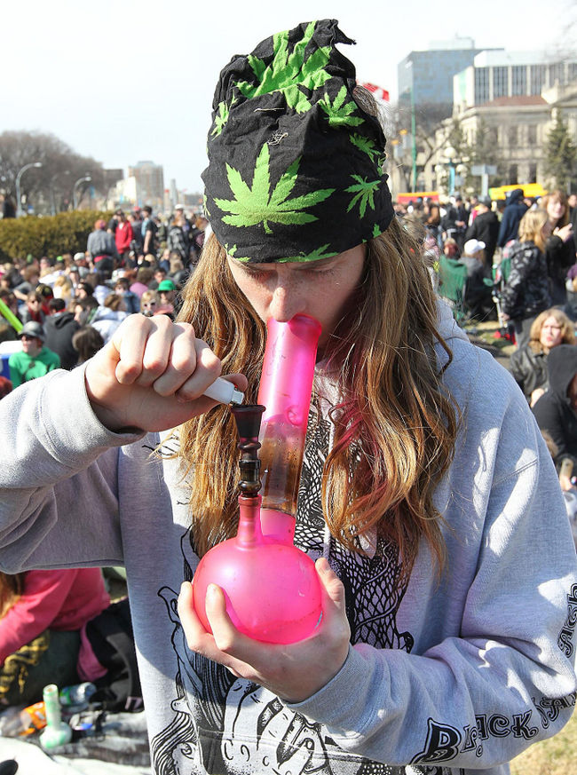
Kind-of-Legal
Why choose this form of protest?

Slide 18
Illegal Protest
Why would you ever use this form of protest?

Slide 19
The Good Bad and Ugly of Media
THE BAD
Does the media “report” news or do they “make” news.
Increasingly they choose stories which they know Canadian viewers will like. News stories have been shortened to average 1 minute
For Example: “In north America people enjoy hearing about scandals and bad things”
“In China the news reports about GDP going up and the strength of the banks.”
Conclusion we have a false sense of Reality

Slide 20
Media the Ugly
Bogus and False news. Stories that cannot be verified.
These days media is easily manipulated and effects how we protest, how we campaign, the media essentially distorts reality rather than reports it.

Slide 21
Media Bad
It needs ratings and viewers just like any other show.
As a result it only reports what the world wants to consume.
The World seems to love to consume garbage.
(Case and point Donald Trump running for president)

Slide 22
Media Good
Media is used to embarrass people for mistakes. This keeps everyone accountable.
Anyone can make their way into the news.
Social media can go where no journalist can go.
We are increasingly connected and informed.
There has never ever been a time when media was not biased and now we give viewers a choice.

Slide 23
Why is this attractive to media?

Slide 24
What would be the best way to change I-boss at our school?
Lobbying
Legal Protest
Illegal Protest
Media embarrassment
Voting
Discuss with partners and be prepared to speak to the class.

Slide 25
Questions
Are pressure groups good or bad?
Do they make a country more secure or less secure?
How should leaders deal with these incidents?
What are the pros of individual freedom what are the cons.
Should social media be limited in its coverage of news.

