Slide 1
Opening Wars
1939-1940

Slide 2
No need to fear!
Nazis hate Communists (Hitler hates Stalin)
Communists hate Nazis (Stalin hates Hitler)
The World believes that if the Nazis try any massive war that the Nazis will stop them.

Slide 3
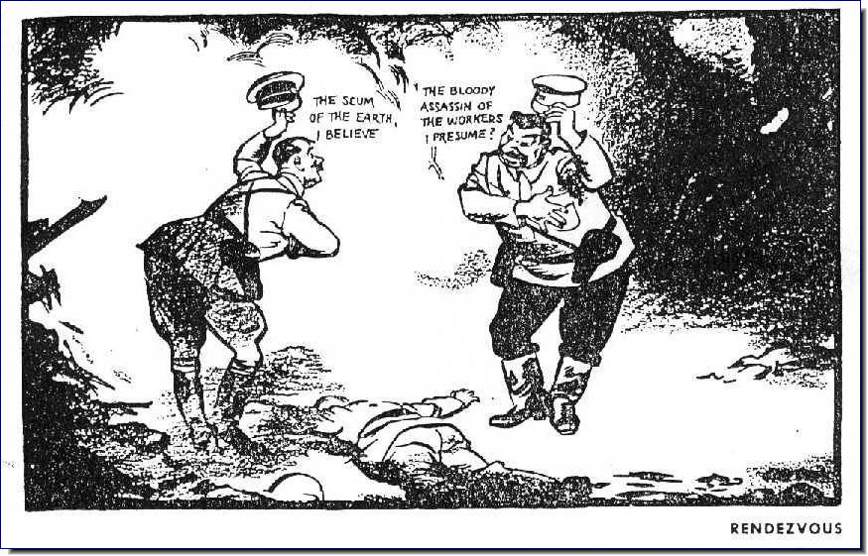
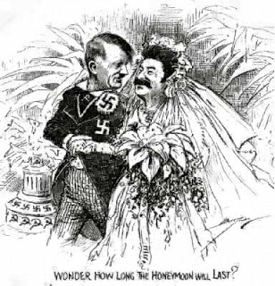
Nazi Soviet Pact (Moltov Alliance)
Hitler and Stalin make a secret alliance for 10 years of peace and to annihilate Poland, splitting the country down the middle.
The world is shocked.

Slide 4
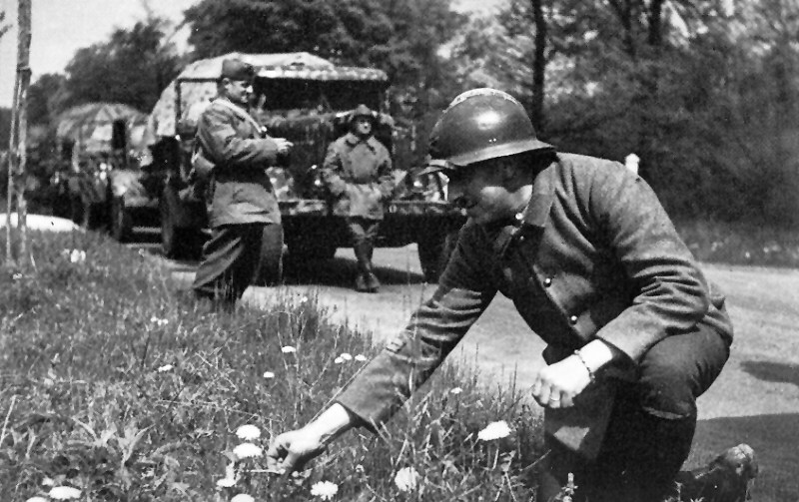
The Phoney War (Spring 1940)
(Show Movie)

Slide 5
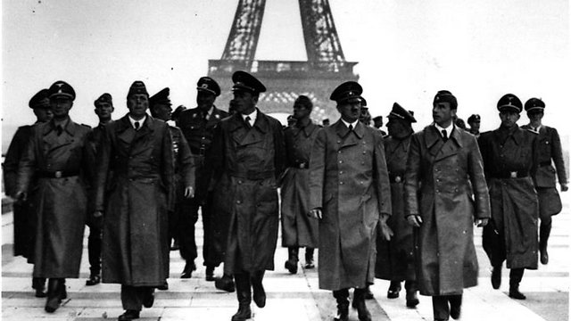
The Blitzkrieg of Paris (Summer 1940)
Watch Movie

Slide 6
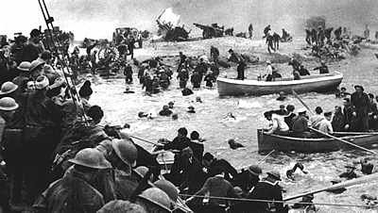
The Evacuation of Dunkirk (Summer 1940)
Show Movie

Slide 7
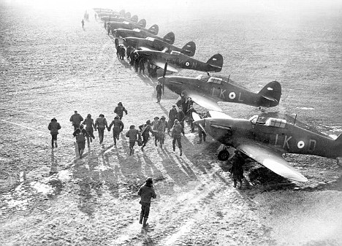
The Battle of Britain (Fall 1940)

Slide 8
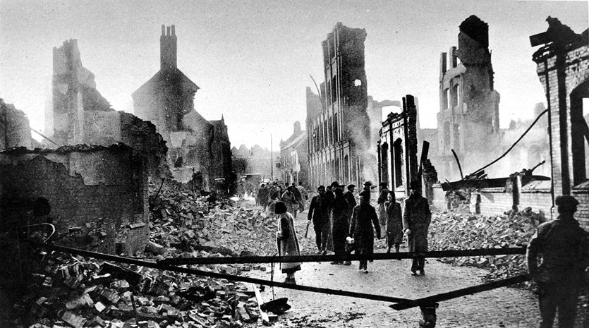
The Blitz of Britain (Winter 1940)
Watch Movie

Slide 9
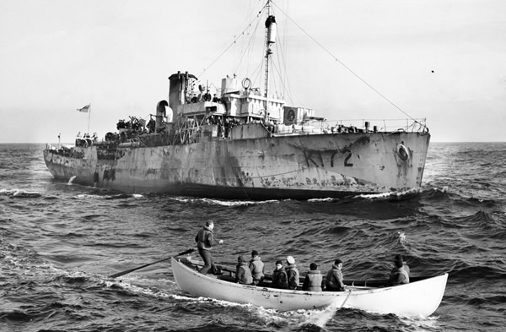
Battle of the Atlantic (1939-1944)

