Slide 1
Types of Government

Slide 2
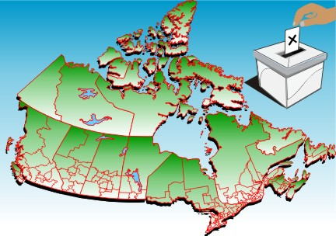
Ridings/Constituents/Electoral District
308 Ridings in Total. This number changes as Canada’s population changes. (338 for next election.)
Vancouver Island has only 7 federal ridings

Slide 3
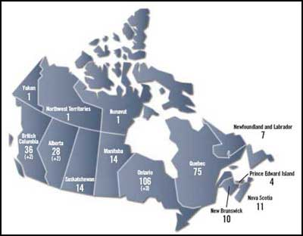
Numbers of Ridings by Province

Slide 4
Vancouver Island Ridings
Why is Riding 6 so small and Riding 1 So Big?

Slide 5
Basics of Voting for Government
In an election you count votes in each riding.
If you have the most votes in your riding you win a seat in the house of commons.
The party with the most ridings wins the election. NOT THE PARTY WITH THE MOST VOTES. This is called First Past the Post

Slide 6
How it Works
Riding Awesome Pop. 107,490
Conservative 33,987
Liberal 19,290
NDP 9,152
Green 28,806
Riding Stop Turd Eau Pop 87,005
NDP 31,777
Green 30,098
Conservative 32,672
Liberal 1,509
Riding Everyone voted Pop. 121,454
Liberal 67,794
Green 38,806
Conservative 7,987
NDP 7,152
Riding We Hate Democracy Pop 100,080
Conservatives 1,364
NDP 1,034
Greens 999
Liberals 987

Slide 7
Why Keep FPP
It gives majority governments.
It has (until very recently) given the Quebec separatist party more power than they democratically deserved. So Quebec has traditionally liked the system.
Keeps crazies out.
Keeps minority parties from popping up everywhere.

Slide 8
Why does Mr Woelke like PR
Prevents voters from feeling like “what’s the point?” -Calgary Center-
Quebec wouldn’t care anymore.
More democratic.
Forces governments to work together.
Be able to find a party that truly fits your needs.

Slide 9
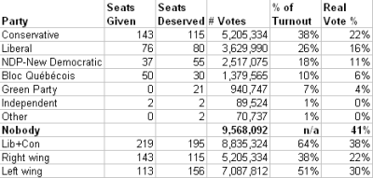
PR compared to FPP

Slide 10
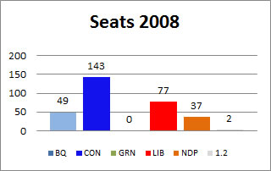
Example 2008 election
Who becomes the government?

Slide 11
Majority Governments

Slide 12
Minority Government

Slide 13
Majority
Some say this is not very democratic.
It is certainly useful for “getting stuff done”
No surprise elections a government will normally spend a full 4 years in power so they have time to accomplish their goals.
No fear of the government falling apart

Slide 14
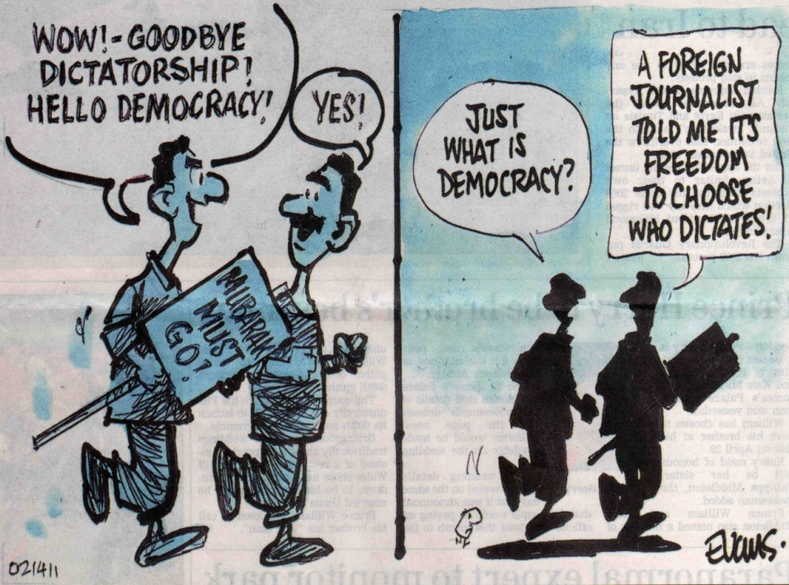
Majority Government
Pros
Cons
Can makes laws for the country and very little can stop them.
Government can get things done.
Don’t have all kinds of elections.
Hmm that sounds like a dictatorship?

Slide 15
Minority Government
Pros
Cons
Government must work together with the opposition to make laws.
Ensures that the government makes compromises
Ensures the status quo is kept and that no crazy changes are made.
Government parties never work together.
Government threatens to have a vote of non confidence & dissolve.
The status quo does not benefit Canada.
Government tries to form coalitions which do not represent the people.
Canadians are forced to vote too much so Government reacts by proroguing parliament.

Slide 16
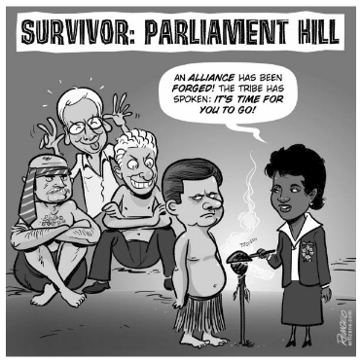
Coalition
Other parties (who are not friends forming a mega party)
Problem: Canadians did not vote for a “mega-party” alliance. These coalitions often do not represent the wishes of Canadians

Slide 17
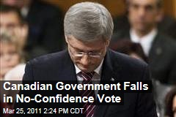
Vote of Non Confidence
At any point a government can have a confidence vote. If the opposition parties feel the government is incapable they can throw it out (dissolve it) and have an election
PROBLEM:
It’s a big nuisance
The Conservative Government was voted incapable 4 times. Each time Canada voted them back into power. Clearly Canada wanted the Conservatives

Slide 18
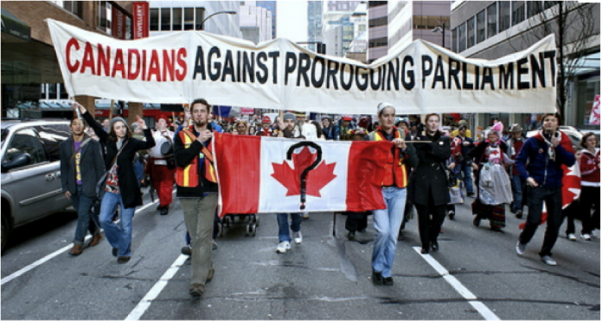
Proroguing
Calls an impromptu government day off.
Usually government uses this to avoid its problems. (like a non-confidence vote)
Like having a “sick day” when you have a big test that you know you’ll fail.
Problem: Canadians don’t like when the government avoids its problems

Slide 19
So which is better
Minority Governments look a little like anarchy (craziness) and cant get much done.
Majority Government look like 4 year dictatorships and do not need to listen to the people.
Write an Essay. Which is better for Canada?

Slide 20
Sample Test Question M/C
What is a disadvantage of direct democracy.
Its very expensive.
This voting system elects numerous political parties which leads to minority governments
It looks suspiciously like dictatorship.
It is impractical for everyone to be involved in government.

Slide 21
Sample M/C Question
What did the Massey Commission do?
Created CBC radio
Funded artists who wanted to make “Canadian art”
Defined what Canadian content is.
Studied the jeopardy that Canadian culture was in.

Slide 22
Sample Short Answer
In the space below draw a picture of the red Ensign:
Why would a government want to avoid giving an “order in council” or “proroguing” the government?

