Slide 1
Legal Philosophy
The basis of legality and morality

Slide 2
What is Law?
The Question is a philosophical question with no agreed upon definition. It is a similar and as interesting as “what is love”
In this unit we will look at 5 philosophical viewpoints that answer this question and the predominate viewpoint which is on the rise in Canada.

Slide 3
What is Law
Legal Positivism
-Rules made by a legal authority through a legal process.
Legal Realism/ Legal Marxism
-A system of rules and control (to protect the controllers)

Slide 4
What is Law
Metaphysical Legal Naturalism
-God given ordinances which guide our lives.
Humanistic Legal Naturalism
-A reasonable common good that can be guided by the observable laws in nature.
Self Law/ Legal Libertarianism/ Individualism
-Systems to protects the rights and the pursuit of happiness of the individual.

Slide 5
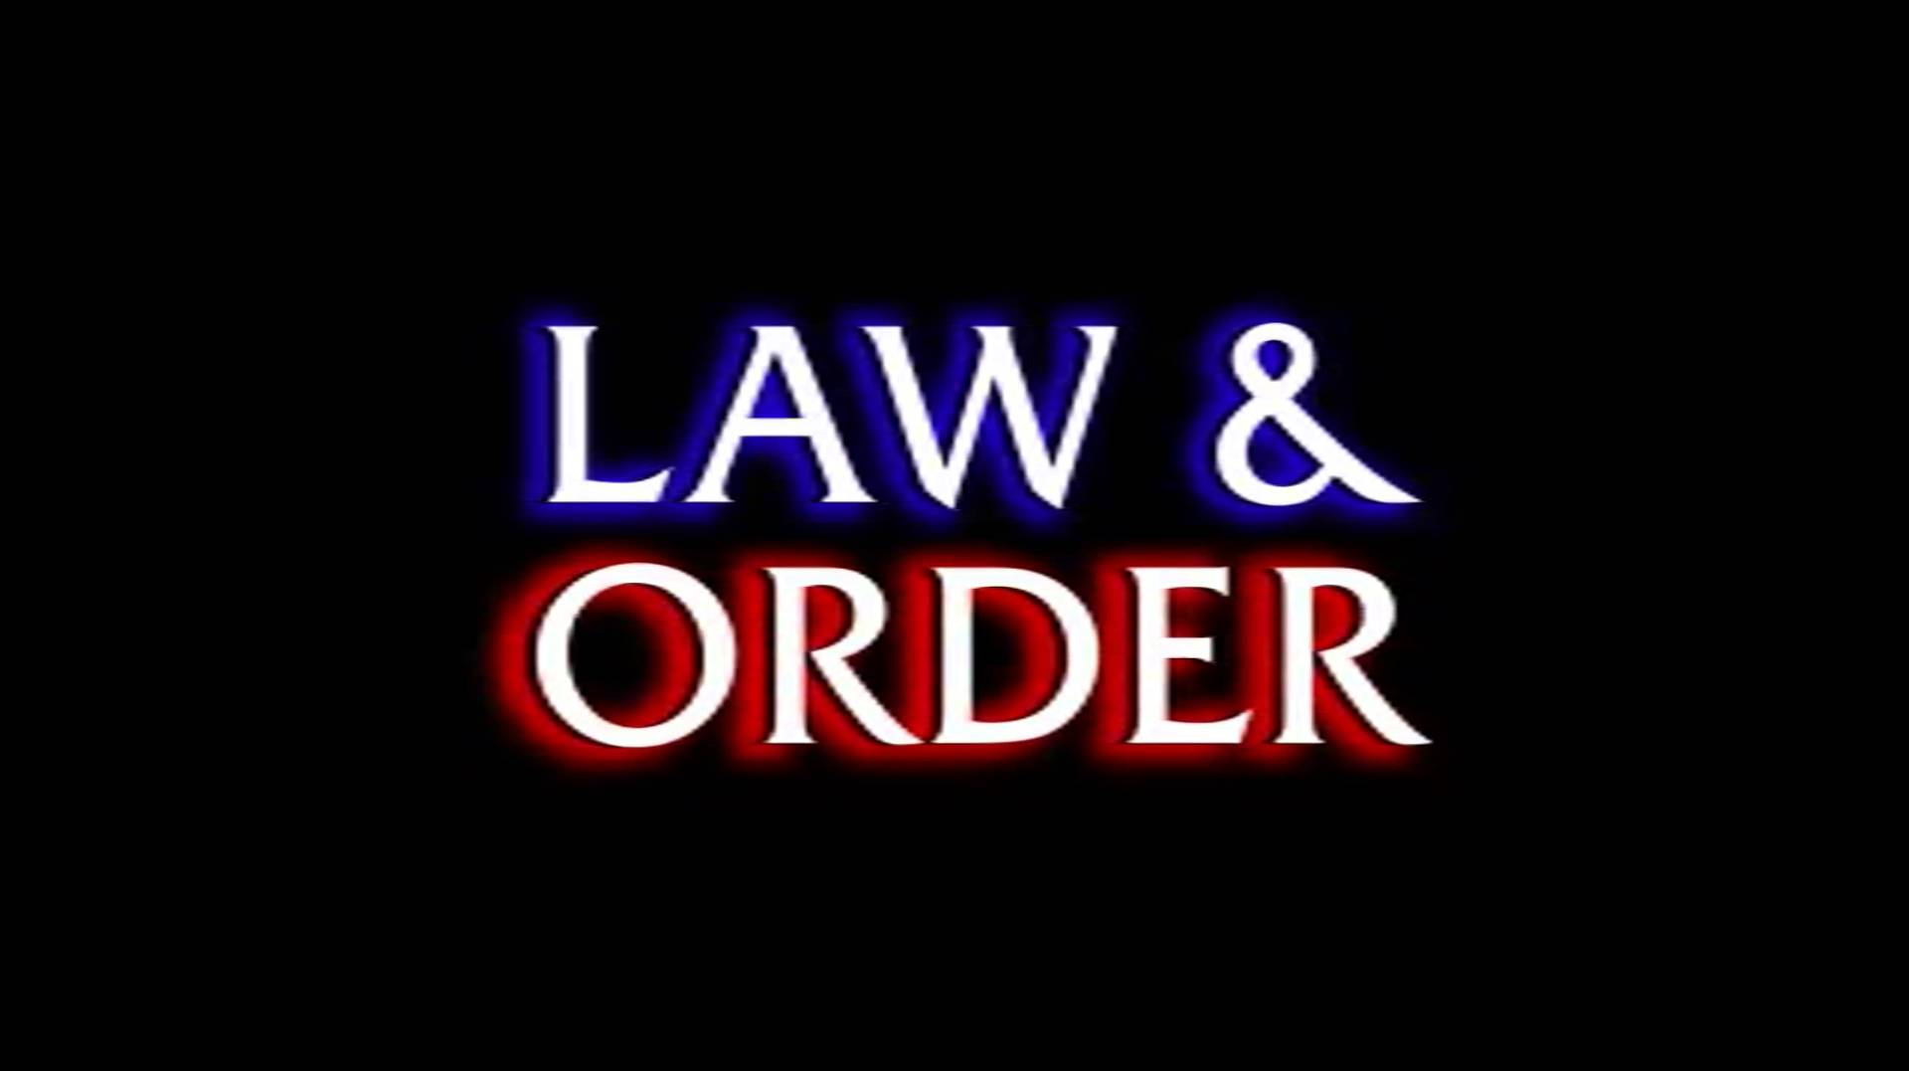
What Law DOES
Shape Moral Standards
Creates Order
Resolves Disputes
Protects our Rights

Slide 6
Metaphysical Natural Law
(The classical Christian viewpoint)

Slide 7
Metaphysical Natural Law
https://www.youtube.com/watch?v=SlDveeISXms

Slide 8
Description of Natural Law (that does not make it seem dumb)
University Law Class (3:10-5:35)
If “Law” is created to shape moral standards.
If this morality is responsible for order.
Then Who/What decides what is moral?
Do politicians and judges have that power?

Slide 9
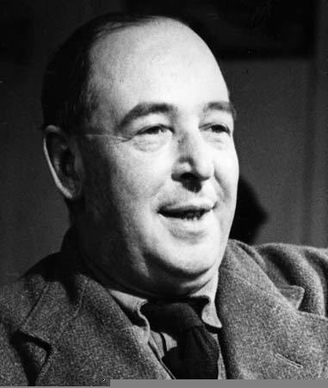
Is there such a thing as morality without God??
Immanuel Kant
John Newman
CS Lewis
Ravi Zachariah
William Lane Craig
Please look into the moral argument. Without God we only have subjective morality
NO!

Slide 10
Natural Law allows for objective morality
Objective Morality
Subjective Morality
Morality is set, unchanging true for everyone at all times in all cultures.
Ex. Murder is wrong
Ex. Cowardice in battle is wrong.
Morality is changing, chosen by individuals and will be different for everyone.
Ex. Lying is wrong because your parents told you.
Ex. Rape is wrong because we think it is.
Ex. Killing Jews is wrong unless a crazy tyrant like Hitler says its okay.
Do Individuals Decide what it Right and Wrong?

Slide 11
Question
Can law exist and be enforced if all morality is subjective?

Slide 12
Not just for: “fundamentalist, extremist, right wing Christians who think everyone in the world is a Christian and doesn’t know it yet.”
The first Line of our Constitution
The Constitution Act, 1982: Preamble
Whereas Canada is founded upon principles that recognize the supremacy of God and the rule of law:

Slide 13
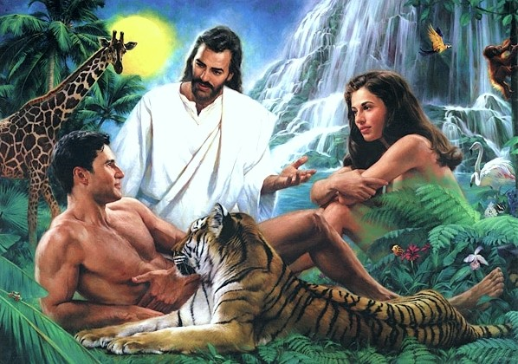
Created with Divine Laws
Law in the Garden
Law with Cain and Able
7 Laws with Noah
(do this don’t do that)

Slide 14
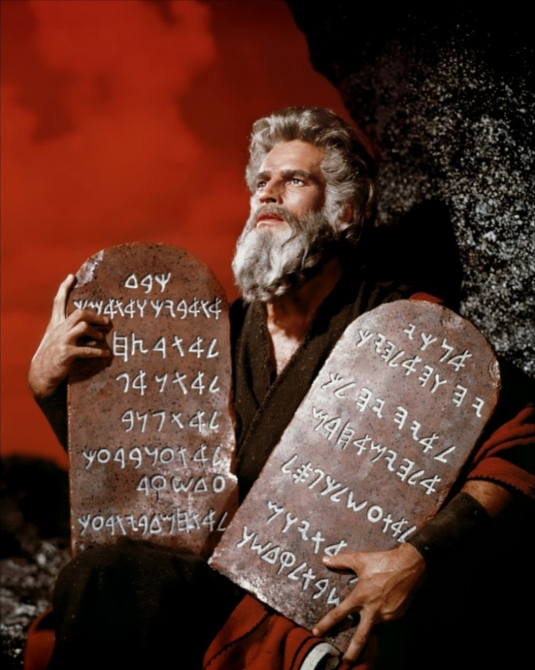
Mosaic Law
10 Commandments
Justice, sexual immorality, sexual conduct and their penalties.
National and ceremonial customs, kosher laws, clothing laws, circumcision.
Civil laws (like a claims court aka what to do when his ox gores yours.)

Slide 15
Sharia Law
Follows the teaching of the Quran
Also follows the life of Mohammed.
Makes for much more flexibility in interpretation than the Mosaic law.
Like mosaic law it also has no division between civil order criminal code and spiritual duties

Slide 16
Ancient Metaphysical Natural Law Codes
Mosaic Law (Torah and others) Jews
Sharia Law Code (Quran and others) Muslims
Sikh Law Code (The Path) Sikh
Hindu Law Code (>) Hindus

Slide 17
Research Law Codes
What’s in the law code?
What are various punishments for law breaking?
How old is the law code?
Is the law code being practiced today and if so where?
Is this law code a viable (good) option for our society?
Reseach your law code for 10 minutes and be prepared to present

Slide 18
Secular Natural Law

Slide 19
Can animals be Good or Bad
Check In
Share a story of a time an animal was either good/bad
Secular Natural Law
There are objective laws in nature. They are a product of evolution and universal to all creatures.

Slide 20
Can animals be moral or immoral?
Some believe that animals have ideas of right and wrong.
https://www.youtube.com/watch?v=oa16P4nFgD8

Slide 21
Animals behaving with morality
Rats will share food.
Many animals will share to avoid conflict within their tribe.
Some animals have been shown to go to some length to help their fellow animal avoid pain.
Mothers go to extremes to protect young.

Slide 22
Evolution as a basis for morality

Slide 23
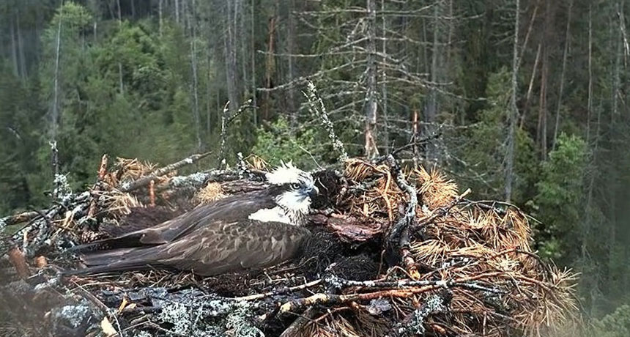
Osprey Observational Experiment
Set up a camera on a osprey nest.
Mother osprey hatches the egg.
Proceeds to deny one chick food while feeding another.
Eventually pecks the one chick to death.
Everyone got to watch.
People almost rioted.

Slide 24
If creatures are morally capable are they morally responsible?
Should that osprey have its children removed.
Should that osprey be charged with neglect.
Should it serve a prison sentence.
Should humanity have ensured that justice was done to the baby osprey?

Slide 25
Can animals be moral or immoral

Slide 26
Animals behaving without morality
Male dolphins (smartest mammal alive) will surround isolated females from another herd and slap her and all forcibly copulate (rape) her. This is presumably done to protect.
Mother polar bears will eat their own young. Apparently hamsters frequently chow down on their new-borns in order to make up for protein deficiency.
Male lions will also kill all the young in pride if they become the new alpha. Very much like “uncle scar” in the lion king. Male horses are likely to kick to death any colt that has no chance of being theirs. Zebras foals have less than 5% chance of not being kicked to death.
Sharks will eat their siblings while still in the womb. Tazmanian devils kill their siblings after being born.

Slide 27
Crazy morality if we follow evolutionary utility
We’d be “moral” to kill any young that had birth defects.
It’d be moral to kill and eat children if we were hungry enough.
Bullying fighting and general violence would be condoned provided it was establishing some sort of social dominance structure.
Rape “forcible copulation” would be tolerated if more genetic diversity was needed or if we couldn’t “naturally” attract a female/male.

Slide 28
Paul gives credit to “natural law”

Slide 29
Legal Positivism
(No values its just legality)

Slide 30
Legal Positivism
Legal Positivism: Laws (not morals) made through a legal human authority with social consent by the people.
Simple Definition: The law is whatever leaders decide and we are willing to follow. The definition avoids notions of morality and focuses on legality. This allowed humans to break free from biblical norms and develop laws for modern society.

Slide 31
Scientific Approach
Law is not contextual it will have the same result every time. It is procedural and scientific.
This approach separates morality and justice out of the equation. Though even positivists have a difficult time explaining how they can do this.
Positivism often assumes morality is subjective.
Positivism is a supposed rational approach to understanding our world. But the rational approach leaves our (God-Given) need for justice unsatisfied.

Slide 32
Legal Realism
Keepin it Real

Slide 33
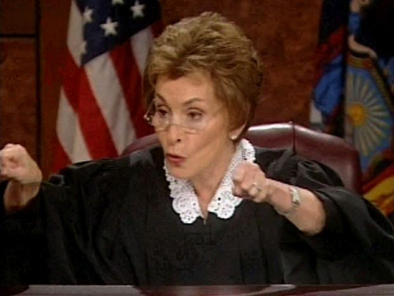
Legal Realism (a cynical look at law)
Whatever courts and judges do is the law.
What they do is neither right nor wrong moral or immoral. It is perhaps practical.
It is unscientific messy and prone to changes.
But it maintains society.

Slide 34
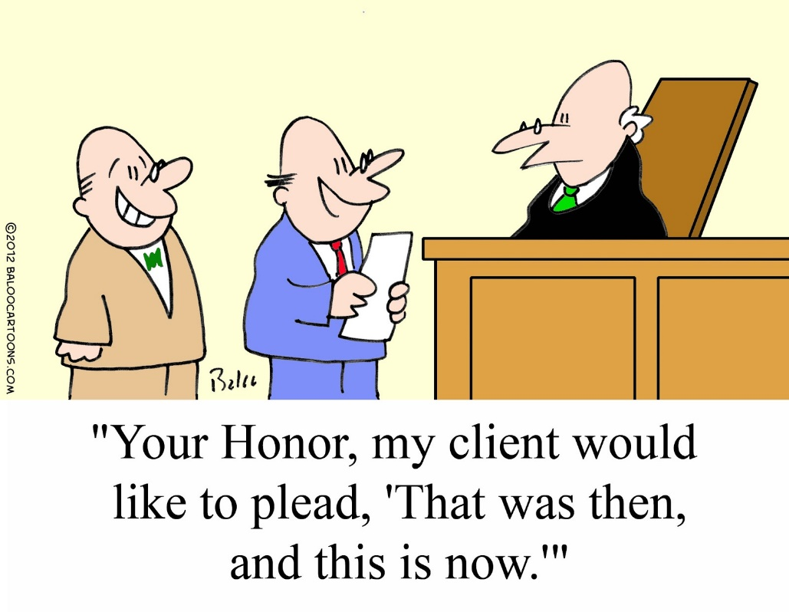
Law will Change
Every judge is unique.
They interpret the law unique.
The day-in-age they live is unique.
What the judge ate for breakfast is unique.
Culture of the day is unique.
Their personal history is unique.
This is why we have hung juries and split decisions among Supreme court justices

Slide 35
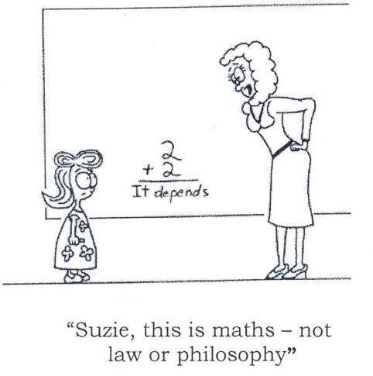
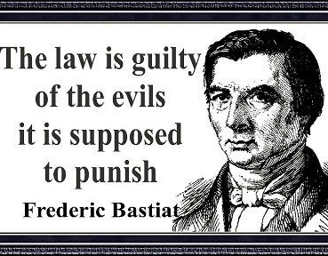
Legal Realism
Trying to rephrase the “philosophy” and look at “WHAT IS”.
By avoiding the philosophy behind law they end up with a very bitter look at this “thing” called law.
“WHAT IS” turns out to be rather disgusting

Slide 36
You have been accused of Rape
Judge #1
Judge #2

Slide 37
Two Judges with the same degree
Judge #1 El Amin
Judge #2 Judge Jilly
El Amin came from Iran
The victim is black and El-Amin has written his masters thesis on African American prejudice in the court system.
El Amin is himself a victim of rape.
Judge Jilly is a feminist.
Judge Jilly has a family about your age. You have a lot in common.
When Judge Jilly was little her father was falsely accused of rape and it split up her family

Slide 38
Legal Realism: Challenges the Systems
To positivism it challenges their philosophy saying the legal authorities and systems brainwashes the public into accepting it legitimacy.
To naturalism it points to the subjectivity or inability to prove moral statements like murder is wrong. It also points (as I have just proved in the previous activity) that dispensing law is highly subjective.
22:00 minutes https://www.youtube.com/watch?v=YeH_ZQskDd4

Slide 39
Self Law/ Postmodern Law
(Truth and morality reside within the individual)

Slide 40
Whatever we call it, it has similar traits.
All morality and all knowledge is subjective.
Words like truth, justice, right/wrong belong to individuals, not a legal system or society.
Laws move away from protecting society and towards protecting individuals.
Protecting all beliefs as equal should be the basis for lawmaking.
Heavily emphasises humanities “rights” as a basis to protect the individual.

Slide 41
Couple of Qualifications
If my worldview endangers or cause harm to someone else's worldview it violates their rights And my view is unacceptable. (It does damage to other individuals)
Governments can only use the law to protect this harm from happening.
Any laws created that are not to protect others from harm is a bad law.
Therefore:
Murdering is wrong because it causes harm to others. The state needs to protect.
Hate speech is wrong because it causes harm to others. The state needs to protect.
Doing drugs is not wrong because it only causes harm to me. The state is not in charge of me.

Slide 42
HARM principle (classic libertarian idea)
https://www.youtube.com/watch?v=R9IM3ZKNMCk

Slide 43
Objectivism: (classic individualist principle)

Slide 44
Individualism In Law
Asking anyone to curb individualistic impulse becomes a violation of their rights.
Meaning this view not only does not follow religion, but despises it, since religion is the primary means of controlling individuals’ views of morality.
This view maximizes freedom.
This view eliminates social expectations. (Nothing an individual does makes them right or wrong.)
Leads to less, rules, laws, and a simplified system.

Slide 45
Christians and Law
(what we traditionally believe)

Slide 46
Christians and Law
We believe God gave us morality in a Holy Text and this serves as the basis for Law
Jesus said obey the Roman legal system but wanted us to follow his moral system.
Jesus and almost all the disciples allowed themselves to be executed in these legal systems without resistance. (they followed the law)
We have numerous examples where Christians and Jews violate the law if it violates the law of Christ. AKA. morality

Slide 47
Scripture and Law Rule #1 We Submit to Secular Authority
17 Tell us then, what is your opinion? Is it right to pay taxes to Caesar or not?” 18 But Jesus, knowing their evil intent, said, “You hypocrites, why are you trying to trap me? 19 Show me the coin used for paying the tax.” They brought him a denarius, 20 and he asked them, “Whose portrait is this? And whose inscription?” 21 “Caesar’s,” they replied. Then he said to them, “Give to Caesar what is Caesar’s, and to God what is God’s.” (Luke 20:17-21)
Let every person be subject to the governing authorities. For there is no authority except from God, and those that exist have been instituted by God. Therefore whoever resists the authorities resists what God has appointed, and those who resist will incur judgment. For rulers are not a terror to good conduct, but to bad. Would you have no fear of the one who is in authority? Then do what is good, and you will receive his approval, for he is God’s servant for your good. But if you do wrong, be afraid, for he does not bear the sword in vain. For he is the servant of God, an avenger who carries out God’s wrath on the wrongdoer. (Romans 13:1-4)

Slide 48
Scripture and the Law Rule #2 Even an evil system is under God’s control
Truly in this city there were gathered together against your holy servant Jesus, whom you [God] anointed, both Herod and Pontius Pilate, along with the Gentiles and the peoples of Israel, to do whatever your hand and your plan had predestined to take place. (Acts 4:27-28)

Slide 49
Scripture and the Law Rule #3 God is our primary authority.
Jesus answered [Pilate], “You would have no authority over me at all unless it had been given you from above.” (John 19:11)
There is no authority except from God, and those that exist have been instituted by God. (Romans 13:1b)

Slide 50
Last Minute Terms
Theocracy: Is a belief that a religious system should be combined with the legal system. It is the purist expression of legal naturalism.
Secular pluralistic society: a society that recognizes that are various people, cultures and viewpoints and does not allow itself to be controlled by any singular viewpoint.

Slide 51
Essay Question
Essay Question #1: Would a Christian theocracy benefit a secular pluralistic society like Canada if it was imposed on our country?
(In other words, should we make everyone follow Jesus’ morality through the use of a political /legal force.)
Essay Question #2: What legal philosophy is the most practical and functional for guiding Canada’s legal system?
(In other words, is metaphysical legal naturalism functional for guiding Canada’s legal system if not then what is the alternative?)

