Slide 1
LaTe middle Ages
A time for some horrible history

Slide 2
Middle Ages Events
Bubonic Plague
Little Ice Age
The Papal Schism
The Challenge of the Church
100 years war.

Slide 3
The Bubonic Plague
The Black Death (Same thing)

Slide 4
How often do you shower in a year?
North American Teenage Average
(Aprox. 300 times)
North American Average
(Aprox. 250 Times)
European Average
(Aprox 125 times)
Medieval King/Queen average
(about 20 times)
Medieval Peasant
(About 2 times)

Slide 5
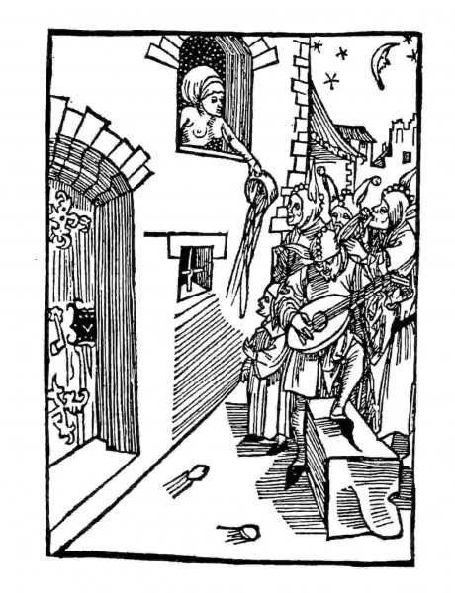
What to do with pee and poo
Dump it out the window.
Someone will stack the poo into a pile and pat it down with their hands.
The liquid will be drained into the rivers. (moat)

Slide 6
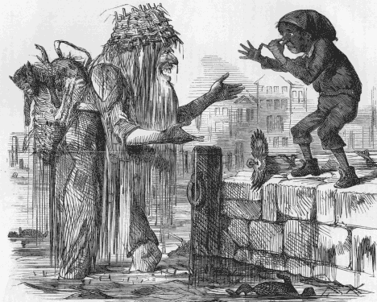
Bathing
Health advisors were saying it was good.
Church was trying to avoid public nudity.
To be a good Christian is was hard to wash yourself.
Peasants/towns had little access to clean water. Rivers were not clean.

Slide 7
Trying to Cut Down on Smell
The British royal court posted a warning (1589):"Let no one, whoever, he may be, before,at, or after meals, Early or late, foul the staircases, corridors; or closets with Urine or other filth.”
Etiquette books Erasmus (1530): It is impolite to greet someone who is urinating or defecating in the street.

Slide 8
Results of not knowing what to do with pee poo bathing
Rats
Flies Fleas Lice
Germs
Disease

Slide 9
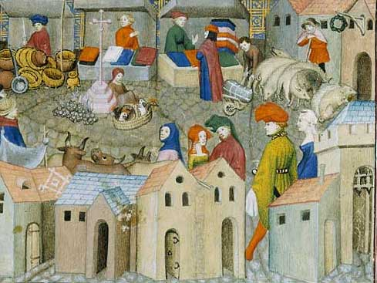
Effect of Trade and Towns
What result would a growing international trade system have on sanitation and disease?

Slide 10
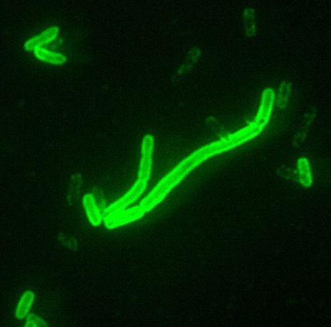
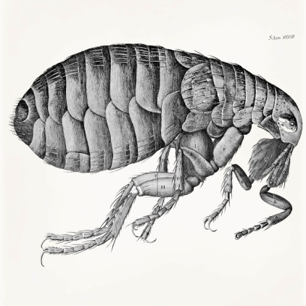
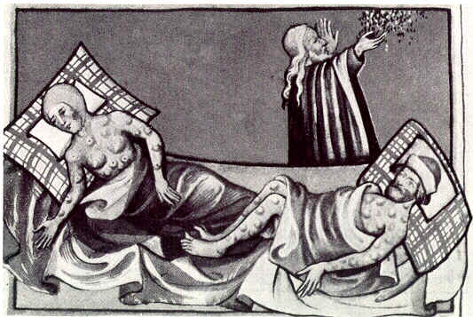
What Caused the Plague

Slide 11
Signs and Symptoms
Cough
Fever (red rosy blotches color)
Swollen Bubos (surrounded by red rings)
Bubos would drain pus and blood.
Dead within about 2 days

Slide 12
50% mortality rate in England

Slide 13
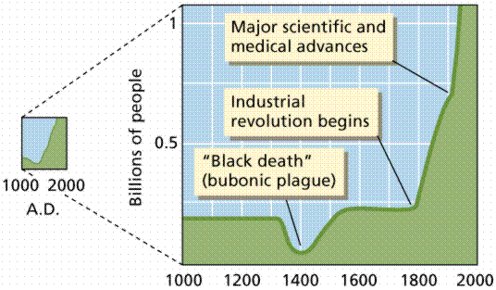
1350 Ring around the Rosie

Slide 14
You’ve Come from the Future
Give the people of London 10 steps to help the get rid of the plague.

Slide 15
Impact of Plague
Social Anarchy
Certain towns are simply gone.
Carefully structured society falls apart.
Castles
Towns
Guards
Guilds
Increased demand for workers

Slide 16
The Little Ice Age 1300-1800
The first climate change problem

Slide 17
How is our climate affected by Global Warming?
Create a mind map. How Society is affected by Global warming
On the outer circle list what changes we can expect to society as a result.

Slide 18
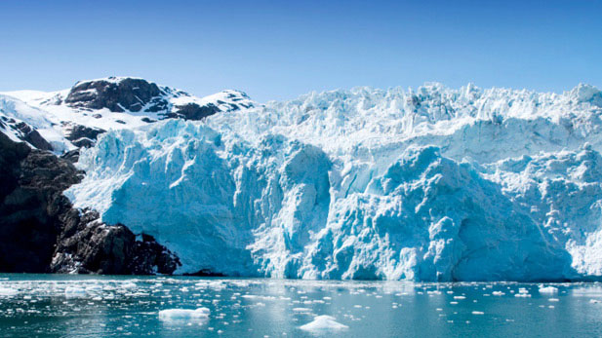
What is an ice age

Slide 19
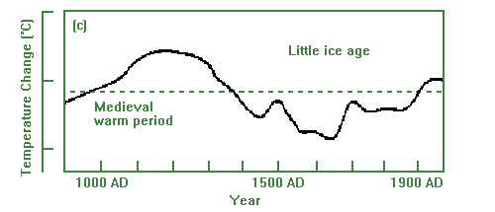
What is the Little Ice Age

Slide 20
Affect of -2 degrees
Growing season change
Frost keeps killing crops
People are dying from cold.
It actually leads to famine.
Search “Little Ice Age Europe impacts”

Slide 21
Great Famine 1315-1322
Let’s play the FAMINE GAME
Goal of the game is to live from 1315 – 1320
In order to survive you must get bread or successfully scrounge if you don’t do either you DIE!
Rules:
Roll for frost 1-2 Frost Gets your crops (No Bread)
Roll for weather 1-2 flood or hail gets your crops. (No bread)
Roll for disease 1 Your labor dies (No Bread Scrounge Roll halves)
Roll for raiders 1 Your robbed (No bread scrounge roll halves)
Roll an 1-4 to scrounge or 1-2 if there was disease or raiders

Slide 22
Scrounge Rolls
You resort to eating the family pets
You must beg until someone gives you half of their bread. Then you must both scrounge at 5 or less.
Luckily you manage to steal someone else's bread (force someone more fortunate than yourself to scrounge.)
Tough times your forced to kill some of your children in order to survive. (recorded historically)
You eat the dead neighbor. If nobody died this turn eat your partner.(recorded historically)
You must beg until someone gives you half of their bread. Then you must both scrounge at 5 or less.

Slide 23
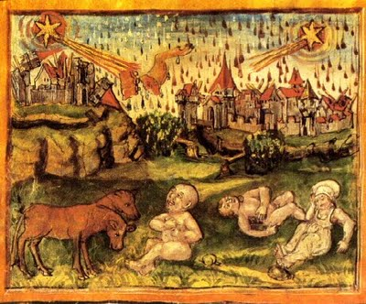
The Great Famine
8%-12% of Northern Western Europe dies of hunger

Slide 24
Facts about Famine
Starvation is very slow death.
When people are starving they often adopt animalistic qualities.
Wheat prices rose 300% who would this affect most.
When grain prices rise we hardly notice.
Most grain land is being switched for cattle land, or cattle farmers are feeding animals while people starve.
Atrocities get committed in areas of starvation 2 kings 6:26
North Americans throw away 1/3 of their food. (enough food to feed half of Africa)

Slide 25
Assignment
Find a country with famine?
What percent of the population is affected or dying?
How did it happen?
What is the world doing to help?

Slide 26
Corruption of the Church

Slide 27
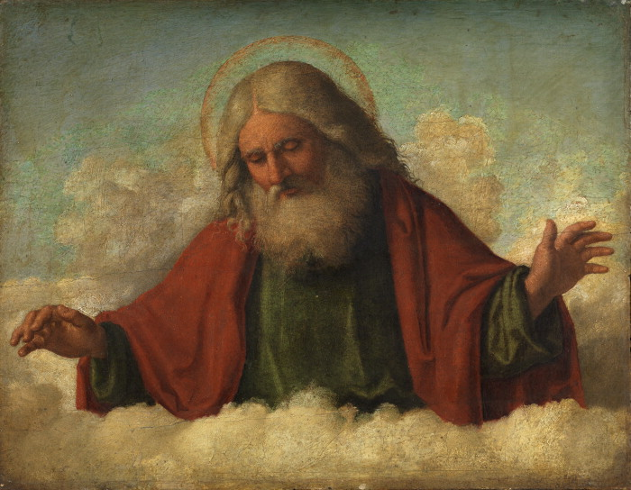
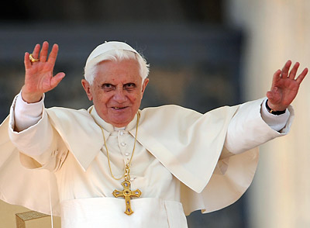
Papal Primacy
The Pope is a descendent of Peter
The Pope is God’s #1 man with full authority over the church and its souls.
Mathew 16:16

Slide 28
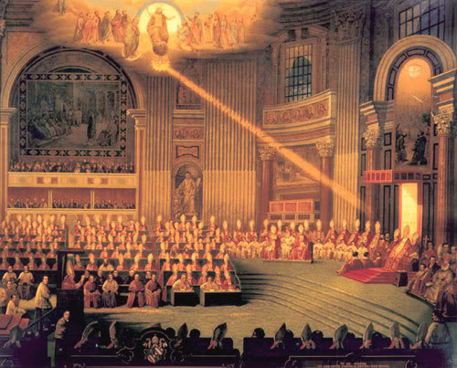
1’st Vatican Council
The Pope in addition to having Primacy over souls is Infallible.
The Pope
Never makes dogmatic mistakes
Never previously made mistakes.
Pope is always divinely inspired
His word are divinely given.

Slide 29
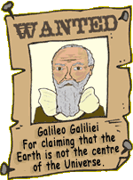
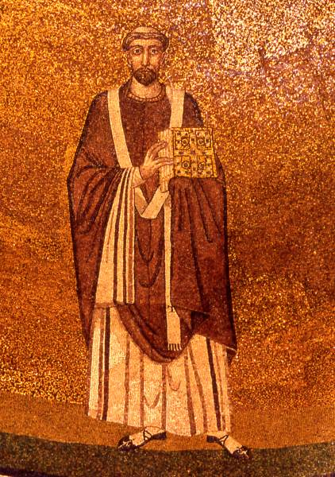
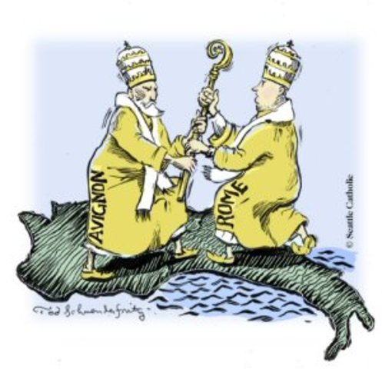
Problems with Vatican 1
Theological problems (Popes who admit they were wrong John Paul and Honourious)
Historic Problems 35 different Schisms (more than 1 pope)
Logical problems (like when they said Galileo was wrong)

Slide 30
Dominium Mundi
A single united empire under God with the pope as ruler
Theocracy: God as King/ Pope as king.
To what extent is a pope in secular control and spiritual control

Slide 31
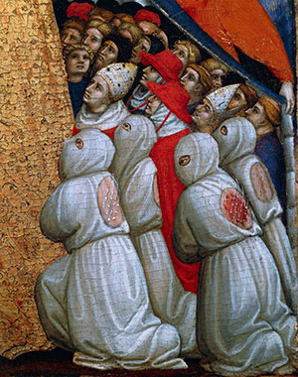
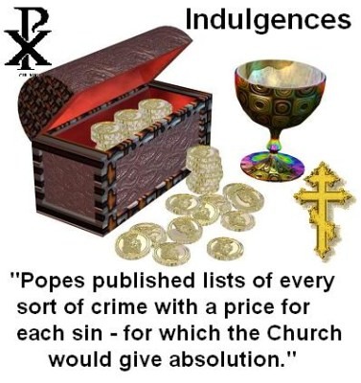
Medieval Salvation
Follow the Church(.)
Salvation is achieved by obedience, the concept of faith was being lost.
Various corrupt theologies (refer to worksheet)

Slide 32
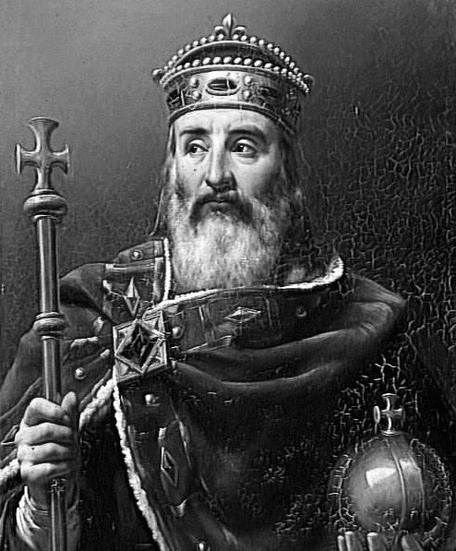
Political Usefulness of the Pope
Having a pope from your country proved to be extremely useful. (they could support your leadership)
Kings would choose popes, and popes could in turn support the kings.

Slide 33
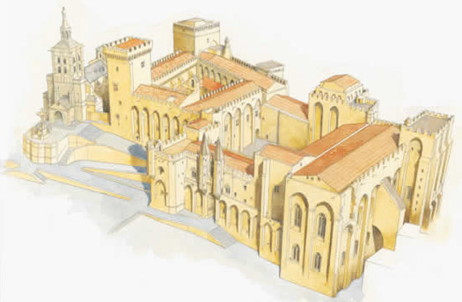
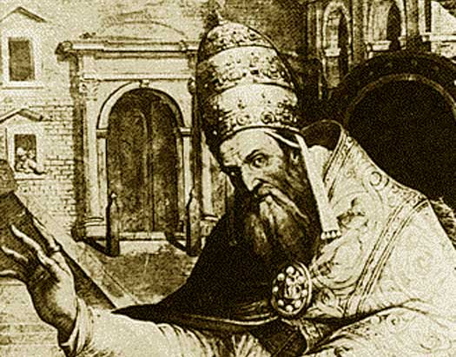
Avignon Papacy/Babylonian Captivity
French people wanted a pope.
French monarchy made sure the next few popes would be French.
The new Pope helped ensure the French Government got rich.
Church got increasingly bad behaved.

Slide 34
Church Loses Power
Add it all up.
Death from plague
+ Church supported Wars
+ Lack of Food
+ Strange Weather
+ Corrupted Church
= People for the first time in 1000 years question whether the church is supported by God

Slide 35
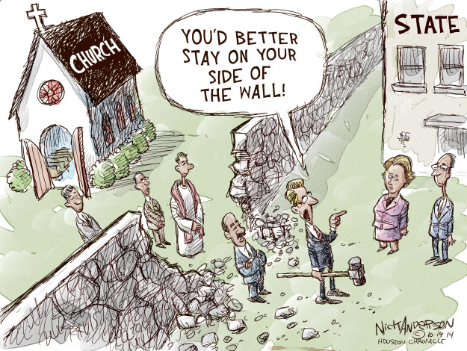
Separation of Church & State
Today we have a strict policy of separating religion and government.
Governments Cannot try to:
Influence the churches sense of morality.
Make rules for the church.
Manipulate religion to advance its agenda
Churches Cannot try to:
Make decisions about taxes and warfare.
Tell people how to vote.
Create laws that supersede government laws

Slide 36
The Papal Schism

Slide 37
Who is God’s chosen one?

Slide 38
Result of the Papal Schism
Small wars between Italians and French
Non French or non Italians losing hope in Catholicism.
Ideas about reformation (Martin Luther) begin growing.

Slide 39
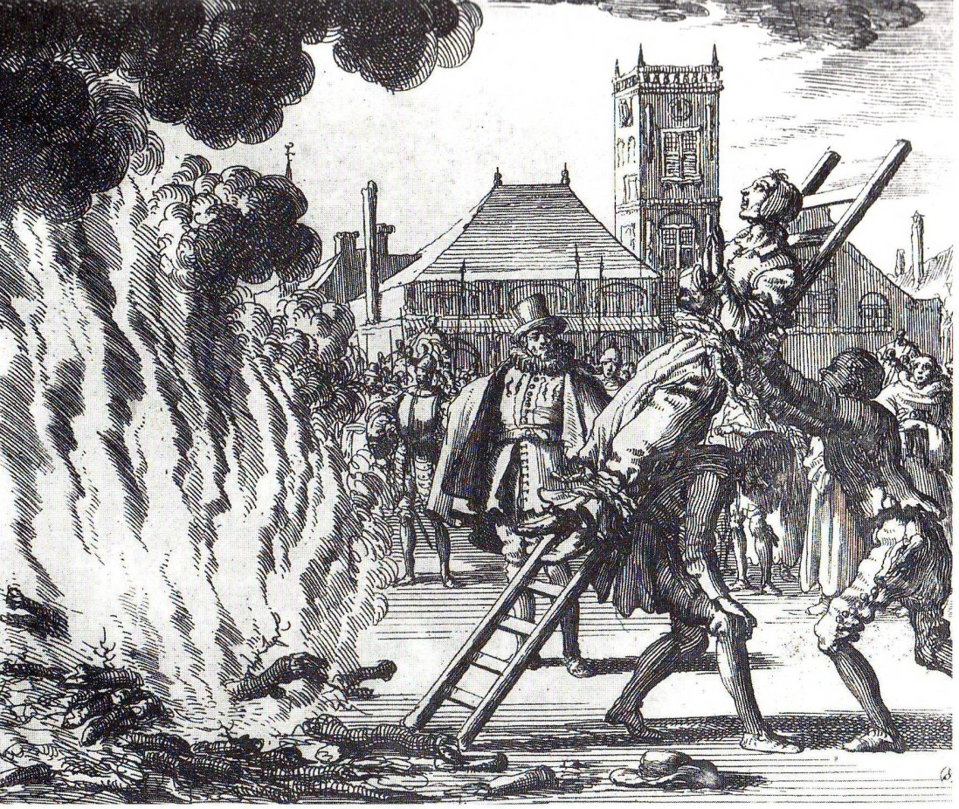
Spanish Inquisition

Slide 40
W-5 method (with emphasis on 5)
Who was involved in the Inquisition
The catholic church and the Spanish government
What was the Inquisition
Torturing brutalizing and chasing away heretics (aka non-Catholics)
When was the Inquisition
Started ??? or 1478 Ended 1838
Where was the Spanish Inquisition
Russia
Kidding (Spain)
*** Why did the Spanish Inquisition happen

Slide 41
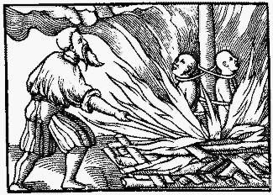
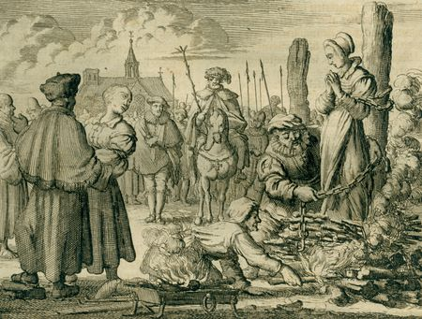
4 Pieces of Background Information
1. Torture of heretics is not new.
Witches, Muslims, cults, Jews, heretics, Templar knights.
Been torturing tor 1000 years
2. The Spanish Inquisition is not the only inquisition.
There is the medieval inquisition and the Roman Inquisition before it

Slide 42
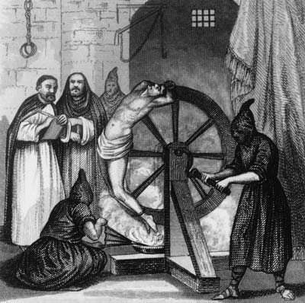
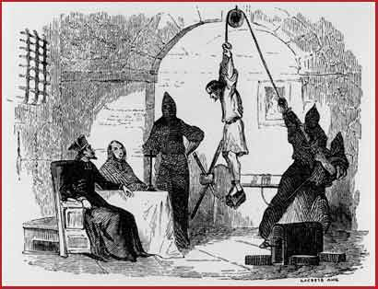
4 pieces of background information
3. Torture and death were not as common as people like to think.
3000 people tortured or killed over 330 years.
150,000 questioned.
4. Inquisition had some respect for people.
Those questioned could not “bleed”
The church did not want unnecessary suffering.
Torture could not exceed 5 minutes.

Slide 43
Think/ Pair / Share
Why would someone want to make historic events like the Crusades and the Inquisition seem worse than they are?
When talking about “identifying truth” we talked about straw-man technique and sexy-ideas. Is the Spanish Inquisition a straw man or a sexy-idea?

Slide 44
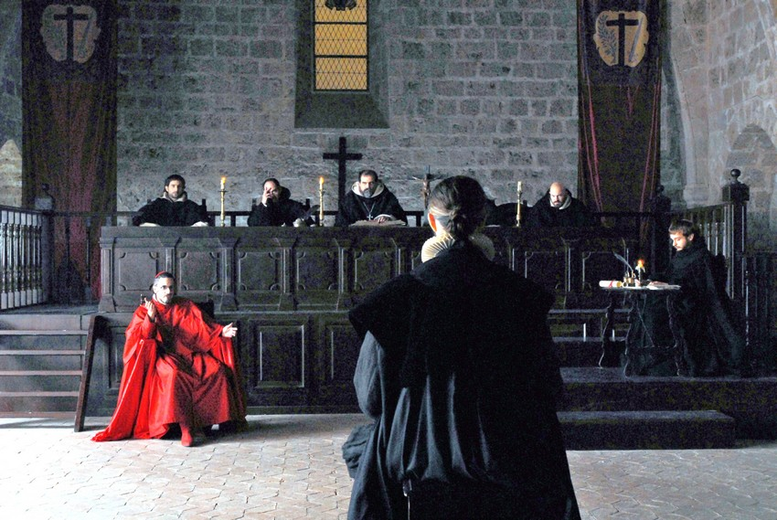
The Fifth W… “Why” Heretics
Jews
(Early Years Conversos 95%)
Strange religions
(Secret societies, Satanism)
Muslims
(Early Years Moriscos 5%)
Protestants
(Late Years Lutherans and Anglicans)
Witch scares
(11 witches in 300 years)
Gays, Fetishes & Bestiality
(Less than 300 in 300 years)

Slide 45
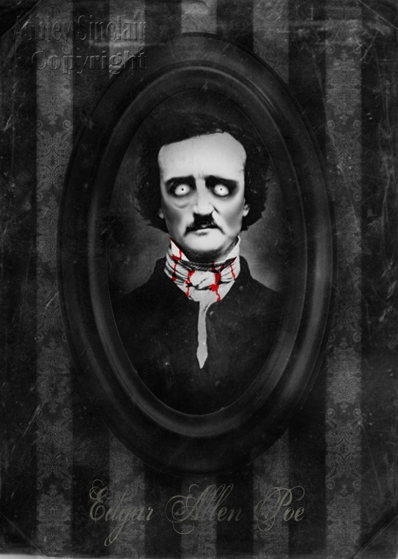
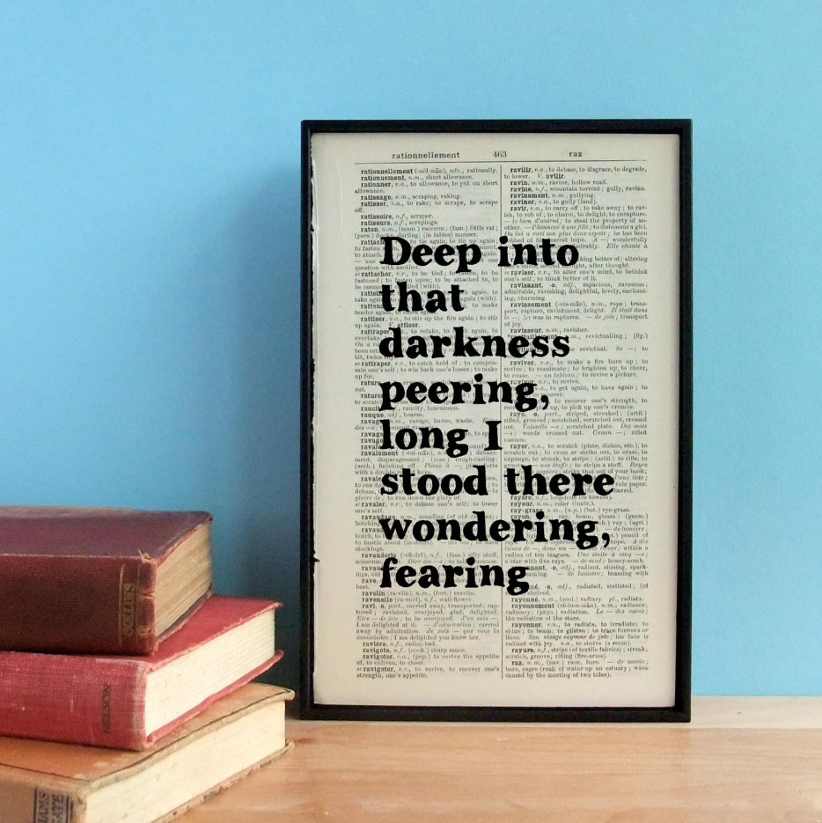
Pit and the Pendulum
Edgar Allen Poe’s short story about the inquisition.

Slide 46
Peasants Revolt

Slide 47
Hundred Years War
http://www.primewire.ag/external.php?title=Joan+of+Arc&url=aHR0cDovL3ZpZHppLnR2L3F5Z2R6MmRhOGFsbS5odG1s&domain=dmlkemkudHY=&loggedin=0

Slide 48
Important Background Ideas
Modern day “France” was not always controlled by Frenchmen and England was not always controlled by Englishmen.
Most peasants felt protective of a town or a lord but not a “nation”
Most knights felt protective of their local land but not a “nation”
The king had a small sense of a “nation.” but there was no flag, no unifying culture, sometimes no unifying language.
***The 100 years war attempted to unify all France and England under a single king.

Slide 49
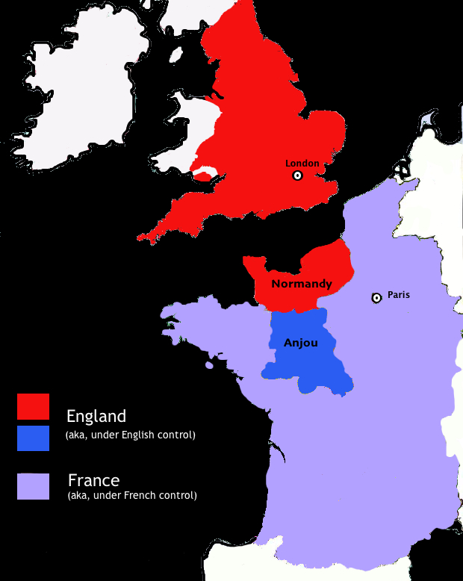
England’s place in France
Since the Norman conquest England had control of parts of France.
Most of William the Conquerors “Barons” of England were also “Lords” in France.
SOOO depending on how you look at it. Either the French Control all of England or the English control some of France

Slide 50
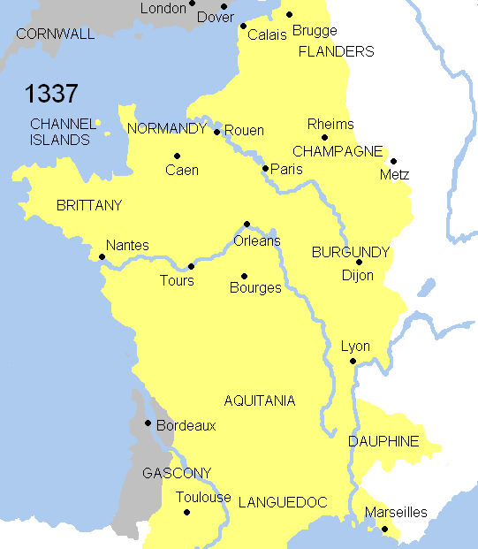
Background to the 100 Years War
The idea of specific language and culture is developing in each area.
It is no longer acceptable for a French king to rule England or an English King to rule France.
This is further complicated by the fact that the next king of France (based on primogeniture) is also the king of England

Slide 51
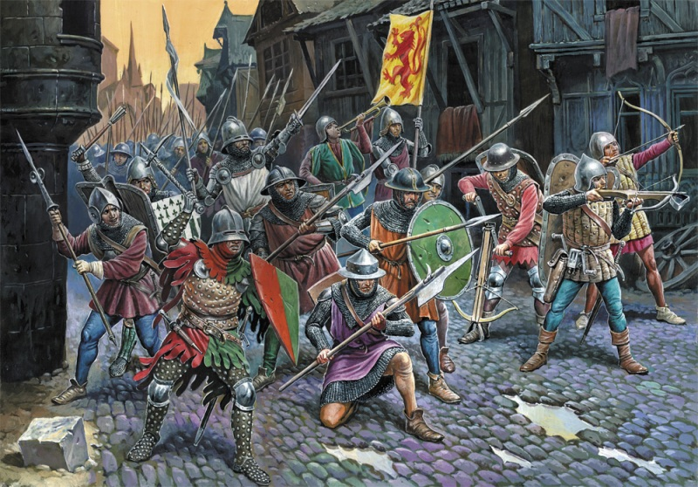
100 years war 1337 - 1453
Is essentially a fight for control of all modern “France” under a single culture and king. (simplified)
Disclaimer: Not a continuous nonstop fight. There were moments of peace.

Slide 52
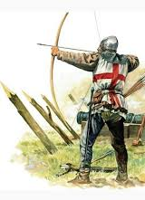
Early Battles/ New Tech
England is mostly successful thanks to two new technologies
Professional Armies (hiring locals and equipping them cheaply paying them with tribute money) France still relies entirely on the Feudal system of knights and his serfs.
Long Bows (A cheap weapon but has the power to fire through armor) France relies on knights banners and cavalry charges.
Professional warriors do not have a sense of chivalry. They kill knights without discretion

Slide 53
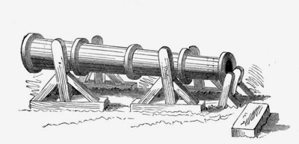
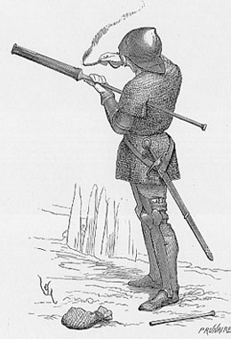
Burgundians Decide to Help
The dukes of Burgandy (who are not fond of their current French king) decide to help England.
After killing the French king they will marry their children together and unite the empire.
The Burgundians and English get their hired soldiers to use even more “advanced” weapons.

Slide 54
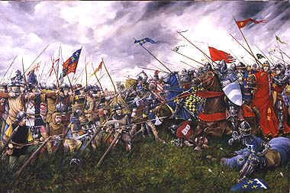
Battle of Agincourt
All the remaining Knight of France fight in a single battle.
France’s loss cripples their ability to fight future battles.
France descends into paying repeated tributes
(Battle Reenactment Monday)

Slide 55
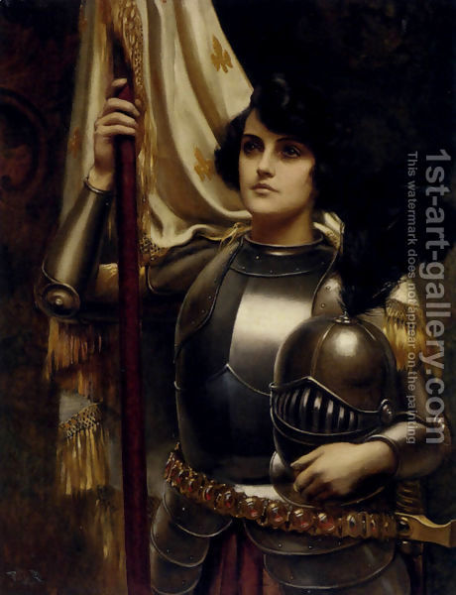
Joan of Arc
Woman who knighted herself under God to restore the Kingdom of France.

Slide 56
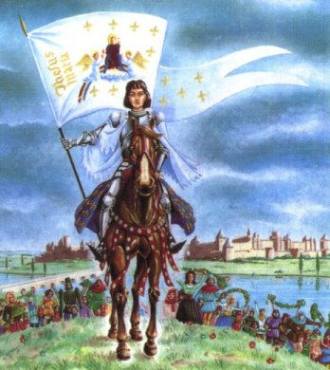
Maid of Lorraine Legend
Various prophecies were circulating in France that God would send them a female warrior
The female warrior would destroy the English
The female warrior would unite all of France

Slide 57
Controversy Surrounds Joan
She’s Really sent by God
She’s a Fake or possibly Crazy
She passed repeated catholic tests for sainthood
She passed repeated virginity tests.
Her faith was devout
Her victories and following were miraculous
She used an urban legend to her advantage
She was a “pawn” of the church and French king.
Her virtues were not universally adhered to.
No true miracles.

