Slide 1
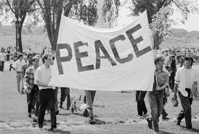
The Civil War of Vietnam
Resistance War Against America
By: Jaydlin

Slide 2
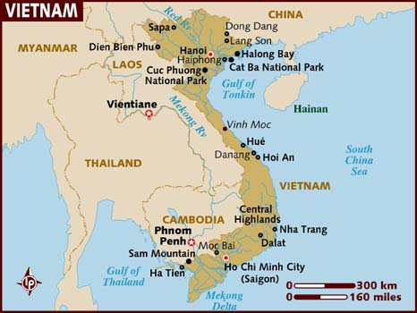
Basic Facts of the Vietnam War
Started 1st of November 1955- 3oth of April 1975 (19 yrs. long)
Fought in South Vietnam, North Vietnam, Cambodia, and Laos
Final Result: North Vietnamese Victory
Who was majorly involved in the war: North and South Vietnam, United States, South Korea.

Slide 3
Teachable Terms from Canada’s Role Slide
Vietnam War: Military conflict between South Vietnam, supported by the U.S.A, and Communist North Vietnam. The war resulted in a North Vietnamese victory and unification of Vietnam under Communist rule.
Non-Belligerent: A person, a place, or an organization that does not fight in a given conflict.
Boat People: South Vietnam refugees that fled to Canada by boat after the fall of South Vietnam.
Draft Dodgers: An intentional decision not to comply with the military conscription of one’s nation and flee to another.

Slide 4
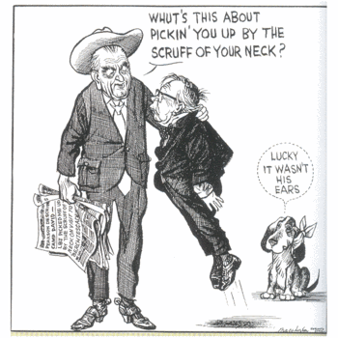
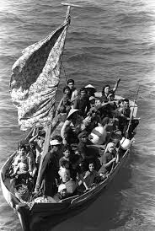
Canada’s Role in the Vietnam War
Canada did barely anything
Almost ruined their relationship with America by accepting Draft Dodgers
Canada did not fight in the Vietnam war, and was officially non-belligerent.
Canadian diplomats tried to tell the France & U.S to not fight because they believed that Vietnam was not strategically vital.
Canadian industries exported military supplies and raw materials to America. After this trade Canadian unemployment fell to a record low of 3.9%
Cultural turning point for Canada because of Boat People.

Slide 5
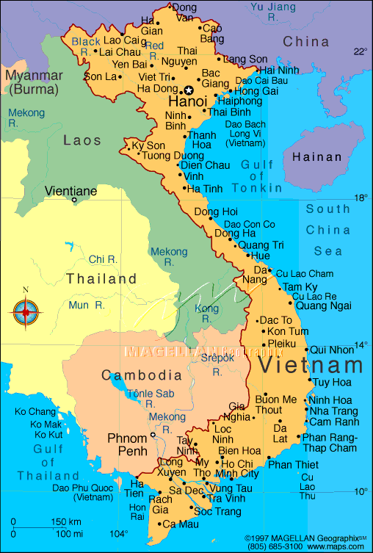
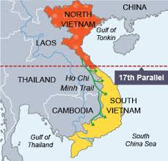
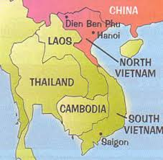
Back Ground
The North Vietnamese government and the Viet Cong were fighting to reunify Vietnam under communist rule. They viewed the conflict as a colonial war, fought initially against France and then America, and later against South Vietnam.
Things would escalate to a civil war between North and South Vietnam.

Slide 6
Exit of the French
In January 1950, the people's republic of China and the Soviet Union recognized the Viet Minh’s Democratic Republic of Vietnam as the legitimate republic of North Vietnam. PRC transforms the VM From a guerrilla force into a regular army.
A month later the French-backed state of Vietnam in Saigon, led by former emperor Bao Dai, as the legitimate South Vietnamese government.
U.S Created Military Assistance and Advisory Group to screen French requests for aid/ to train Vietnamese shoulders. U.S shouldered 80% of the cost of war.
On May 7th 1954, The French Union surrendered.

Slide 7
Viet Minh
opposed the re-occupation of Vietnam by France and later opposed South Vietnam and the United States in the Vietnam War.
Received crucial support from the Soviet Union and PRC (People’s Republic of China)
Communists

Slide 8
Teachable Terms from Transition Slide
Domino Theory- United States argued that if one country fell to communism, then all the surrounding countries would follow.
Temporary Partition- North and South Vietnam were temporarily joined together.
17th Parallel- the provisional military line between North and South Vietnam established by the Geneva Accords of 1954. The line did not exactly coincide with the 17th parallel but ran south of it.

Slide 9
Transition Period
Vietnam was temporarily partitioned at the 17th parallel.
Around 1 million northerners, mainly minority catholics, fled to S.V fearing persecution by communists.
U.S tried to help by putting in $93 million relocation program to ferry refugees, but were stopped by the Viet Minh.

Slide 10
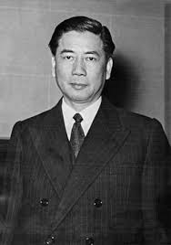
Ngo Dinh Diem
Established the first Republic of Vietnam in South Vietnam.
Devout Roman Catholic
Majority of Vietnamese people were alarmed by actions such as Diem’s dedication of Vietnam to the Virgin Mary.
Overthrown and executed with his brother in 1963.

Slide 11
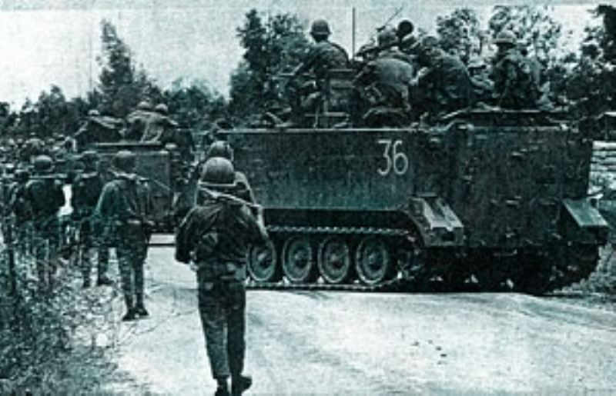
Battle of Bin Gia
Fought by South Vietnam and United States vs. Viet Cong.
Viet Cong won because they took full advantage of South Vietnam’s political instability over the ousting of President Ngo.
lasted only four days
Viet Cong only suffered light casualties, while America and S. Vietnam suffered heavy losses.

Slide 12
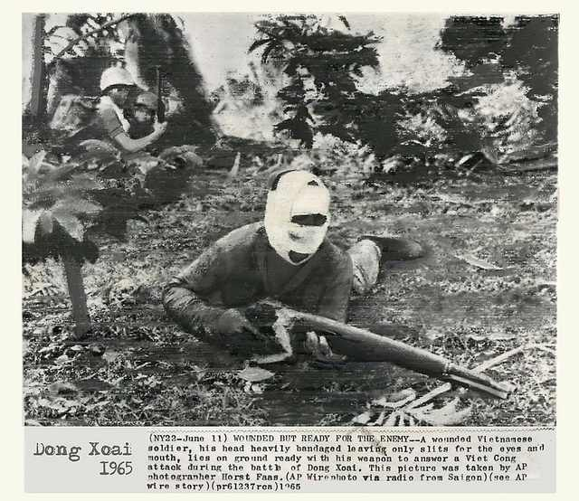
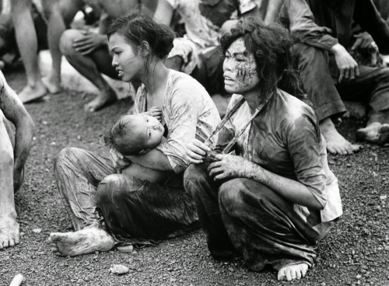
Battle of Dong Xoai
Viet Cong vs. S. Vietnam and U.S
Viet Cong wins once again when the Viet Cong ambushed and captured the U.S Special forces camp in Dong Xoai.
U.S Tries to fight back but they were too confused and under prepared.

Slide 13
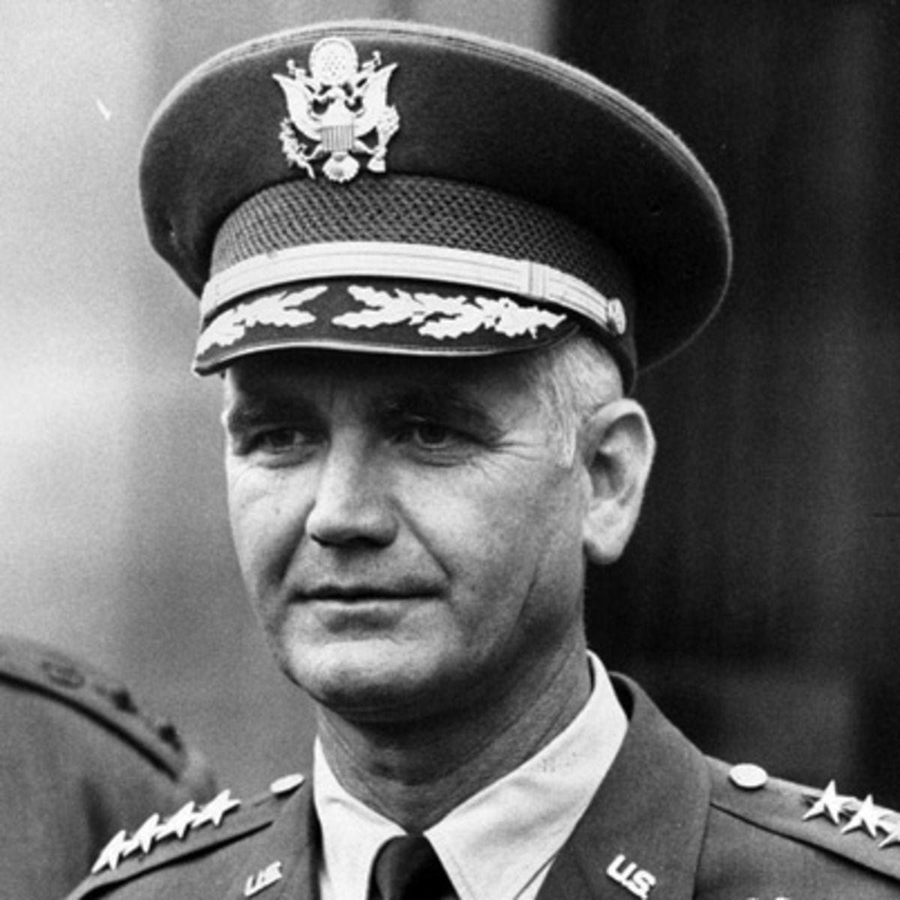
Westmore’s Three Point Plan
After their second loss in a row, morale plummeted for the U.S and South Vietnam soldiers/nations. Desertion rates increased.
Westmore’s Plan:
Phase 1: Commitment of as much U.S force necessary to stop the losing streak and win.
Phase 2: U.S and allied forces mount major offensive actions to destroy guerilla and organized enemy forces
Phase 3: If we haven’t won yet, and extra year is to be taken to have another chance.
This plan does not work at all.

Slide 14
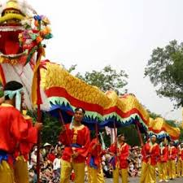
Tet
Vietnamese New Year, most important tradition/holiday in Vietnamese culture.

Slide 15
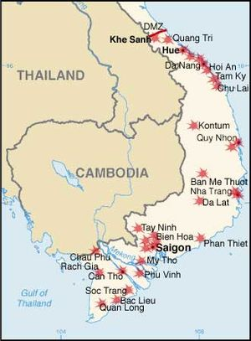
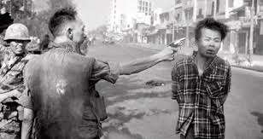
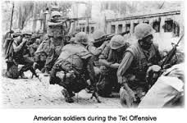
Tet Offensive (Jan. 31st 1968)
Largest battle of the war.
Broke the truce that traditionally accompanied the Text, in hopes of a national uprising.
1,000 Americans, 1,400 civilians, 3,200 Viet Cong died.
Significant victory for the Viet Cong allied forces because it showed that the Viet Cong is a real force to be reckoned with.

Slide 16
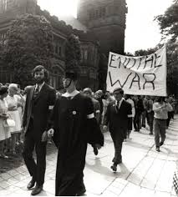
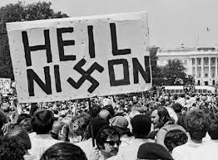
Cambodia and Laos
N. Vietnam invaded Cambodia in 1970, U.S and ARVN (South Vietnamese Army) forces invaded Cambodia to attack NVA and Viet Cong bases.
Invasion sparked protest as new president Nixon had promised to stay out of Vietnam.
Four students were killed by National Guards at Kent State University during a protest which provoked and started the public outrage at the U.S from all over North America.

Slide 17
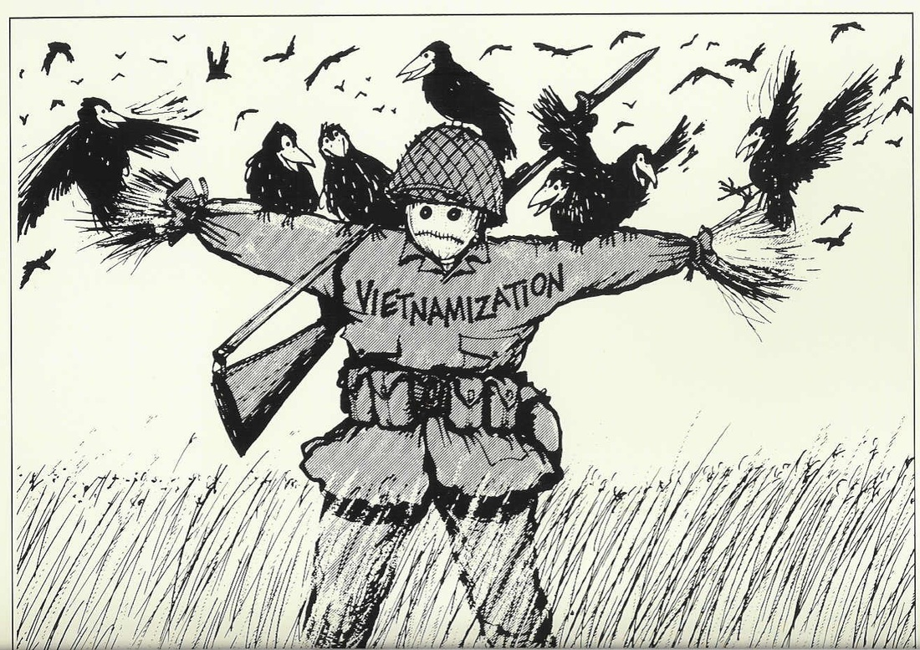
Vietnamization
Policy of Richard Nixon administration to end U.S involvement in the Vietnam War. Doesn’t work.

Slide 18
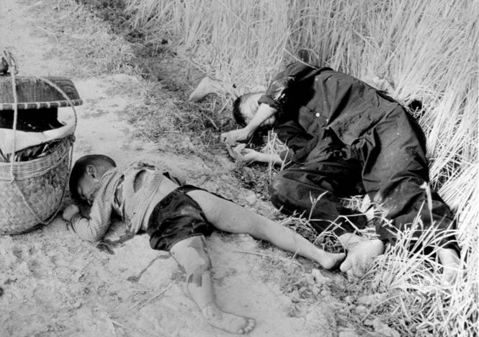
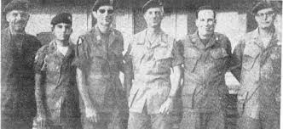
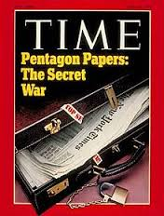
Causes Of Outrage
My Lai Massacre- U.S Army platoon raped and killed civilians in 1968. 504 killed, many more injured.
Green Beret Affair 1969- Eight special forces soldiers were arrested for murder of a suspected double agent.
1971 Pentagon Paper leak- a leak of top secret history of U.S Involvement in Vietnam. Lies are brought to the forefront.

Slide 19
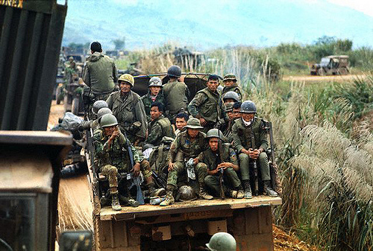
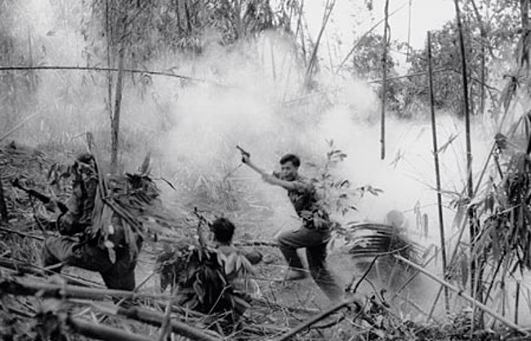
ARVN Failure 1979
Operation Lam Son 719, aimed at cutting the Ho Chi Minh trail in Laos.
After meeting resistance, ARVN escaped in mass confusion, and tried to escape on U.S Helicopters.
Half of ARVN troops involved were captured or killed.
After this failure, the last remaining American Troops were withdrawn at the end of March 1973.

Slide 20
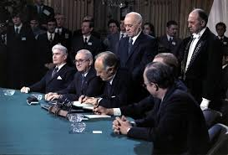
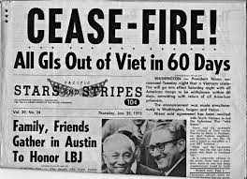
Paris Peace Accords
Signed on 27th Jan. 1973
Ceasefire declared across N. And S. Vietnam.
North American war prisoners released.
Proved to be the only one of the Paris Agreements which was fully carried out.

Slide 21
Teachable Terms for Aftermath slide
Reeducation Camps- prison camps operated by the Communist government of Vietnam following the end of the Vietnam War. Most prisoners were inducted with no trials or former criminal charges. 165,000 people died, 1-2.5 million people imprisoned.
Killing Fields- locations of which anyone associated with South Vietnam were killed and buried in mass graves. Estimated 1.5 million people killed.

Slide 22
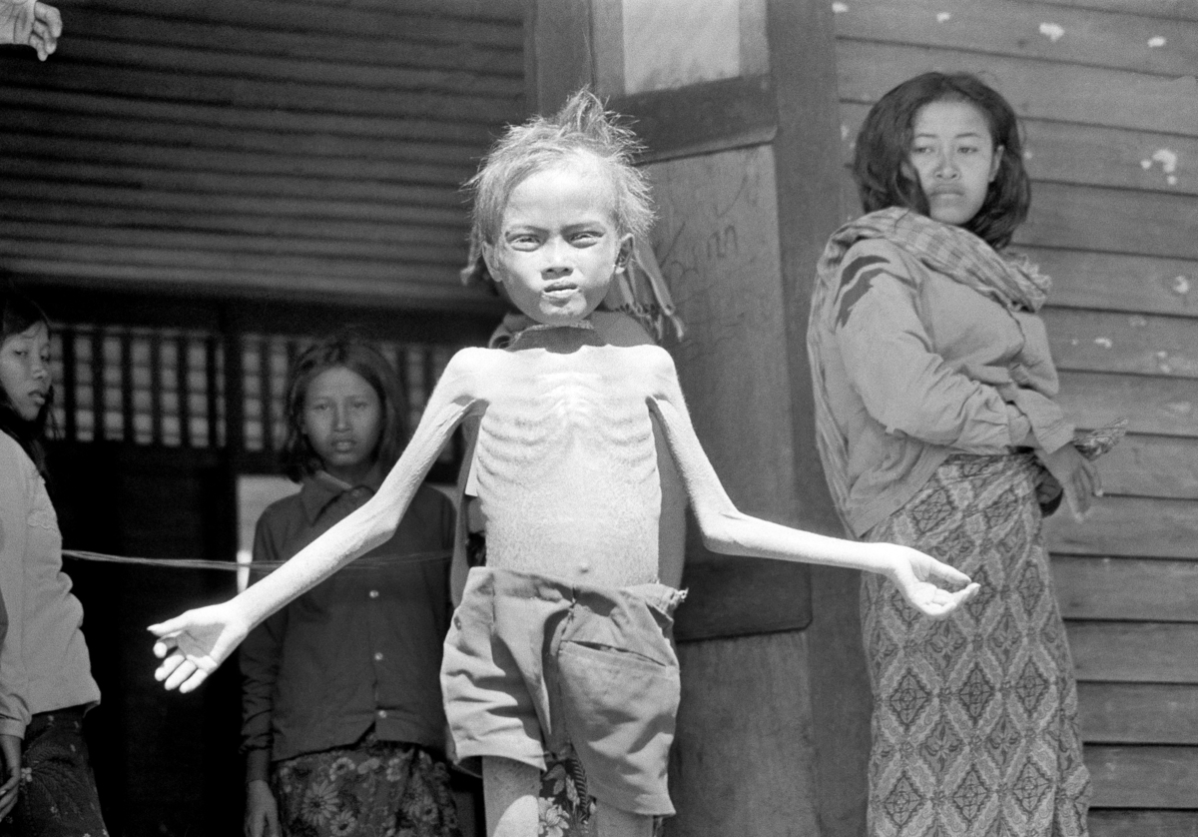
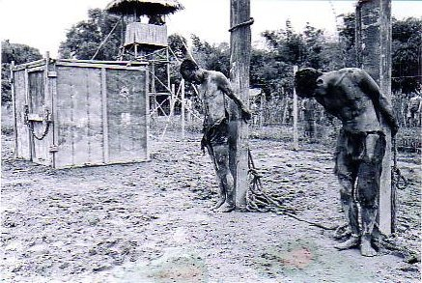
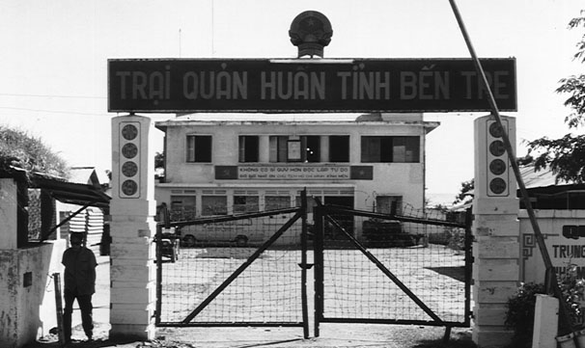
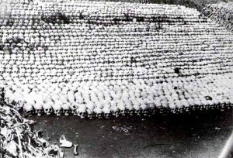
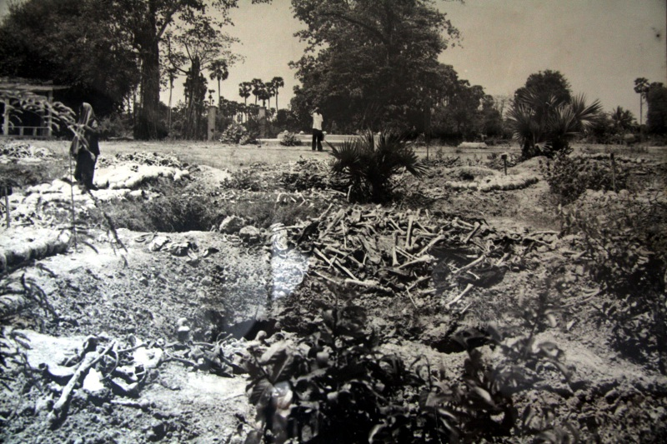
After Math
On 2nd July 1976, South and North Vietnam merged to form the socialist Republic of Vietnam.
1-2.5 Million people sent to reeducation camps.
Capital of Cambodia, Phnom Penh fell to communist Khmer Rouge. They would kill 1-3 million Cambodians in the killing fields. Impact of KR contributed to a 1979 famine in Cambodian, which killed 300,000 additional people.
Over 3 million people left Vietnam, Laos, Cambodia in the refugee crisis. Most asian countries unwilling to accept the refugees.
An estimated 1.2 million refugees resettled in U.S Canada resettled over 500,000.

Slide 23
Test Questions
#1- What were 2 causes of public outrage because of the Vietnam war?
#2- Why was the Tet Offensive significant?
#3- What would describe Canada’s role in the war?
significant
non-existent
non-belligerent
destructive

