Slide 1
Holocaust 2

Slide 2
What is: Holocaust?
Killing of 6,000,000 Jews
Trying to enact genocide on the Jewish people
By 1938 The German people had seen enough propaganda that they were ready for their “Dominant race (Germans) to destroy the weaker race (Jews)”
*Warning Some Pictures are Disturbing*

Slide 3
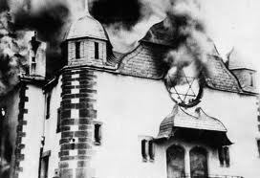
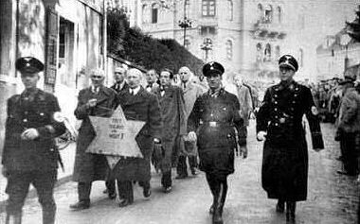
Kristallnachte. (Night of broken glass)

Slide 4
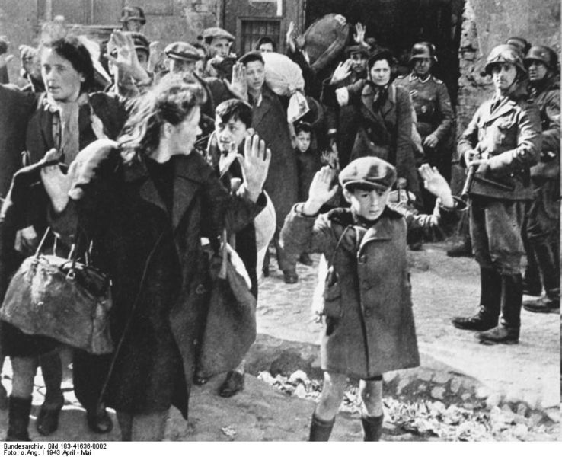

Slide 5
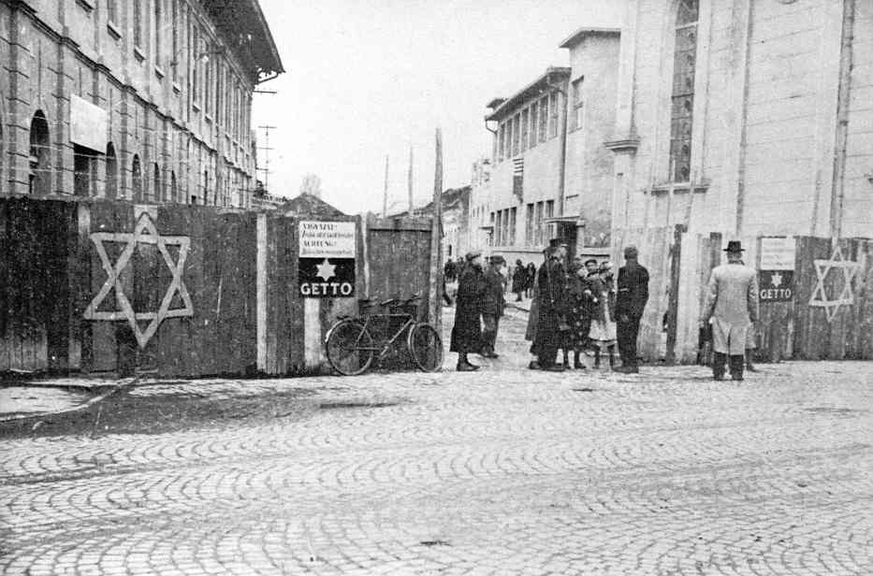
German Ghetto 1938

Slide 6
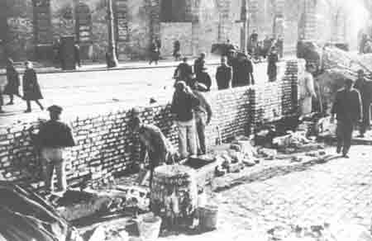
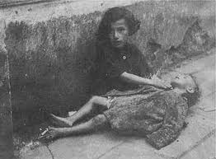
Warsaw Ghetto 1940

Slide 7
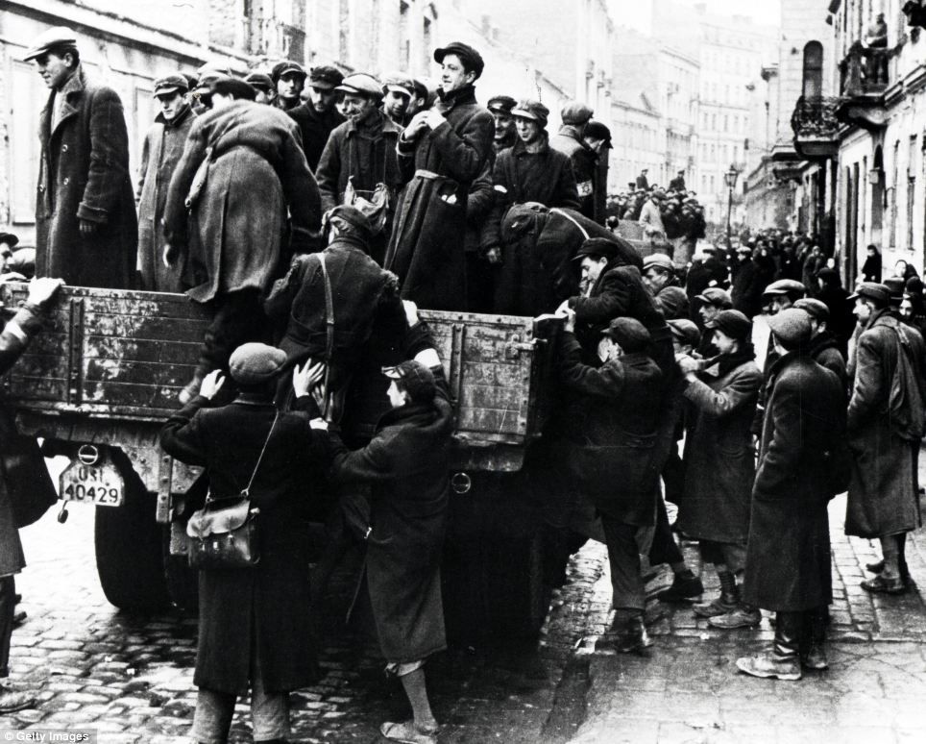
Being moved from the Ghetto
40,000 Ghettos across Europe.
One in every large city.
Jews were taken to these Ghettos. If they refused they were sent to prison.

Slide 8
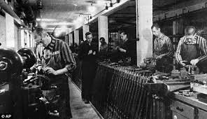
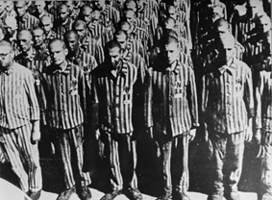
Labor Camps

Slide 9
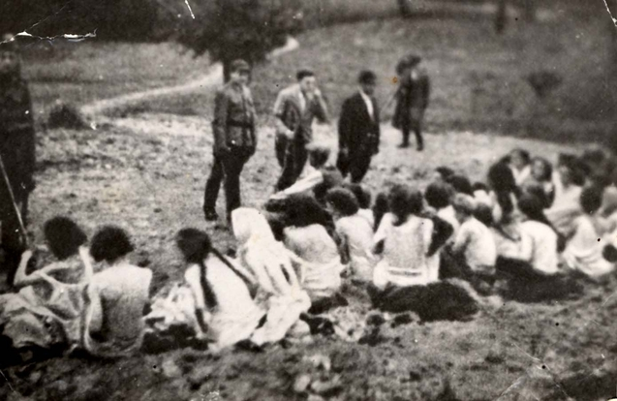
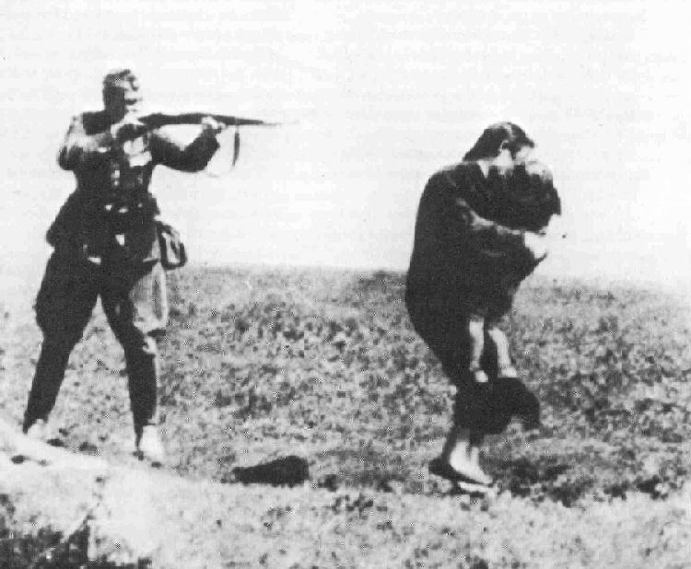
Final Solution 1942
Killing every Jew on the Earth

Slide 10
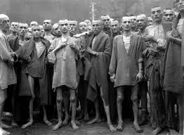
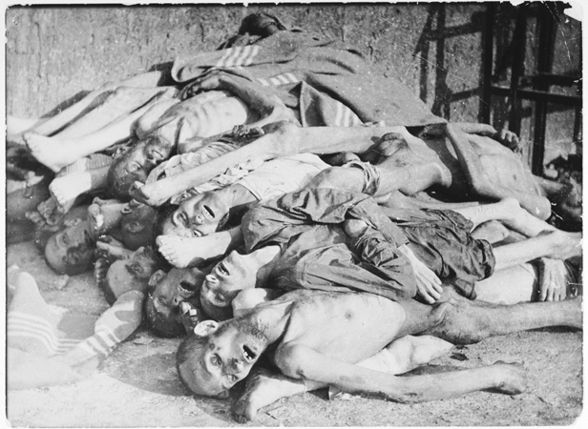
Concentration Camps

Slide 11
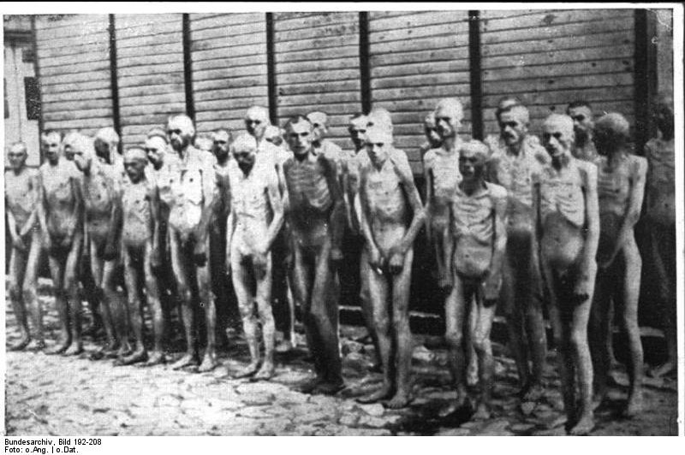

Slide 12
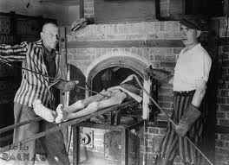
Jews taking care of their own dead

Slide 13
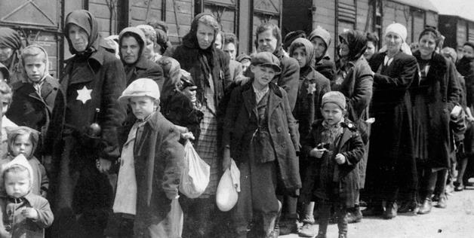
For Women Children and Old People

Slide 14
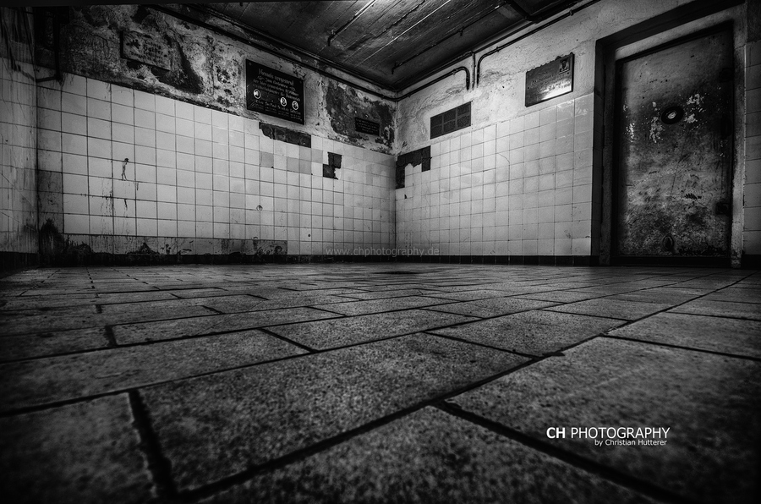
Gas Chambers

Slide 15
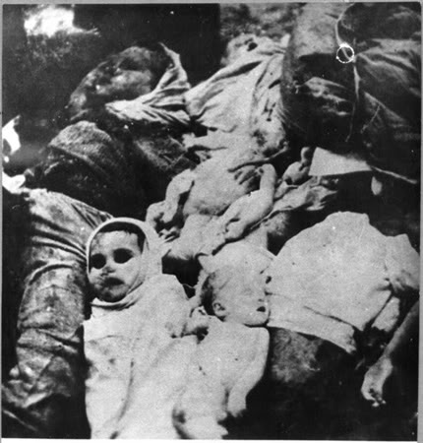
Death Camps
6 Death camps in total.
Most them are in present day Poland.
Bodies were killed quickly and burned

Slide 16
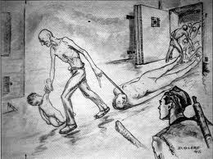

Slide 17
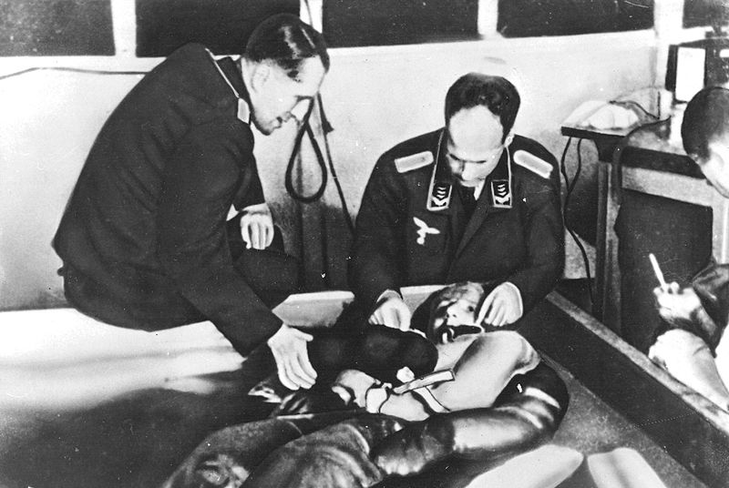

Slide 18
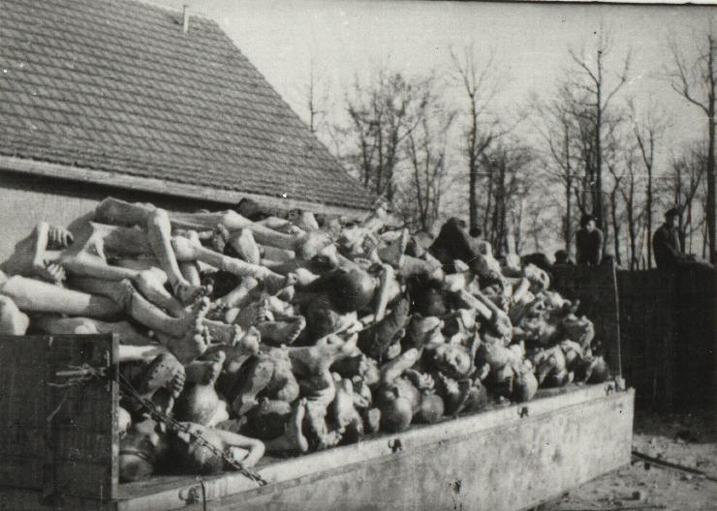

Slide 19
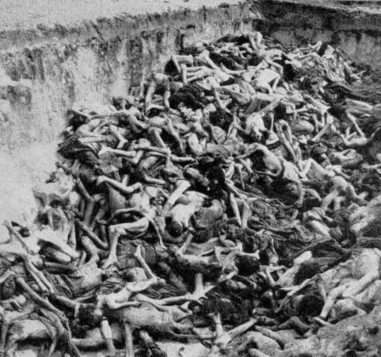

Slide 20
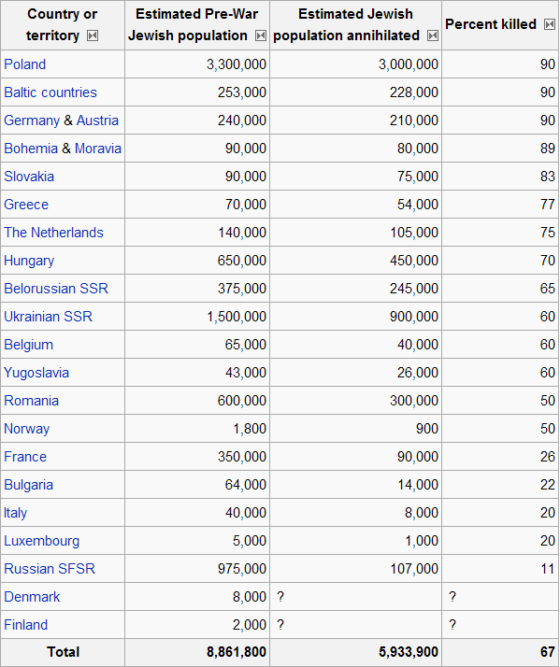

Slide 21
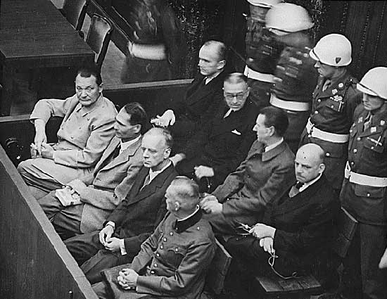
Nuremberg Trials

