Slide 1
Holocaust

Slide 2
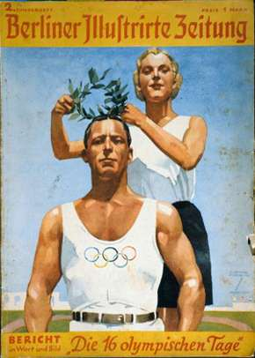
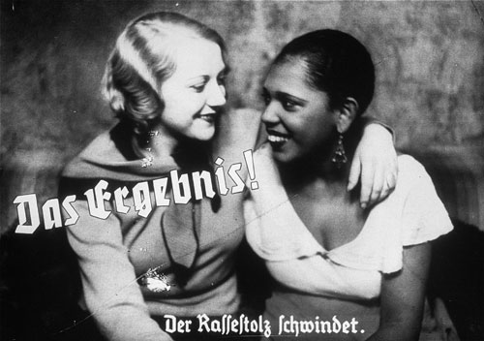
What is a Nazi
Nazi believes some people are superior
Germans
Scandinavians
Blonde Hair Blue Eyes
Nazi believes some races are wicked and useless.
Jews
Slavs
Blacks
Gypsies

Slide 3
Evolution & Naziism
FACT Evolution is true.
FACT Humans evolve over time into something better.
FACT Some humans are more evolved than others.
FACT Weaker races will be destroyed in the process of natural selection.
FACT Natural selection should eliminate the mentally and physically disabled.
FACT Killing Jews, Gays and Handicaps simply speeds up evolution.

Slide 4
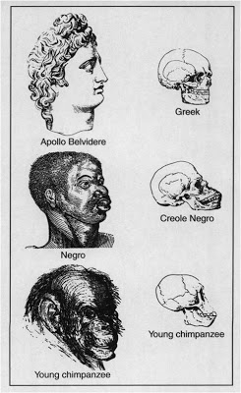
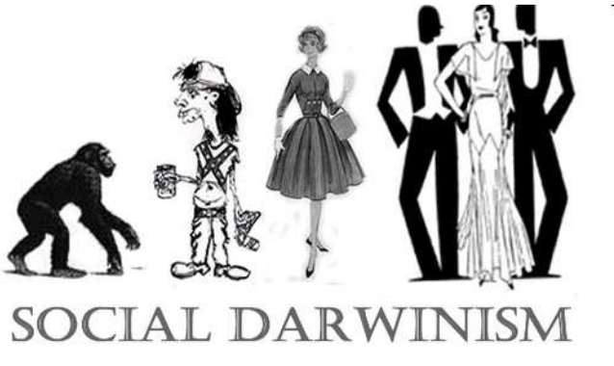
Social Darwinism
In a society/country the rules of evolution should apply.
Peoples ideas are either evolved or not.
Peoples cultures are evolved or not.

Slide 5
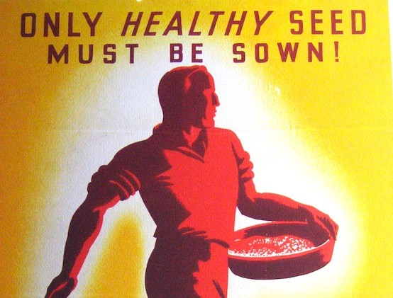
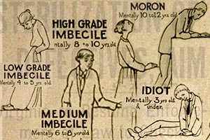
Eugenics (still practiced today)
Based on genetic theory, certain genes are superior. You breed the strong genes you sterilize weak genes.
Strong Genes
IQ testing
Physical Form
Genetic Traits
Cultural Ideals

Slide 6
The Facts that People Don’t Like
FACT Hitler’s ideas and evolution are linked.
FACT If evolution is true you cannot judge Hitler as morally wrong.

Slide 7
Nazi Rally

Slide 8
What is a Nazi
One Leader Fuhrer or “Leader/Father” controls everything.
Everyone works together for the benefit of the nation and the leader.
More land is required for the dominant culture to grow.
“War is required to unite the people.” blame a weak culture or create a common enemy.

Slide 9
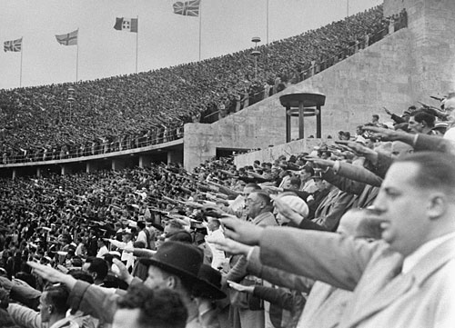
Use of Olympics
Germans as a superior race would perform better at the Olympics

Slide 10
Dictators are Common countries once again believing they are superior to others

Slide 11
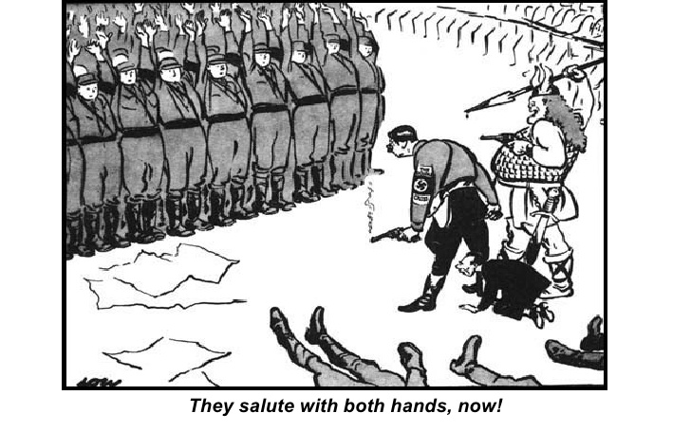
Night of the Long Knives
Any political leader who disagrees with Nazism is killed or sent to a concentration camp.

Slide 12
Antisemitism
Antisemitism = Hating Jews
Germans blame the Jews for Treaty of Versailles
Germans blame Jews for stock market crash
Germans blame Jews for the “dirty thirties”

Slide 13
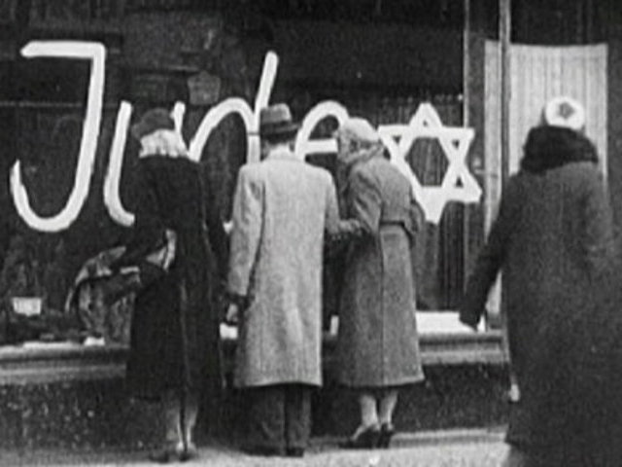
What is a Nazi
Only 10% were Nazis
The other 90% were willing to look the other way.

Slide 14
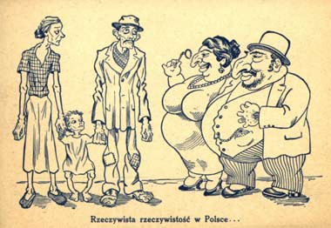
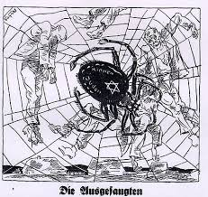
German and Polish Cartoon

Slide 15
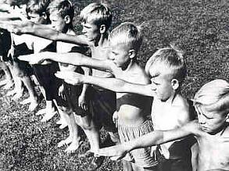
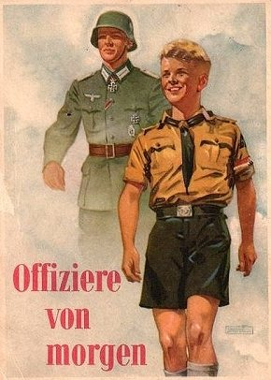
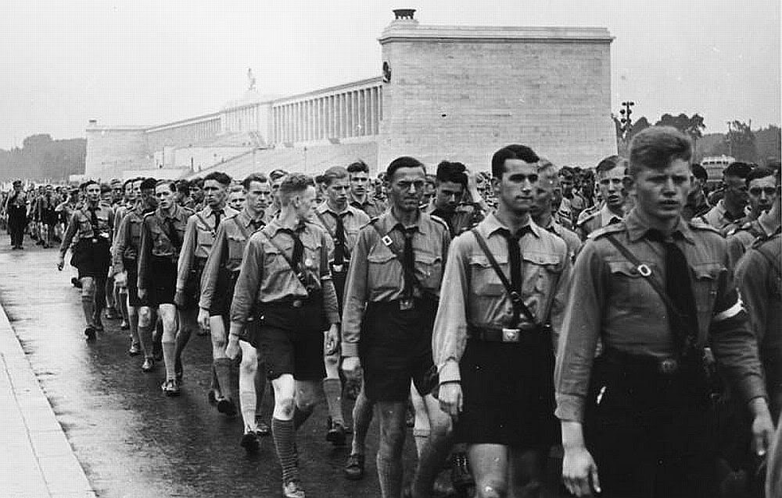
Hitler Youth

Slide 16
Series of Laws
1933. Nazis don’t allow people to buy things from Jews.
1935 Nuremberg Laws. Jews are no longer considered Germans Germans are not allowed to marry Jews.
1935-38 Jews not allowed in parks, not allowed to have government jobs etc.

Slide 17
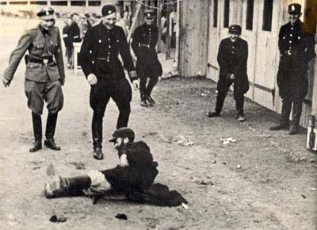
Jew being Tormented

Slide 18
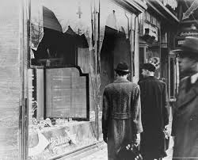
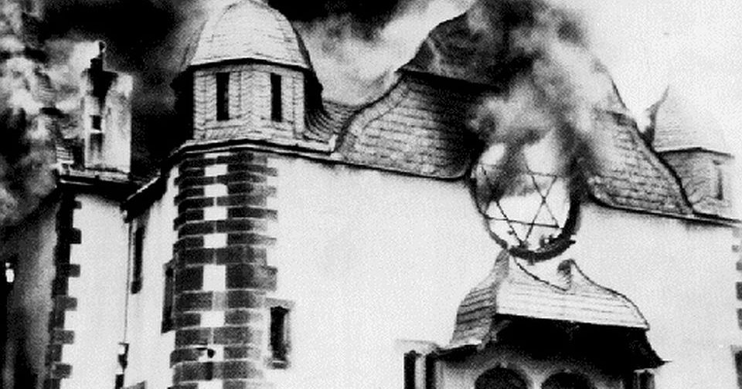
Kristellnacht (night of broken glass)
1938

