Slide 1
Unit #1 Christianity to Conversion of Rome
The First 6 Centuries

Slide 2
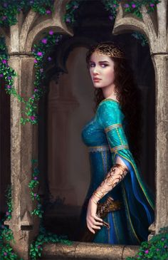
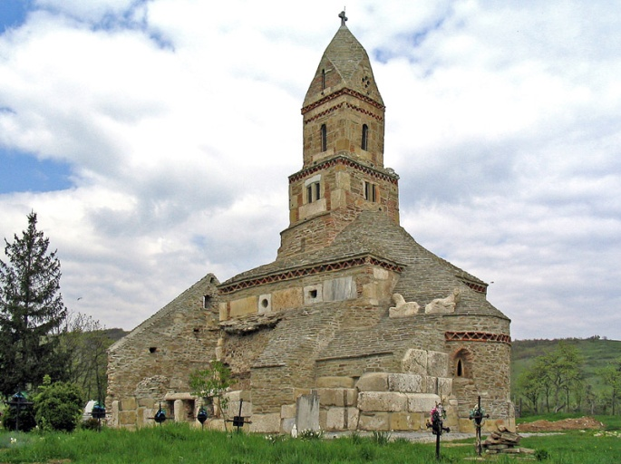
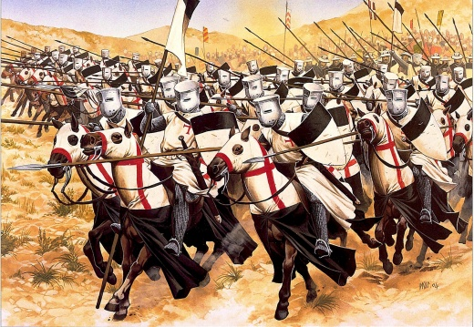
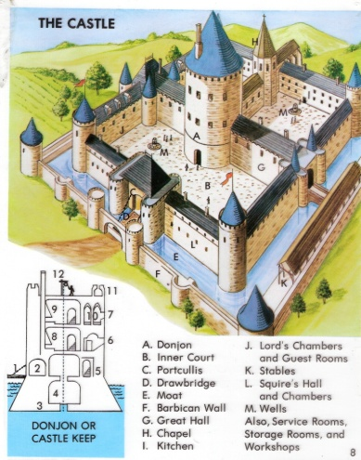
What we are Covering
We are covering the years 500-1500.
This time is called the Middle Ages or medieval times, or sometimes the Dark Ages.

Slide 3
How Centuries Work
Talk to a Friend
1800’s = 18’th century
1800’s = 17’th century
1800’s = 19’th century
1800’s = 118’th Century
How Come?

Slide 4
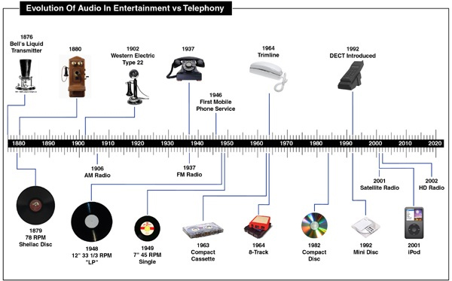
Build a Timeline
Two papers long stapled and taped together.
Each century has to be marked with even spacing
Titled
Lines

Slide 5
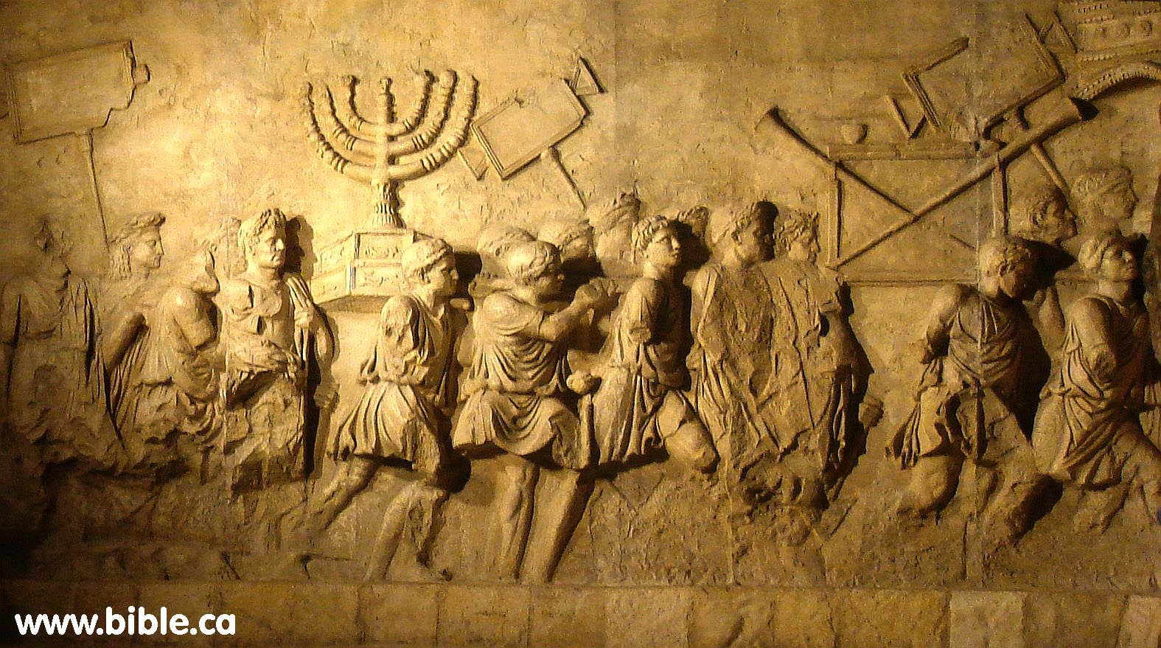
The Death of Jesus The Fall of the Temple
Jesus’ crazy prophecy that got him killed. (Mathew 24)

Slide 6
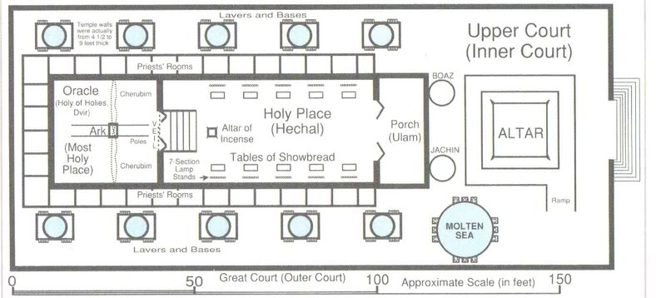
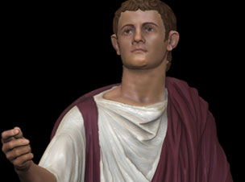
Jewish Persecution
Persecution of the Jews had started even when Jesus was alive.
Caligula defiled the temple shortly after Jesus’ death.

Slide 7
It would be fulfilled 70AD By Emperor Titus

Slide 8
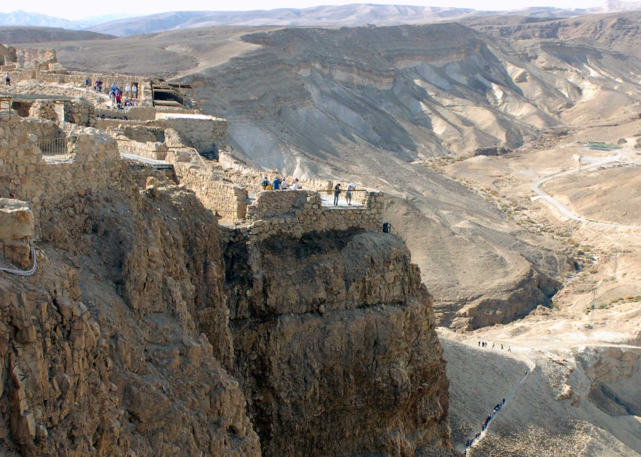
Jewish Zealots flee to Masada
Jews begin to fight against Romans. Titus responds by killing and destroying Jerusalem
Small group of zealots were most successful in resisting them.
To the Romans they would have been seen as terrorists.
They took over one of the most defensible forts in the western world.

Slide 9
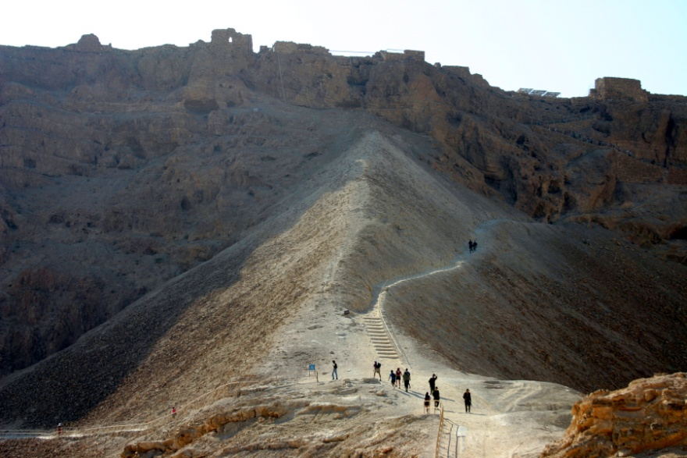
The Romans Eradicate the Zealots

Slide 10
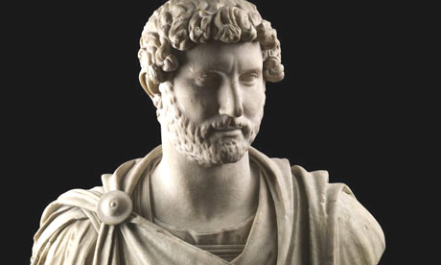
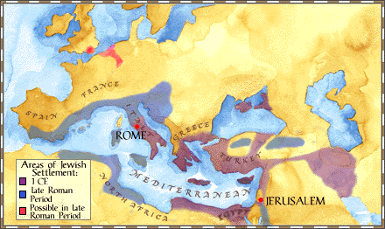
Emperor Hadrian
Emperor Hadrian would rebuild Jerusalem as a Roman city dedicated to the Roman Gods.
No Jews were allowed in this New Jerusalem
Sometimes this is referred to as the Diaspora.

Slide 11
Why is this Important
Jews have no religious center, no way of practicing their faith.
Romans are having difficulties keeping order in Israel.
Hatred towards Jews begins. This hatred still exists today and is called anti-Semitism.
Jews are gradually moving away and scatter through Europe.

Slide 12
While the Jews are being dispersed Christianity expands

Slide 13
What you need to know about Rome when it takes over.
Taxes
Religion
Roads and Buildings
Military
Technology

Slide 14
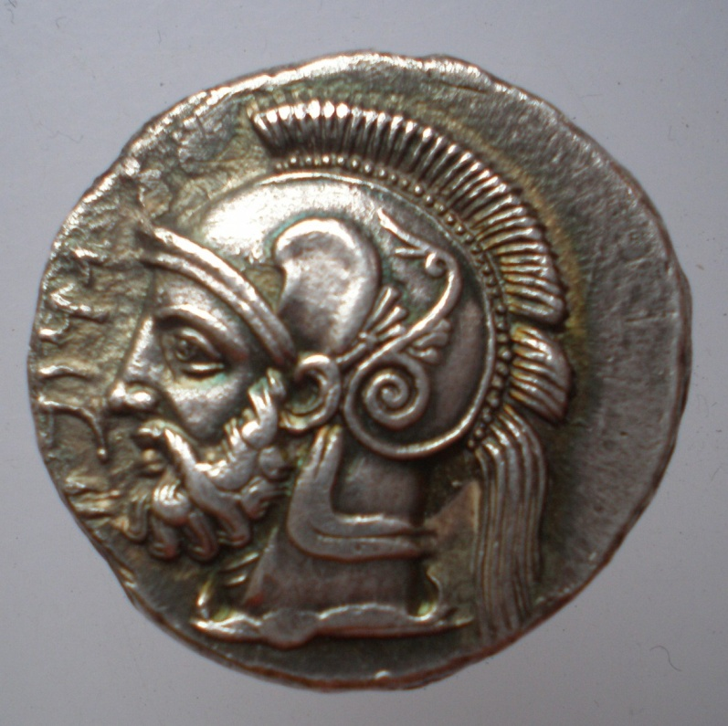
Roman Taxes
Roman needed a way to pay for the riches that it offered.
What could Rome offer it citizens?
(Short role play)
Taxes were seen as the best way to pay for the system.
By the time of Jesus, taxing was getting harsh because Rome was having financial difficulties
The Jews were constantly revolting and needing lots of soldier supervision. This made Israel and Palestine more troublesome to Rome than profitable. Perhaps this is one of the reasons the Romans sacked the temple.

Slide 15
Roman Religion
Romans were tolerant of *most* religion, as long as that religion did not speak anything bad about Rome. (China is the same today)
Emperor worship was standard. Along with planet worship
Romans had all kinds of Gods and nobody really cared who you chose to worship.
Jews and Christians were Monotheistic and therefore posed a problem

Slide 16
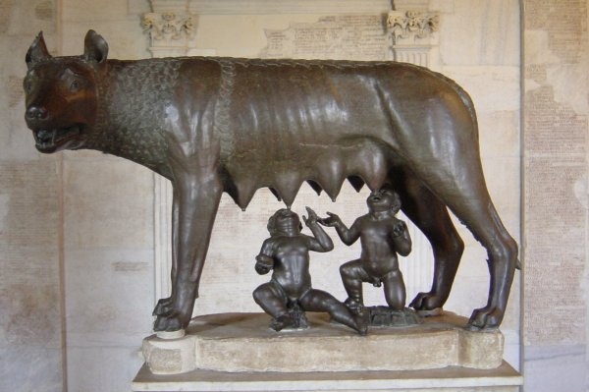
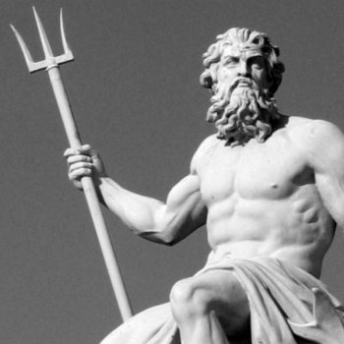
Grab-Bag of Religion

Slide 17
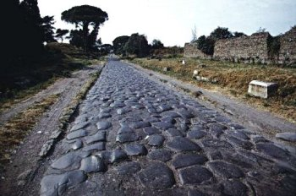
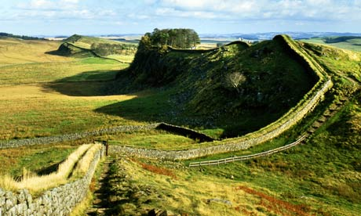
Roman Roads and Buildings

Slide 18
Roman Military

Slide 19
Technology
Numerals, writing, currency
Aqueducts and sanitation
Court systems
Security and Policing
Sculpture and Art

Slide 20
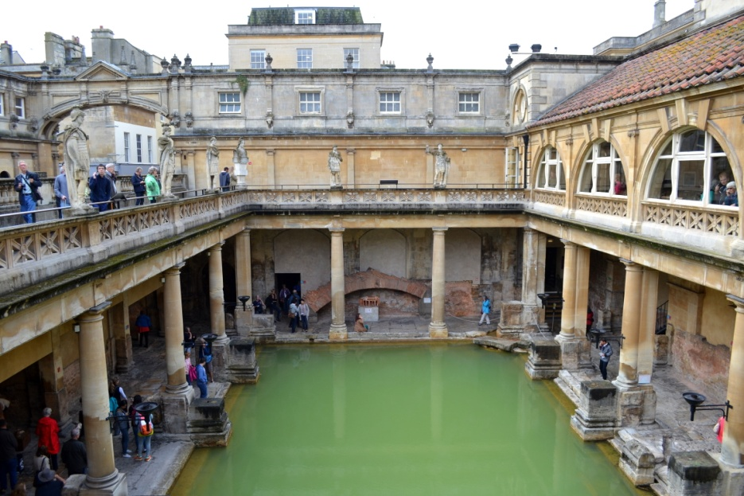
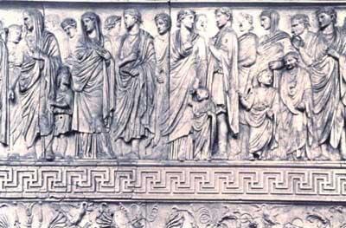
IMPORTANT Rome is offering its advances to its subjects

Slide 21
Reasons for The Fall of Rome
Reason #1 Lechery
Romans1:1-9
Jeremiah 50 23-26
Revelation 17:5, 18:1-3

Slide 22
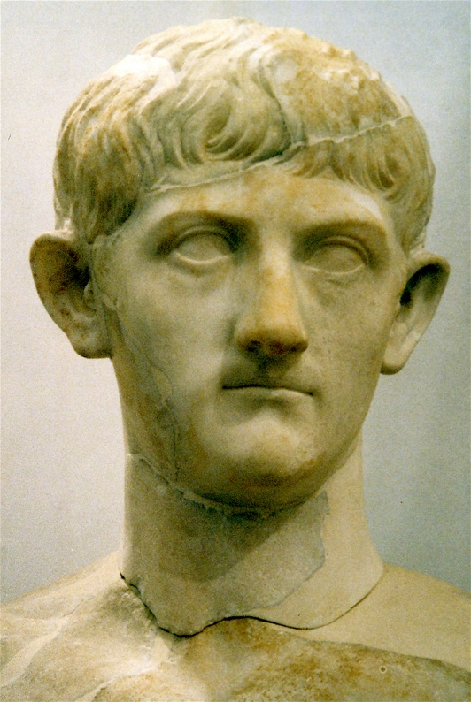
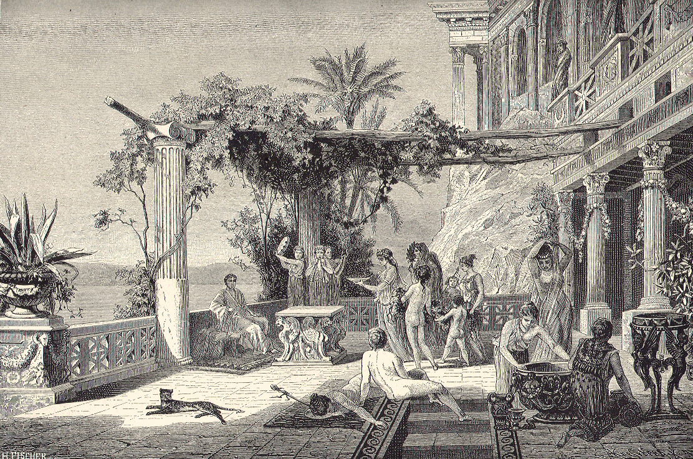
Tiberius
Secluded himself in his pleasure palace.
Involved Very Young Children and animals etc.
Performances of pornographic plays.
Forgot to run the empire

Slide 23
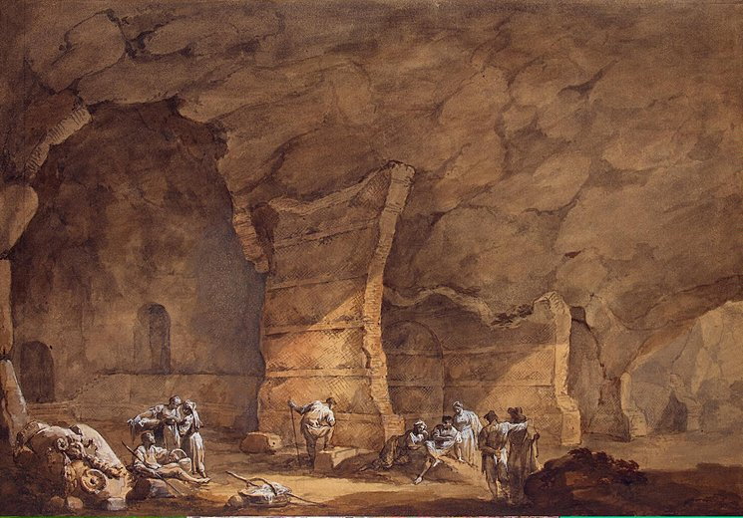
Tiberius the Monster
Skin broke out in pussy boils he became obese
He devoted his palace Grotto towards torture devices which he would watch for amusement.
Nobody liked Tiberius
Fearing for his job he started six years of executing anyone who was in power.
He would end up murdering thousands of the most able people.
Finally someone was able to murder him before he was able to execute anyone else.

Slide 24
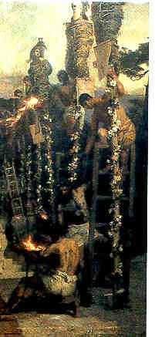
Nero’s violence
Killed his brother and mother as a teenager.
Beat his wife to death.
Ordered people to kill themselves (lots)
Murdered people on the streets for fun.
Tried to kill ALL Christians

Slide 25
Nero’s Moral Depravity (insane)
Incestuous relation with his mom whom he killed.
Castrated boys. Tried to marry one.
Married his Cousin.
Burned his capital city to the ground and played music while it burned.
Was a terrible singer and actor but went to the coliseum to perform where paid attendants told him how good he was.
Publicly display gigantic orgies.

Slide 26
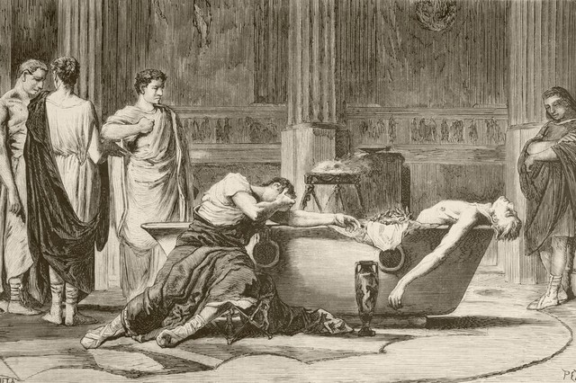
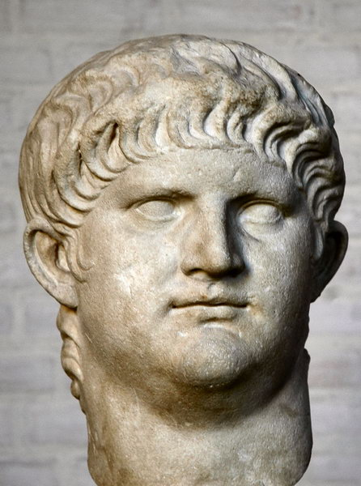
Nero

Slide 27
Emperor Commodus the most foul
Said to be more depraved than Nero.
Went into the gladiator ring where he fought 735 times.
Enjoyed dressing like a woman.
Enjoyed disfiguring people so he could mock them.
Erected statues of himself and demanded worship.
Could care less about what was happening to the Roman empire.

Slide 28
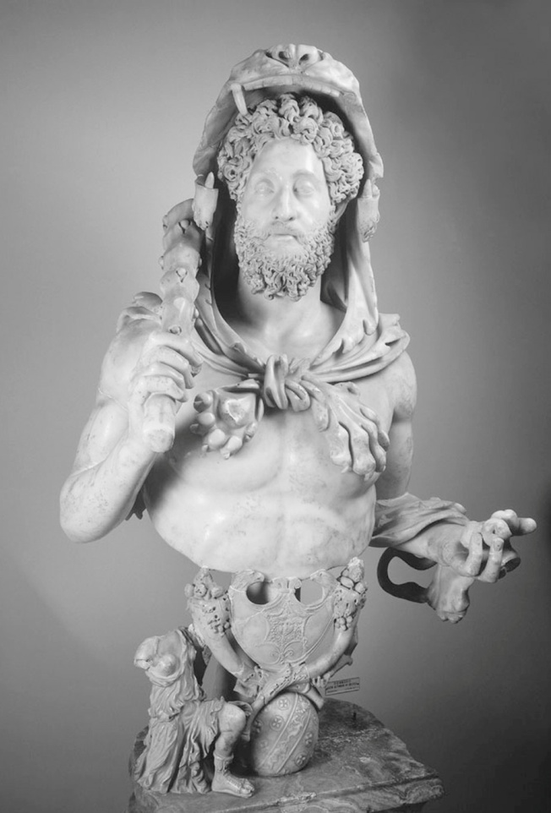
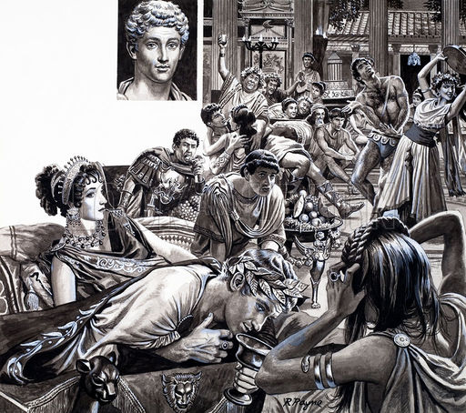
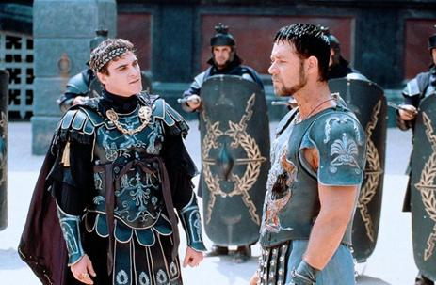
Emperor Commodus

Slide 29
Question for Discussion
Craze for sport.
Craze for sex.
Consumed by pleasure
Loss of faith in God
Does God still overthrow countries and governments that are engaging in debauchery and licentiousness?
Are North America and Europe in danger of God’s wrath?

Slide 30
The Fall of Rome
Reason #2 Economics
Size
Expenses
Inflation

Slide 31
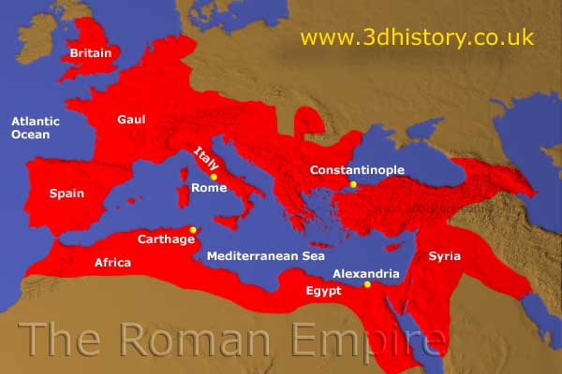
The Size
The empire was so big it was getting difficult to organize.
It was also very expensive to administrate.
The super-cool parties and fun and games were starting to get very expensive.

Slide 32
The Budget does not Balance
Rome keeps building roads and buildings and hiring workers but cannot pay for them.

Slide 33
What NOT to do when you’re an Emperor facing bankruptcy.
Do NOT Print more money!
Do NOT hire more slaves to work for free.
DO NOT hire a “cheap” foreign military.
DO NOT burn Rome to the ground and have lavish and lecherous parties and kill all your smartest people and then go for a holiday in Capri.

Slide 34
The Fall of Rome
Reason #3 Corruption
Senate Scandals
Praetorian Guard

Slide 35
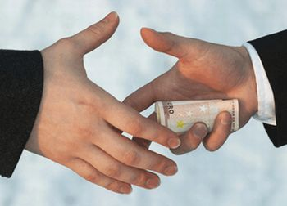
What is corruption?
Paying someone to vote in your favor.
Paying someone to look the other way.

Slide 36
The Roman Senate’s Corruption
The government in charge of keeping financial order.
Bribery into their positions of authority was happening constantly
Authorities were being bribed by contractors.
Laws were being made with bribe money.
They were trying to run the country with bribe money.
They assassinated Emperors with bribe money.
The emperor was assassinating them with bribe money.

Slide 37
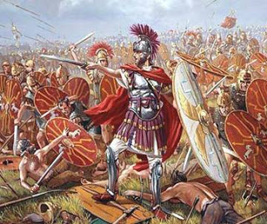
The Praetorian Guard
The emperors personal army.

Slide 38
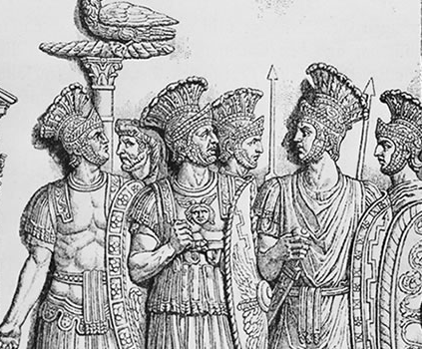
Praetorian Guard’s Corruption
They policed the city of Rome
They protected the Emperor
They did spying and assassinations.
Question: If you were the Emperors only line of defense, do you serve the Emperor or does the Emperor serve you?

Slide 40
The Fall of Rome
Reason #4 Barbarians

Slide 41
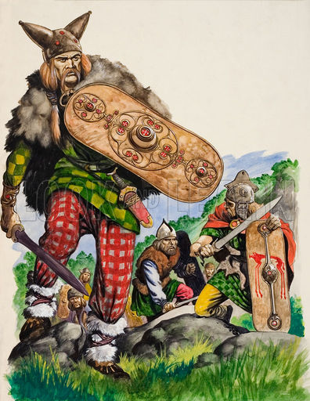
Anglo Saxons and Celts

Slide 42
Huns

Slide 43
Visigoths

Slide 44
Vandals

Slide 45
The Goths (Osogoths)

Slide 46
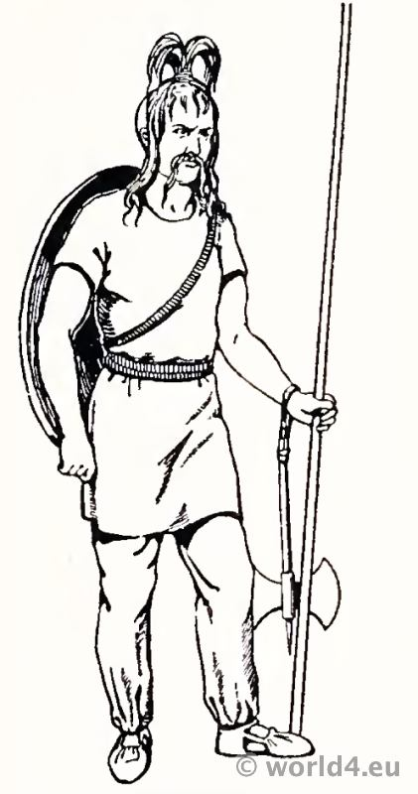
The Franks

Slide 47
The Invaders

Slide 48
The Fall of Rome
Reason #5 Religion & Schism

Slide 49
Overview on the Problems
Caesars were bad guys.
Running into money problems
The Government system has become corrupt.
Barbarians are attacking everywhere.
SOLUTION????

Slide 50
Divide the Empire

Slide 51
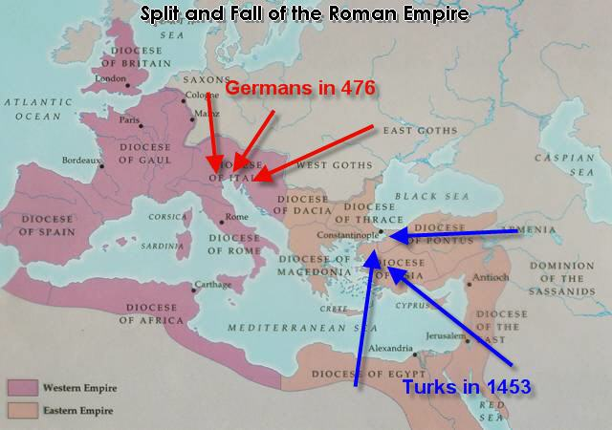
Solution Explained
At first they would call the two Empires Eastern Roman, and Western Roman.
Later they would call them Holy Roman and Byzantine.
The Holy Roman Empire would be defeated first by the Vandals and later by the Visogoths.
The Byzantine empire would survive until the crusades.

Slide 52
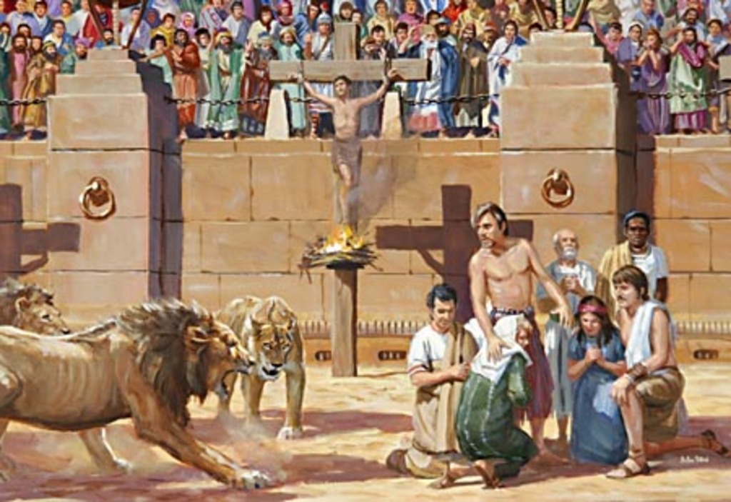
Rome had traditionally persecuted Christians.
They would not worship Caesar.
They would not concede that Rome was the highest power.
They would not tolerate other religions.

Slide 53
Rome Becomes Christian

Slide 54
Council of Nicea
We believe in one God the Father Almighty, Maker of all things visible and invisible; and in one Lord Jesus Christ, the only begotten of the Father, that is, of the substance of the Father,God of God, light of light, true God of true God, begotten not made, of the same substance with the Father through whom all things were made both in heaven and on earth; who for us men and our salvation descended, was incarnate, and was made man, suffered and rose again the third day, ascended into heaven and cometh to judge the living and the dead. And in the Holy Ghost. Those who say: There was a time when He was not, and He was not before He was begotten; and that He was made out of nothing or who maintain that He is of another substance [than the Father], or that the Son of God is created, or mutable, or subject to change, the Catholic Church anathematizes.

Slide 55
The Solution (mark on timeline)

Slide 56
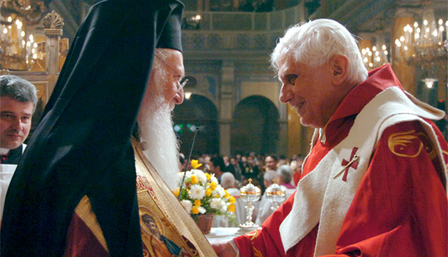
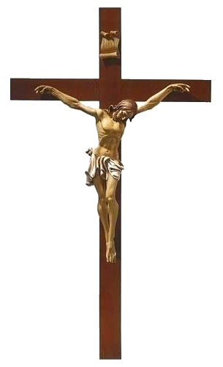
Why is this important.
It eventually divided the church.

Slide 57
Rome Falls 479 Importance of Roman History
Medicine
Education
Roads
Latin
Free Market/Currency
Writing
Christianity’s spread

Slide 58
Sample Test Questions
How did Caligula defile the Jewish temple?
He burned it to the ground.
He did not prevent his angry soldiers from slaughtering Jews
He put a statue of himself in the holiest place.
He tortured Jewish preists.

Slide 59
Sample Test Question
What is the most important influence the Roman Empire had on medieval Europe?
Christianity as the state religion.
Roads
The Latin language
Military inventions

