Slide 1
Government Constitution
Canada’s constitution
3 branches
Complexities of Government

Slide 2
The Canadian Constitution
Canada’s laws made up of 3 parts
BNA (British North America Act)
These laws joined the colonies together confederation
In grade 10 you played confederation games
The unwritten constitution
Laws that have never been put into writing but will never be changed.
For example FPP system and representation by population.
The Supreme court has said these are in fact laws and need to be changed with the consent of Canadians

Slide 3
The Constitution Continued
Charter of Rights and Freedoms
Fundamental Rights
Democratic Rights
Mobility Rights
Legal Rights
Equality Rights
Language Rights

Slide 4
Situations which alter our Constitution
War Measures Act
Canadians have some of their freedoms temporarily suspended.
For example this act was used to “camp” Japanese people and take their property during ww2
Not withstanding Claus
Gives provinces the right to ignore areas of the constitution
For Example Quebec wants a new non-religious law of no religious icons in public places.
Section 2
Section 7-14
Section 15

Slide 5
How to change the constitution
We CAN change the rules that govern Canada by getting :
7 provincial Governments
50% of Canadians
And the Federal Government
To agree to change the rules its called The Amending Formula

Slide 6
The Supreme Court 335-340
The Supreme Court is called in when:
Canada has laws which conflict with the Charter of Rights and freedoms. (Gay rights)
Canadians have rights and freedoms which sometimes violate other peoples rights and freedoms. (Carrying a Sikh knife onto a soccer field)
The government has broken the law. (Senate Scandal)
People suggest changes to the constitution. (NDP)
All other courts cannot figure it out, or the problem keeps deferring to higher courts (First Nation land claims)

Slide 7
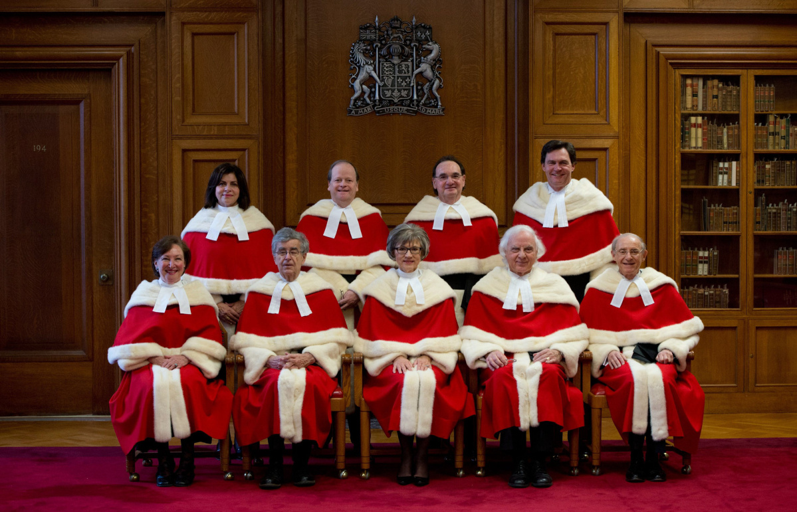
The Supreme Court Justices
Their ability to interpret laws and have final say gives them more power than the PM

Slide 8
3 branches of Government
3 distinct branches of government
(Other teachers emphasize this a great deal)
Legislative Branch
Legislate = make, or create
People in charge of creating laws:
The Queen
Governor General
The House of commons
The senate

Slide 9
3 branches continued
Executive Branch = Execute = Enforce and acts out the laws.
People who make the laws happen after they have been created:
The Queen
The Governor General
Cabinet (including the PM)
Government workers and civil servants

Slide 10
3 Branches Continued
Judicial Branch
Judicial Branch = Judge = In charge of interpreting laws and punishing laws that have been broken.
Kept separate from the other two branches
(We will talk about its structure next unit)

Slide 11
Assignment(s) For Tomorrow
Summarize each section of the constitution and guess why it is important to Canadians.
Worksheet
Mind Map Assignment Due tomorrow.
Go over jeopardy slides and study for Tomorrows test.

