Slide 1
Fear of the Red Menace
by Nathan and Bronté

Slide 2
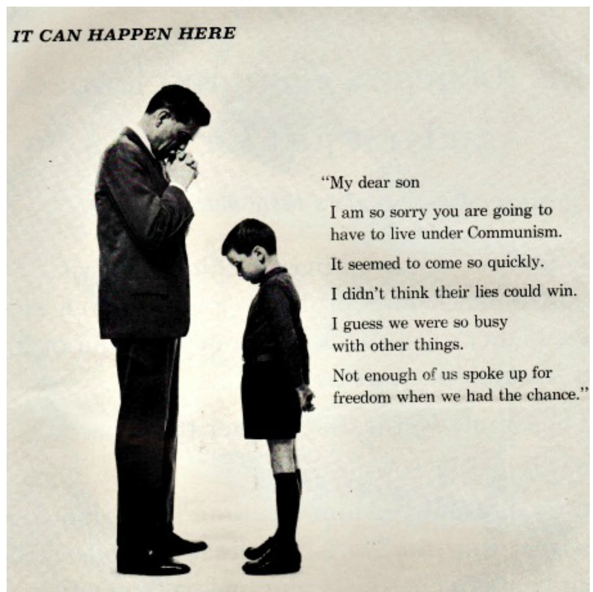
Red Menace/Red Scare
The fear that Communists would infiltrate and take over Capitalist countries

Slide 3
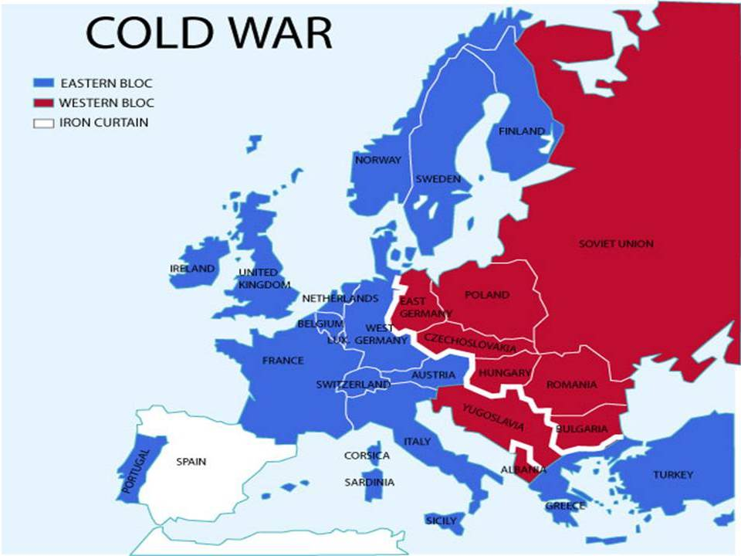
Iron Curtain
The line separating the Capitalist states of the West and the Communist states of the East
No information passed through the iron curtain
This later led to the creation of Spy Rings

Slide 4
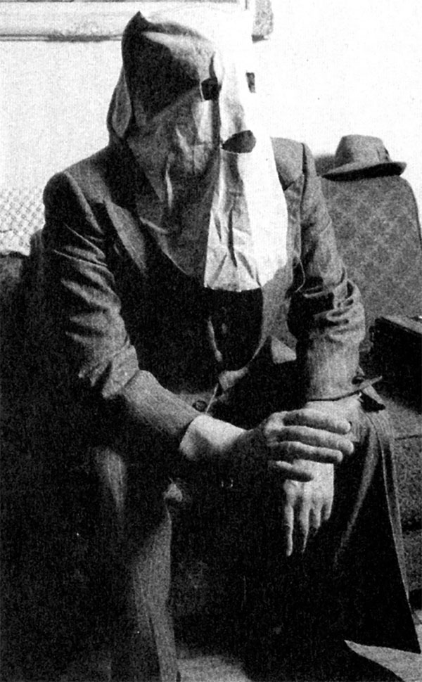
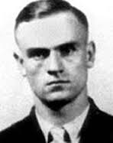
Igor Gouzenko
Ukrainian Spy allied with Canada who decoded Russian messages and revealed Russian secret agents and nuclear plans
Initially took information to RCMP, then Prime Minister, but none believed him
When the documents got out, they sparked the flame of the Red Scare

Slide 5
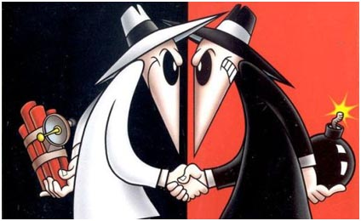
Spy Rings
Agents working with government to infiltrate enemy government to collect enemy information and spread misinformation
Both sides had spies in enemy territories

Slide 6
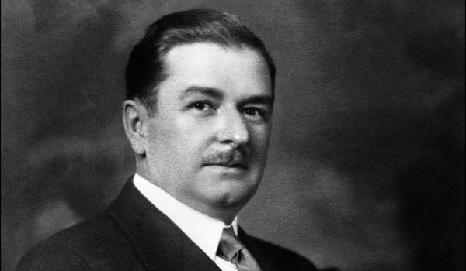
Maurice
Duplessis
Add to teachable term:
Created the Quebec Padlock Laws during the Great Darkness

Slide 7
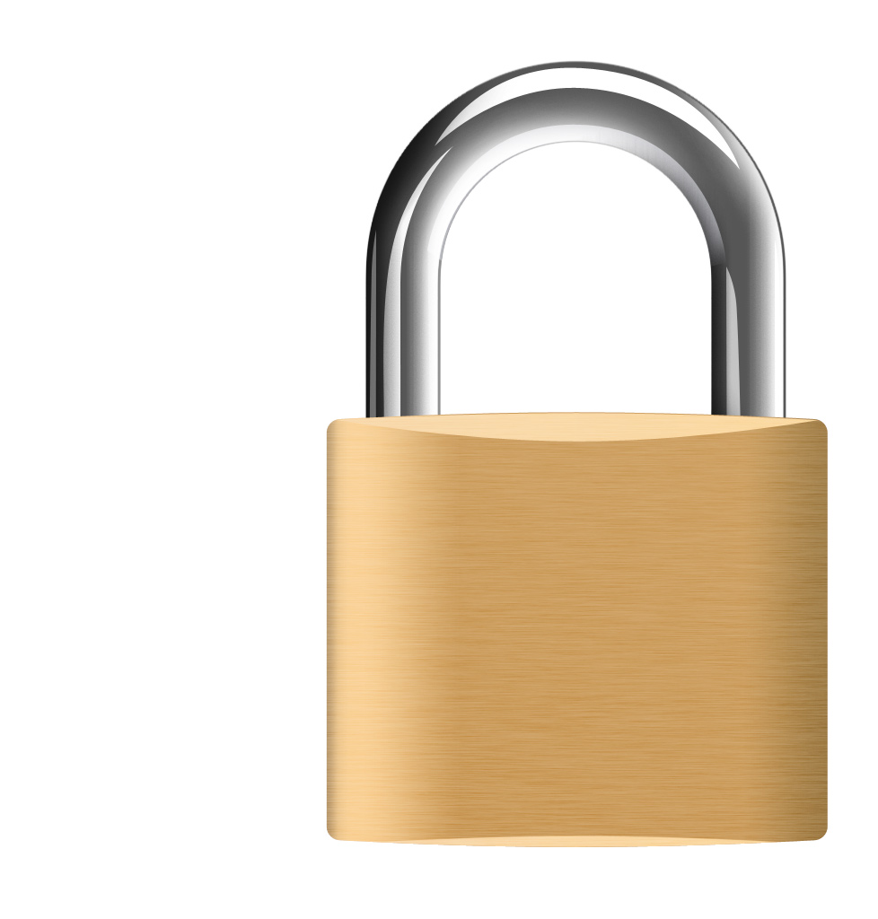
Padlock Laws
Unconstitutional, vaguely worded Quebec law that suspended basic rights in order to catch suspected Communists
Prohibited Communist sympathies and spreading Communist Propaganda
Never defined “Communist” or “Bolshevikist” thought
No padlock law ever became law at Federal Level

Slide 8
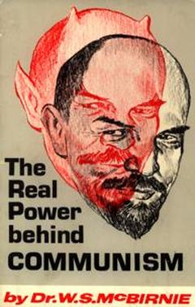
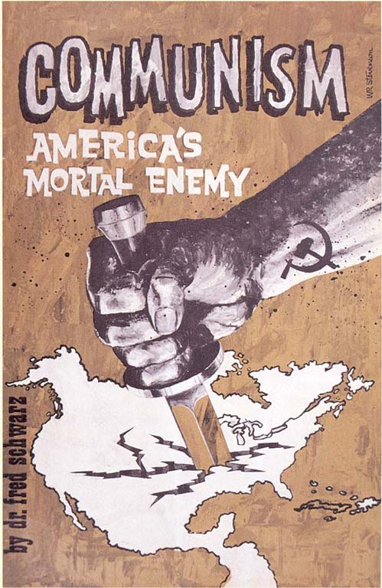
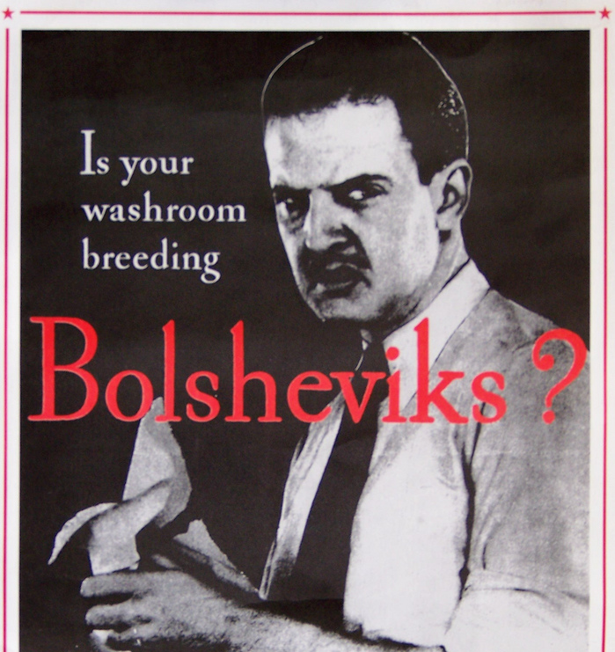
Anti-Communist Propaganda

Slide 9
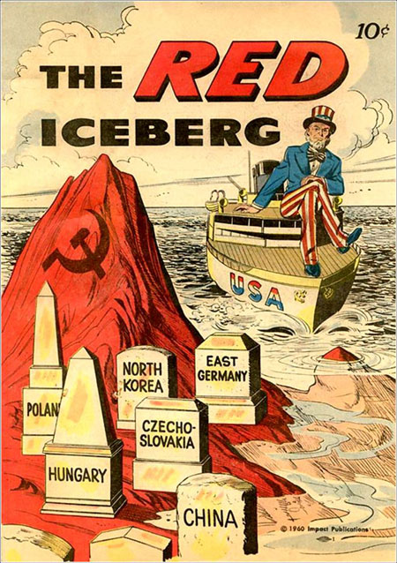
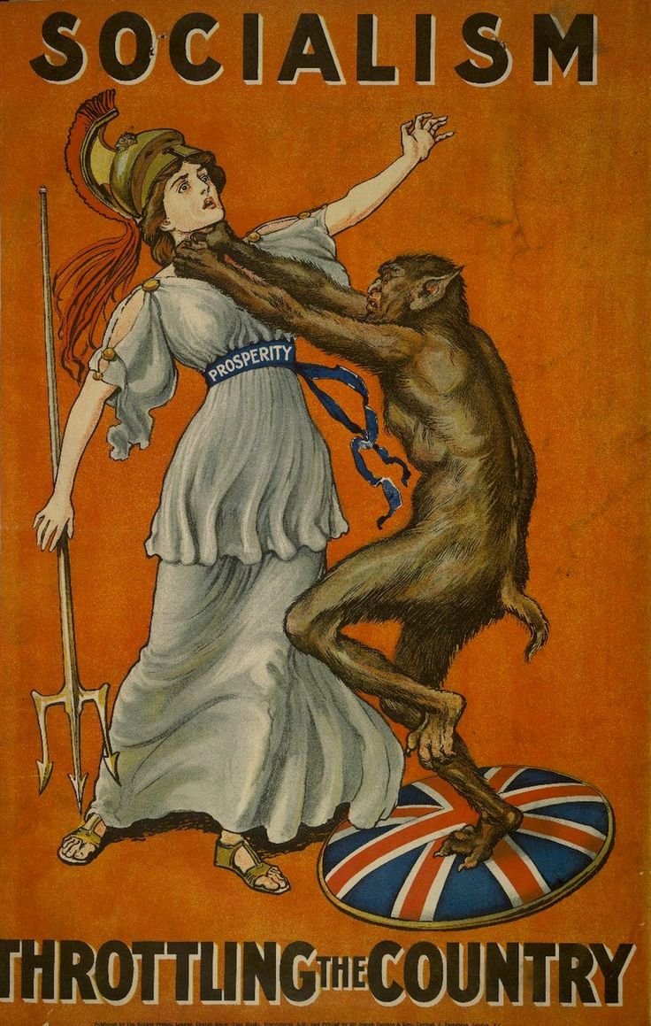
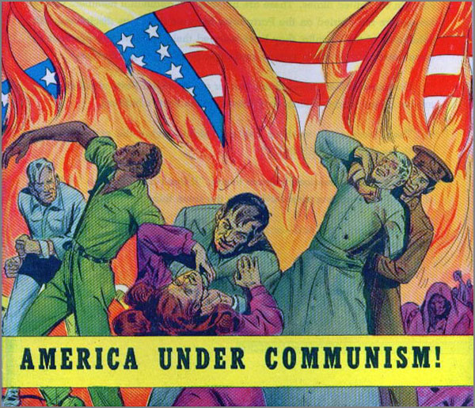
More Propaganda

Slide 10
Videos! :D
1st https://www.youtube.com/watch?v=SkYl_AH-qyk
2nd: https://www.youtube.com/watch?v=aMwbvIVh2EQ

Slide 11
Possible Test Questions
Which Government did Igor Gouzenko work alongside? A. The United States B. Canada C. The USSR D. The United Kingdom
The Quebec Padlock Laws were A. Unconstitutional B. Sympathetic to Communists C. Constitutional D. Created to catch Fascists
Opinion Short Answer: Was the Red Scare an overreaction? Why or why not?

