Slide 1
End of WW2

Slide 2
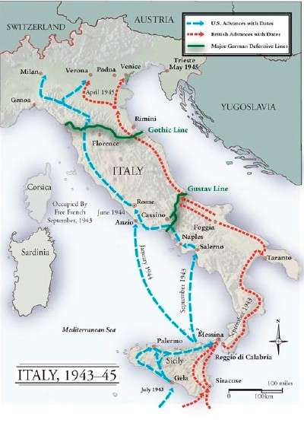
The Italian Campaign
Joint attack from British, Americans, Canadians.
After the invasion of Sicily the Italians surrendered
Nazi’s were forced to defend Italian land.

Slide 3
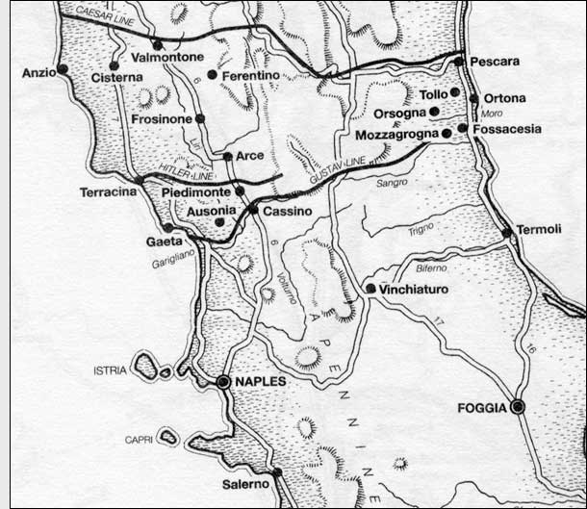
Gustav Line
Germany forced to fight on 2 fronts
Canadians and British took the East Coast
Americans took the West
Heaviest resistance met at Ortona

Slide 4
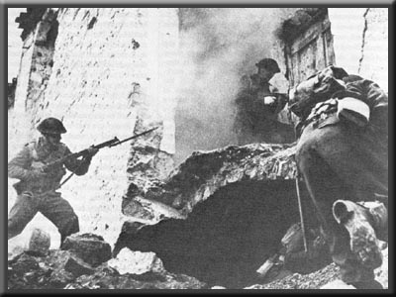
Battle of Ortona

Slide 5
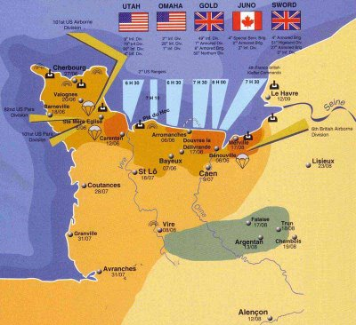

Slide 6
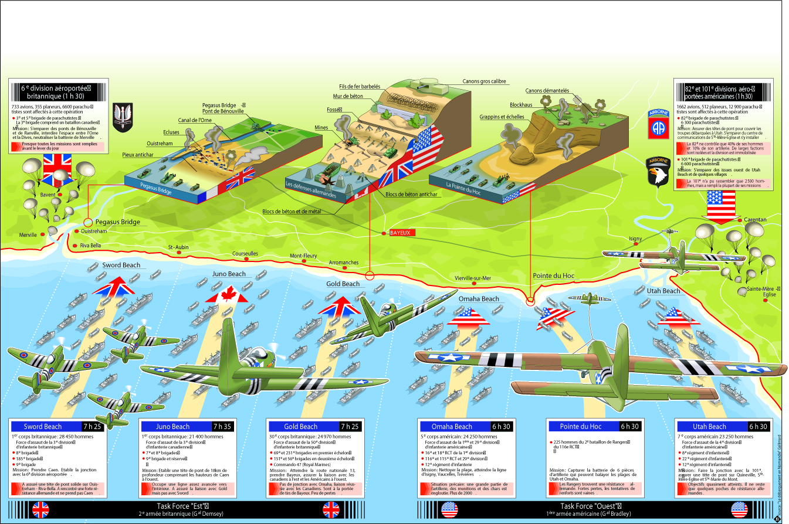
Topographic differences

Slide 7
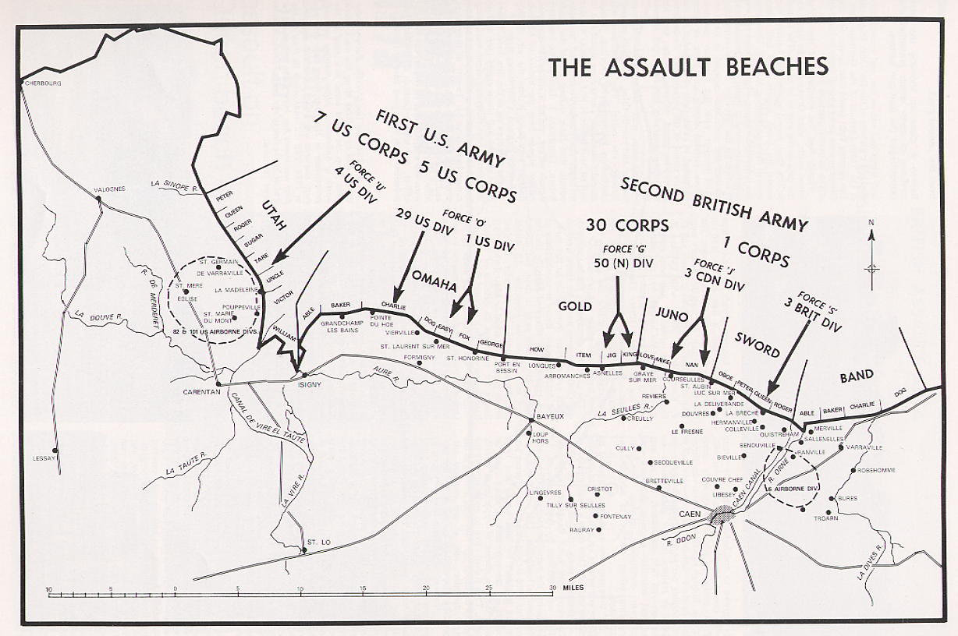
D-day “Operation Overlord”

Slide 8
Battle of Scheldt

Slide 9
Operation Market Garden
Get Across the Rhine and Take the battle to Germany
America and Britain trying to end the war quickly
Trying to prevent another German front from forming

Slide 10
Operation Market Garden

Slide 11
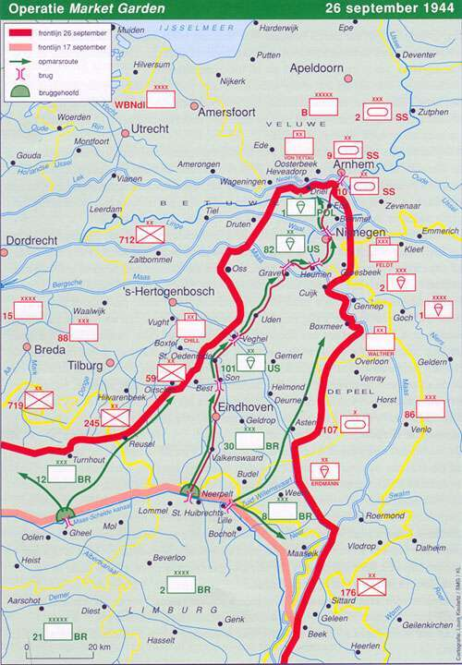
Battle of the Bulge
As a result of operation Market Garden England and USA were over-extended.
Germans took the opportunity to launch their last Blitzkrieg of the war.

Slide 12
Eventually the cut off divisions would be rescued.

Slide 13
V-E Day (Victory in Europe day)
By December 1944 German troops had been pushed back to their original territory.
Eastern front is collapsing quickly.
USSR encircles Berlin.
April 30’th 1945 Hitler commits suicide.
May 8’th Germans surrender to USSR and everyone throws a Big party

Slide 14
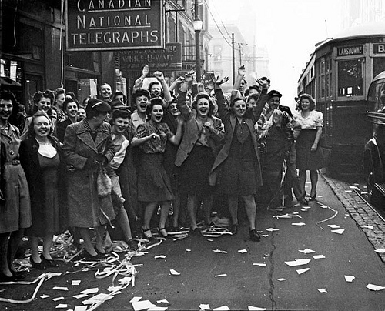
VE day party

Slide 15
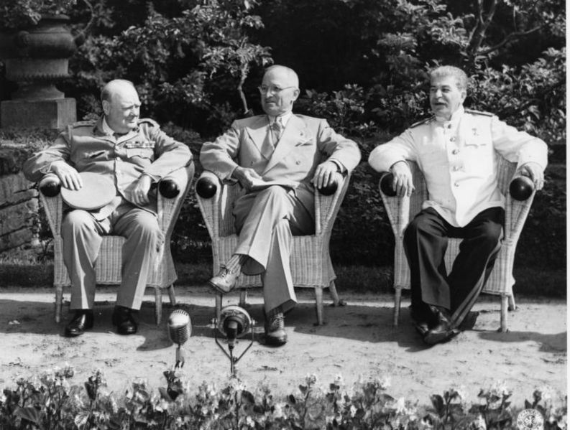
Potsdam Conference
USSR, U.S, U.K. Meet to discuss what next.
Demilitarize Germany
Divide Germany into 4 zones.
Try Nazi war-criminals in court of law.
Outlined surrender options for Japan.
USSR would join the war against Japan.

Slide 16
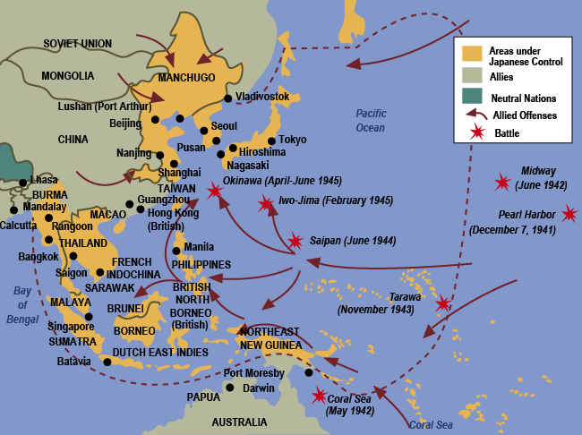
Battle of the Pacific

Slide 17
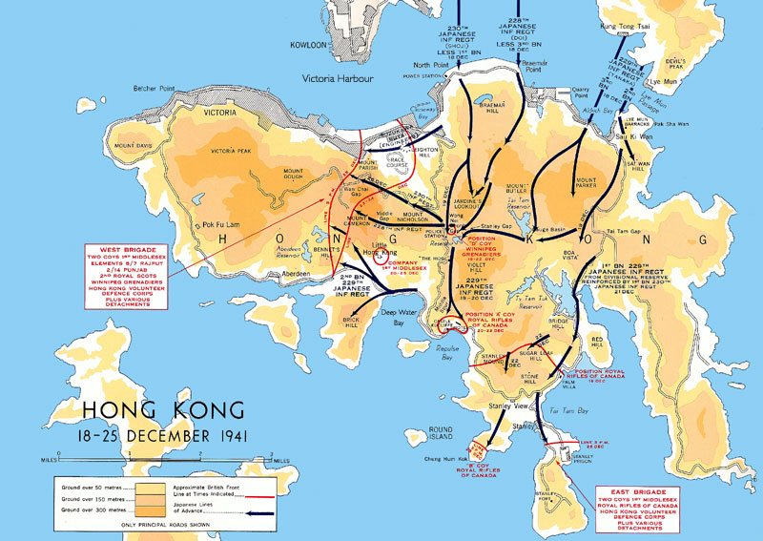
Battle of Hong Kong 1941
Canada’s only major contribution in the pacific.

Slide 18
Manhattan Project
Scientists told to invent a weapon to win the war.
German scientists stolen from Germany.
Learned how to split an atom
Manhattan is where most of the Uranium was enriched

Slide 19
Fat-man and Little-boy

Slide 20
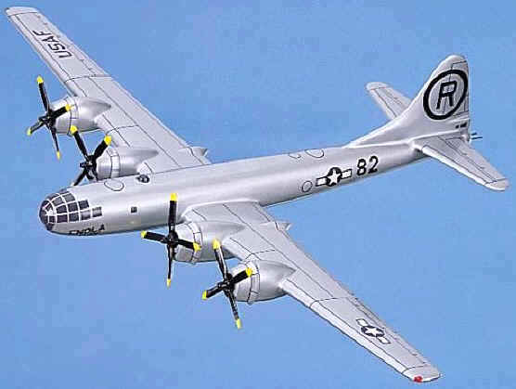
Enola Gay (B-29 bomber)

Slide 21
Is the use of the bomb justified?
Yes the a-bomb saved lives by shortening the war.
No, use of the a-bomb is never justified. atomic weapons, are morally evil.
America and Britain should have used a land invasion.
Use of one bomb was fine, but why drop a second bomb.
The only reason they dropped a bomb was because they were afraid of USSR getting more territory.

Slide 22
VJ Day September 3, 1945
Potsdam declaration accepted and Japan surrenders.
WW2 is officially over.

