Slide 1
End of WW1

Slide 2
3 Reasons for the End of The War

Slide 3
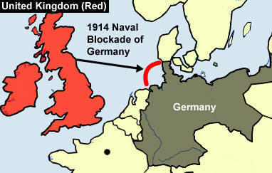
#1 Naval Blockade
Keep supplies from reaching Germany.
Results in almost 1,000,000
people dying from lack of food.

Slide 4
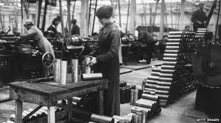
#2 Industrial fatigue
Germany was running out of supplies including Ammunition and other materials to supply their people.

Slide 5
#3 Americans Join
Huge moral boost.
Huge industrial capacity boost.
Fresh troops
*** When Americans got to Europe the war was already over***

Slide 6
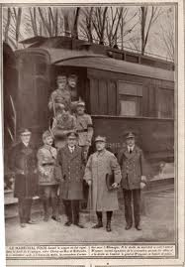
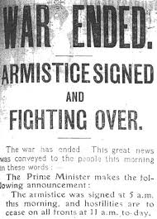
Armistice Day
You need to know this date Nov. 11 1918
November 11 is now known as Remembrance day.

Slide 7
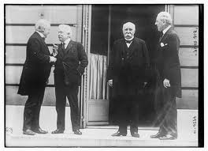
Treaty of Versailles
Germany, United States, Great Britain, France.
These countries meet together to discuss an agreement.
Canada asks to be included (but denied)
A clear intention to punish Germany for the war.

Slide 8
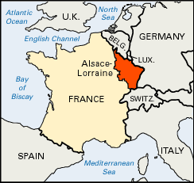
Treaty of Versailles Role Play
Who is at fault for the war?
Who should own Alsace Lorraine, France or Germany?

Slide 9
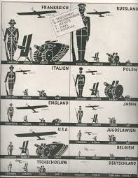
Treaty of Versailles Continued
The war cost Britain and France about 30 Billion dollars, who should pay for this?
Germany’s Navy and army were far too big. Should they be reduced to ensure they won’t attack again?

Slide 10
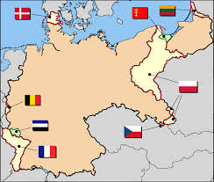
Treaty of Versailles Cotinued
Should German’s land be reduced to allow ethnic groups like Poles have their own countries?

Slide 11
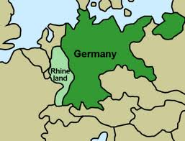
Treaty of Versailles Continued
To avoid future wars should Germany’s army be prevented from getting too close to the French border?
No army in the Rhineland!

Slide 12
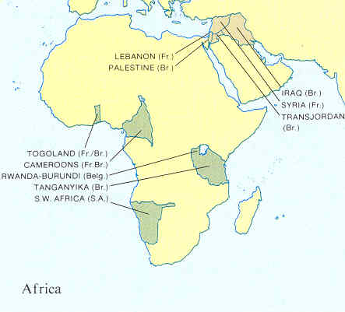
Treaty of Versailles Continued
Should the German colonies in Africa be given to Britain, France and Belgium to pay for damages?

Slide 13
Treaty of Versailles Continued
Should multi-government run institution be created to make sure there is never another war.

Slide 14
Treaty of Versailles
You already know this treaty leads to WW2
What would have been a fairer conclusion?
(100 words)

