Slide 1
Cultural Industry
What does the fishing industry produce?
What does the Oil and Gas industry produce?
What does the forestry industry produce?
What does a cultural industry produce?

Slide 2
Cultural Industry
A countries pop-culture machine. Stronger the industry the stronger the culture.
…Consumption of the easy pleasures of popular culture, made available by the mass communications media, renders people docile and content, no matter how difficult their economic circumstances.
-Max Horkheimer

Slide 3
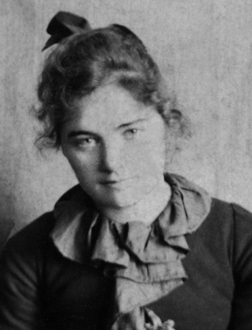
Countries produce their own cultural

Slide 4
Culture moves from large, culturally powerful countries to smaller, weaker countries.
USA
CAN
CHINA
VIETNAM

Slide 5
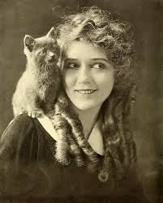
Mary Pickford, America’s Sweetheart

Slide 6
Canadian is next to the most powerful culture and most powerful country.

Slide 7
Brief History of Canadian Cultural Industry
1920’s Broadcasting act decides to make a entertainment for Canadians across the country.
1930’s CBC (Canadian Broadcast Corporation) is created as a radio station for all Canada. Gives viewers something distinctly Canadian to watch.
NFB (national film Board) Canada’s version of Hollywood. Prior to WW2 it was one of the most powerful film agencies around.
Problem
Soon American’s Films and Radio are being sent into Canada. (And they are better)

Slide 8
Massey Commission (176-177)
Studies why “Canadian” talent keeps moving south.
Concerned that there will be no difference culturally between Canada and the U.S.A..
Believes Canada needs to culturally protect itself.
HOW Does a country Culturally protect itself???

Slide 9
Canada protects its culture
Massey Commission
Canadian Council of the Arts (1951)
CBC Television (1952)
Canadian Content Rules
1968 Broadcasting
Act
CRTC

Slide 10
Council of the Arts (1951)
Gives government money to Canadian Artists.
Music, Painting, Drama, Dance, Photography…etc

Slide 11
Broadcasting Act (1968)
Provide Canadians with phone, television, and radio services.
Ensures that phone companies and TV companies will not have compete financially with larger companies in America (protects Telus and Bell and ensures we always have CBC radio and TV)
Includes Canadian Content regulations

Slide 12
CRTC
“Canadian Radio and Telecommunications Commission”
Makes sure Canadians promote their own culture by creating rules for TV and Radio.
Makes sure that radio and TV have enough “Canadian Content” “CAN-CON”
Make sure Canadian T.V. is shown during “prime time”
Keeps lots of American television, music, cell phone companies out of the country. (censorship?)

Slide 13
Canadian Content
What is Canadian Content?
Having a beaver.
Having a Canadian flag.
Canadian Actors
PROBLEM: its hard for Canada to have Canadian content when Canada has very little that is culturally different than the United States.

Slide 14
Does Canada need to protect our Culture?
Write an quick Essay.
Point form is acceptable.
Don’t take too long on it, it won’t be for marks.
I’m trying to get a sense of where your skills are.

