Slide 1
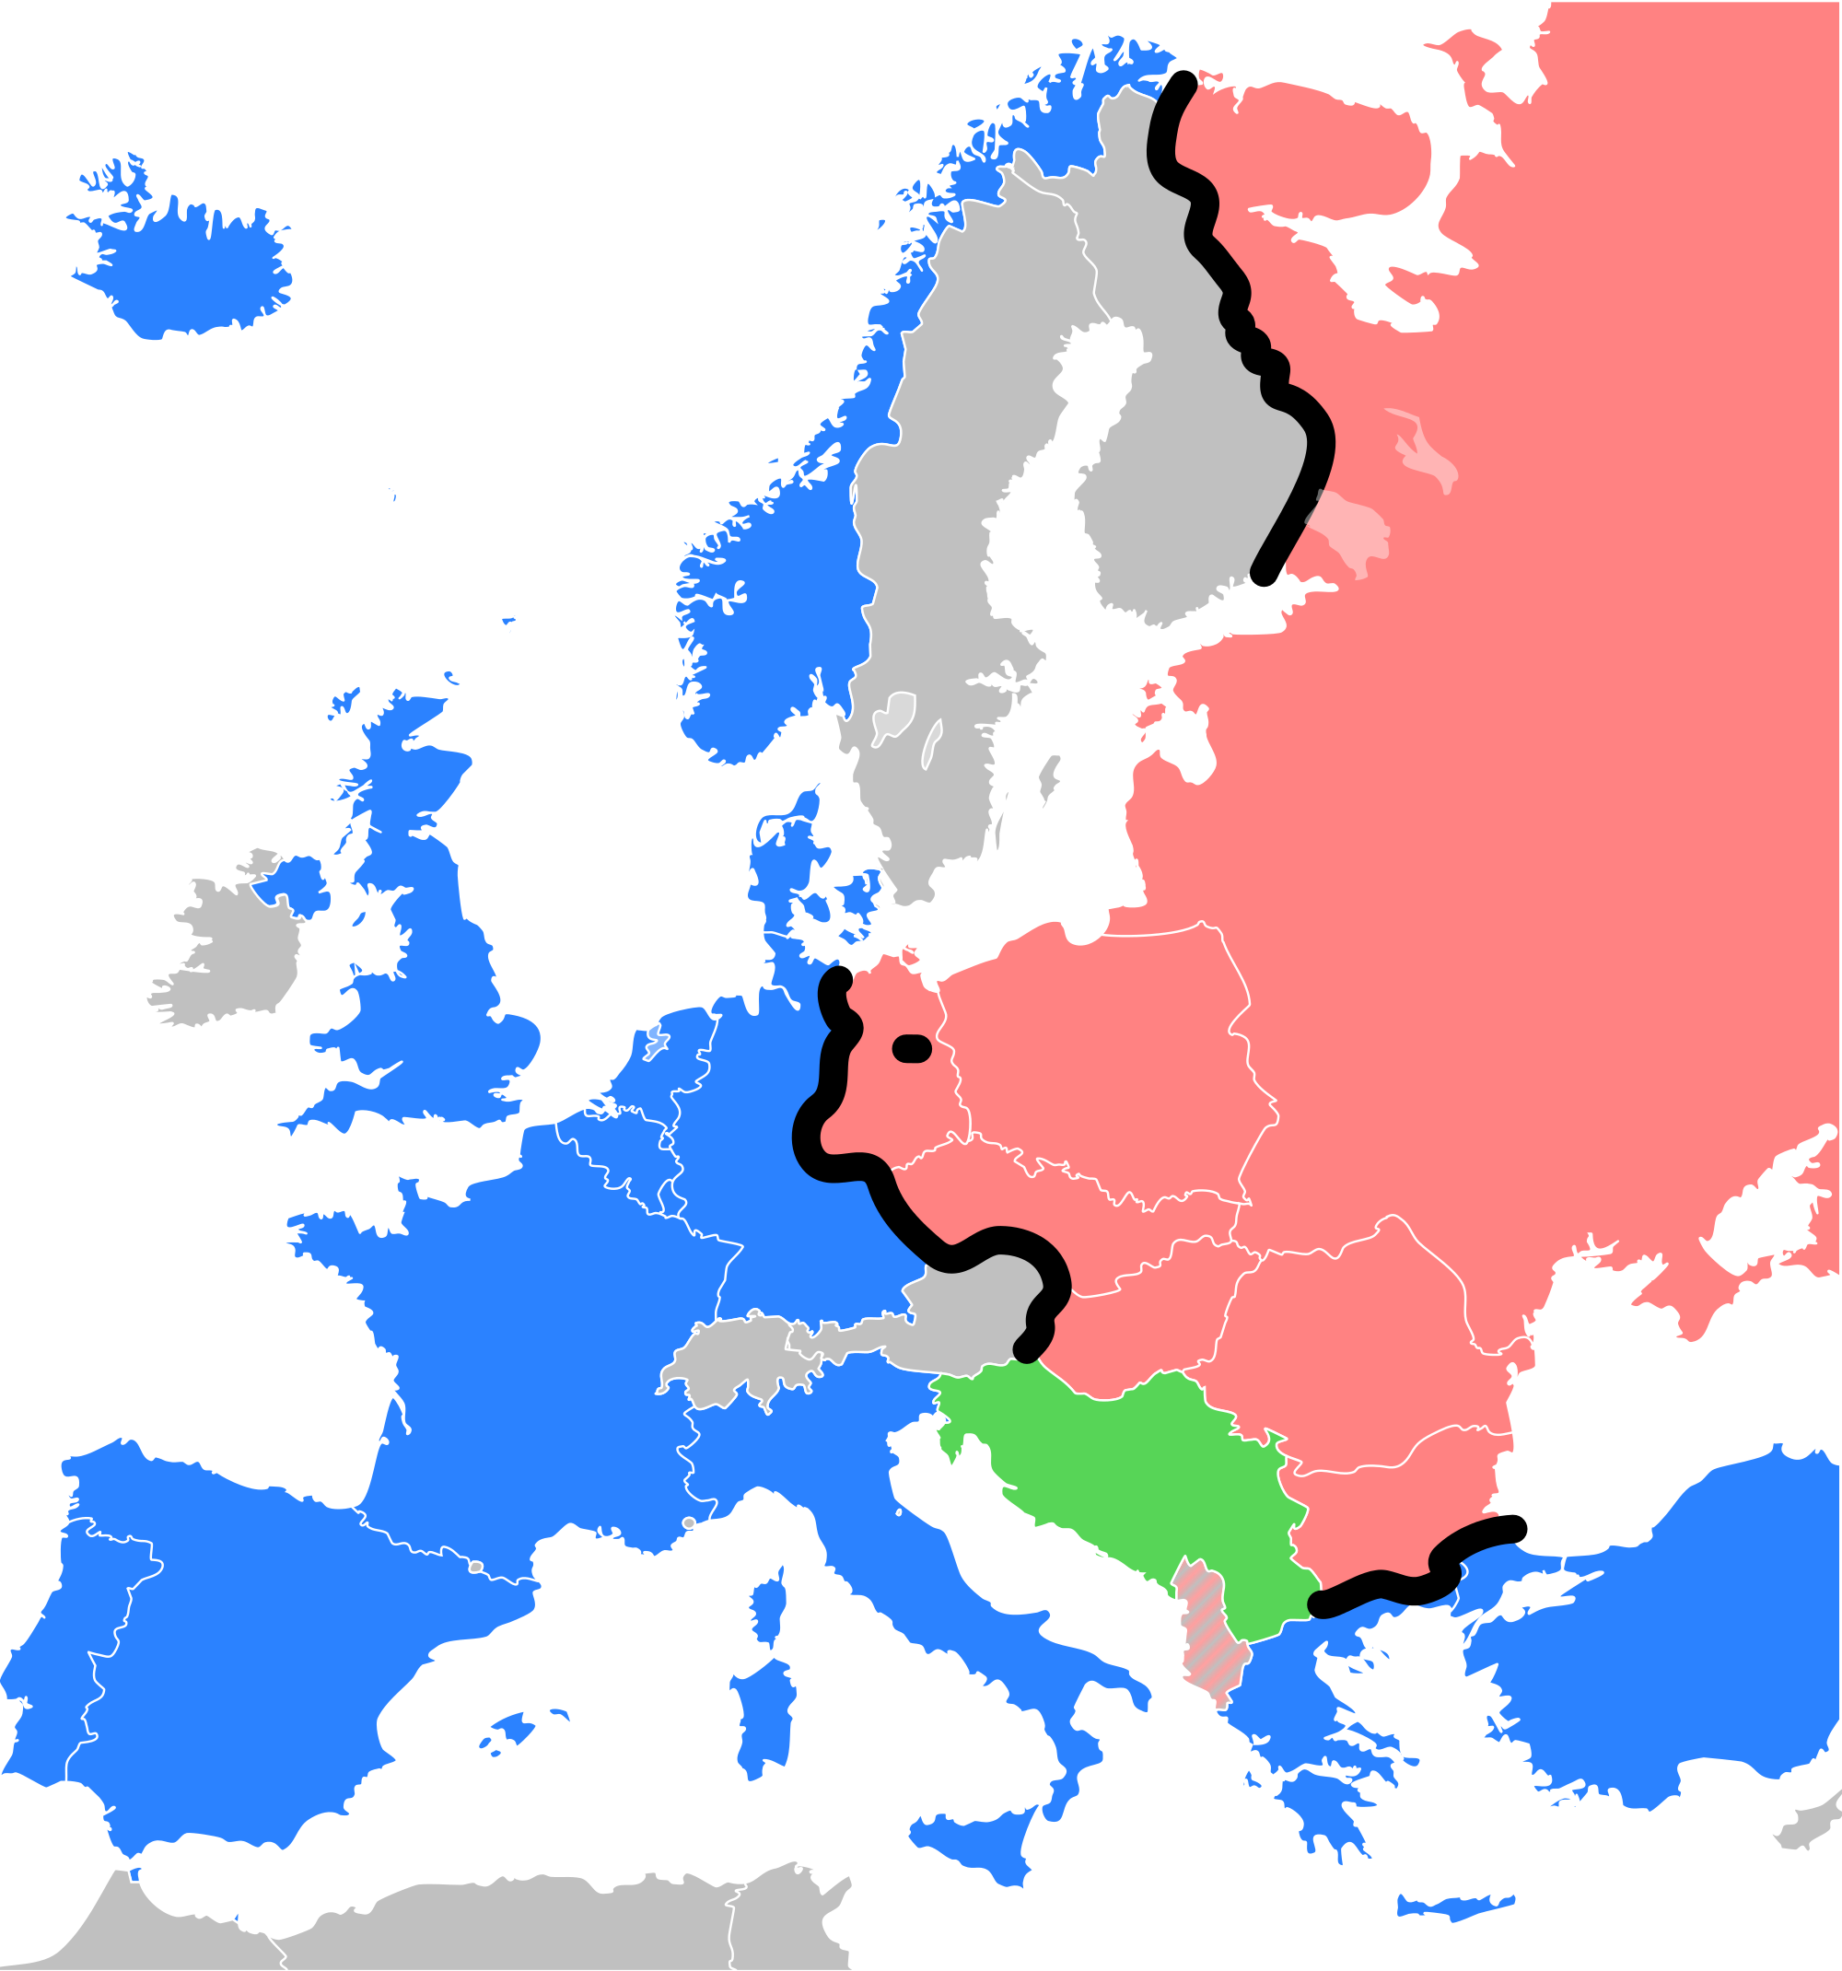
Cold War
Military Alliances
By Sarah & Sierra

Slide 2
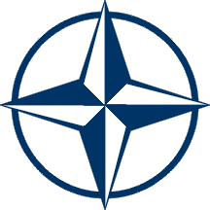
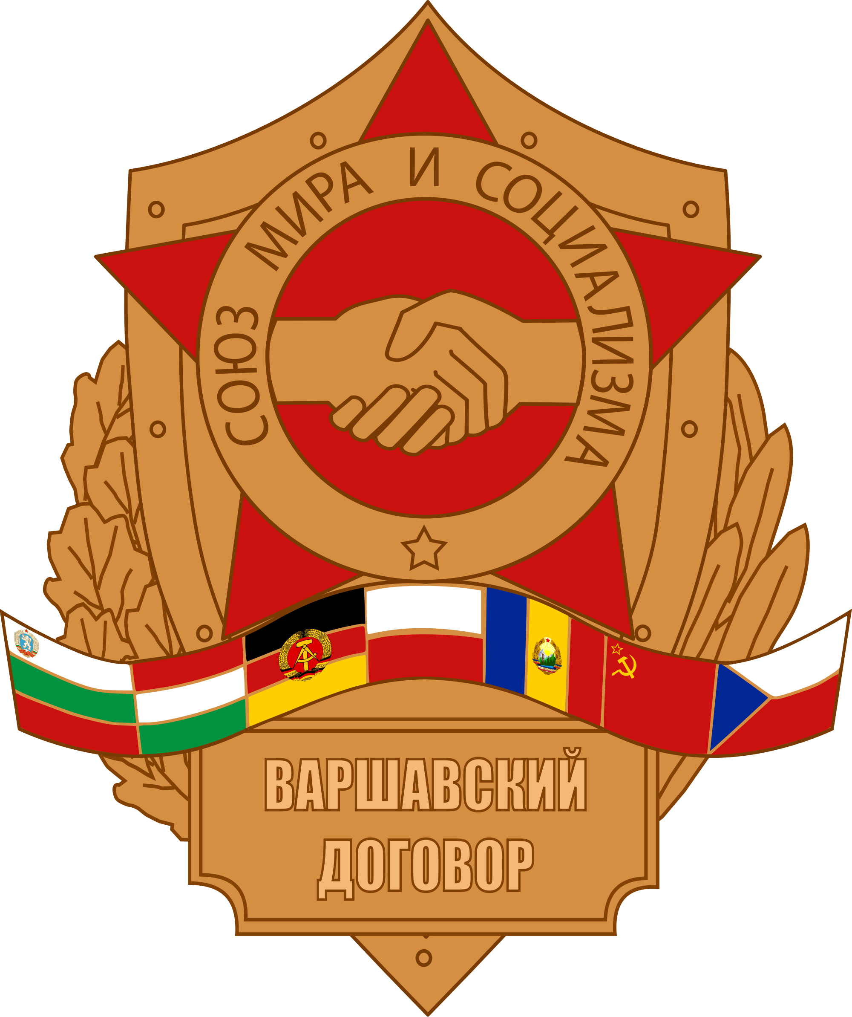
Conflicting Countries
Most of the countries on one side were allied in NATO, whose most powerful country was the United States. The countries on the other side were allied in the Warsaw Pact whose most powerful country was the Soviet Union. These groups were divided by the Iron Curtain. The Cold War started in 1947 due to the belief that the government would become either communist or capitalist.

Slide 3
Alliance System
Alliance System is a formal agreement or treaty between two or more nations to cooperate for specific purposes.
Examples of an Alliance System can be found in different shows such as Big Brother or Survivor

Slide 4
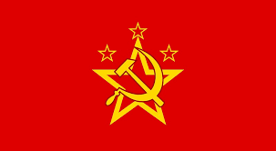
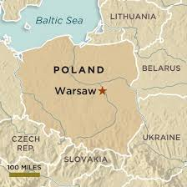
What Was the Warsaw Pact?
This pact was established in May of 1955 in Warsaw against NATO. The members in the Warsaw Pact were: Soviet Union, East Germany, Czechoslovakia, Bulgaria, Hungary, Poland, Romania, and Albania. All the Communist states of Central and Eastern Europe signed except Yugoslavia. The Pact lasted until the end of the Cold War when some members quit in 1991.

Slide 5
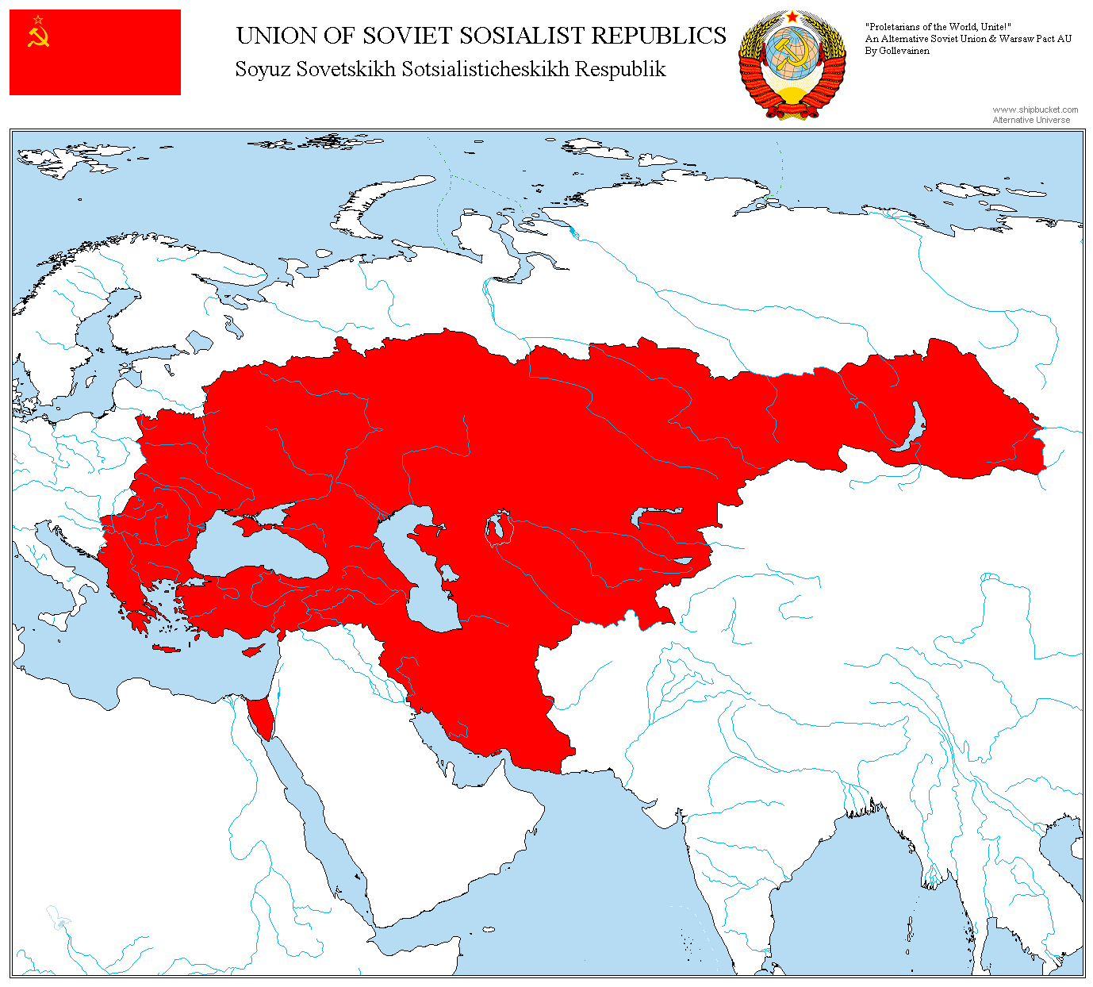
Warsaw Pact
•What was the Warsaw Pact? The communist alliance fighting against NATO •Who is in the Warsaw Pact? Soviet Union, East Germany,Czechoslovakia, Bulgaria, Hungary, Poland, Romania, and Albania. •Where was it formed? Warsaw, Poland •When was it established? May of 1955 •Why was this alliance formed? It was in response to NATO and had the same theories as NATO, that if one country was threatened or harmed by a Western country then all countries of the Warsaw Pact would come to its defense. It was also a way for Eastern Europe to say to the West-keep out.

Slide 6
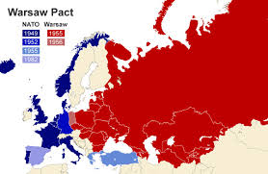
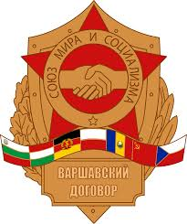
Warsaw Pact Definition
The Warsaw Pact was the alliance of Central and Eastern European Communist states.

Slide 7
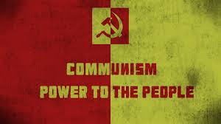
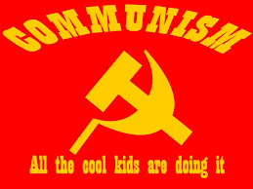
Communism Definition
Communism is a type of government and its goal is to form a society where everything is shared equally.

Slide 8
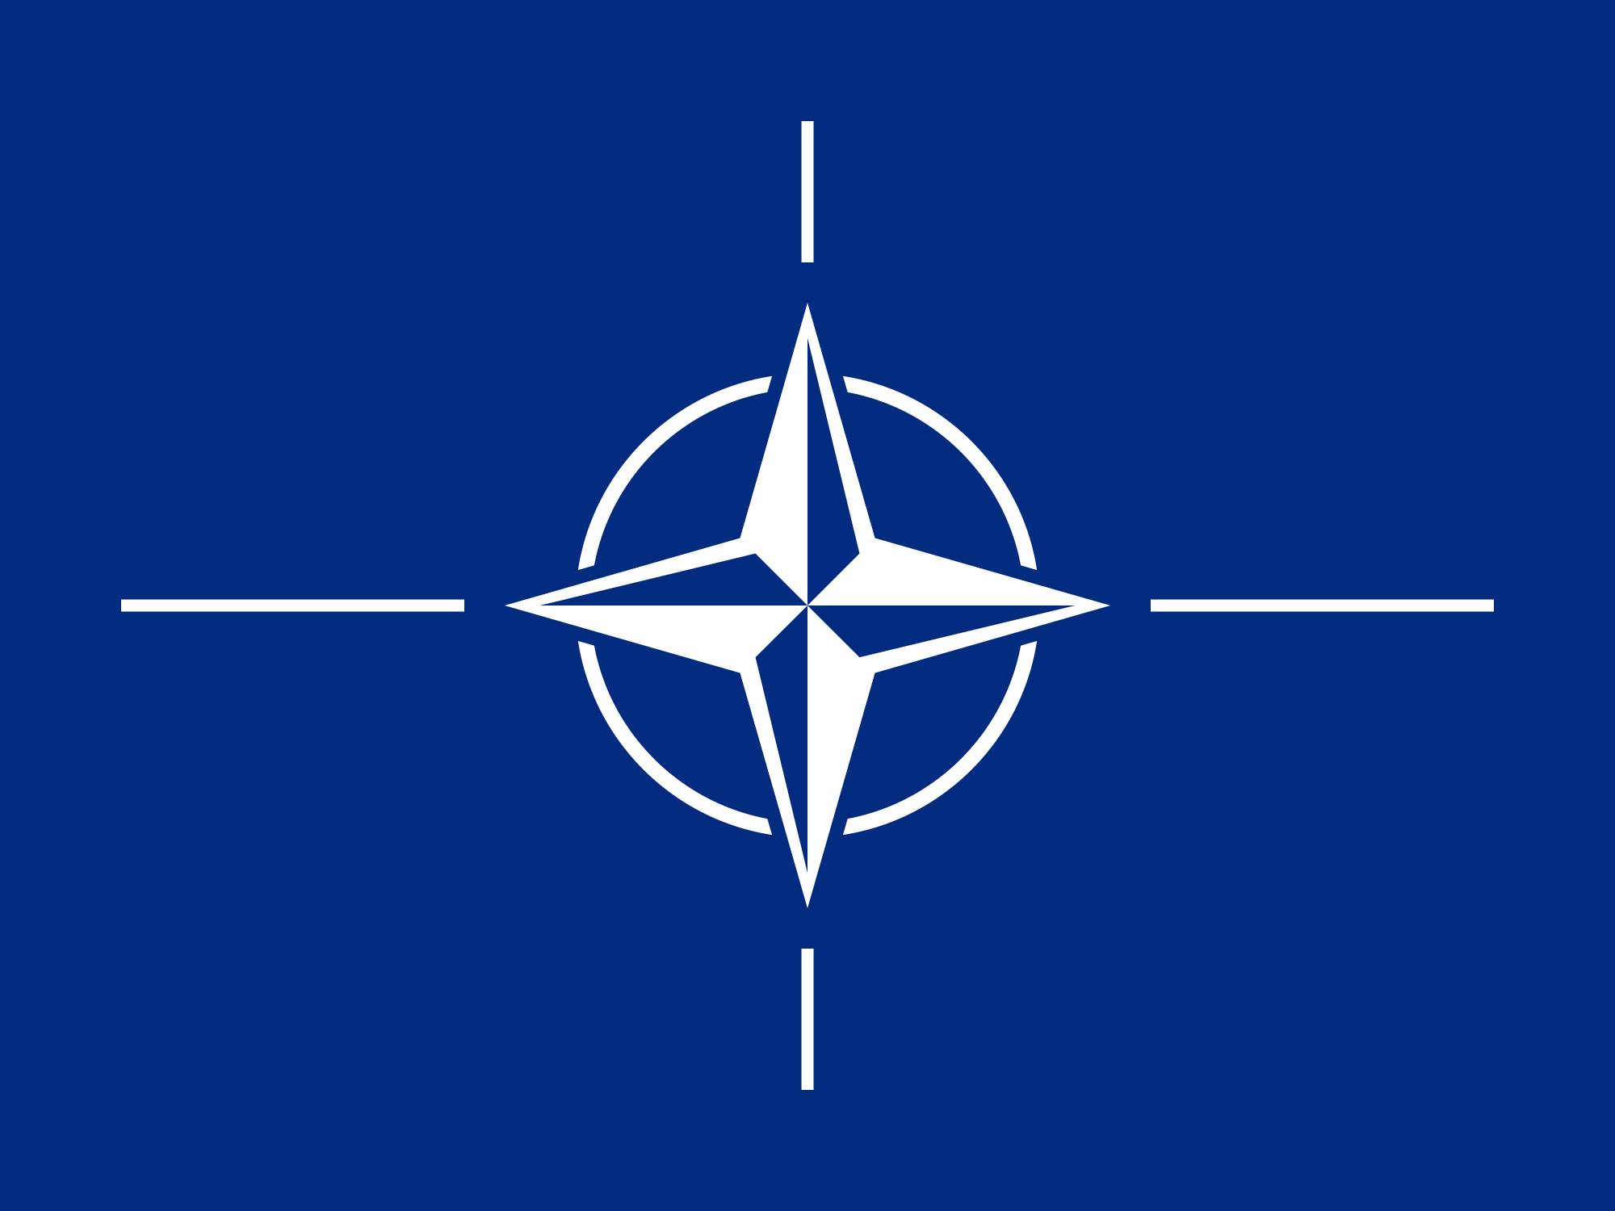
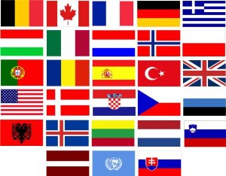
NATO North Atlantic Treaty Organization
NATO is a defence Alliance formed with the US, Canada and multiple European countries to ensure the safety and security of all the countries involved.
The flags of all the countries associated with NATO ⟶

Slide 9
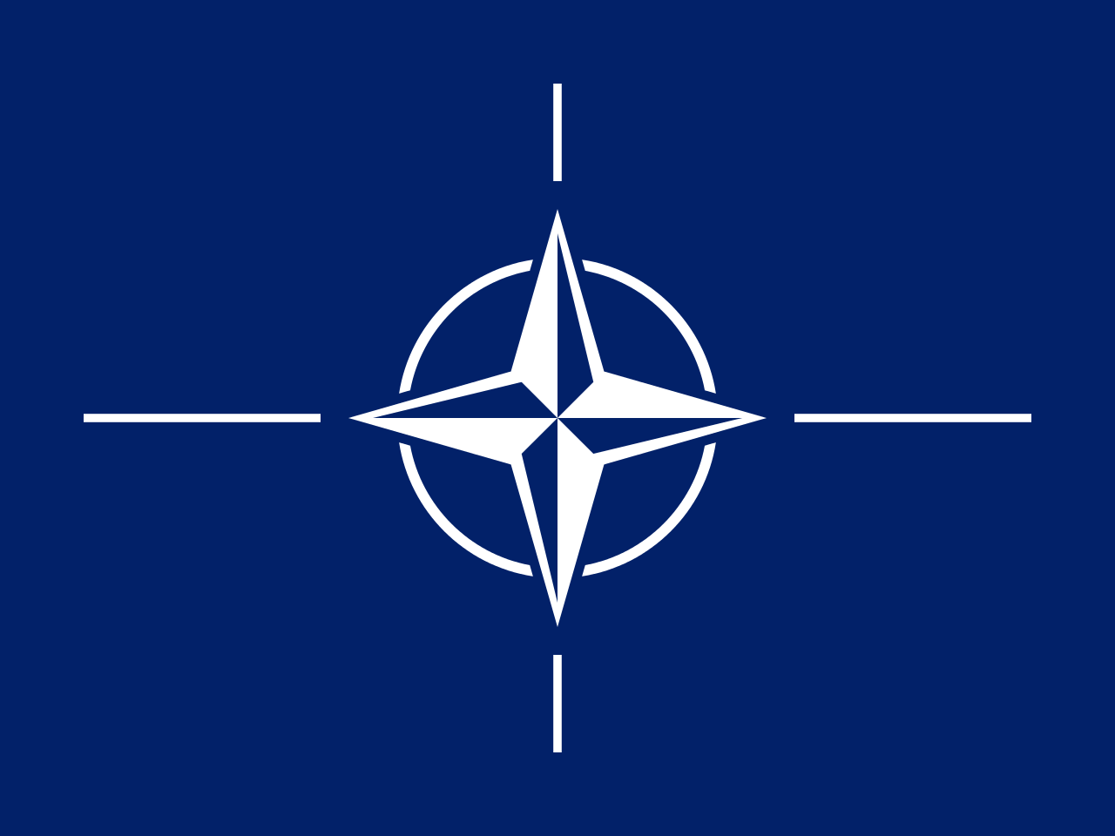
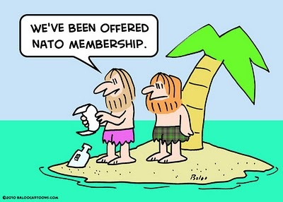
NATO North Atlantic Treaty Organization
Who? Canada, US, European Countries What? An alliance that signifies defense Where? The headquarters is located in Belgium When? NATO was formed April Fourth 1949 Why? To make sure that countries are safe and secure

Slide 10
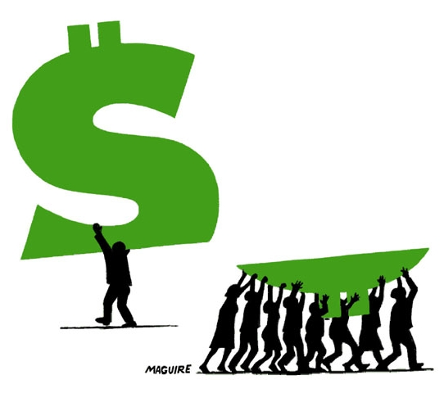
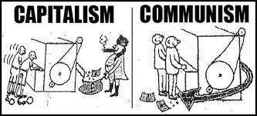
Capitalist Definition
•Private ownership of industry •Freedom of competition •Laissez-Faire •Creates different economic classes

Slide 11
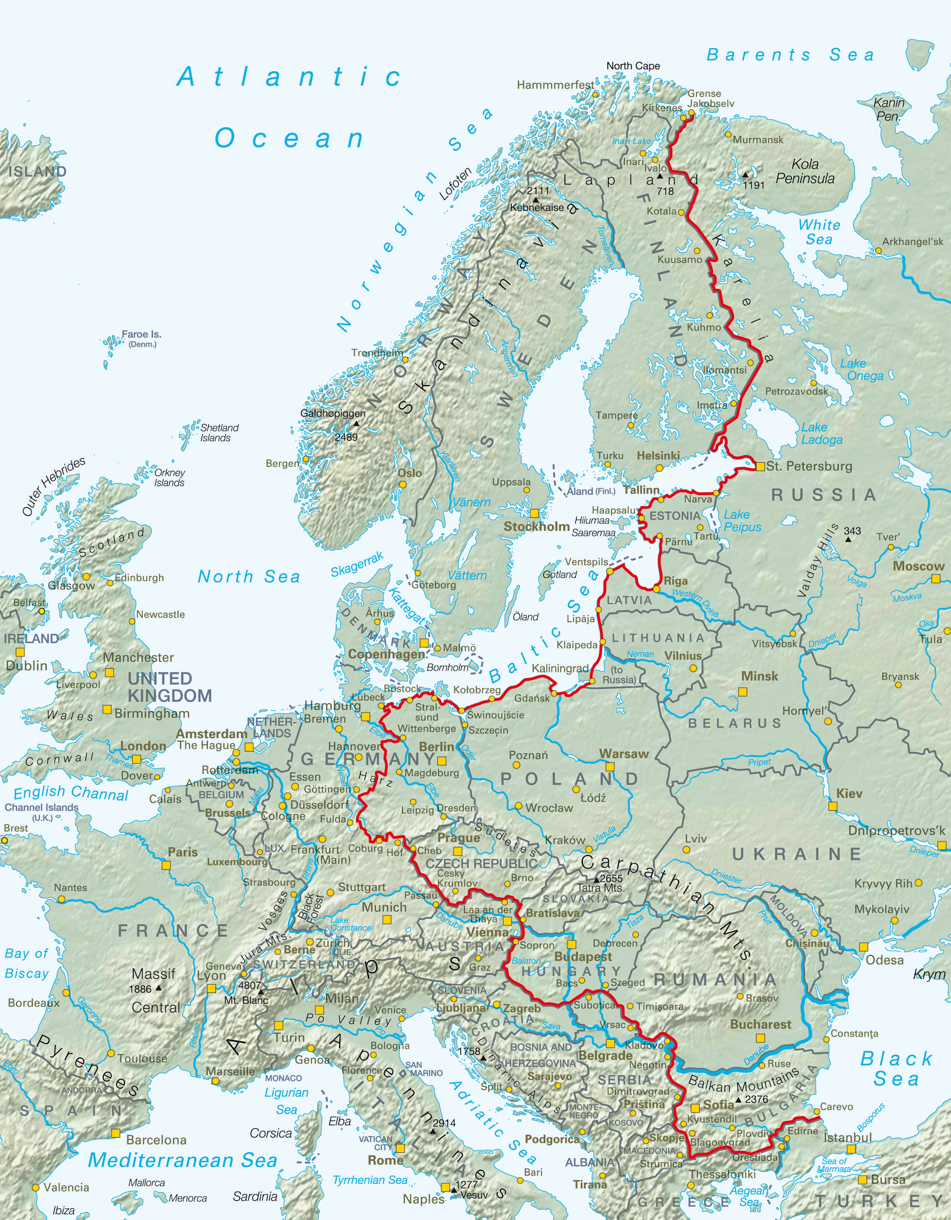
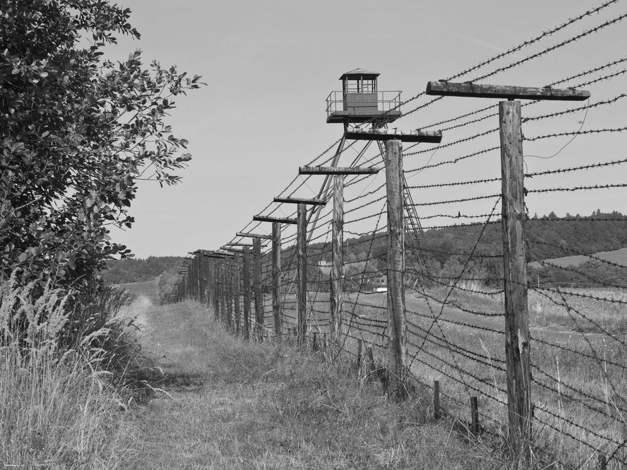
Iron Curtain
The Iron Curtain is the physical division between West and East Europe that was created at the end of World War II and lasted until the end of the Cold War.
The East side of the iron curtain was the communist group (Warsaw Pact) and on the West side of the iron curtain is the capitalist group (NATO).
Geographically, the borderline ran from Estonia in the north to Yugoslavia in the south.

Slide 12
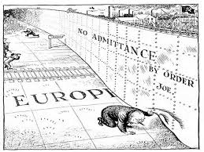
Iron Curtain
Between 1946 and 1989, this border forced many Central and East European countries to join the Communist bloc (Warsaw Pact) under the control of the Soviet Union. These countries were: Bulgaria, Czechoslovakia, East Germany, Hungary, Poland, Romania, and Albania (until the 1960s) and were labeled “Iron Curtain countries.”
After 45 years of dividing Europe into two different alliances, the iron curtain ended when the cold war was finished.

Slide 13
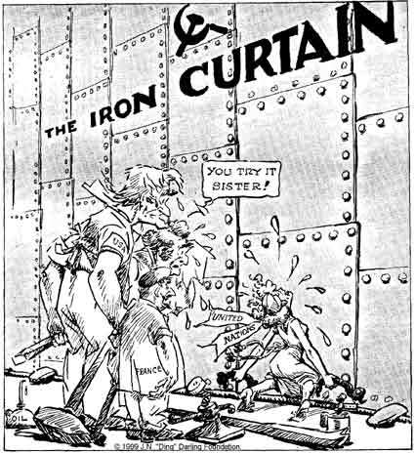
Iron Curtain Definition
The Iron Curtain was a barrier separating Europe in two sides with Communists on one side and Capitalists on the other.

Slide 14
Test Questions:
How many countries created NATO?
Who was the main contributor/the leader of the Warsaw?
When did the iron curtain begin?

Slide 15
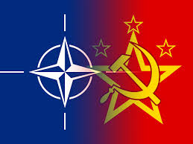
The End

