Slide 1
Canadian Identity
What are Canadians?
How do we see ourselves?

Slide 2
Is this Canada’s Flag?
Canadian Flag from 1867- 1914
“Union Jack”

Slide 3
Is this Canada’s flag?
Canadian Flag from 1914-1965
“Red Ensign”

Slide 4
Is this Canada’s Flag?
Prime Minister’s favorite Flag
“Pearson Pennant”

Slide 5
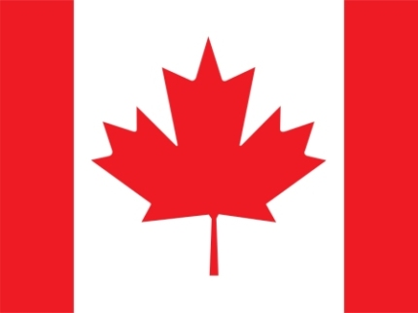
Is this Canada’s Flag?
Canadian Flag from 1965
“Maple Leaf”
What can you learn about Canadian identity from these flags?

Slide 6
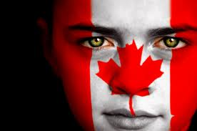
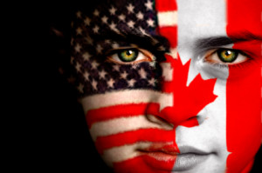
Canadian identity is influenced by U.S.A.

Slide 7
Canada is multicultural
Describe what a Canadian looks like.
Which one of these people looks the most Canadian?

Slide 8
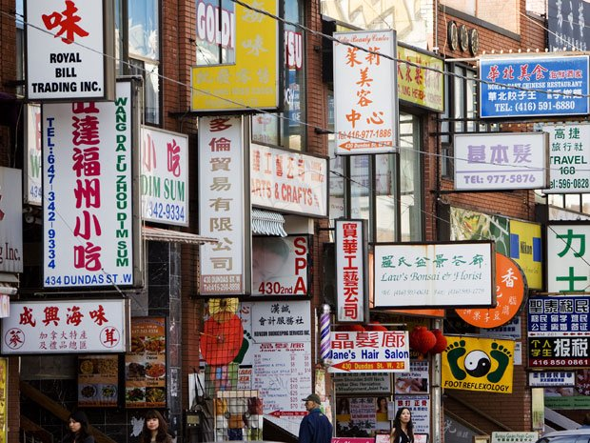
Where are we

Slide 9
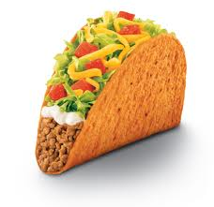
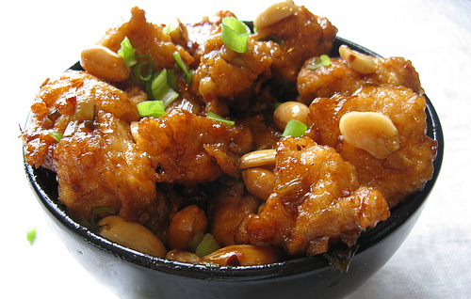
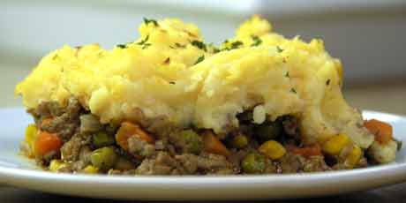
Which is a Canadian Food?

Slide 10
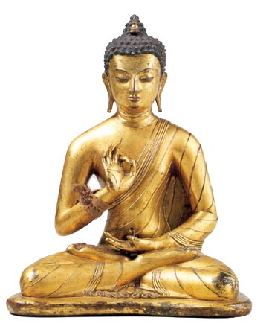
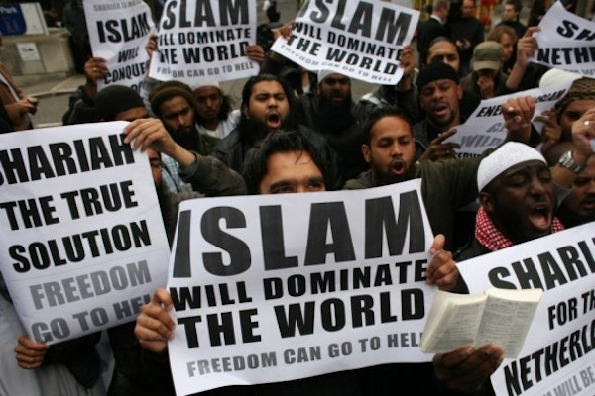
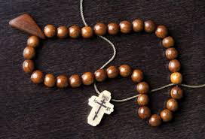
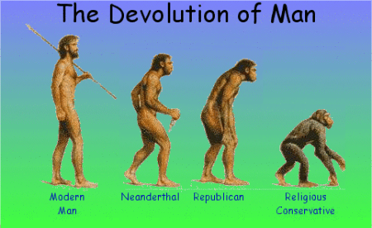
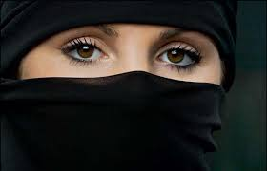
What is the Canadian Religion?

Slide 11
3 major themes in Canadian Identity
Canada was influenced by Britain
Colony of Britain
Follows political traditions of Britain
Canada is influenced by United States
Watch American T.V.
American Sports, American music.
Sell our products to America
Canada is even protected by the American military
Canada is influenced by multiculturalism
There is no typical Canadian
There is no single language or religion
There is no typical Canadian food

Slide 12
Show What You Know
Review Game

Slide 13
Example #1
My Grandma, is British.
My Grandpa, is Mennonite
My other Grandpa is Russian
My other Grandma is Mennonite
But I am a Canadian.

Slide 14
Example #2
Since the terrorist attacks in (Sept 11 in New York) Canadians can no longer travel to the United States without a passport.

Slide 15
Example #3
American television shows are not allowed to be shown on Canadian T.V. at certain times of the day.

Slide 16
Example #4
Many Canadians stayed up all night to see Prince William and Kate Middleton marry

Slide 17
Example #5
United States places their own missile bunkers in Canada’s territory.

Slide 18
Example #6
Canada has a governor general

Slide 19
Example #7
There are more Italian restaurants than Canadian restaurants in Canada.

Slide 20
Example #8
Canadian Justin Beiber speaks with an American accent to improve his record sales.

Slide 21
Example #9
Our most famous Canadian singers and actors choose not to live in Canada.

Slide 22
Example #10
Canadian laws are quite different than American laws.

