Slide 1
Bill Becomes Law & Senate Reform

Slide 3
Definitions
Caucus: a party meeting, government parties decides their actions at these meetings.
Party Whip: Once decisions are made in Caucus the whip makes sure everyone “adheres” or follows those decisions. If you don’t follow your party the whip punishes you.
Party Solidarity: looking like everyone agrees.
Party Discipline: Every MP in a party voting the same way

Slide 4
More Definitions
Free Vote: Allowing MP’s to vote how they like. Not needing to show “party discipline.”
Committee Stage: Letting regular people look over a bill and offer suggestions and changes
Amendments: Small changes to a bill.
Vote: Sharing your opinion.
Tabulation: Counting up the votes.

Slide 5
Cabinet:
Is made up of the prime minister and his smartest and most capable MP’s.
Often these MP’s have specific skills or knowledge that make them good choices for Cabinet.
The cabinet always shows “solidarity” even when they have different opinions.
Cabinet decides on most of the laws for the country.

Slide 6
Canada’s Cabinet
Almost 40 Ministers in Cabinet
Minister of National Defence
Minister of Environment

Slide 7
More of Canada’s Cabinet
Minister of foreign affairs
Minister of international trade

Slide 8
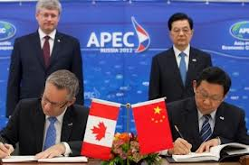
Ministers of international trade making a deal

Slide 9
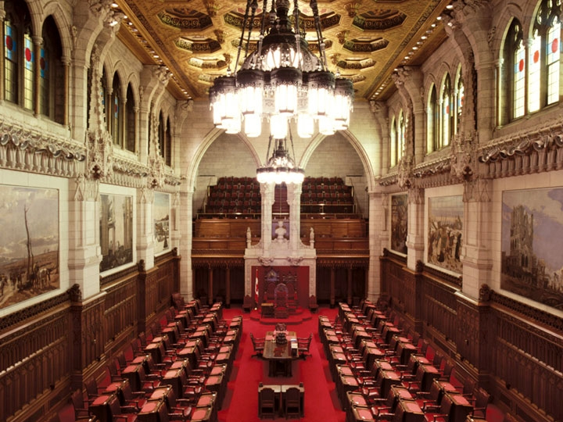
The Senate
After a bill has been supported in the house of commons “lower house” it must move into the senate “upper house”

Slide 10
The Senate’s powers.
In the senate the bill goes through multiple readings once again. At any point the Senate can stop the bill.
This is why senate is sometimes called, “chamber of sober second thought”
Since the end of WW2 how many bills has senate vetoed?
45
1080
65, 986
1

Slide 11
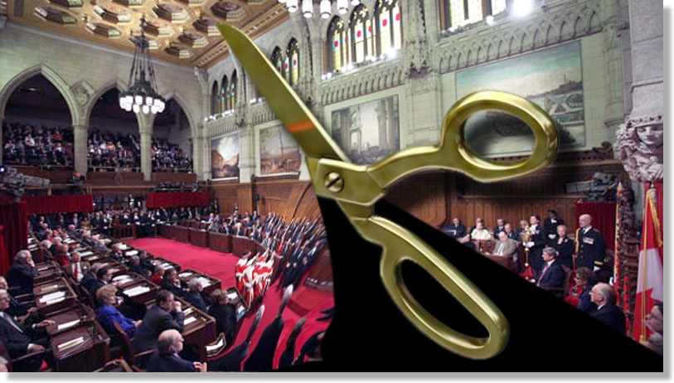
How come senate does not stop bills?
Senators get paid on average $132,000 a year.
They are appointed by the Prime Minister .
They are given these jobs with the expectation that they will vote favorably for Government “Patronage”

Slide 13
Senate causes more feelings of western alienation

Slide 14
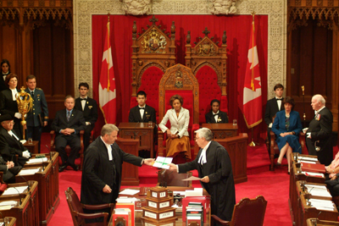
Governor General
The last step to passing a bill to become a law.
This is the equivalent of the Queen of England stopping the bill.
When the governor general signs the bill it is called Royal Assent, because the Queen of England has now agreed to the bill.

Slide 15
3 positions on the Senate
Position #1 Get rid of it.
Waste of money.
Patronage does not actually do anything
Symbolic of a time when there were lords and commoners
Is not equal to Provinces
Position #2 Reform
Triple E Senate
“Elected” by voters in Canada
“Equal” All provinces have the same # of senators
“Effective” No more patronage. Have it actually stop something

Slide 16
3 positions on senate
Keep it.
Having it there helps prevent bad bills
Citizens of Canada do not always make good choices having a government level that does not need to listen to the people of Canada is a good thing.
Its a government tradition that is hundreds of years old.
Why would you want to stop sober second thought?

