Slide 1
Appeasement

Slide 2
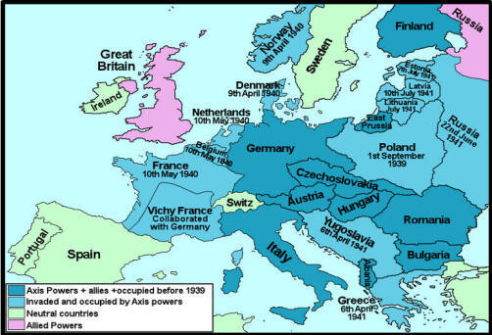
Example of Option #1

Slide 3
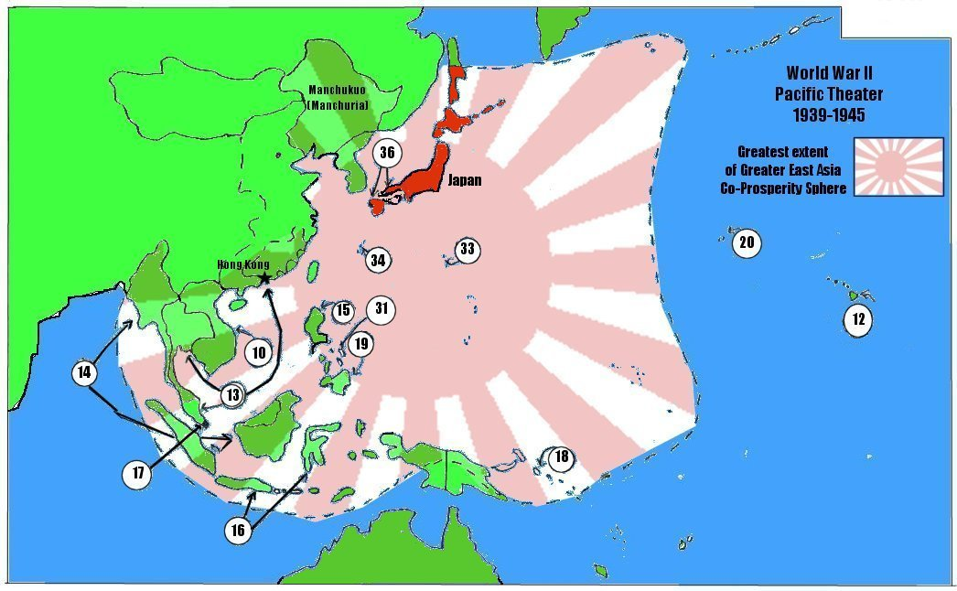
Example of Option #2

Slide 4
Appeasement Is
The belief that you should listen to hostile/mean people or countries so that they are not provoked to fight.
That you should try to be conciliatory, kind trying to pacify your enemy or person acting out by helping them.
Think of a situation where this is the right thing or wrong thing.

Slide 5
Are you for appeasement or against?

Slide 6
Pro Appeasement Arguments
War should always be avoided.
Countries do not have the right to tell other countries what to do.
Its better to give a little bit than to argue.
People are reasonable and talking to them and giving them what they want will lead to a peaceful outcome eventually.

Slide 7
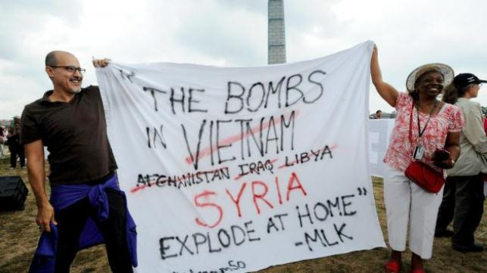
Pro Appeasment

Slide 8
Senkaku Diaoyu

Slide 9
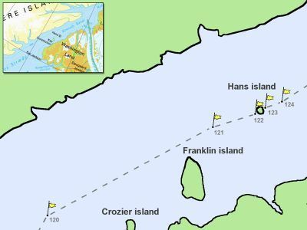
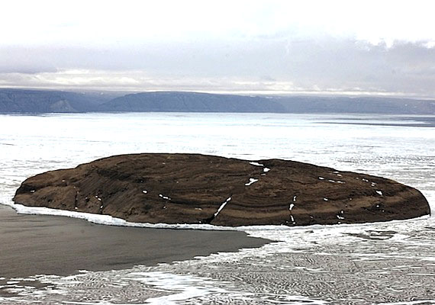
Denmark Conflict
Http://freehansisland.com/

Slide 10
Anti Appeasement
You do not “talk” when something is wrong you have to do something.
Countries CAN tell other countries what to do, if what they are doing is wrong.
Sometimes war must be used to create greater peace.

Slide 11
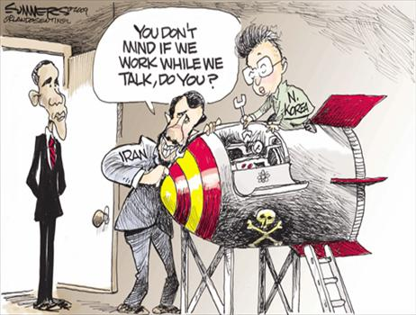
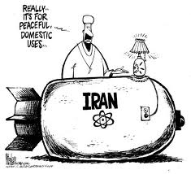
Does the UN have the right?

Slide 12
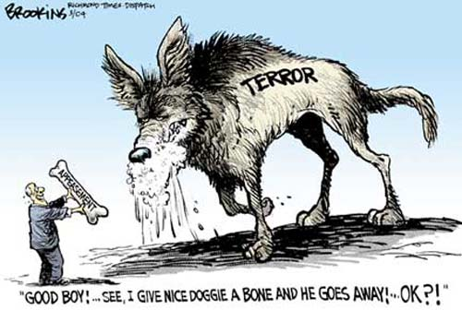

Slide 13
The 1919 Treaty of Versailles
Broken almost as soon as it was created
Germany stop paying war reparations after the stock crash
Germany starts rebuilding its navy and military with Swedish help
Does not listen to League of Nations which was set up as a prototype UN.

Slide 14
Let’s play a Game
When would you stop Hitler?

Slide 16
1. Breaks Militarization Laws
Germany has 1,000,000 soldiers, 100 warships (excluding subs) and 1000 planes
Treaty of Versailles allows 100,000 soldiers 10 ships and 0 planes.

Slide 17
2. He Enters into the Rhineland
He entered the Rhineland with these forces in 1936. Nobody said anything.
French troops posted at their position were ordered not to fire.

Slide 18
3. In 1936 he annexes Austria.
Hitler was Austrian
Austria was rich
Austria was culturally similar to Germany.
Pro-Facist movements pop-up in the country to place pressure on German take over. “Sound of Music”
50% of Austrians were supportive of annexation.
Very similar to Russia annexing Crimea.

Slide 19
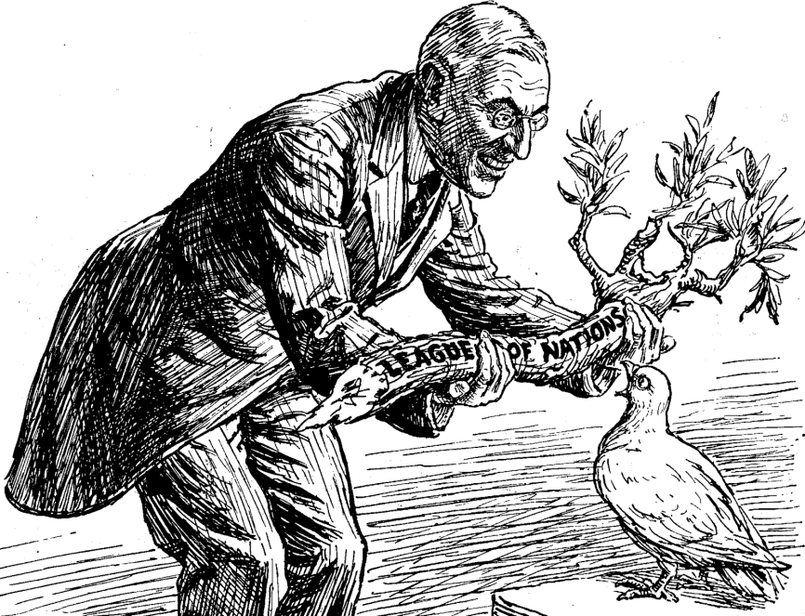
4. Stops listening to the League 1937
What’s the League of Nations?
Woodrow Wilson makes it to make sure the balance of power can be assured without militarism.
Keeps track of alliances
Reduces arms build ups
International venue for talking
A way to bully aggressors

Slide 20
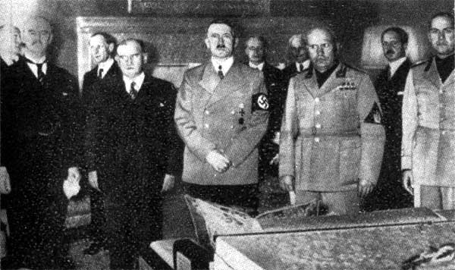
Most Countries were FOR appeasement.
Munich Agreement 1938
Countries agree to let Hitler invade Sudetenland

Slide 21
5. 1939 Sudetenland Czech Annexation
Sudetenland was German speaking.
They were more supportive of the Reich (Nazis) than any other region in Germany.
Czech government was failing. President of Czechoslovakia was weak.
Hitler threatened attack on Prague.

Slide 22
6. Hitler Invades Czechoslovakia
After taking the agreed upon territory his soldiers continue to march into Prague thus taking the entire nation.
Czech government was failing. President of Czechoslovakia was weak.
Hitler was opposed by the president but not by the citizens of Czechoslovakia.

Slide 23
7. Hitler asks for the Polish Corridor
Germans were being persecuted in Poland
Poland was a creation of Versailles and had not existed since medieval times.
Germans needed to join to their main to the territory of East Prussia
Hitler wants the Polish Corridor returned to the German people.
When the League refuses Hitler attacks all of Poland.

Slide 24
Road to war caused by appeasement.
Germany Creates mass militarization breaking the “Treaty of Versailles” 1935
Germany militarizes the Rhineland 1937
Germany takes Austria 1938
Germany takes Sudetenland 1938
Nobody does anything!

Slide 25
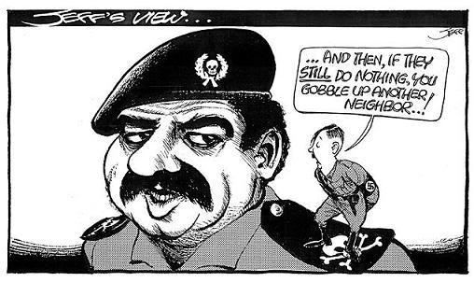
Is it so different from Today

Slide 26
At what point should Hitler have been stopped?
Write a 200 word paragraph.
At what point should countries have resisted German aggression?
How come?

