Slide 1
4 reasons 4 war

Slide 2
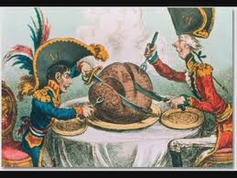
#1 Imperialism

Slide 3
Germany’s Problem

Slide 4
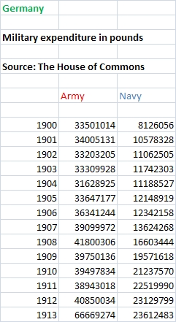
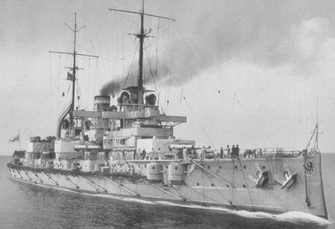
#2 Militarism
Naval Arms Race
How are Britain and France going to react to this kind of spending?

Slide 5
Arms Race

Slide 6
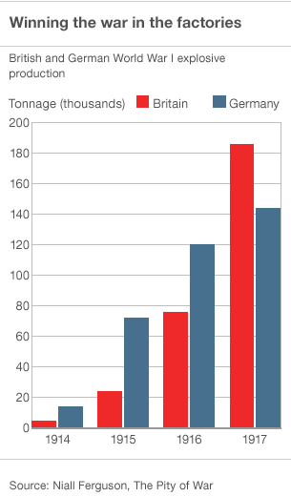
Arms Race
Germany and England get competitive.
Both countries want to be #1

Slide 7
#3 Alliance System

Slide 8
WW1 Alliances
Triple Alliance or Central Powers
Germany
Austria Hungary
Italy
Later… Ottoman
Later… Bulgaria
Triple Entente
Britain
Russian Empire
France
Later… Serbia
Later … Japan
Later… Romania

Slide 9
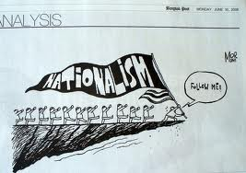
#4 Nationalism
(type #1) Pride for a country and believing it is special and other countries are not.
(type #2) Pride for an ethnicity or people group believing they are the best and others are the worst.
(type #3) Wanting your own independent nation.

Slide 10
Type 1 & 2 (national pride, national Stereotyping)
Great Britain believes it’s British colonies are God’s gift to earth. (Look at Canada’s immigration policies for example)
Germans see Britain as controlling, selfish and keeping people from power.
Russians have grown to believe Slavic blood is superior to all blood lines. (similar to Hitler in WW2)
French have come to see themselves as the cultural center of the world and Germans as barbarians. (Hun)

Slide 11
Negative Impact of Nationalism (Propaganda)

Slide 12
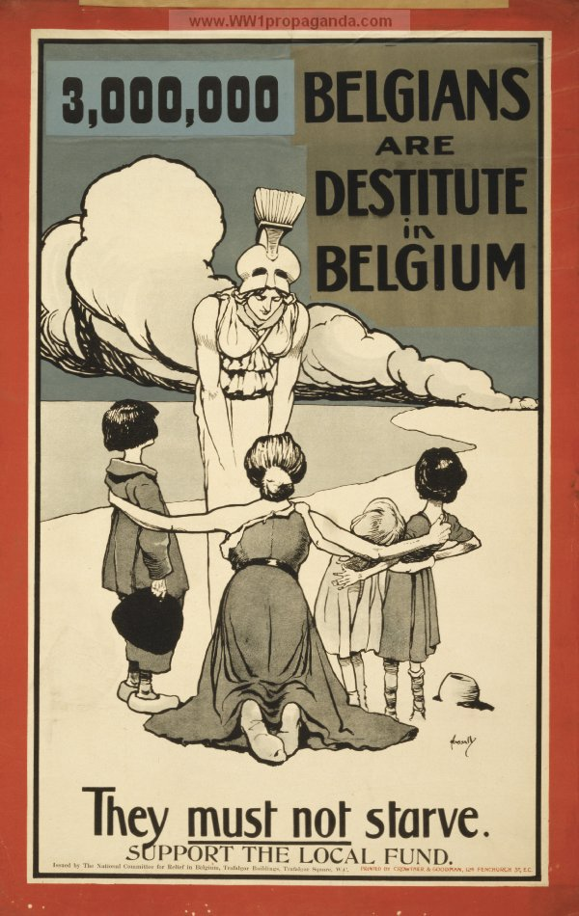
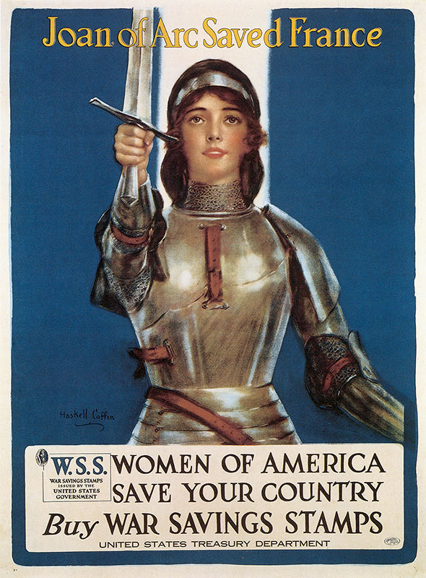
Economic Propaganda WW1
Example Of Total War
Example of War Bonds

Slide 13
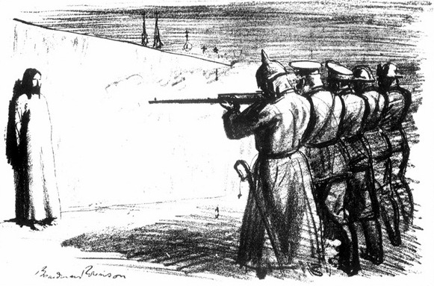
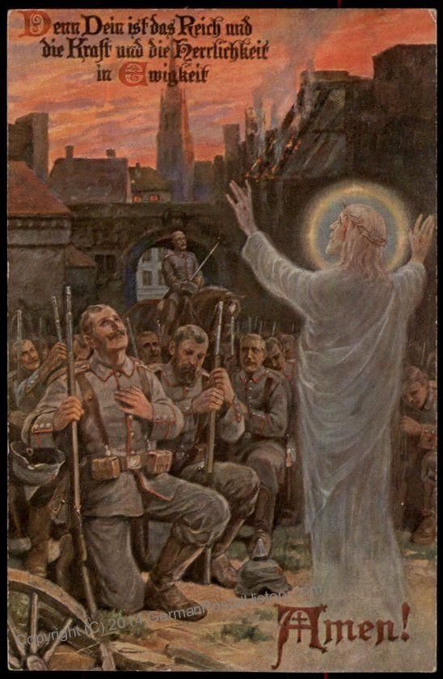
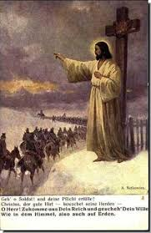
Spiritual Propaganda WW1

Slide 14
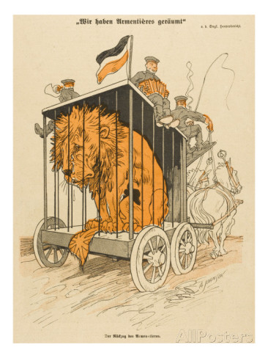
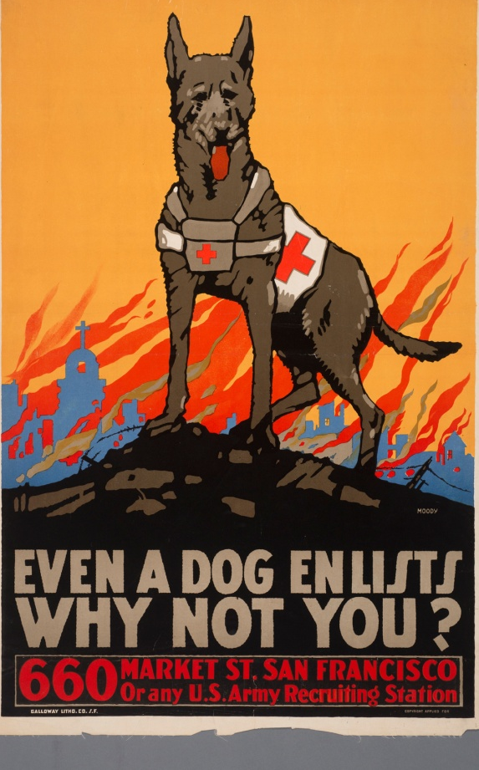
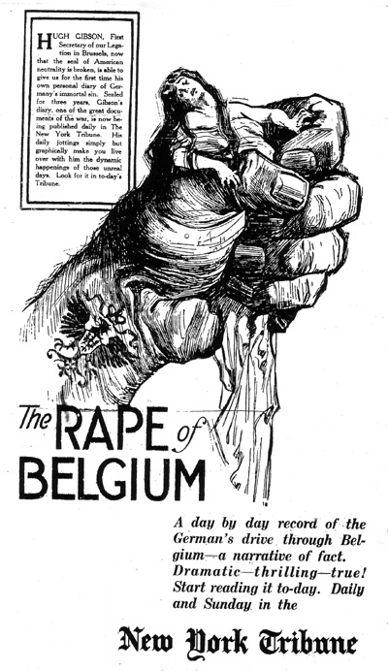
Political Propaganda WW1

Slide 15
Type #3 Separation Groups
Italians wanting to separate from Austria Hungary
French People wanting to separate from Germany
German people wanting to separate from France
Poles wanting their own country.
Egyptians wanting self control.

Slide 16
Is Germany Dead?

Slide 17
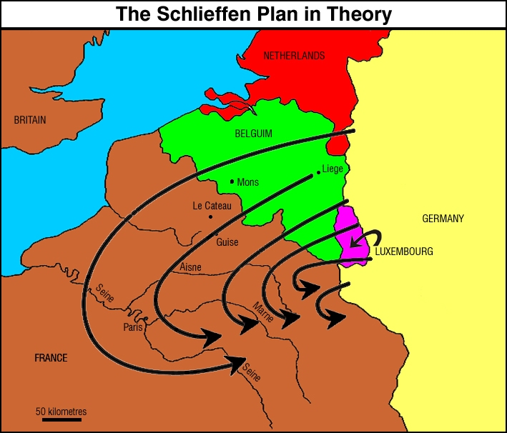
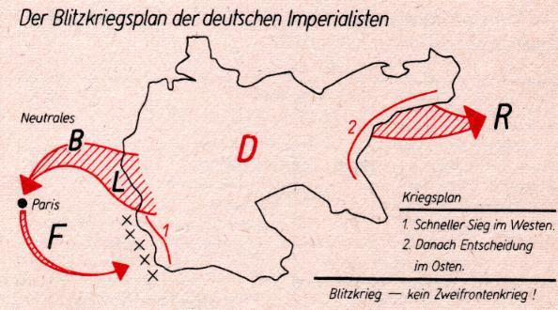

Slide 18
The German Army was stopped 35km from Paris, and the French and British Armies pushed them back to North France, where both sides dug trenches and both sides spent the next 4 years fighting over the area between Belgium and France. It was a stalemate!

Slide 19
Despite not working Germans survive
Russia going through increasing uprising and revolution. Its military failing.
Russia cannot industrially support its troops
British Navy and German Navy afraid to meet.
Essentially becomes a single front war.

Slide 20
Four Causes of War (actions)
Imperialism (arms out front)
Nationalism (Salute)
Militarism (finger pistols in the air)
Alliances System (shaking own hands)
Lets Practice !

Slide 21
Hitler’s mandatory military training in German schools.

Slide 22
Weapons build Up

Slide 23
1936 Olympics

Slide 24
Flag Raising Ceremony

